Slide 1
LhARA WP3
Working Concept: To design, construct and test a Gabor lens to capture and transport the 5/10 Hz LhARA proton and ion beams
Split of the WP into two overlapping worklines:
Short term [0-2 yrs] – to include: test experiments at Swansea to test/validate plasma simulations; the design and construction of a new Gabor lens test bench based upon state-of-the-art plasma techniques and diagnostics; overlap with WP2 and Instrumentation
(2) Longer term [1-5 yrs] – details of Gabor lens fixed; thorough testing of plasma loading, stability and reproducibility undertaken and working prototype Gabor lens finalised
Overall Aim: Gabor lens prototype available for beam tests (possible start of tests …)

Slide 2
Musings on content - 1
Need to define and quantify basic plasma parameters – density, radius, length and temperature
Radius to overlap source output; density and length to determine focal length
Magnet field should be greater than/order of 0.1 T, with a magnet of around 10 cm bore and a 10 cm (at least) internal region with a “uniform” field
Overall – prioritise within the package; plasma properties and holding stability and loading reproducibility tensioned against lens requirements

Slide 3
Musings on content - 2
Presume magnet from Strathclyde/Berkeley (see below) or purpose built
2 x PDRAs for the duration – plus postgraduate students
Staff at 10% where applicable; possibly 20% in first 2 years
Equipment: magnet power supply, vacuum chambers, 2 x high load turbos and backing, gate valves, mass spec, vacuum gauges, manipulators for sources and diagnostics, HV and LV power supplies, RF supply for rotating wall …
Consumables: usual vacuum stuff, gas feed system, chamber mountings, Penning trap electrodes, electron sources, MCPs, electronics, possible stuff for Berkeley …
Travel … £15k per annum? (Possibly more if Berkeley involved)

Slide 4
Musings on content - 3
Advantages of Berkeley involvement:
Expertise of Fajans and Wurtele
Access to magnet with stronger field and known field properties, including uniformity
Disadvantages of Berkeley involvement:
Key experiments done at a distance

Slide 5
WP3: Proposal Outline (2.5 pages maximum)
Introduction to, and rationale for, the Gabor lens – Mike and Will
Outline of WP; what will be achieved etc – All
Interface with source – HT and Elisabetta
Simulations and test experiment(s) – Titus and Chris
The Gabor test bench: description and rationale – Mike/Will/Chris
Methodology(ies) – All
Outcomes/Deliverables – All
Risks and Mitigation – All
Suggestions for resources needed – All

Slide 6
WP3: Risks
2 year programme: failure to achieve understanding of simulations and test experiments; failure to construct Gabor test bench in a timely fashion; solenoid issues; equipment delivery …
AND
an under-resourced programme leading to failure of the …
2. 5 year programme: failure to achieve stable/reproducible plasmas; failure to reach 5/10 Hz loading/holds; failure to achieve efficient interface with output of WP2/source

Slide 7
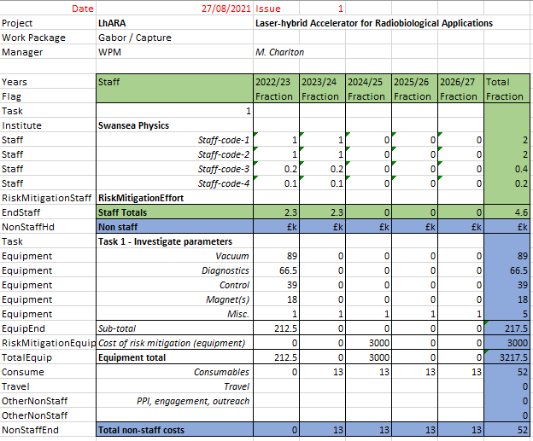
Early Costings – need to work on this and develop a risk matrix (is there a LhARA style?)

