Slide 1
Report from Spokespeople
Since last time (31May22)

Slide 2
Alignment: LhARA and the ITRF

Slide 3
LhARA and the ITRF
H. Owen at ITRF IAC, 20Jul22

Slide 4
ITRF planning
ITRF “Kick-off” meeting:
20Sep22; Daresbury Laboratory
H. Owen at ITRF IAC, 20Jul22

Slide 5
ITRF work packages
WP1: LhARA – will come back to status of our preparation …
H. Owen at ITRF IAC, 20Jul22

Slide 6
ITRF work packages
WP1: LhARA – will come back to status of our preparation …
WP2: Facilities and Costing
H. Owen at ITRF IAC, 20Jul22

Slide 7
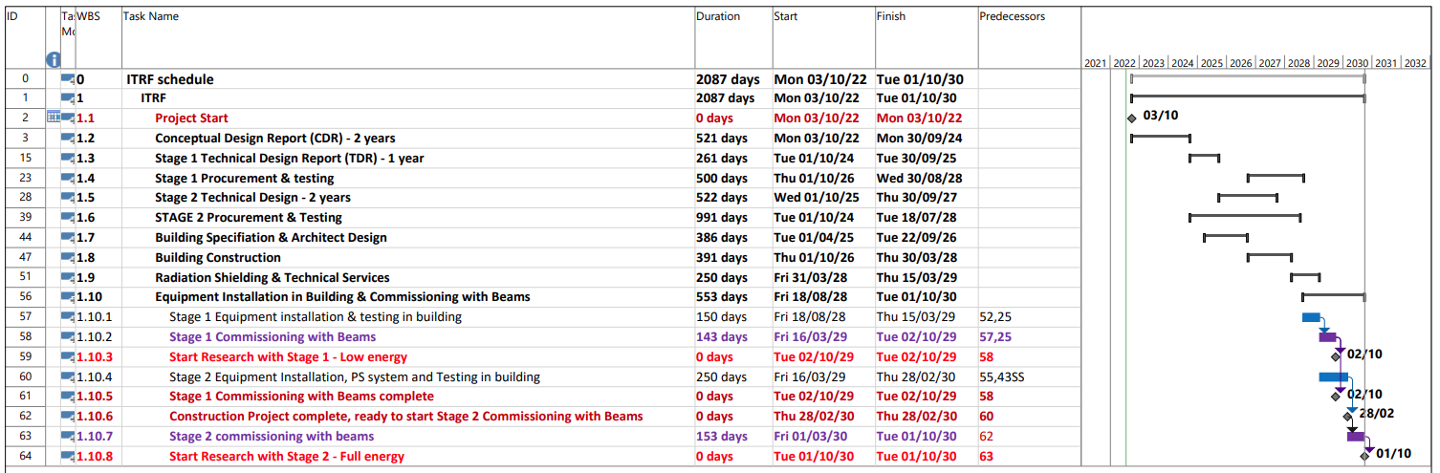
ITRF Project Schedule
1272-pm-ppl-0001-v2.0 - ITRF schedule 2022-07-20
H. Owen at ITRF IAC, 20Jul22

Slide 8
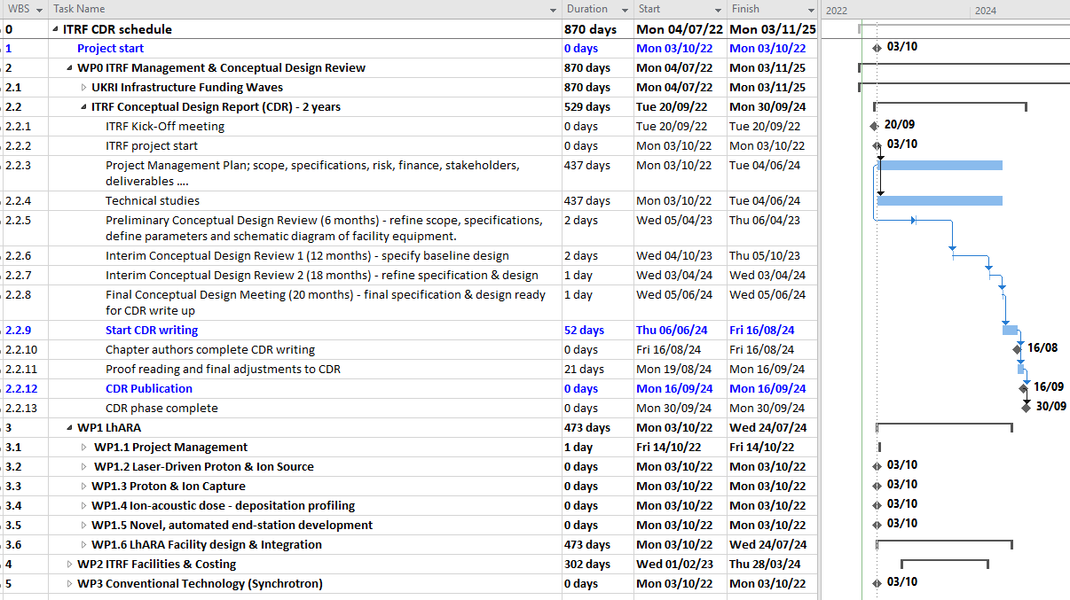
ITRF Project Schedule
1272-pm-ppl-0004-v0.1 - ITRF CDR schedule 2022-07-20
H. Owen at ITRF IAC, 20Jul22

Slide 9
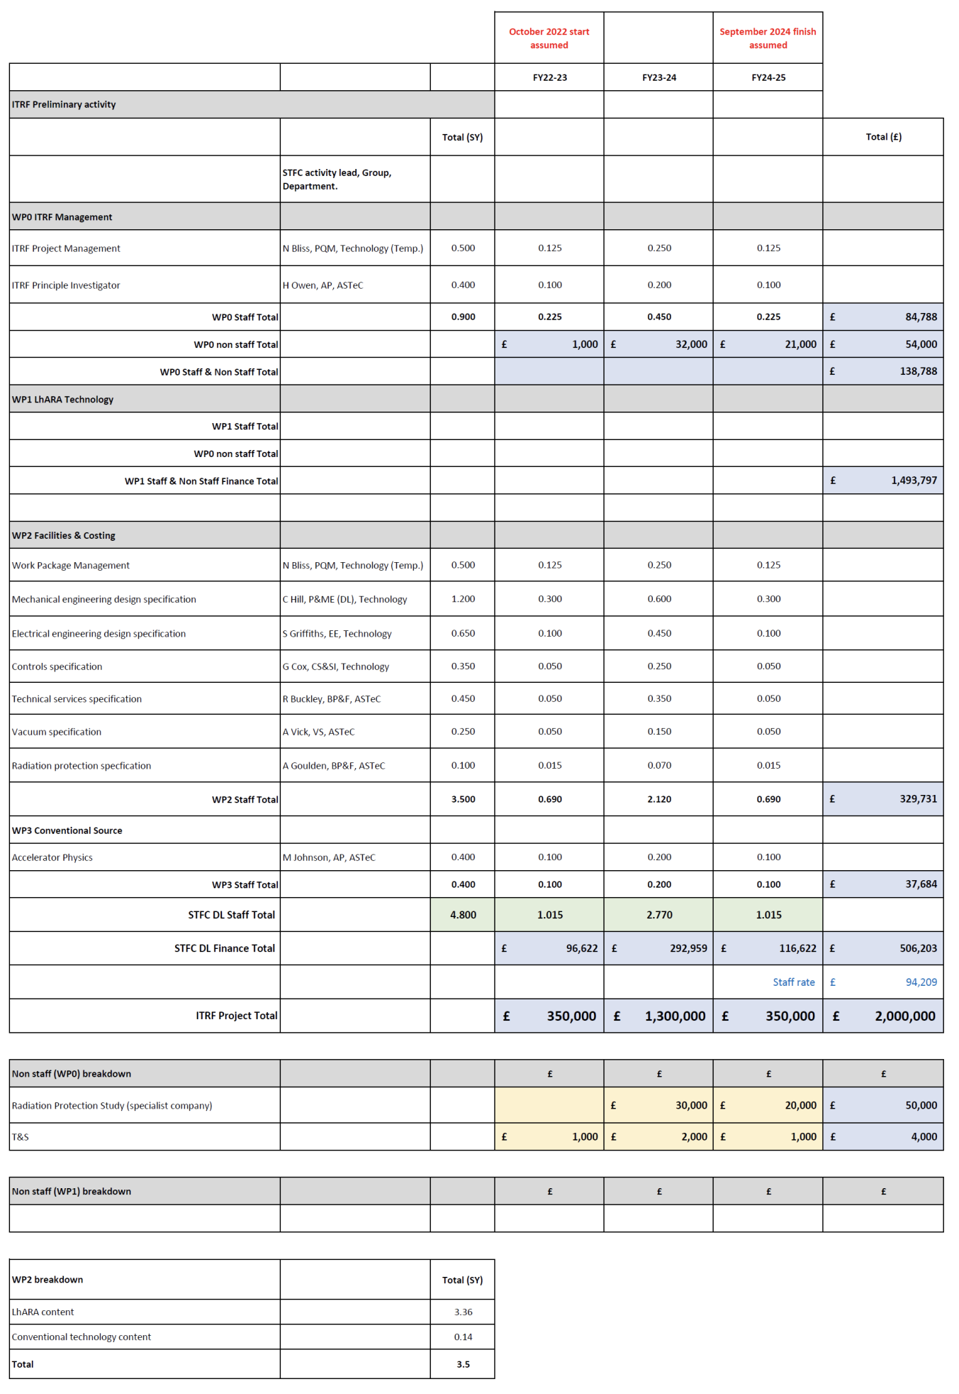
LhARA and the ITRF

Slide 10
Proposal status

Slide 11
Proposal for LhARA contributions to Preliminary Activity and ITRF Preconstruction Phase
Finalised 01Jun22: CCAP-TN-10;
Revision 1: 27Jul22: cost overview table updated to remove error in handling working margin (10%), contingency (20%) and inflation in years 3—5
To serve ITRF: 2 + 3-year project in 6 work packages:
Project Management
Laser-driven proton and ion source
Proton and ion capture
Real-time dose-deposition profiling
Novel, automated, end-station development
Facility design and integration
Requested resources for 2-year preliminary phase;
Identified need for further 3-year preconstruction phase

Slide 12
Proposal
CCAP-TN-10;
Revision 1: 27Jul22: cost overview table updated to remove error in handling working margin (10%), contingency (20%) and inflation in years 3—5

Slide 13
Preliminary & Preconstruction Phase proposal summary

Slide 14
Alignment of LhARA with ITRF
Aligns programmes,
“working methods”,
reporting arrangements,
allocations by workpackage
Update in progress
Defines scope of work, cost, schedule, risk, etc. for the programme supported by the ITRF funding line
In preparation

Slide 15
Next steps
Require now to reconcile 2-year ITRF Preliminary Activity programme with ~£1.5M from ITRF “line”
Require to invest to mitigate key risks to the LhARA project
Top-level risk table from proposal
Prioritise investment in:
Source, capture, end-station specification

Slide 16
International review

Slide 17
International review of proposal
CCAP IAB have agreed to review the proposal:
CCAP IAB:
M.Lamont (CERN, Chair)
P.Bolton (LMU, retired)
M.Baumann (DKFZ)
B.Sorensen (Arhuus)
Split into two parts focussing on:
The machine and associated technology
Proposed chair: Gianluigi Arduini
Proposed additional experts: Malek Haj Tahar (PSI), Christian Carli (CERN)
Radiobiology and longer-term ambitions
Chair/additional experts: to be confirmed
Timeline:
Still held up by reviewers’ availability; working with Chair to resolve

Slide 18
Stop press

Slide 19
Outreach
CERN Courier:
M. Chalmers, Editor: picked up on LhARA at ICHEP 2022 (Jul22)
Received draft of 500-word news piece yesterday
EB taking a look
Will forward to IB and H. Owen and DL team after this meeting
Press release:
STFC DL planning to make press release in conjunction with ITRF kick-off meeting (20Sep22)
LhARA outreach planned to follow:
LhARA collaboration press release drafted by T. Greenshaw, to be circulated
Example institute-specific press release drafted by H. Dunning (ICL), to be circulated in case it helps institutes prepare
LhARA and LhARA institutes releases to be coordinated to follow STFC lead
C. Palmer (Queens, Belfast) has secured IoP small award for outreach promoting benefits of research into PBT
Activities being developed, followed in our fortnightly meeitngs:
WWW site (A.Kurup, H.Hall, et al)
4-nation PPI event (A.Kurup et al)

Slide 20
Dates for your diaries

Slide 21
Notable upcoming events
20Sep22, DL: ITRF kick-off meeting
14Oct22, Liv: LhARA collaboration meeting
Feb23; LhARA collaboration meeting
Offer from Brm to host
[Collaboration meetings 6-monthly thereafter]

