Slide 1
Report from Spokespeople
Since last time (22Nov21)

Slide 2
Alignment: LhARA and the ITRF

Slide 3
LhARA and the ITRF

Slide 4
Mapping onto ITRF proposal
Multidisciplinary collaboration comes together to create proposal
Lab (ASTeC, CLF, PPD, TD), HEIs from across the 4 nations, accelerator institutes, key international partners
CDR/TDR development – WP6
End-station specification, design – WP5
Exploit/benefit from Brm ambition to create vertical beamline
Scientific measurement and prototype test and commission
Programme to address key technical risks – WP2, WP3, WP4:
WP2: Source
WP3: Capture
WP4: Realtime, shot-by-shot, non-destructive dose-mapping

Slide 5
LhARA and the ITRF
Constructive discussions continue:
Some notes on meetings at:
https://ccap.hep.ph.ic.ac.uk/trac/wiki/Research/DesignStudy/ITRF/Meetings -- necessarily cryptic
Agreed:
Organisational breakdown structure (presented above)
Conventional option (off ramp) developed in collaboration with CERN/NIMMS2
Majority of notional £2M from UKRI infrastructure fund to be invested in LhARA
More work to do

Slide 6
Proposal status

Slide 7
Proposal status
Getting there
Still work to do
Executive summary:
Needs update when proposal complete
Lay summary:
GJ + HH drafting
Section 1:
Bioscience – will plug from pre-CDR, AG, JPar, YP will update
Tech adv -- needs to be drafted
Section 2:
Full draft
Section 3:
3.5 working towards draft
Section 4:
Will be written “at the end”
Annex:
Most project management text is drafted:
Need to add summary Gantts etc.
WP 5 now pushing on text etc.

Slide 8
Timeline
08Apr22: full draft, ready to circulate for comment
15Apr22: Comment deadline
22Apr22: Goal for final document
27Apr22: “Sign-off” at our collaboration meeting

Slide 9
International review

Slide 10
Review of proposal by CCAP IAC
CCAP IAB have agreed to review the proposal:
CCAP IAB:
M.Lamont (CERN, Chair)
P.Bolton (LMU, retired)
M.Baumann (DKFZ)
B.Sorensen (Arhuus)
For review of proposal (i.e. co-opted):
I.Robson (STFC, retired)
Agreed with M. Lamont this am:
Based on our timeline, he will set up the review:
Co-opt of expertise on, e.g., source, FFA, …
Propose to do the review in two pieces:
Biomedical science
Technological and project aspects
Timeline:
To be agreed, but, looking at May/June

Slide 11
Events

Slide 12
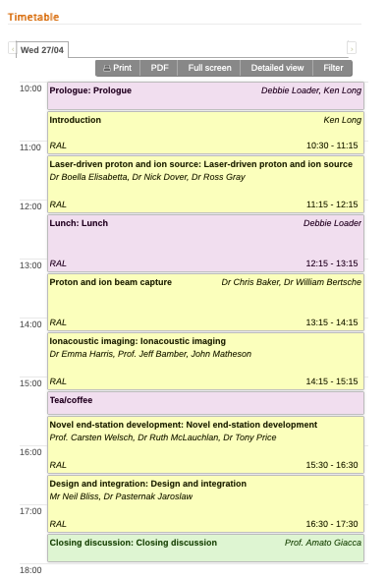
Future
Next LhARA collaboration meeting:
27Apr22
Please register!
Reminder email will be sent
CR12/13 booked
Holding 10 rooms in Ridgeway House
Time to develop
the agenda now!
https://indico.stfc.ac.uk/event/517/timetable/#20220427

Slide 13
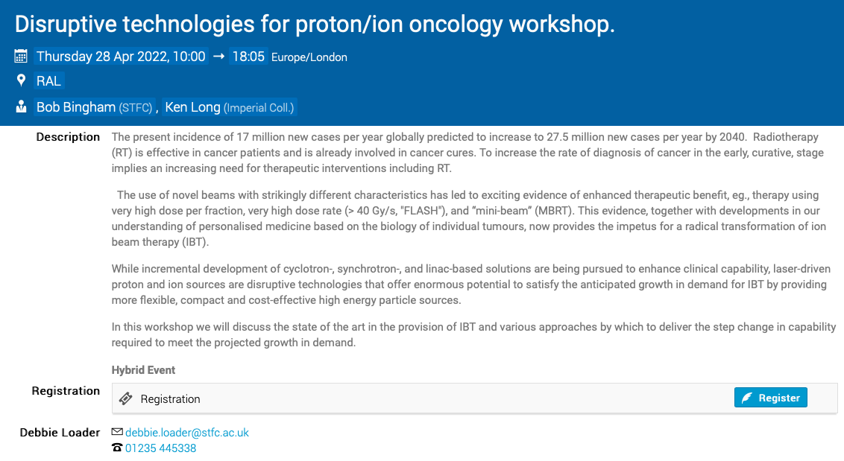
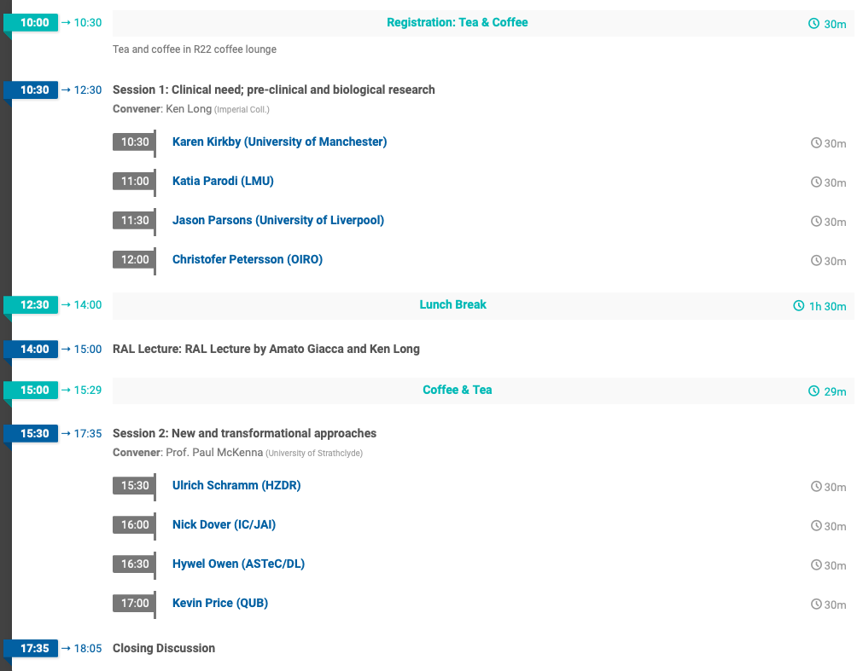

Future
https://indico.stfc.ac.uk/event/536/timetable/?view=standard

