Slide 1
Update on progress

Slide 2
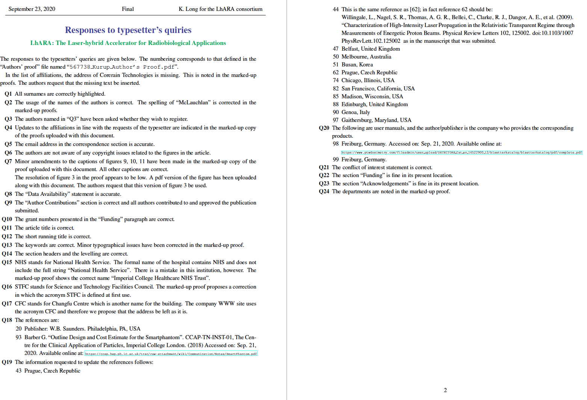
LhARA paper in Frontiers [1]
Anticipated publication date:
29Sep20

Slide 3
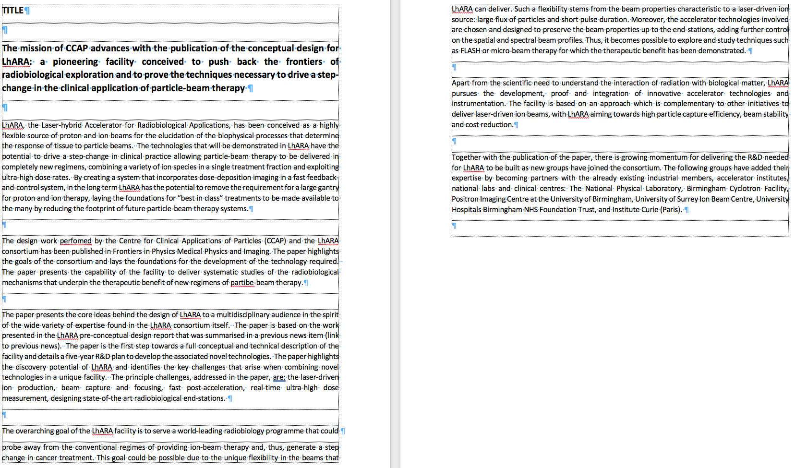
LhARA paper in Frontiers [2]
News item:
Draft from TS Dascalu
STFC wish to make press release:
Coordinator: Amy Pollock
Request sent for local communication contacts to be sent to Amy Pollock

Slide 4
Incremental technical progress
Continued development of:
Radiobiology programme:
Jason Parsons; next meeting Friday 25Sep20, 15:00
Capture section (Gabor lens):
Colin Whyte et al:
Titus-Stefan Dascalu: Gabor lens time-resolved plasma and beam simulation
New, LhARA lens and first prototype;
Seeking to simulate plasma instability observed in first prototype for paper in preparation
Hin Tung Lau: Time-resolved simulation of laser-driven source
Better understanding of convergence criteria and limitations
Particle distributions for tracking generated (first pass)
Loop back for comparisons with data/published simulation
Excellent 3-way collaboration developing: Strathclyde, RAL (Bob Bingham), IC
Simulation/experiment meetings: Ajit Kurup, Will Shields:
Now restarted, discussion of issues and solutions
Incremental development of BDSIM:
Longer term goal to introduce space charge
Implementation of OPAL (cyclotron code); will allow study of tracking with space charge
As noted before; feeling lack of personnel

Slide 5
ERC Advanced Grant submitted
Source/capture system:
Gabor lens development: IC (KL, JPa, ZN, et al)/Strathclyde (CW et al)
Exploit ZHI laser at Imperial and SCAPA
Budget:
“Squeezed”: ~3.5MEuro over 5 years
Benefit:
Worked out proposal; B1 and B2 posted on LhARA proposals page

Slide 6
Rosalind Franklin Insitute
Pleasure! Excellent joint meeting on end station:
Organisers: Tony Price, Ruth McLauchlan, Laura Holland (RFI)
Speakers included:
Jim Naismith (RFI Director), Angus Kirkland (Correlated Imaging theme lead)
Outcome:
Specification for content of proposal to EPSRC Transformative Healthcare Technologies call
Proposal will be developed and submitted together

Slide 7
STFC [1]
Meeting with Department directors: 06Jul20
Present:
ASTeC: Jim Clarke
CLF: John Collier
ISIS: John Thomason and Robert McGreevy
PPD: Dave Newbold
Outcome:
KL, JTh, Ceri Brenner, Jim Clarke will write 2-pager for transmission to STFC EB:
Benefits and challenges of LhARA, raise issue of how to propose LhARA to STFC
2-pager will go to EB “over the signatures” of the 4 directors
Progress:
Slow – pick up now/after EPSR THT submission

Slide 8
STFC [2]
EPSRC Transformative Healthcare Technologies call:
See later, but, Phase 1:
£300k over 15 months for “development”
In the absence of additional resource possible scope limited
Informal discussion with STFC:
Develop proposal on basis that STFC will provide matching funds if proposal is successful in EPSRC peer review
KL to write to C. Jamieson outlining LhARA, the content of the bid to EPSRC THT, and explaining the request to STFC
Principle is that STFC funds would be directed at the critical “risk-mitigating” accelerator R&D requirement

Slide 9

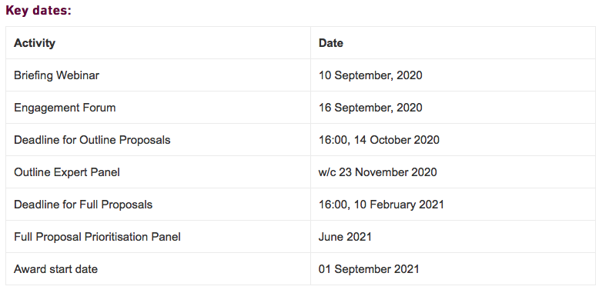

Slide 10
LhARA collaboration [1]
Paul Beard (UCL) seeks to join in the EPSRC THT proposal:
Expert on photo-acoustic imaging
Patient and public involvement:
Through Kelly Gleason and CXH PPI group welcome:
Gareth Jones and Harry Hall: PPI representatives on SG
GJ and HH have drafted PPI strategy [agenda item]
Clinician engagement:
Stuart Green has agreed to coordinate development of clinician-engagement strategy for LhARA [agenda item]
Industrial engagement:
Last time we agreed that Fiona Jamieson (IC industry liaison) would coordinate this aspect of the EPSRC THT proposal
KL will meet FJ and Stephen Towe (Leo Cancer Care) later today:
Hope to broaden discussion and get FJ and ST to draft industrial-engagement strategy for LhARA
EPSRC THT proposal will be first “outing” for the industrial-engagement strategy

Slide 11
LhARA collaboration [2]

Slide 12
LhARA collaboration [2⎖]
Need:
Generate agreed text-based list
SG composition update:
1 person per institution?
Perform the role of “institute board”

Slide 13

LhARA collaboratiaon [3]
Closing on final choice:
Vote jointly organized by KL and Kelly Gleason:
PPI group and academic peers
Deadline for votes 05Oct20
Close in time for EPSRC THT submission

