Slide 1


Status of the development of the pre-CDR
LhARA Steering Group Meeting
Ajit Kurup
31st January 2020

Slide 2
Introduction
Overview of the preparations for the LhARA pre-CDR.
  https://ccap.hep.ph.ic.ac.uk/trac/wiki/Research/DesignStudy/PreCDR
Interface between the laser and the proton and ion capture.
Progress on the end-to-end simulation.
Floor plan update.
LhARA project schedule and R&D plan.
Preparations for writing up.

Slide 3
Interface between the laser and capture
Critical interface between the laser target vessel and the first Gabor lens of the proton and ion capture.
Meeting on 20th December 2019 to discuss issues.
  Space needed after the target for laser diagnostics.
  First lens needs to be relatively close to capture the beam.
  Aperture needs to be large enough to allow the beam through.
  Pressure in the laser target vessel may be three orders of magnitude higher than the vacuum needed for the Gabor lens.
  Agreed on 10cm distance from target to front face of the first Gabor lens.
    This requires an 8mm diameter hole in the interface plate.
  Re-entrant shape for the interface.

Slide 4
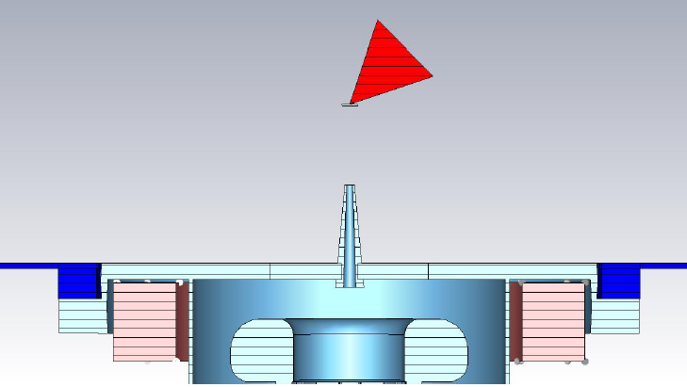
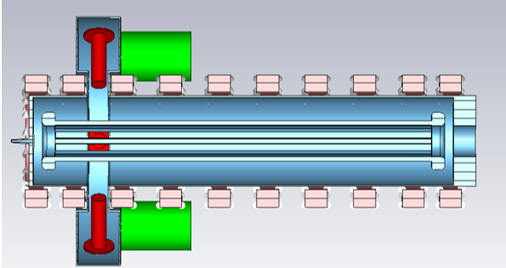
Interface between the laser and capture
Details from Colin Whyte.
  Rough calculations of differential pumping capability showed can achieve three orders of magnitude.
  Sketch of the interface.
  Preliminary designs of pumping in the Gabor lens.

Slide 5
Simulations
Five codes are used for the simulation.
  BeamOptics
    Used to do the beam optics design the accelerator (except the FFA ring).
    Input parameters taken from the simulation of the laser target interaction.
  MADX
    Verify BeamOptics calculations.
    Match optics to design the vertical bends.
  BDSIM
    Geant4 based single particle tracking toolkit.
    Visualisation.
    Energy deposition in the end stations.
    Compare optics parameters.
  GPT
    Verify design including space charge effects.
    Compare optics parameters.
  pyZygoubi
    FFA ring design.

Slide 6
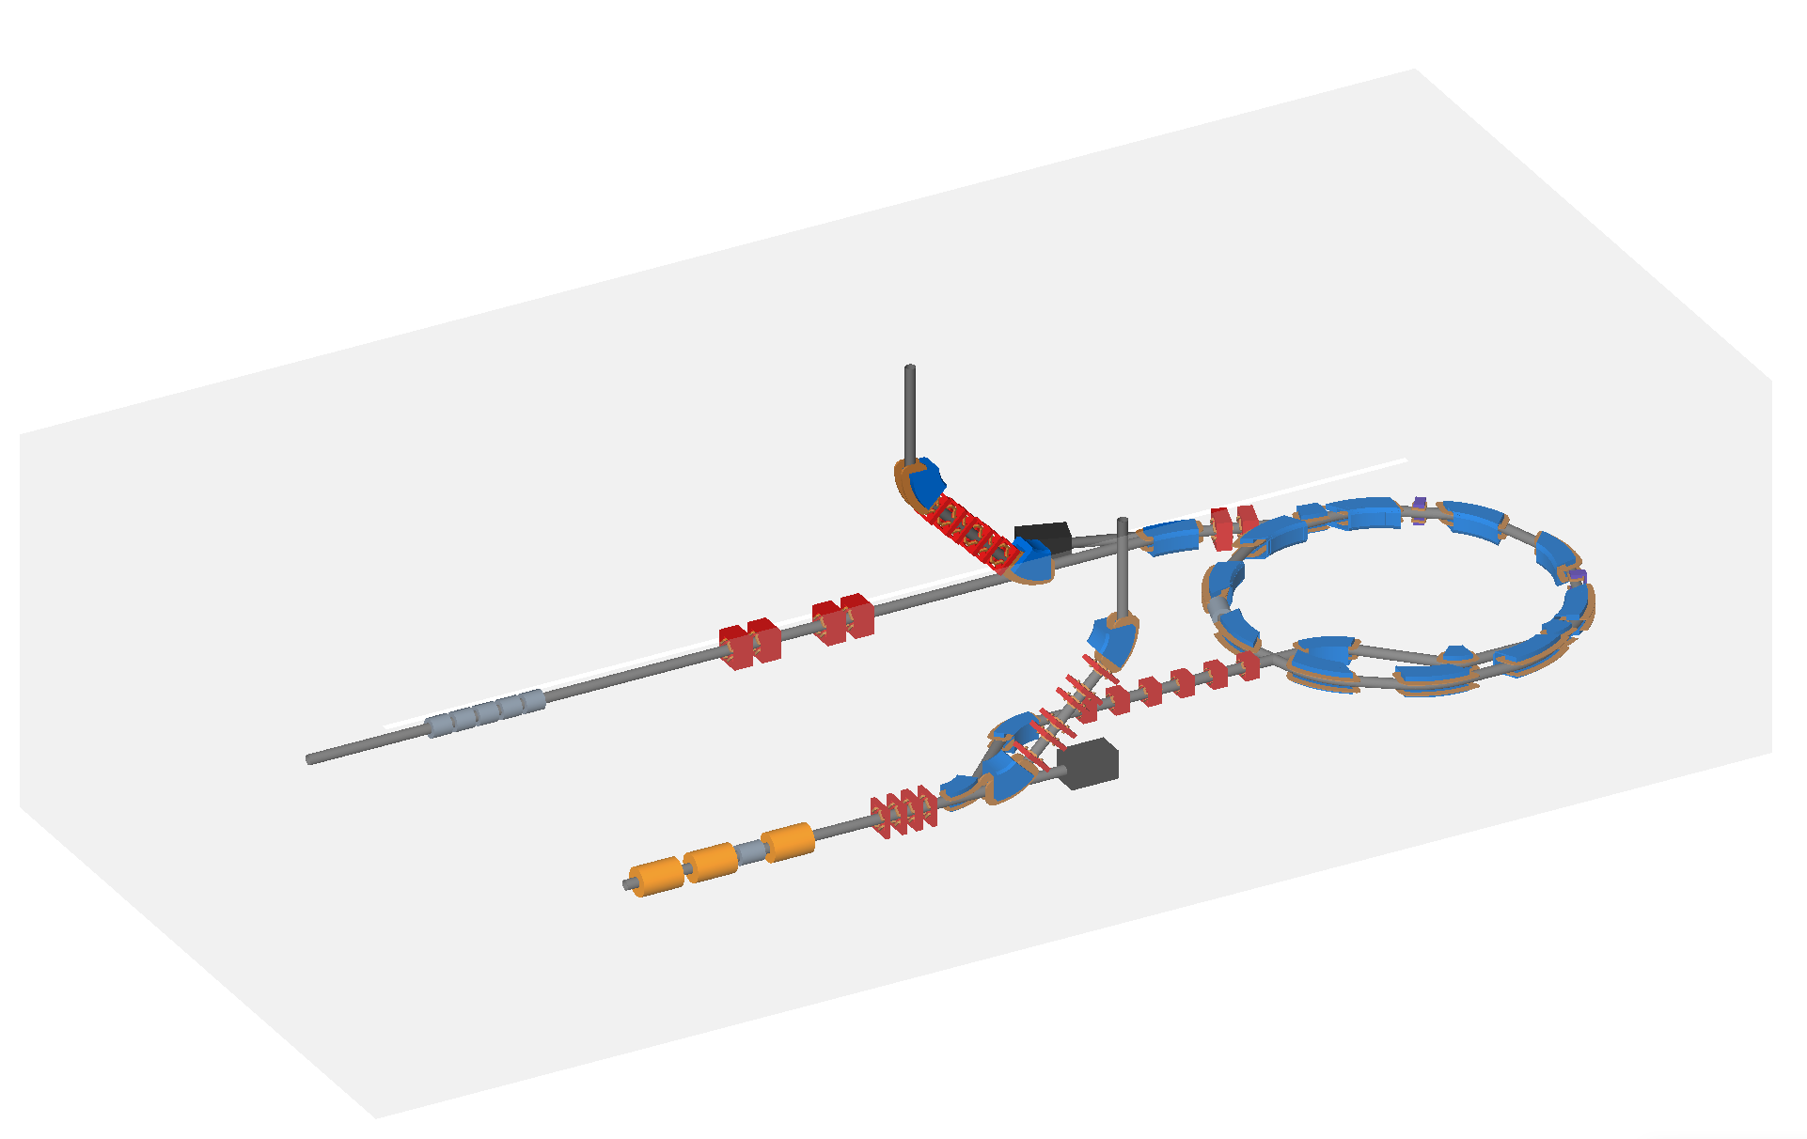
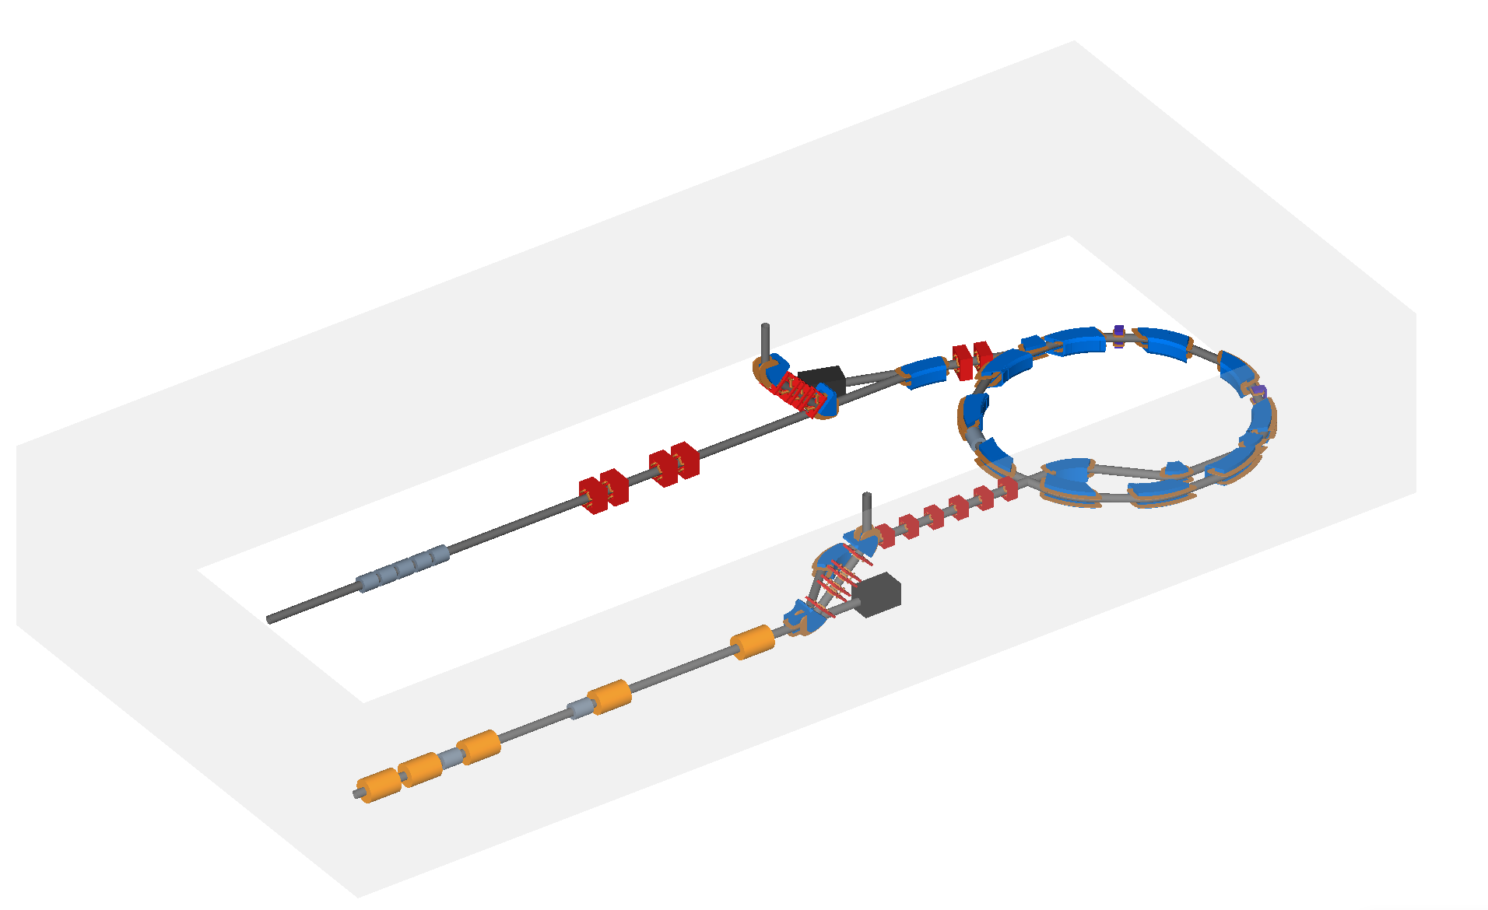
Simulations
Main progress on Stage 1 design.
  Optics design has been done.
  Performance being evaluated using BDSIM and GPT.
Gabor lenses are simulated as equivalent solenoids.
Version 4.2 of the accelerator
Version 5.0 of the accelerator

Slide 7
Simulation of version 5
Input beams
  An idealised Gaussian beam generated from Twiss parameters.
  Based on a 2D EPOCH simulation where the results (histogram of energy and theta) have been extrapolated to 3D assuming a Gaussian distribution for phi.
    Peak of the energy-theta distribution not centred at 0 degrees.
    Peak of the energy-theta distribution centred at 0 degrees.
  3D beam from a Smilei simulation beyond timescale for the pre-CDR.
Simulation of the 10cm drift before the first Gabor lens.
  Drift of 5cm where the beam is assumed to be space charge neutralised.
  Further 5cm drift with space charge (using GPT).
  Then run parallel simulations in BDSIM and GPT (with and without space charge).
For comparison with BeamOptics an idealised beam is generated at the target and tracked though.

Slide 8
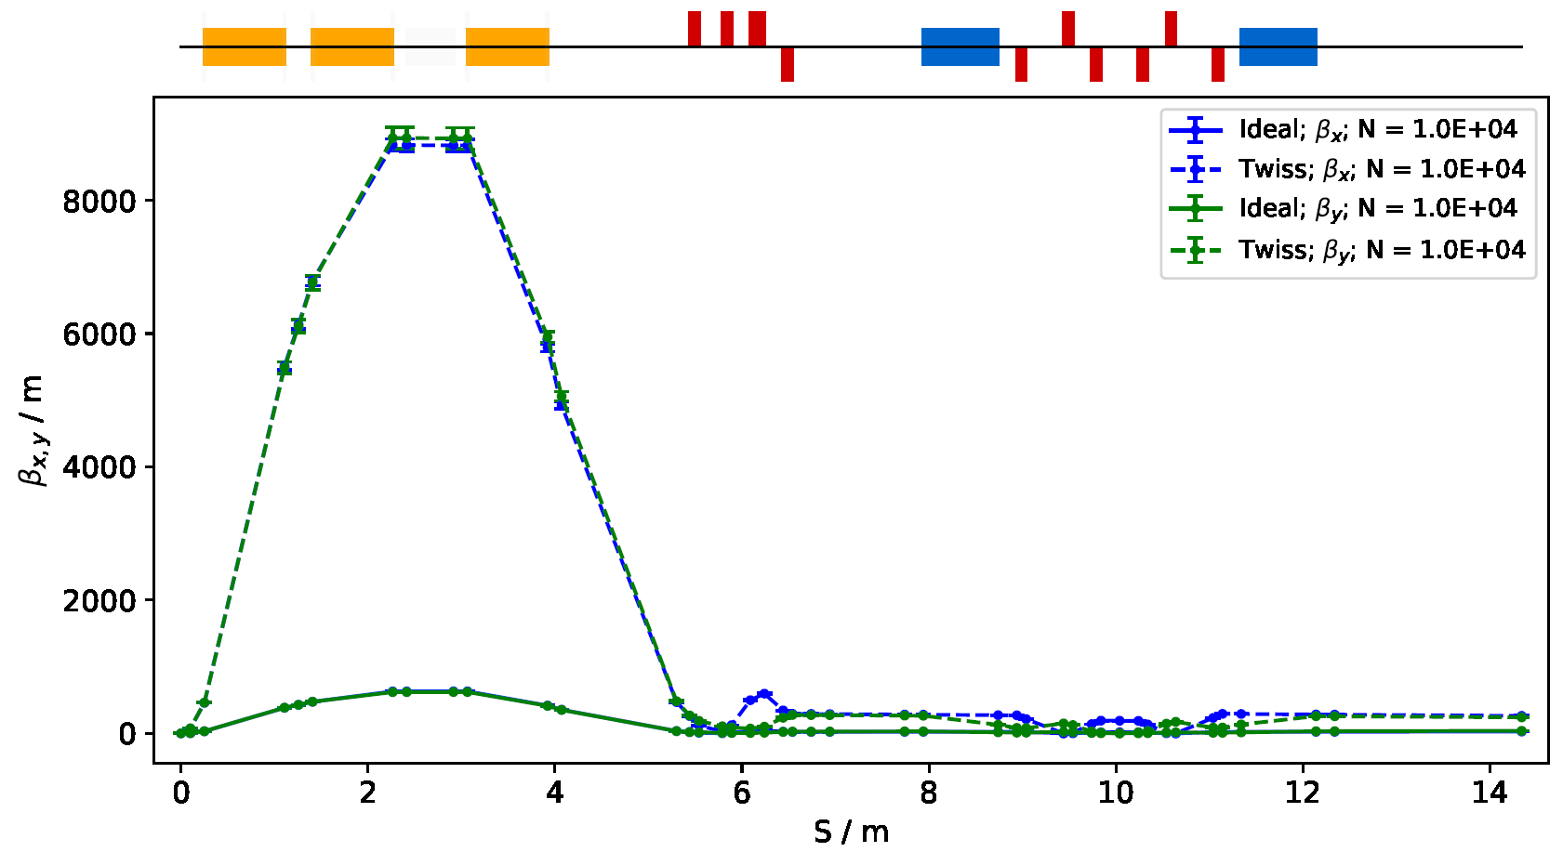
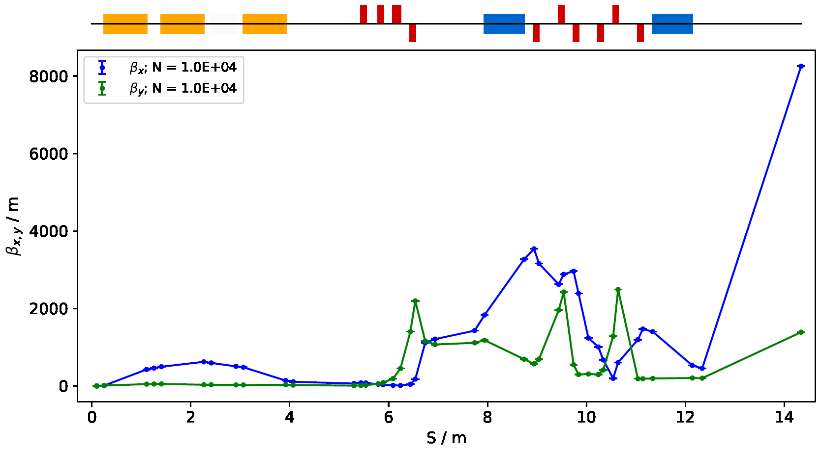
Version 5 very preliminary simulation results from Will Shields
Comparison of the beta functions for the idealised beam (includes the 5cm drift with space charge) and Twiss beam (no space charge effects).
The Twiss beam gives similar results to MADX.
Beta functions for the shifted EPOCH beam.

Slide 9
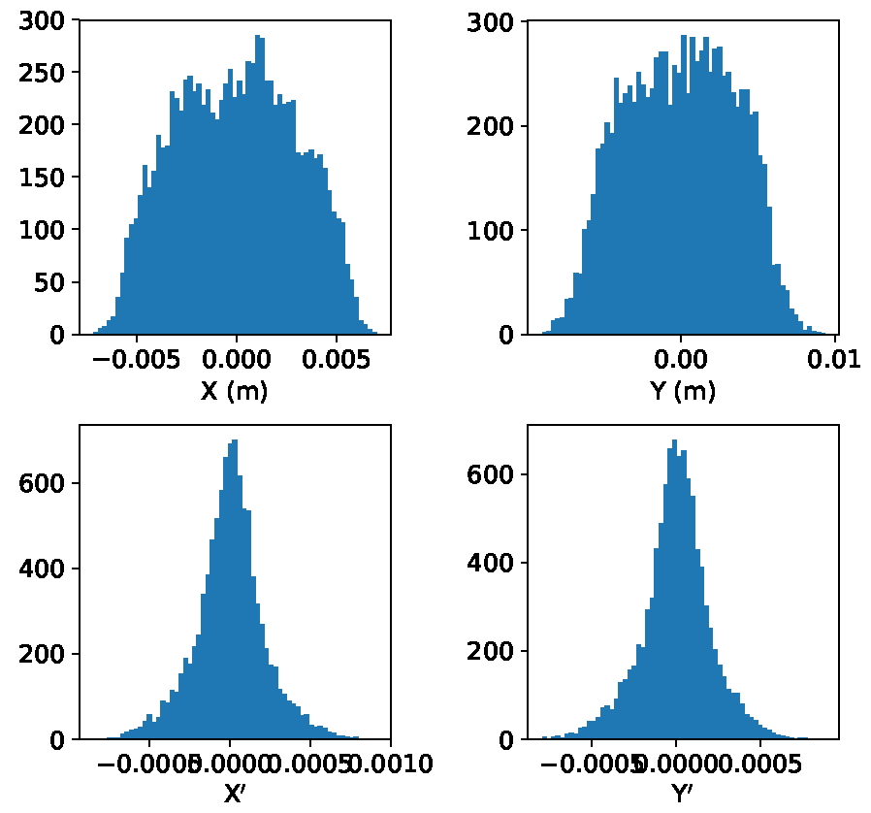
Version 5 very preliminary simulation results from Will Shields
Particle coordinates at the end station for the idealised beam.

Slide 10
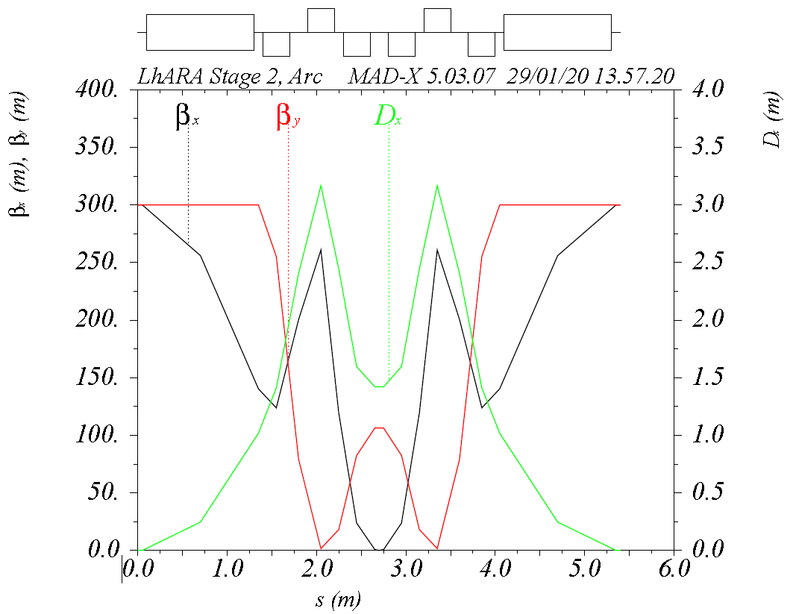
Simulations – Current status
Initial design of the Stage 2 high-momentum vertical arc done by HT Lau.

Slide 11
Simulations – Current status
Remaining tasks.
  Injection line into the FFA ring is being designed.
    The mirror of this will be used for the extraction line.
  Design the beam transport to the in vivo end station.
  Design of the FFA ring.

Slide 12
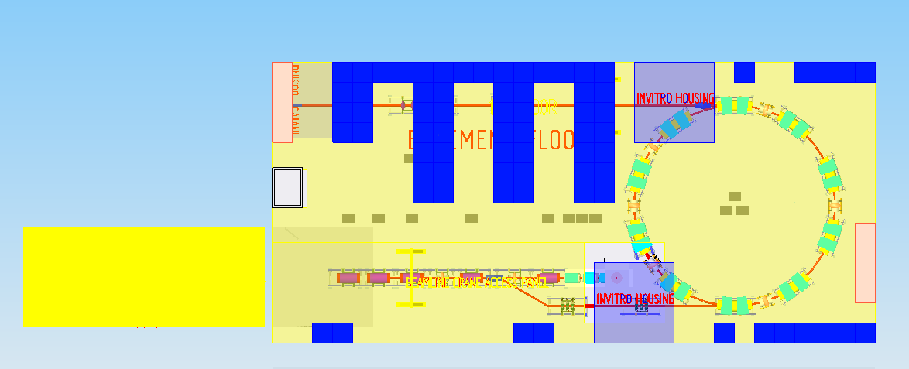
Floor plan update
Simeon Greenwood from RAL is working on updating the floor plan.
Number of details to be addressed.
  Will be finalised when the design is fixed.

Slide 13
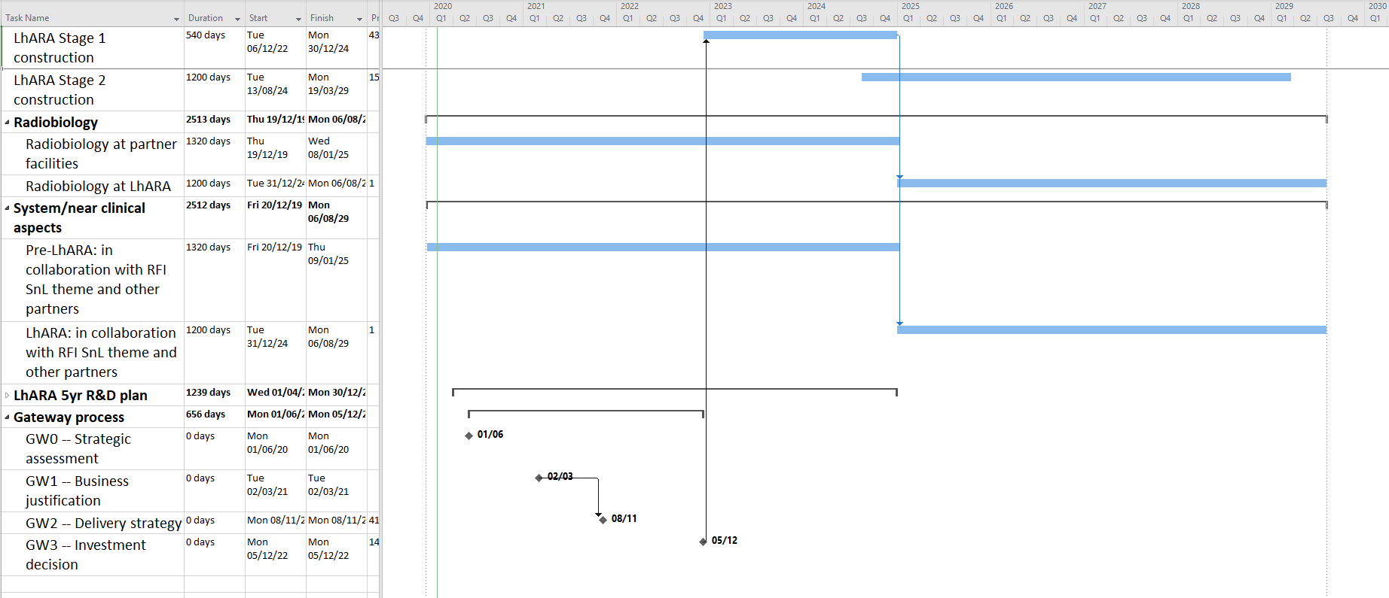
LhARA project schedule
Ken prepared an outline project schedule.

Slide 14
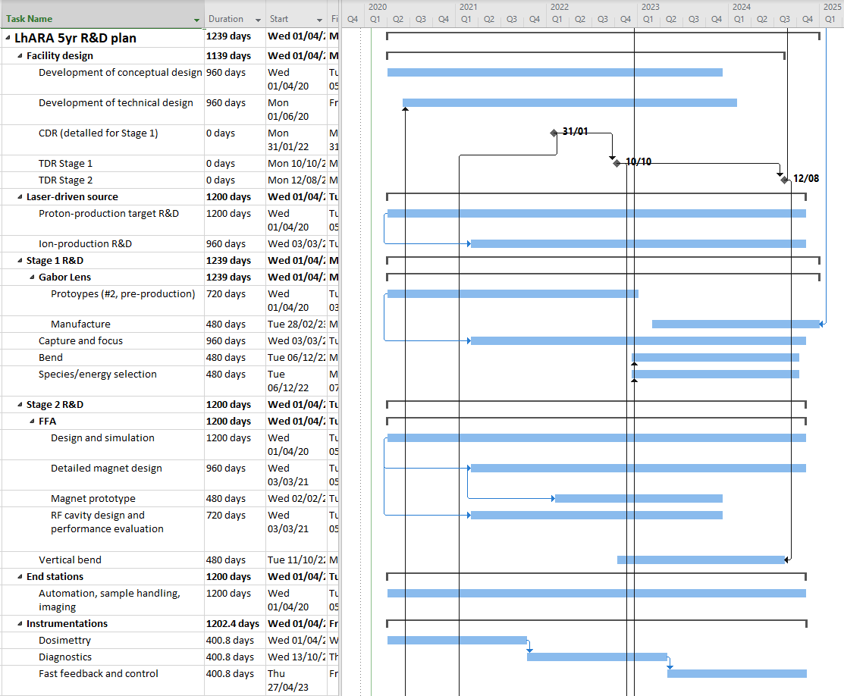
LhARA project schedule

Slide 15
R&D plan
https://ccap.hep.ph.ic.ac.uk/trac/wiki/Research/DesignStudy/PreCDR#RDPlan
Laser
  No major R&D needed for the laser since it will be a commercial system.
  Target particle production and diagnostics.
Proton and ion capture.
  Gabor lens prototype development and performance verification.
Stage 1 beam transport.
  No major R&D needed.
Stage 2 beam transport.
  FFA: Magnet design and prototyping.
  FFA: RF cavity performance verification.
End station
  Automation.
Instrumentation.
  Dose calibration for high-intensity beams.
  Online dose monitor.
  Online beam monitor for low energy beam.
  Fast feedback monitoring and control.

Slide 16
Preparations for writing up
Ken prepared an outline of the pre-CDR.
Main sections.
  Executive summary.
  Lay summary.
  Introduction.
  Motivation.
  LhARA facility.
  Infrastructure and integration
  Conclusions.
Appendices.
  Timeline.
  Costs.
  Risk analysis.

Slide 17
Preparations for writing up
LhARA facility.
  Overview.
  Laser-driven proton and ion source.
    Technical challenges and R&D programme.
  Proton and ion capture.
    Technical challenges and R&D programme.
  Beam transport and delivery to the in-vitro end station.
    Technical challenges and R&D programme.
  Post-acceleration and beam delivery to in-vitro and in-vivo end stations.
    Technical challenges and R&D programme.
  Instrumentation.
    Technical challenges and R&D programme.
  Software and computing.
    Technical challenges and R&D programme.
  Staging considerations.
    Technical challenges and R&D programme.
  Biological end stations.
    In-vitro end station.
    In-vivo end station.
    Development of radiobiological capability.

Slide 18
Deadlines
https://ccap.hep.ph.ic.ac.uk/trac/wiki/Research/DesignStudy/PreCDR#Keydates
29 Nov 2019: First issue of the baseline. This will include lists from the various systems of what needs to be updated on the existing floor layout, WBS, interfaces document and the parameter table.
31 Dec 2019: First end-to-end simulation.
31 Jan 2020:
  Design of the facility will be frozen.
  First view of the costs.
  R&D programme needed to realise LhARA and be able to write a technical design report will be defined.
28 Feb 2020: Complete the write-up of the pre-CDR.
Mar 2020: External review of pre-CDR in advance of publication.

