Slide 1





Radiobiological motivation for LhARA
Dr Jason Parsons
Cancer Research Centre
Department of Molecular and Clinical Cancer Medicine

Slide 2
Radiotherapy in cancer treatment
~50 % of all cancer patients will receive radiotherapy.
Conventional (photon) radiotherapy is the still the most effective treatment for solid tumours (e.g. head and neck).
Dose rates of ~1-5 Gy/min utilised.
Significant irradiation of normal tissues and organs at risk in proximity to the tumour being treated.
Biological factors including oxygen (hypoxia) and inherent radioresistance of tumours (e.g. glioblastoma) are a barrier to effective treatment.

Slide 3
Particle beam therapy (PBT)
In contrast to conventional (x-ray) radiation, PBT can deliver energy within a finite region (termed the Bragg peak) which can directly target cancer cells.
This limits radiation dose to proximal normal, healthy tissues and organs at risk.
Tumour
Bragg peak
Distal fall-off
Relative dose
LET
Particle energy
Depth in tissue
Vitti and Parsons (2019) Cancers
Currently, ~90 PBT centres worldwide and 40 in construction demonstrating the importance of this precision radiotherapy.

Slide 4
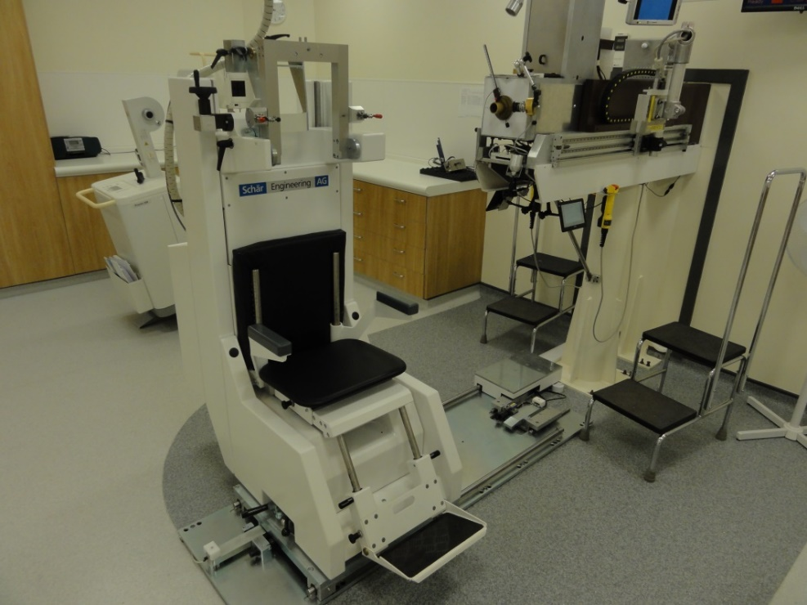
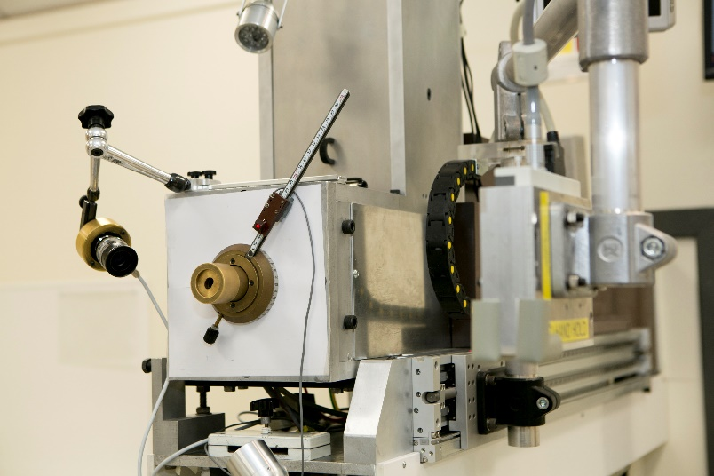
Eye Proton Therapy Centre at Clatterbridge
Successfully treating patients (currently ~300/year) with cancers of the eye for >25 years with 60 MeV proton beam.

Slide 5
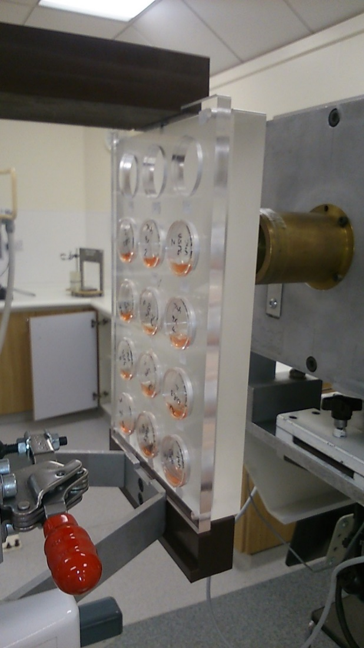
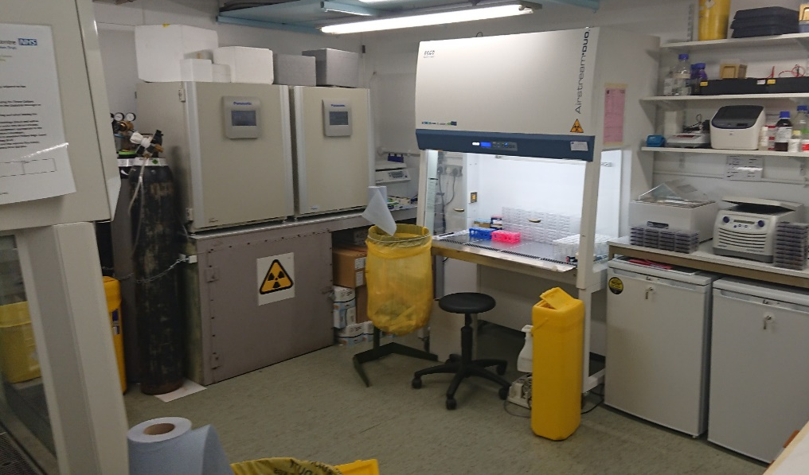
Radiobiology Research Facilities at Clatterbridge
Limited time and proton beam access due to patient treatments.
Limited in vitro capabilities and unable to perform in vivo research.

Slide 6
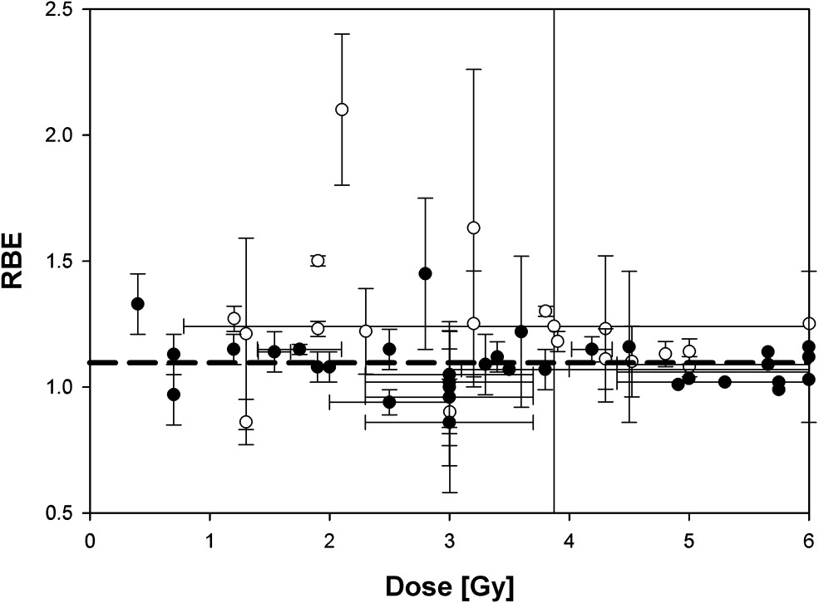
Biological uncertainties with particle radiotherapy
Tumour
Bragg peak
Distal fall-off
Relative dose
LET
Proton energy
Depth in tissue
Vitti and Parsons (2019) Cancers
Taken from Paganetti and van Luijk (2013) Sem Rad Oncol
A constant relative biological effectiveness (RBE) value of 1.1 is used in clinical practice for protons. However, there is a large uncertainty with using this approach as RBE is variable and dependent on many factors, including:-
Proton energy (therefore linear energy transfer, LET) and dose/dose rate.
Radiosensitivity/radiobiology of the specific tumour tissue (e.g. based on DNA repair capacity, hypoxia and tumour microenvironment).
Biological end-point examined (e.g. clonogenic survival, tumour growth delay).
Further research exploiting the biological impact of particle ions is vital for investigating RBE, and thus improving clinical use of PBT.

Slide 7
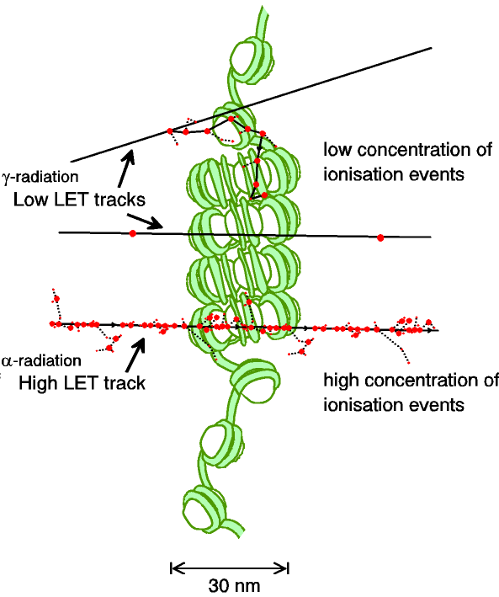
DNA damage and relationship to LET
****
Low-LET
Low-LET (modified assay)
High-LET
High-LET (modified assay)
CDD
*
***
**
RBE=~1.7
Low-LET radiation produces repairable DNA damage (e.g. single and double strand breaks).
High-LET radiation generates increased amounts of complex DNA damage (containing multiple DNA lesions) that are more difficult to repair, utilises multiple DNA repair pathways, and which can enhance cell death.
Low-LET
High-LET
Carter et al, and Parsons (2018) IJROBP
Carter et al, and Parsons (2019) IJROBP

Slide 8
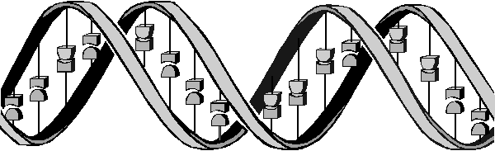
Oxidative DNA base damage,
abasic sites, SSBs
Complex DNA Damage
DSBs
(A) BER
(B) Classical-NHEJ or (C) alternative-NHEJ (G_{o}/G₁)
(D) HR (S/G₂)
DNA glycosylase
DSB
DSB
DSB
Abasic site
Ku70/80
MRN
MRN
APE1/PARP-1
dRP
DNA-Pkcs
XRCC4-Lig IV
PARP-1
RPA/RAD51
Pol β
XRCC1-Lig IIIα/
Lig I
RAD52/RAD54
XRCC1-Lig IIIα
Vitti and Parsons (2019) Cancers

Slide 9
Modulation of proton-induced cellular sensitivity following siRNA knockdown screening
Low-LET protons
HeLa
High-LET protons
Significant variability in the response of cells to low and high-LET protons dependent on cellular proteome.
Carter et al, and Parsons (2019) IJROBP

Slide 10
FLASH radiotherapy
Using ultra high-dose rates (>100 Gy/s).
However, the mechanism of the FLASH effect is unclear (role of oxygen?).
Impact of FLASH on specific tumour models not well defined.
Effect of FLASH photon vs protons (and impact of LET), not been demonstrated.
Further research exploiting the biological impact of FLASH on appropriate in vitro and in vivo models is important for translation to the clinic.

Slide 11
Radiobiology Research Facility at LhARA
Accelerator level
In vitro end-station level
In vitro end station with protons up to 15 MeV.
In vitro and in vivo end station with protons (125 MeV) and carbons ions (30 MeV).

Slide 12
Challenges and opportunities for PBT radiobiology research
Challenges
The radiobiology of PBT at the molecular and cellular level is still not entirely understood.
Other factors that impact on RBE not well defined (e.g. hypoxia, tumour microenvironment, drug-IR combinations, fractionated doses, FLASH).
More research required using specific and validated cancer models, plus relevant normal tissue models, in vitro (e.g. 3D spheroids/organoids) and in vivo.
Lack of access to PBT facilities for research.
Current facilities not fully equipped for in vitro, but more so in vivo experiments.
Opportunities with LhARA
Highly accessible facility for in vitro and in vivo particle ion radiobiology research.
Enhance our understanding of the radiobiological effects of particle ions (protons and carbon ions), including delivery at FLASH dose rates.
Significant opportunity to develop research that will have a major Worldwide impact through the optimisation and personalisation of cancer treatments using PBT in the clinic.

