Slide 1





Radiobiological motivation for LhARA
Dr Jason Parsons
Cancer Research Centre
Department of Molecular and Clinical Cancer Medicine

Slide 2
Radiotherapy in cancer treatment
  ~50 % of all cancer patients will receive radiotherapy.
  Conventional (photon) radiotherapy is the still the most effective treatment for solid tumours (e.g. head and neck).
  Dose rates of ~1-5 Gy/min utilised.
  Significant irradiation of normal tissues and organs at risk in proximity to the tumour being treated.
  Biological factors including oxygen (hypoxia) and inherent radioresistance of tumours (e.g. glioblastoma) are a barrier to effective treatment.

Slide 3
Particle beam therapy (PBT)
  In contrast to conventional (x-ray) radiation, PBT can deliver energy within a finite region (termed the Bragg peak) which can directly target cancer cells.
  This limits radiation dose to proximal normal, healthy tissues and organs at risk.
Tumour
Bragg peak
Distal fall-off
Relative dose
LET
Particle energy
Depth in tissue
Vitti and Parsons (2019) Cancers
  Currently, ~90 PBT centres worldwide and 40 in construction demonstrating the importance of this precision radiotherapy.

Slide 4
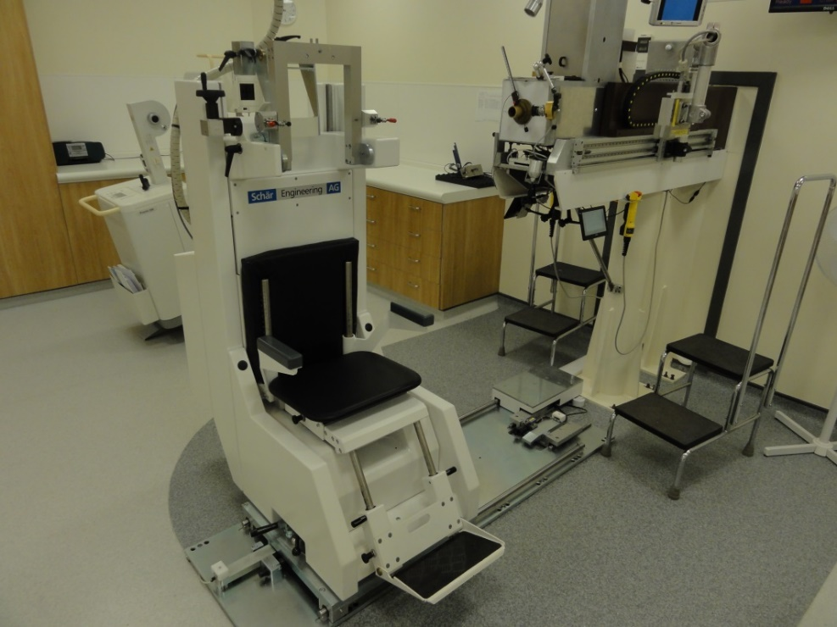
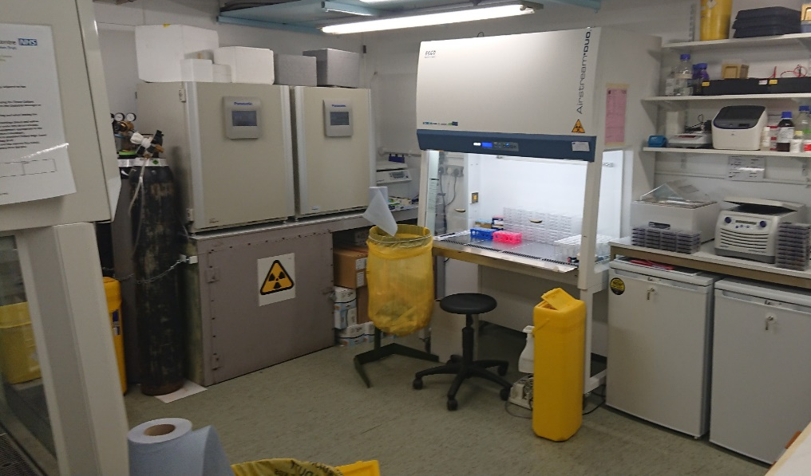
Eye Proton Therapy Centre and Radiobiology Research Facilities at Clatterbridge
  Successfully treating patients (currently ~300/year) with cancers of the eye for >25 years with 60 MeV proton beam.
  Limited time and proton beam access due to patient treatments.
  Limited in vitro capabilities and unable to perform in vivo research.

Slide 5
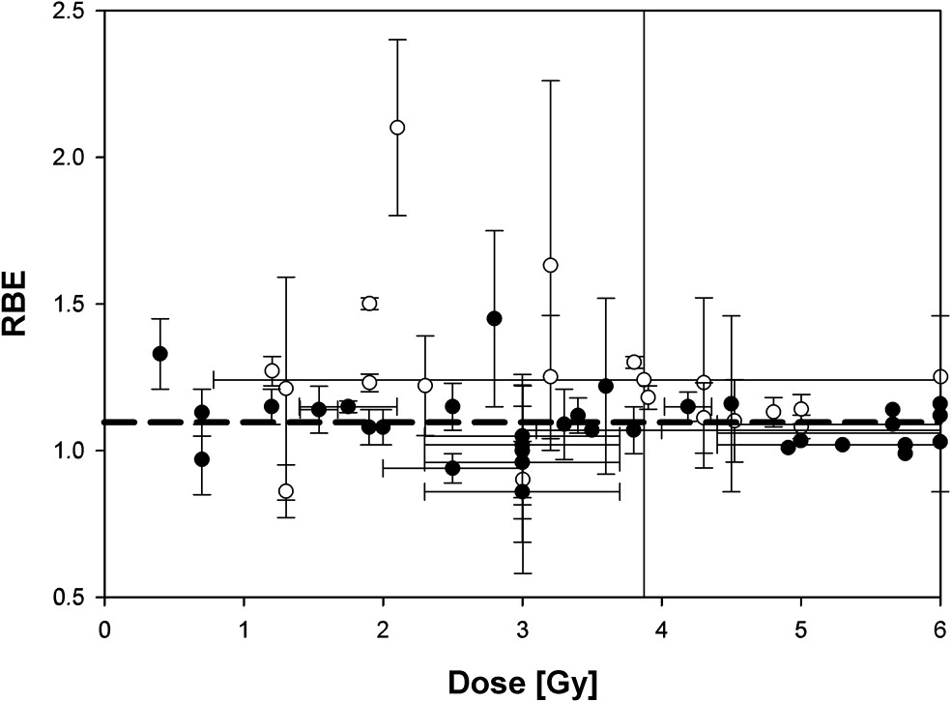
Biological uncertainties with particle radiotherapy
Tumour
Bragg peak
Distal fall-off
Relative dose
LET
Proton energy
Depth in tissue
Vitti and Parsons (2019) Cancers
Taken from Paganetti and van Luijk (2013) Sem Rad Oncol
  A constant relative biological effectiveness (RBE) value of 1.1 is used in clinical practice for protons. However, there is a large uncertainty with using this approach as RBE is variable and dependent on many factors, including:-
  Proton energy (therefore linear energy transfer, LET) and dose/dose rate.
  Radiosensitivity/radiobiology of the specific tumour tissue (e.g. based on DNA repair capacity, hypoxia and tumour microenvironment).
  Biological end-point examined (e.g. clonogenic survival, tumour growth delay).
  Further research exploiting the biological impact of particle ions is vital for investigating RBE, and thus improving clinical use of PBT.

Slide 6
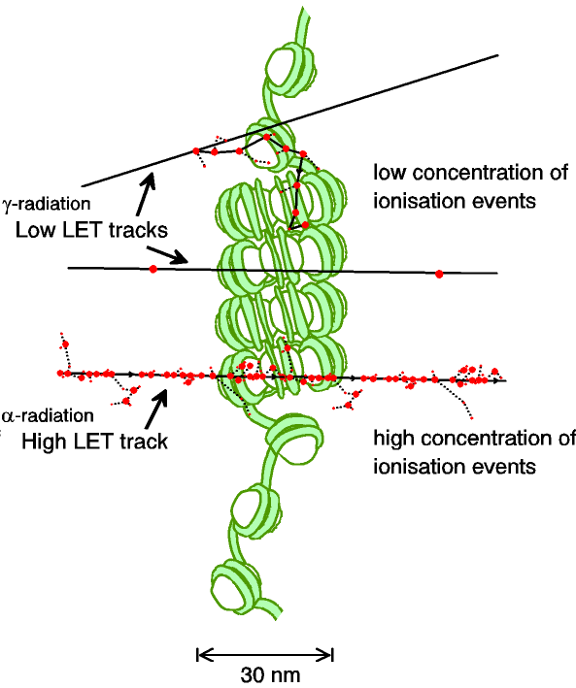
  DNA damage and relationship to LET
****
Low-LET
Low-LET (modified assay)
High-LET
High-LET (modified assay)
CDD
*
***
**
RBE=~1.7
Low-LET radiation produces repairable DNA damage (e.g. single and double strand breaks).
High-LET radiation generates increased amounts of complex DNA damage (containing multiple DNA lesions) that are more difficult to repair, utilises multiple DNA repair pathways, and which can enhance cell death.
Low-LET
High-LET
Carter et al, and Parsons (2018) IJROBP
Carter et al, and Parsons (2019) IJROBP

Slide 7
Modulation of proton-induced cellular sensitivity following siRNA knockdown screening
Low-LET protons
  HeLa
High-LET protons
Significant variability in the response of cells to low and high-LET protons dependent on cellular proteome.
Will identify specific cellular targets (e.g. for combinatorial drugs/inhibitors) to exacerbate the effects of PBT.
Carter et al, and Parsons (2019) IJROBP

Slide 8
FLASH radiotherapy
Using ultra high-dose rates (>100 Gy/s).
  However, the mechanism of the FLASH effect is unclear (role of oxygen?).
  Impact of FLASH on specific tumour models not well defined.
  Effect of FLASH photon vs protons (and impact of LET), not been demonstrated.
  Further research exploiting the biological impact of FLASH on appropriate in vitro and in vivo models is important for translation to the clinic.

Slide 9
  Challenges and opportunities for PBT radiobiology research
  Challenges
  The radiobiology of PBT at the molecular and cellular level is still not entirely understood (e.g. impact of LET, dose rate delivery).
  Other factors that impact on RBE of PBT not well defined (e.g. hypoxia, tumour microenvironment, drug-IR combinations, fractionated doses, FLASH).
  More research required using specific and validated cancer models, plus relevant normal tissue models, in vitro (e.g. 3D spheroids/organoids) and in vivo.
  Significant lack of access to PBT facilities for radiobiology research.
  Current facilities not fully equipped for in vitro, but more so in vivo experiments.
  Opportunities with LhARA
  Highly accessible facility for both in vitro and in vivo particle ion radiobiology research, capable of analysing a multitude of biological end-points.
  Enhance our understanding of the radiobiological effects of particle ions (protons and carbon ions), including examining dose delivery (FLASH) and combinatorial treatments through high-throughput screening.
  Significant opportunity to develop research that will have a major Worldwide impact through the optimisation and personalisation of cancer treatments using PBT in the clinic.

Slide 10
  Feedback from Yolanda Prezado
  LhARA is a very promising facility which would offer unique features for radiobiology research.
  Flexibility of beam would enable exhaustive investigations on how the biological response depends on temporal and spatial beam structure (pulse width, repetition rate, instantaneous dose, dose rate and particle type).
  Comprehensive studies in the temporal axis (fractionation, drug/immunotherapy combinations, thresholds/mechanisms of FLASH).
  Be the few places in the World to offer the evaluation of different particle ions within the same facility.
  Flexibility to perform both in vitro and in vivo experiments.
  In vivo experiments are very important given lack of current facilities and of in vivo data relating to PBT.
  Stability of the beam important for radiobiology studies.
  Exhaustive evaluations of RBE using various and more complex end-points (e.g. angiogenesis, inflammation).
  Main drawback in phase 1 is low energy beams, however these will have a similar range of high-LET irradiations within the tumour.

