Slide 1
LhARA - Beam Capture
Dr C. G. Whyte,
SUPA Department of Physics, University of Strathclyde, Glasgow, G4 0NG,
Notes:
Good morning everyone
This is the first of a two-part work package
We’ve been looking at up at Strathclyde
Here looking at Magnetically insulated line oscillators
Or MILOs

Slide 2
Gabor Lenses
Why use Gabor lenses?
History
Program
  Challenges
  Progress to date
    Interface with Laser target
    Vacuum pressure
  Plans
    Numerical simulations
    Experimental program
  Mitigation

Slide 3
Gabor Lenses
Advantages
Focal length scales with the kinetic energy of the incoming beam
Solenoid like, but requires much lower B field for equivalent focal length
B_{GPL} = B_{SOL}*(m_{e}/m_{ion})^{0.5}
For protons
B_{GPL} = B_{SOL} /44
Quadrupole scales with momentum, longer focal length at high beam energy.

Slide 4
Gabor Lenses
Gabor – ‘A space-charge lens for the focussing of ion beams’ Nature July 19, 1947.
A uniform static electron ‘cloud’ produces an ideal focusing electric field.

Slide 5
Gabor Lenses - History
Brookhaven. Mobley, Gammel,
        Maschke
Russia Morozov, Goncharov
Livermore NL Booth & Lefevre
Fermi NL Palkovic
Maryland Reiser
But… lens performance was below
prediction in terms of both
focal length and aberration.
Re-emergence – heavy ion beam focussing.
Devices with background plasma for beam space charge neutralisation.
Goncharov, Tauschwitz, Ivanov, Neuner.

Slide 6
Gabor Lens – more recent
Frankfurt/ICL Pozimski, Schulte, Meusel
Experiment
  n_{e} ~1 x 10¹⁵
Numerical simulation
Diagnostics
  Electron density – ion beam
  Electron temp – spectroscopic
  n_{e} < 1 x 10¹⁵ dicotron instability
    Seen in numerical simulation

Slide 7
Gabor Lens - Theory
Radial confinement
n_{e} = ε₀ B²/2m_{e}e =5x10¹⁸ B² <= 1x10¹⁵
Axial confinement
n_{e} = 4ε₀ V_{A}/eR²
Focal length
f= 4m_{e}m_{p}v_{p}²/e²B²l
B field reduction
B_{g}/B_{sol} = (m_{e}/m_{ion})^{0.5} ~= 44

Slide 8
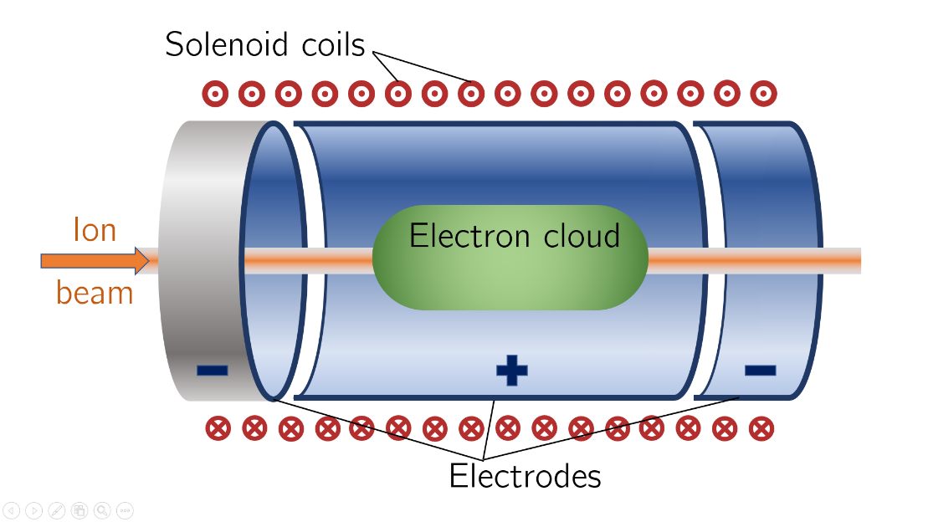
Penning – Malmberg trap
Excellent beam aperture
Design for High voltage

Slide 9
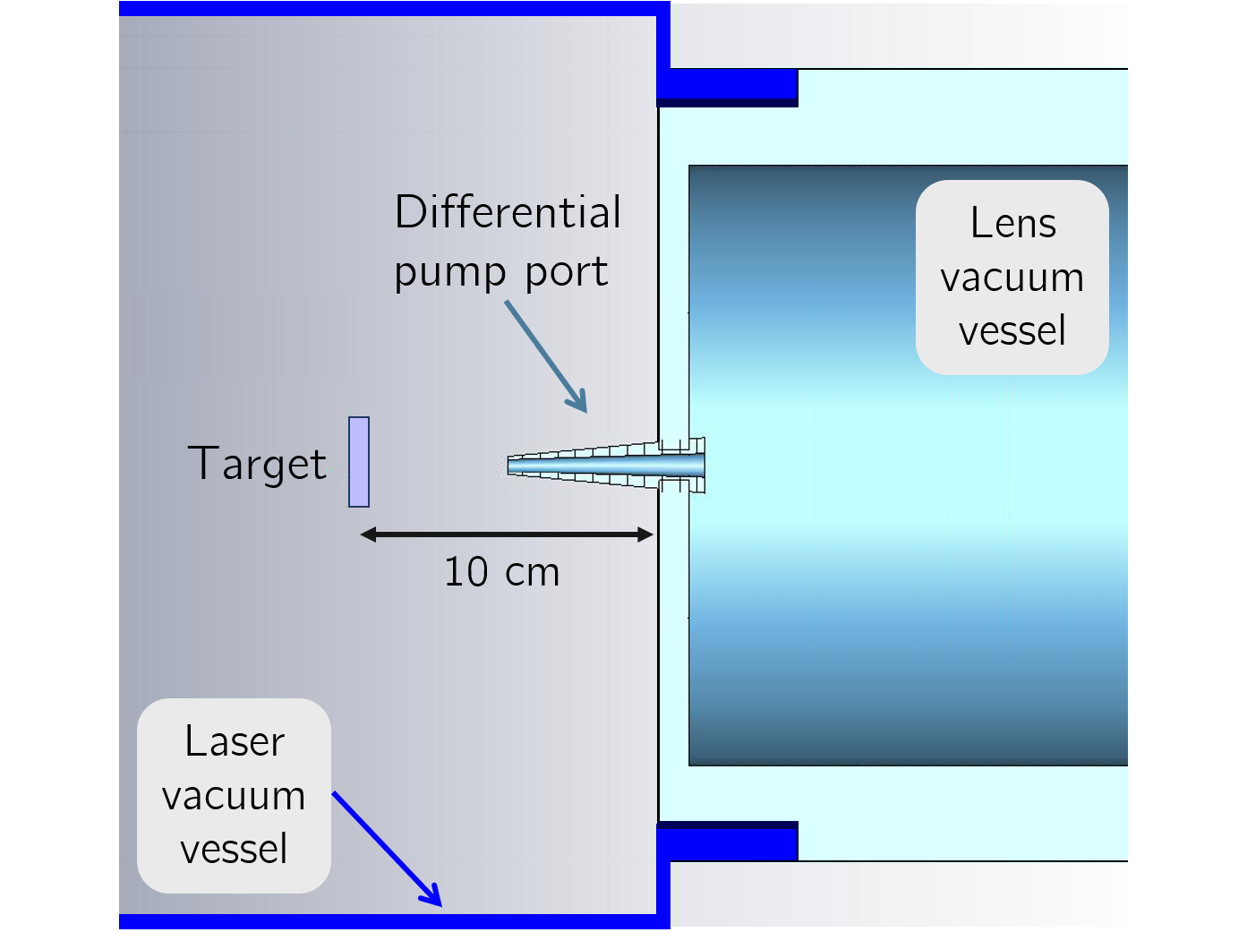
Target Capture Interface
Vacuum vessel division line 100mm upstream of target foil
Target vacuum 1x10⁻⁶ mBar at best, possibly considerably poorer - ablation of target
Gabor lens 1x10⁻⁸ mBar desirable
No physical barrier – differential pumping.
Re-entrant ‘cone’ penetrating 50mm into Target-side vacuum
3 orders of magnitude pressure differential

Slide 10
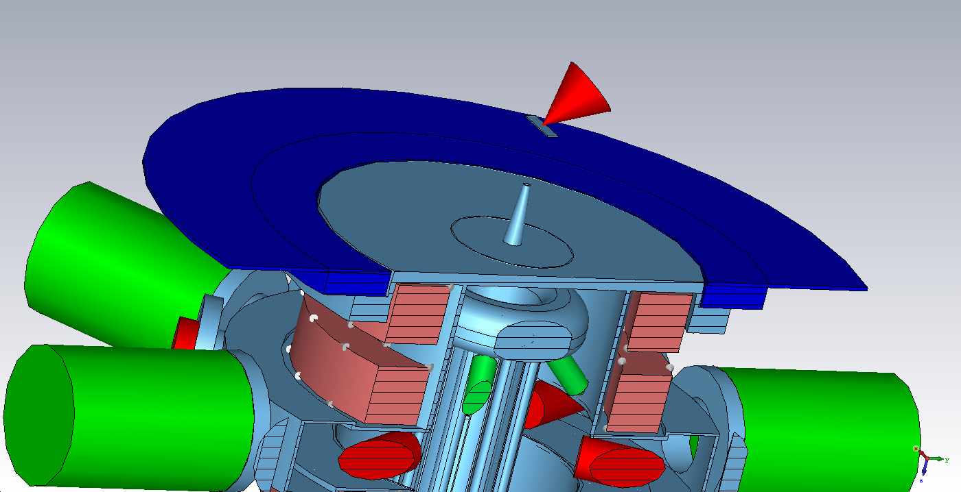
Target-Capture Interface

Slide 11
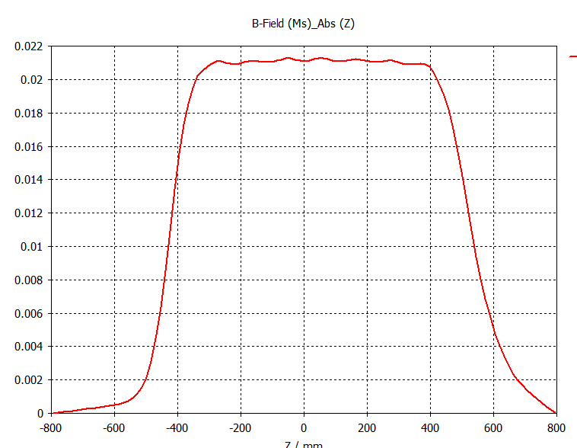
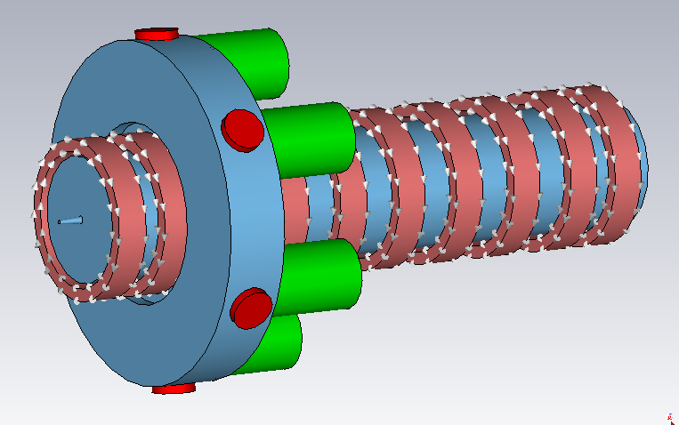
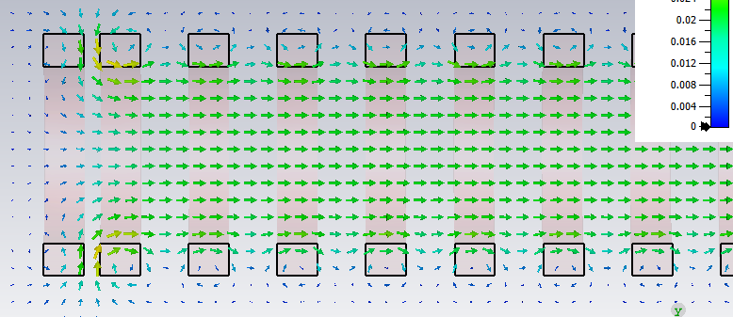
Magnetic Field

Slide 12
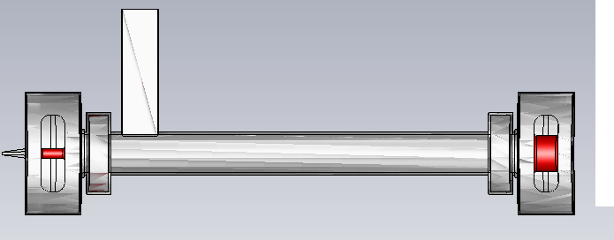
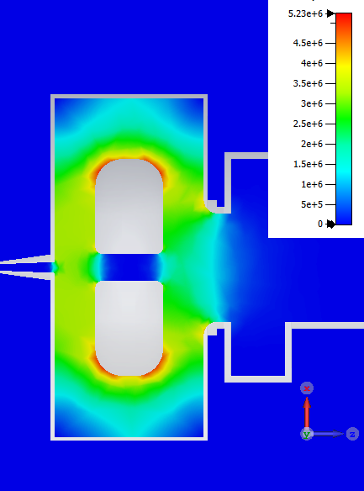
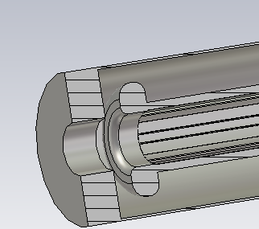
High Voltage design

Slide 13
Vacuum
All dry system
Turbo drag pump backed by scroll pump.
Permanently pumped system.
Requires excellent conductance paths to remove debris from target chamber
Possible
  ion pump
  NEG pumping

Slide 14
Experimental Investigation
1st Pass plasma lens
Penning-Malmberg Trap
  3 ‘floating’ electrodes
  Options to operate
    grounded anode
    grounded cathode
Processed for high vacuum operation
DC high voltage
Characterisation of properties using alpha source and thin film detector in vacuum.

Slide 15
Diagnostics
Electron density
Phase shift = n_{e}*l*λ*[e²/4πc²m_{e}ε₀]
Where
λ=wavelength of probe radiation
l=length of probe path through plasma column
Phase shift = n_{e}*l*λ*constant
Maximise λ and l to maximise phase shift
For λ = 100mm, l =2m
phase shift ~<1 degree at n_{e}=1 x10¹⁴
No spatial resolution – limited bandwidth
Spatially resolved data via light emission from plasma

Slide 16
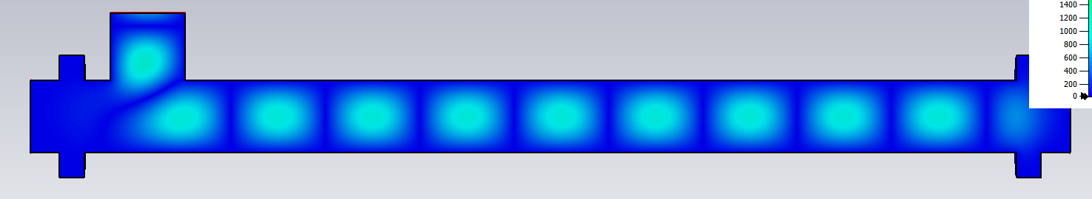
Electron Density
Low frequency, long wavelength, 2 pass design.
Input and output from rectangular port to top
Directional couplers – Vector network analyser
Less than 1 degree phase shift at n_{e}=1x 10¹⁴
  Measureable via VNA
  Can increase number of passes but will reduce bandwidth

Slide 17
Numerical simulation
Plasma Stability
Full 3D pic code simulation
Well established group
  Prof. Bingham RAL/Strathclyde
  Mini-cluster or larger
Diocotron instability.
OSIRIS, VSIM, Vorpal, EPOCH, Magic

Slide 18
Electron beam simulation
Original proposal by Gabor
‘hot wire’ electron source.
modern cathode ~2-10A/cm² <10⁵A/m²
required electron density, n_{e}=1x 10¹⁴
required current density is easily achievable with modern cathodes – an order of magnitude uplift in electron density may be possible
CST Microwave Studio to simulate electron gun – Strathclyde expertise in high alpha electron guns

Slide 19
Experimental Investigation
2nd generation plasma lens
Input from PIC code modelling for stability
Electron source inside lens
RF system for measurement of e density
Processed for high vacuum operation
Pulsed HV ~10s of ns pulse length.
Characterisation of properties using alpha source and thin film detector in vacuum.

Slide 20
Parallel – Solenoid design
Recognise possibility Gabor lens design may not converge in time.
Parallel investigation of alternate solenoid design.
1.3T magnet 1m long 35mm aperture.
Warm magnet design possible, superconducting possibly too expensive.
Pulsed at 10Hz also possible.
Break point in program to allow switch to alternate solution.

