Slide 1
LhARA Pre-CDR Biological End Stations 31/03/20 Jonathan Hughes

Slide 2
LhARA Biological End Stations
Three biological end stations (two in vitro and one in vivo)
Low energy in vitro – proton beams between 12 – 15 MeV
High energy in vitro – proton beams between 15 – 127 MeV
– ion beams (including C⁶⁺) up to 33 MeV/u
High energy in vivo – proton beams between 15 – 127 MeV
– ion beams (including C⁶⁺) up to 33 MeV/u

Slide 3
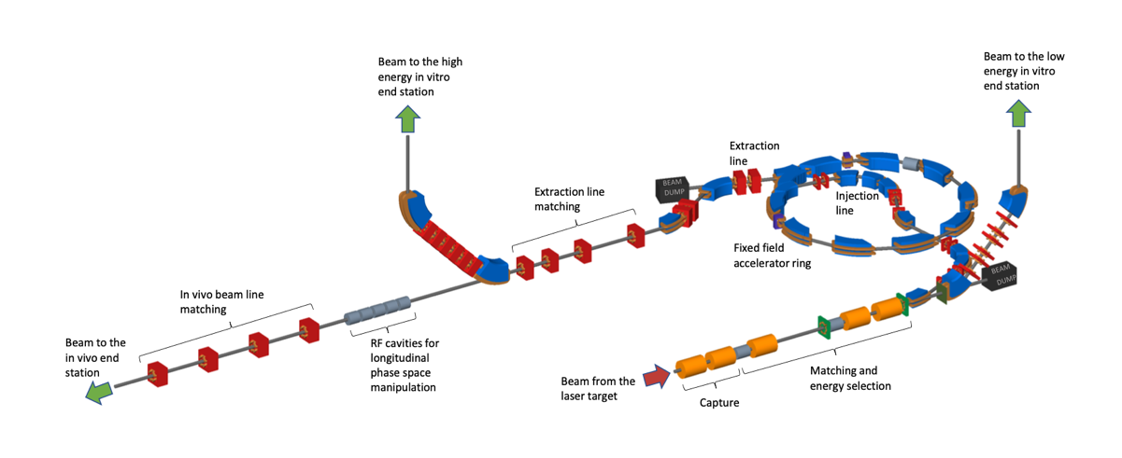
LhARA Biological End Stations

Slide 4
In vitro Biological End Stations

Slide 5
In vitro Biological End Stations
Two in vitro end stations – high and low energy
Located within a state-of-the-art laboratory
Fully equipped, with various work spaces
Investigation of the biological response of 2D monolayer and 3D cells to PBT

Slide 6
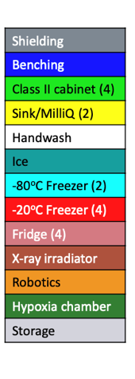
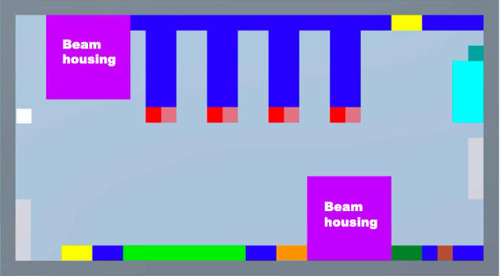
In vitro Biological End Stations

Slide 7
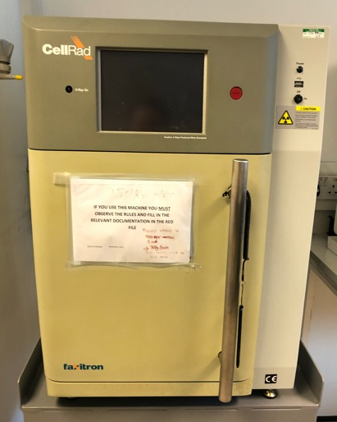
In vitro Biological End Stations

Slide 8
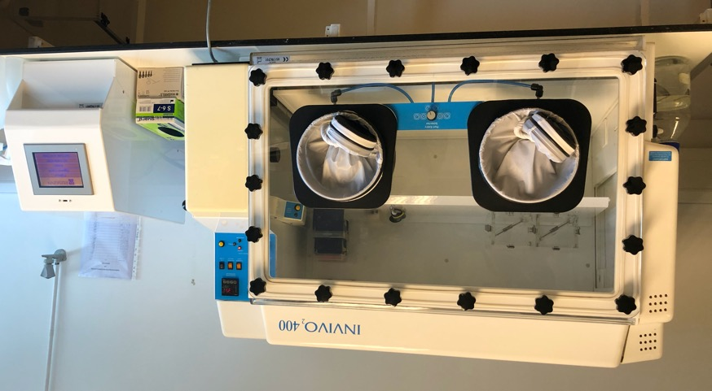
In vitro Biological End Stations

Slide 9
In vitro Biological End Stations

Slide 10
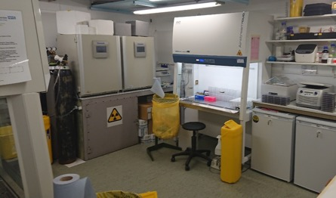
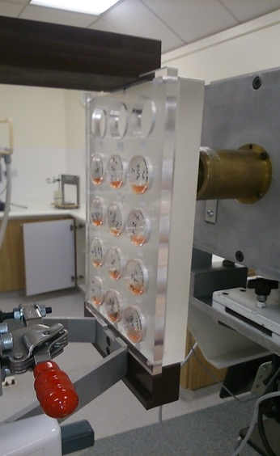
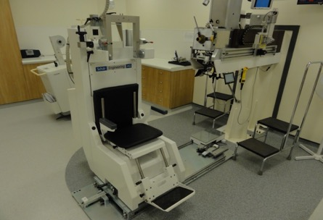
Clatterbridge Cancer Centre (CCC) – Clinical proton beam

Slide 11
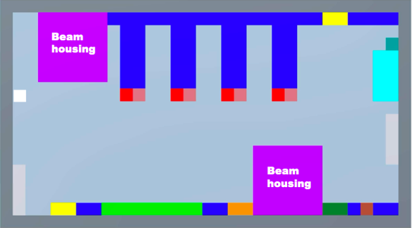
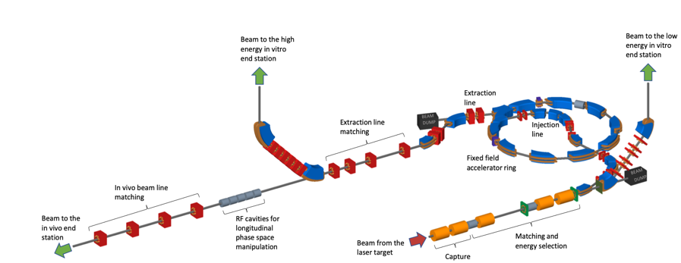
In vitro Biological End Stations
Vertical beam allows culture vessels to be flat

Slide 12
In vitro Biological End Stations
Vertical beam allows culture vessels to be flat
Beam line within the end stations to be sealed within units supplied with gases (CO₂, N₂), act as hypoxia chamber

Slide 13
In vitro Biological End Stations
Vertical beam allows culture vessels to be flat
Beam line within the end stations to be sealed within units supplied with gases (CO₂, N₂), act as hypoxia chamber
Robotic arm within sealed units to position culture vessels in front of and away from the beam line

Slide 14
In vivo Biological End Station
High energy protons (up to 127 MeV) and ions (up to 33 MeV/u)
Located on the basement floor
Irradiation of small animal models to investigate the effect on PBT on appropriate biological end points (e.g. tumour growth)
Beam flexibility - passive scattering, pencil beam scanning, micro beams
Animal handling area within end station for anaesthetisation of animals
CT scanner to guide targeting
Animal holding facility off site for long term biological measurements

Slide 15
Conclusion
Three biological end stations, fully equipped to fulfil radiobiological research requirements
Multiple energies (high and low), particle irradiation types (proton, carbon ions), dose rates (conventional vs FLASH)
Capable of irradiating a wide range of biological models to investigate a myriad of biological end points (tumour growth, high throughput drug screens, hypoxia, inflammation)
Translation into future effective patient treatment

