Slide 1


LhARA pre-CDR:
Infrastructure, Integration & Safety
Galen Aymar
31 March 2020

Slide 2
Outline
Floor Layout
Safety
Costing
R&D

Slide 3
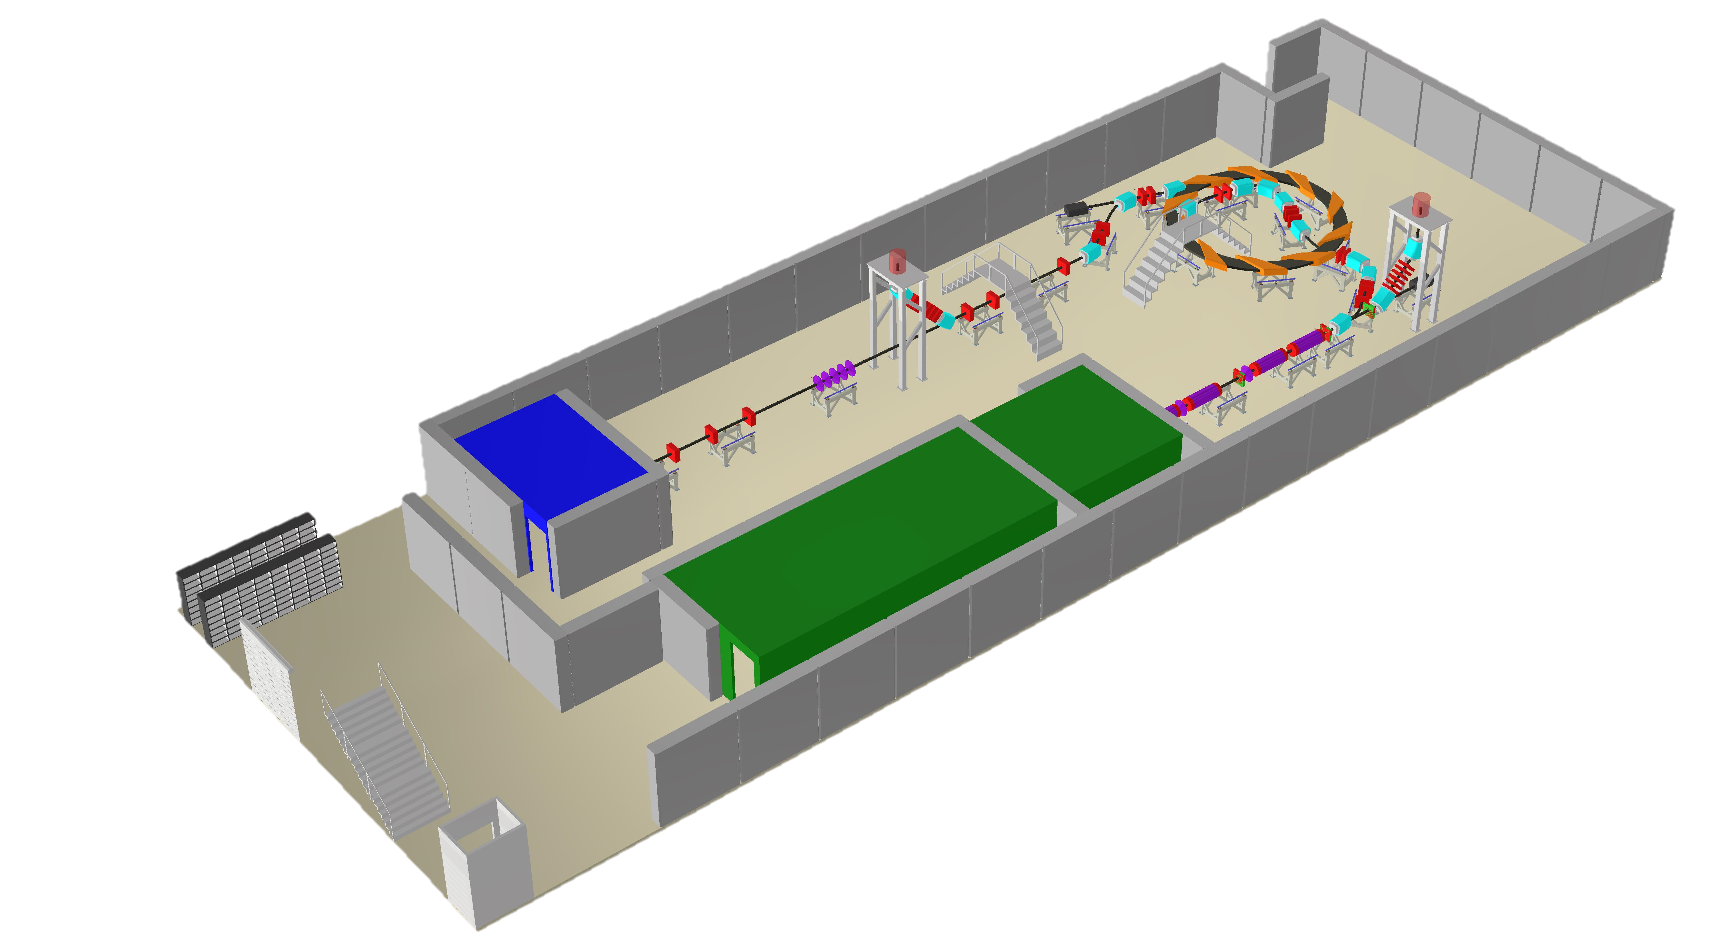
Accelerator Layout

Slide 4
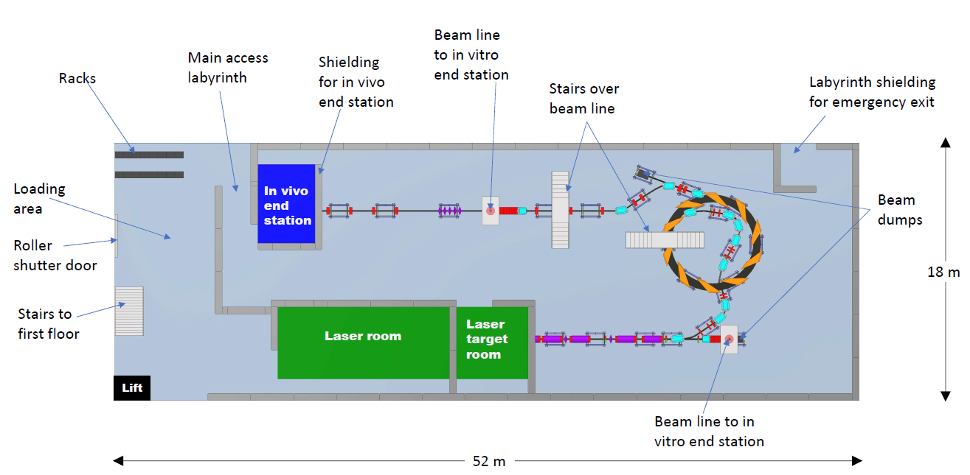
Accelerator Layout

Slide 5
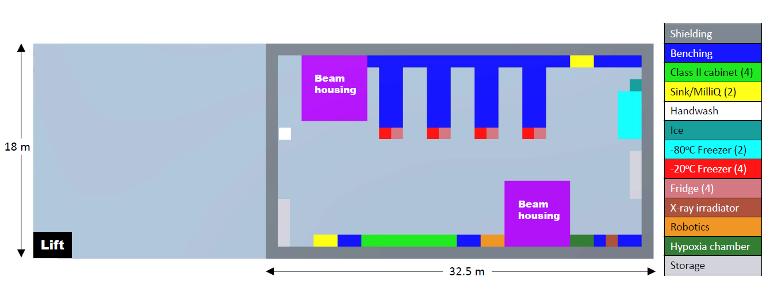
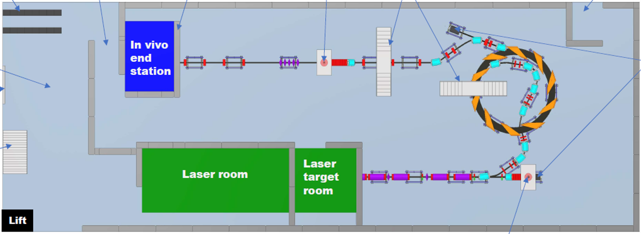
End Station Layout

Slide 6
Safety
The facility is expected to be built at an STFC National Laboratory or equivalent research institute
Safety will follow guidelines set out by the institute and with the support of staff and appointed responsible persons, such as
Radiation Protection Advisors
Laser Responsible Officers
Authorising Engineers

Slide 7
Safety
Relevant STFC safety codes:
SC6 – Risk management
SC13 – Construction design and management
SC16 – Biological safety
SC22 – Working with lasers
SC23 – Working with time-varying electro-magnetic fields
SC29 – Management of ionizing radiation at work
SC34 – Electrical safety

Slide 8
Safety
Comparable facilities operated by STFC
Lasers:
  Gemini Target Area 2 – 0.5 J, 5 Hz, 30 fs
  Gemini Target Area 3 – 15 J, 0.3 Hz, 30 fs
  Extreme Photonics & Applications Centre (EPAC) – higher energies at 10 Hz
Accelerators:
  Front End Test Stand (FETS) – H⁻ ions, 3 MeV, 60 mA, 2 ms, 50 Hz
  ISIS Neutron & Muon Facility – H⁻/Protons, 800 MeV, 240 µA, 10 ms, 50 Hz

Slide 9
Safety
End Stations
Administration of chemicals and drugs to cell performed in Class II biological safety cabinets in the laboratory
As necessary, plates and dishes sealed prior to irradiation in end-station
Radiation
Controlled under Regulation 8 of the Ionising Radiation Regulations 2017 – a risk assessment is required prior to starting work
To consider: nature of the source, dose rates, contamination, dosimetry, engineering controls, PPE, access, accidents, failures

Slide 10
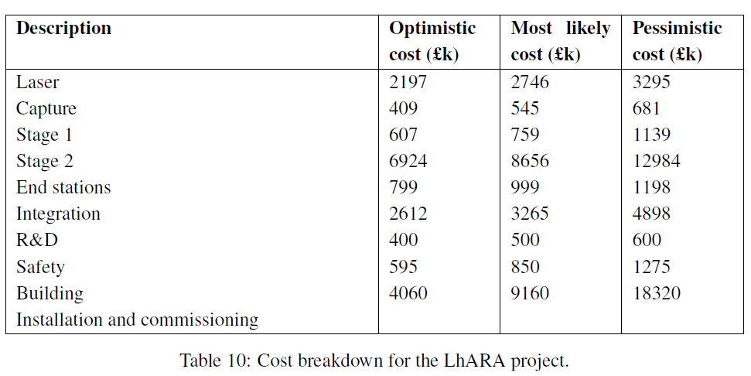
Costs
Total Cost Estimates
Optimistic | Most Likely | Pessimistic
£22M | £33M | £53M

Slide 11
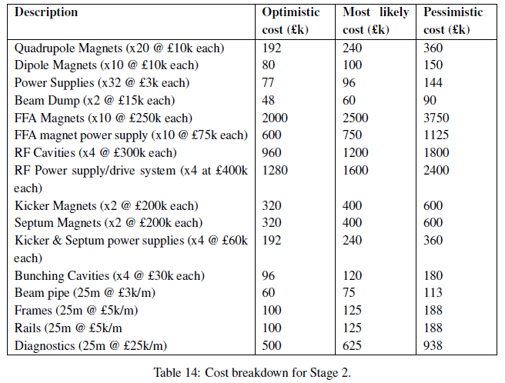
Costs
Stage 2 Accelerator
Estimates are
Comparative
Parametric
Formal quote
Budgetary quote
Guess
Comparative
Guess
Parametric

Slide 12
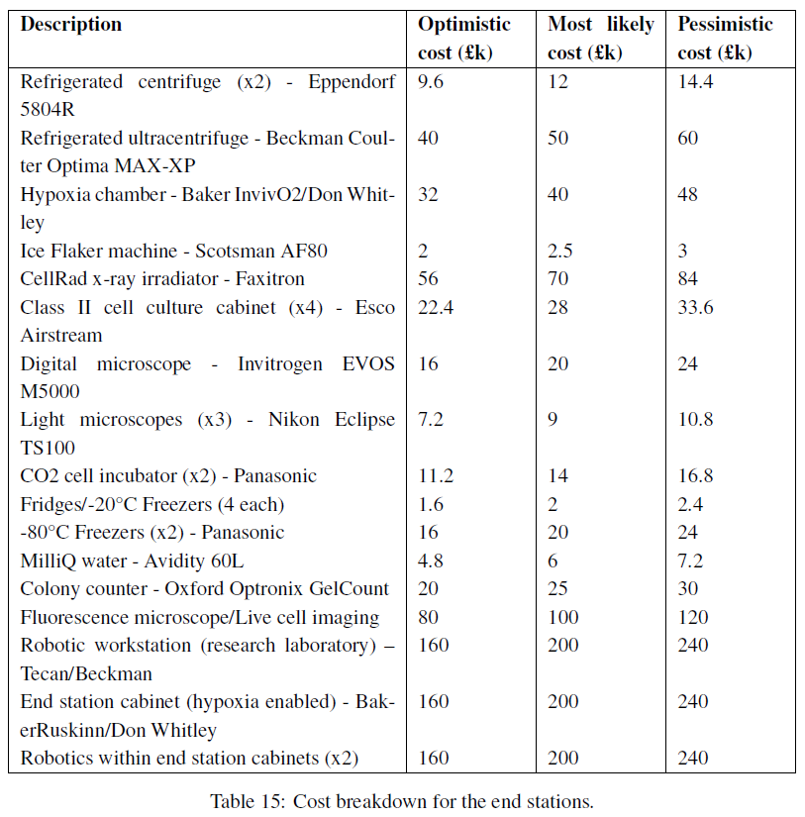
Costs
End Stations
Estimates are
Comparative
Parametric
Formal quote
Budgetary quote
Guess
Budgetary & formal quotes

Slide 13
R&D Plan
Four key areas for infrastructure and integrations:
Full project risk analysis (e.g. resource availability and technical challenges)
Full facility safety risk assessment
Radiation simulations and shielding design
Control systems development

Slide 14
Thank you

