Slide 1


Overview of the LhARA Facility
Review of the LhARA pre-CDR
Ajit Kurup
31st March 2020

Slide 2
Introduction
Overview of the design of the facility.
Design parameters.
Staging.
Accelerator.
Instrumentation.
Project schedule and R&D plan.

Slide 3
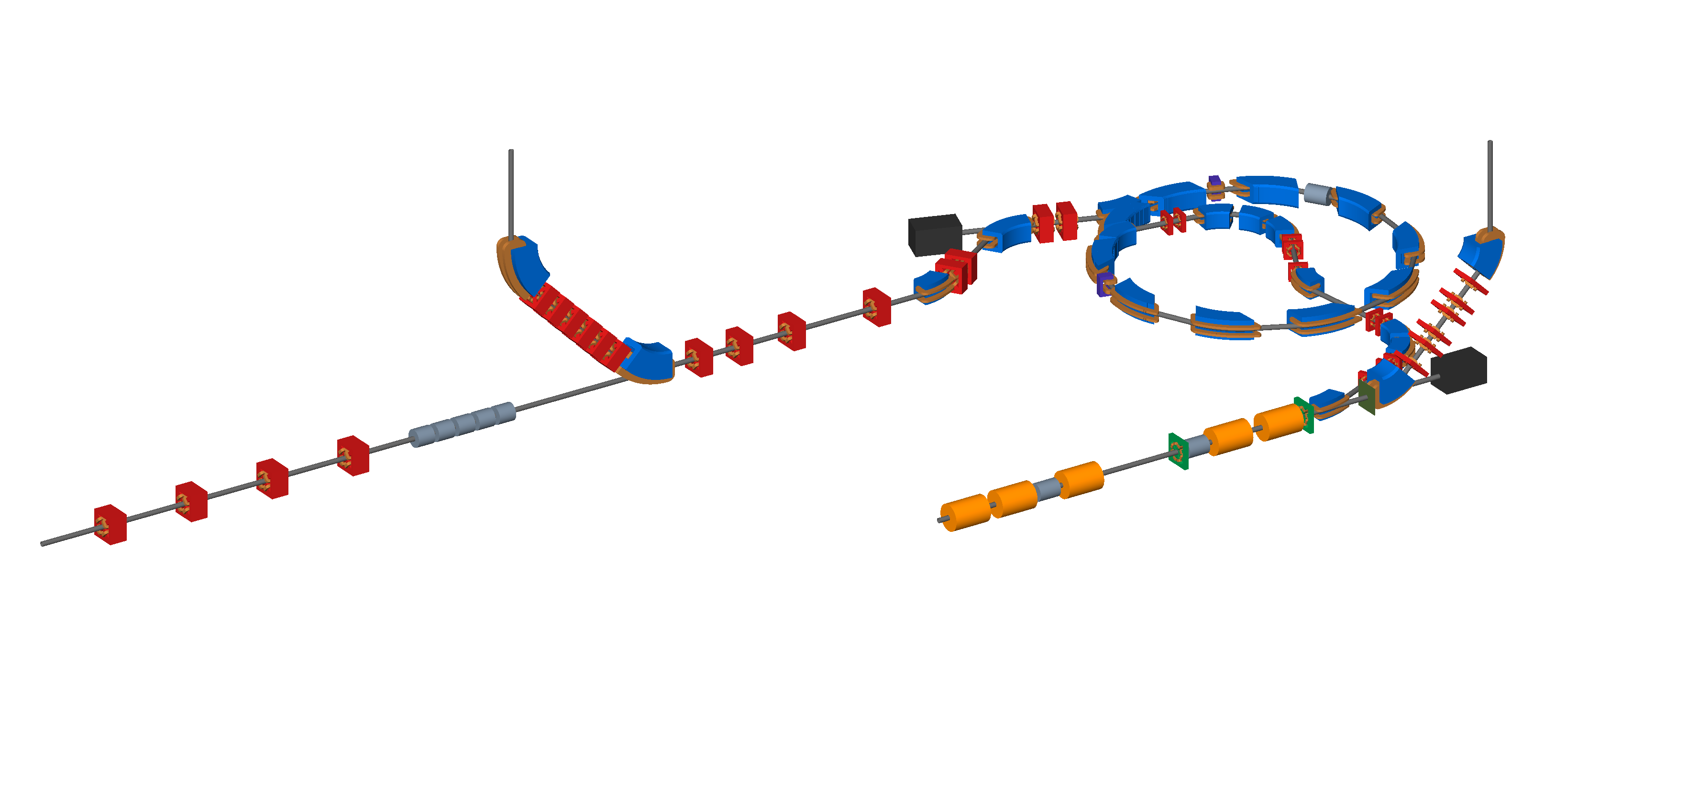
Accelerator
Beam to the high energy in vitro end station
Beam to the low energy in vitro end station
Extraction line
Extraction line matching
BEAM
DUMP
Injection line
Fixed field accelerator ring
BEAM
DUMP
In vivo beam line matching
Beam to the in vivo end station
RF cavities for longitudinal phase space manipulation
Beam from the laser target
Matching and energy selection
Capture

Slide 4
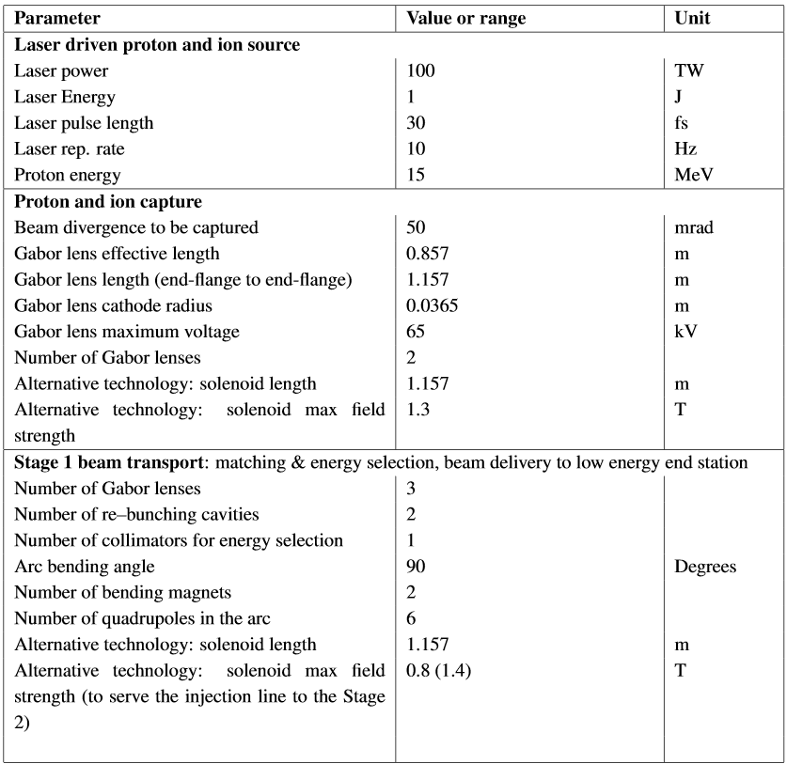
Design parameters

Slide 5
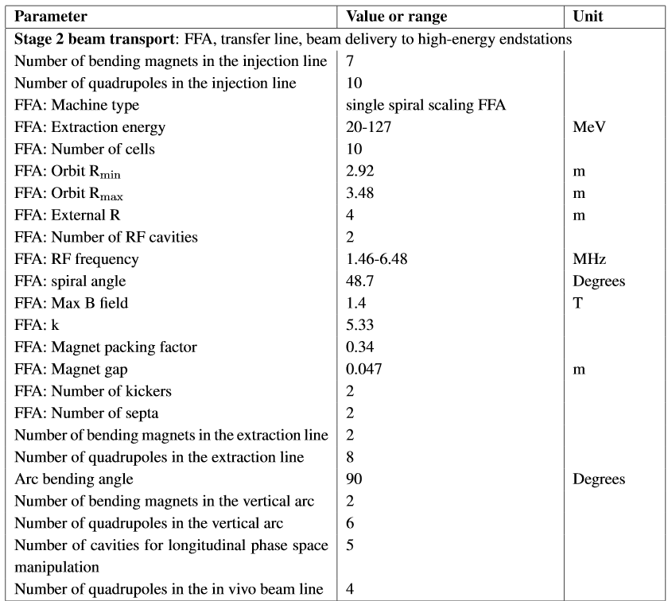
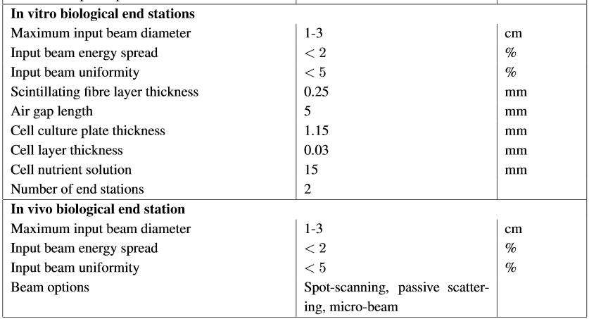
Design parameters

Slide 6
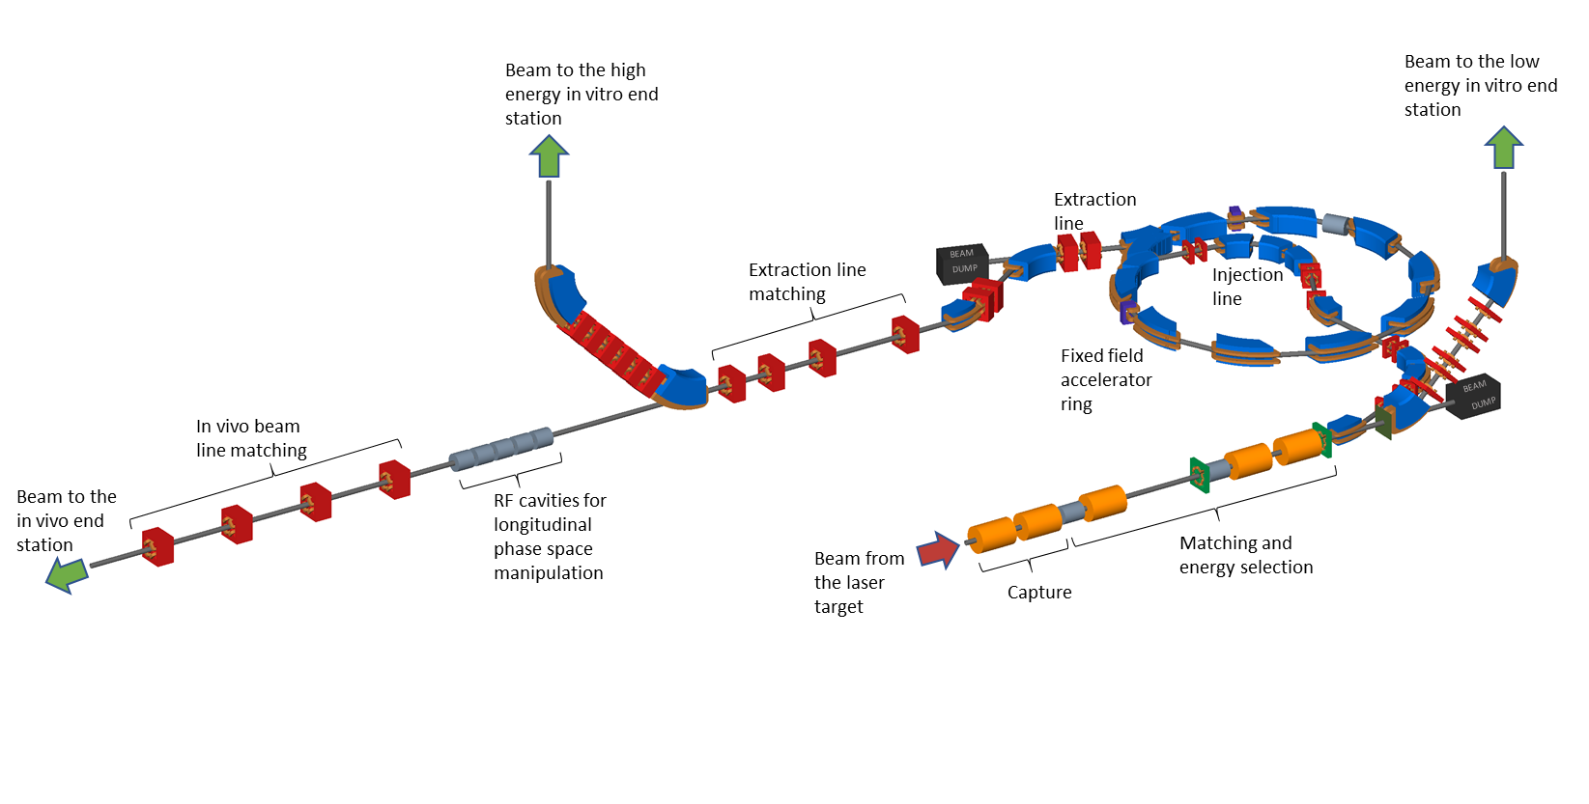
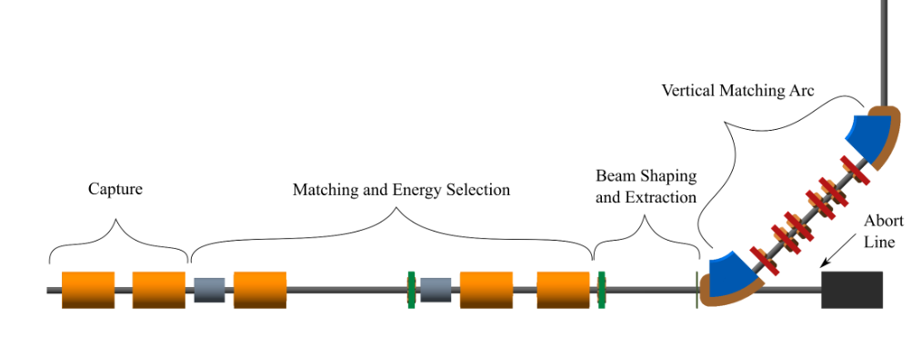
Staging
Construction will be done in two stages.
The goal is maximise scientific output.
  Generate scientific output during construction of Stage 1.
  Radiobiology programme using Stage 1 whilst constructing Stage 2.
Beam from laser source
Stage 1
Stage 2

Slide 7
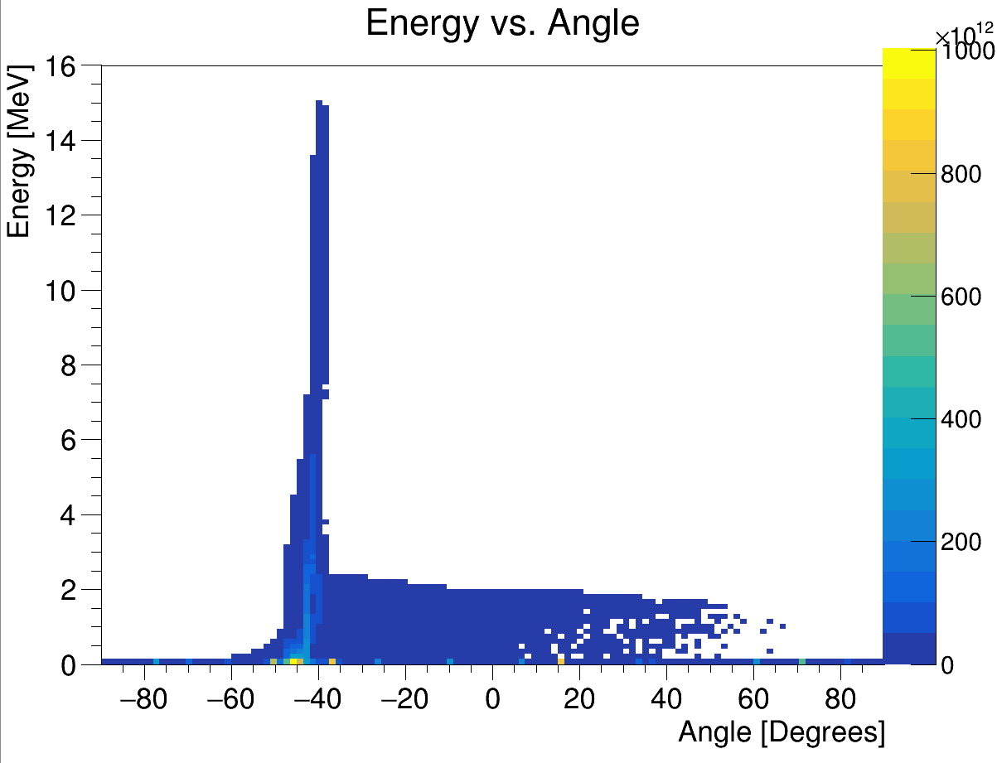

Laser source
Positive ions from hydrocarbon contamination on the target surface
Energy vs angle with respect to laser beam direction
LASER
45$°$
+
+
+
+
+
+
+
+
+
+
-
-
-
-
-
-
-
-
Ion beam
Electron sheath generated by the laser accelerates positive ions from the target
Principle of target normal sheath acceleration (TNSA).
Laser driven ion beam simulation using EPOCH.
Produces intense beams and multiple species, e.g. proton and carbon ions.
  Overcome space charge limit of conventional sources since beams are produced with energies O(10) MeV.
Issues to consider
  Large energy spread.
  Large divergence.
  Ion beam stability.
    Laser has been over specified so it is not operated near it limits.
    Target.
Notes:
At the start we have a laser which is fired at a thin metal target at an angle of 45 deg. This then generates an ion beam from the surface of the target.
Using this method we can produce very intense beams but with a very large angular spread.
Simulations used a beam generated from the same parameters used in the optics design. Beta means small spot size and with this emittance that means you have a beam with a very large divergence.
Need a strong focusing element to prevent the beam being lost.

Slide 8
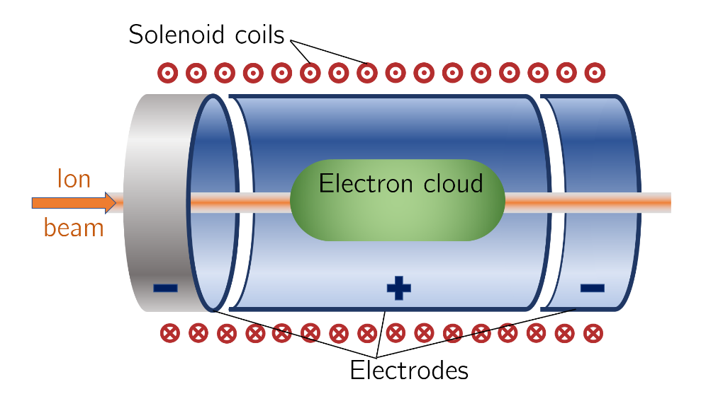
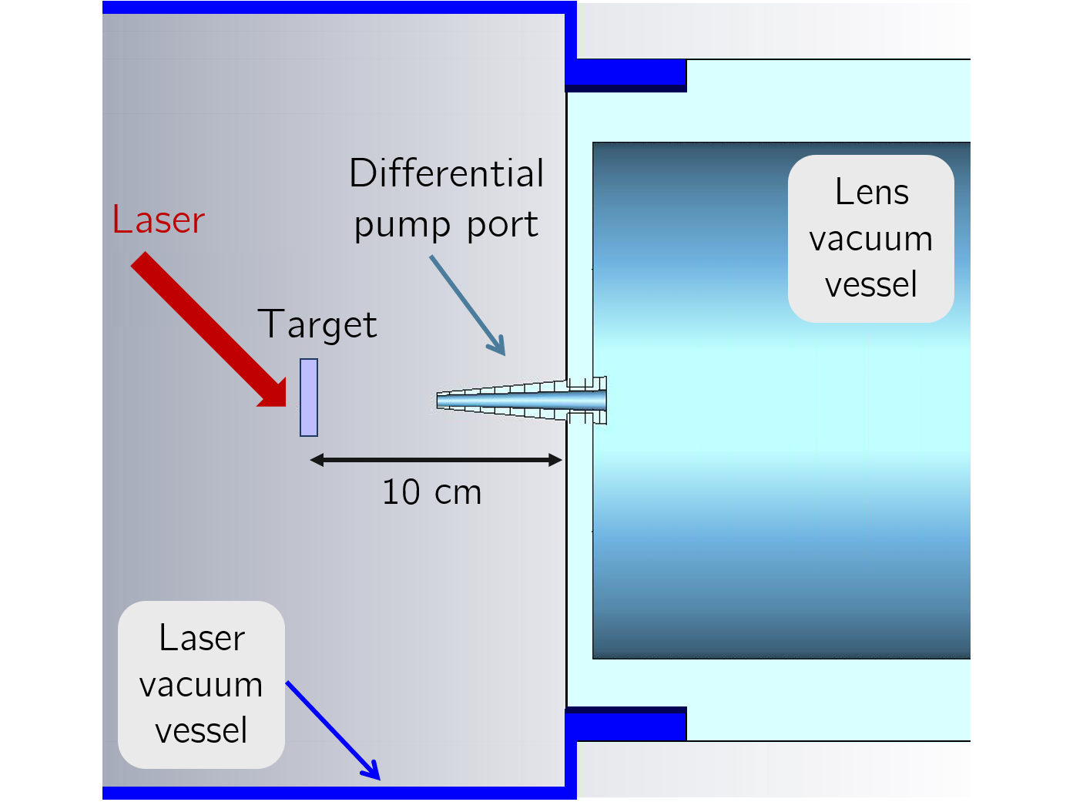
Capture
Solenoid coils
cylindrical
anode
Grounded
end plate
Space to insert diagnostics
       
       
Grounded
end plate
Ion beam
Electron cloud
       
       
Strong focusing essential to capture the beam from the laser source.
The Gabor lens uses a plasma to generate a strong electro-static focusing field.
  Focal point is energy dependent.
Equivalent solenoids require field of 1.3T
Prototype development to study plasma stability, electron density and verify operation in relatively high vacuum.
Different electrode configuration to allow inserting diagnostic probes
Original Gabor lens prototype was to be tested with the Cerberus laser at Imperial.
Schematic of proposed differential pumping scheme.
Notes:
What we plan to use to capture these particles is a a Gabor lens. This can provide a very strong focusing field in a short space by utilizing a confined electron plasma.
Schematic of the principle and a prototype at Imperial that we plan to test with a laser-ion beam.
To model in BDSIM
Lines from Jaroslaw’s beam optics code shows Beta_x and Beta_y (a measure of the beam envelope) are on top of each other. The points from BDSIM show the particle tracking simulations are well matched to the optics design.

Slide 9
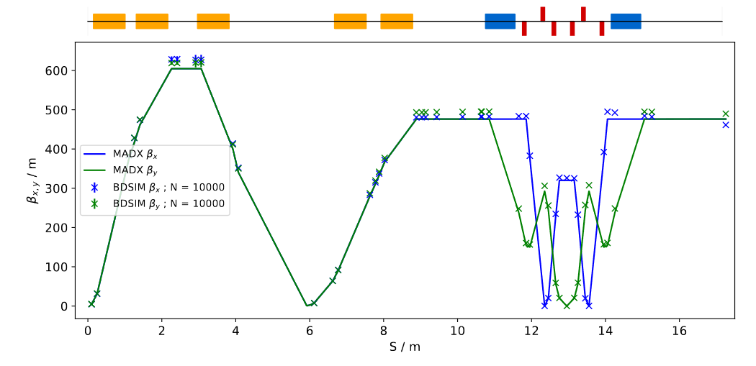
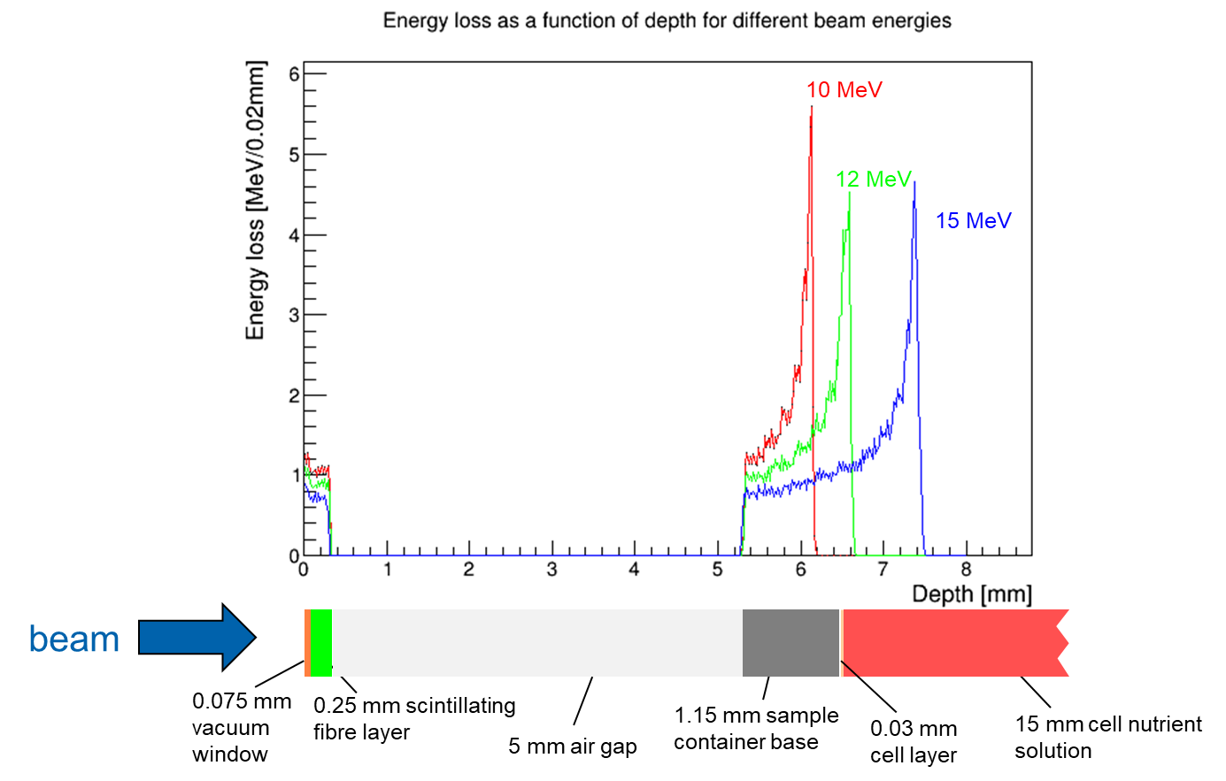
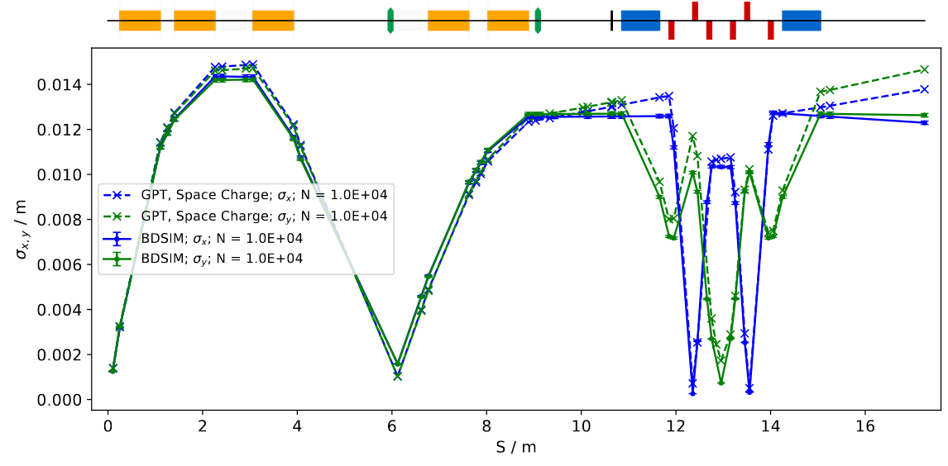
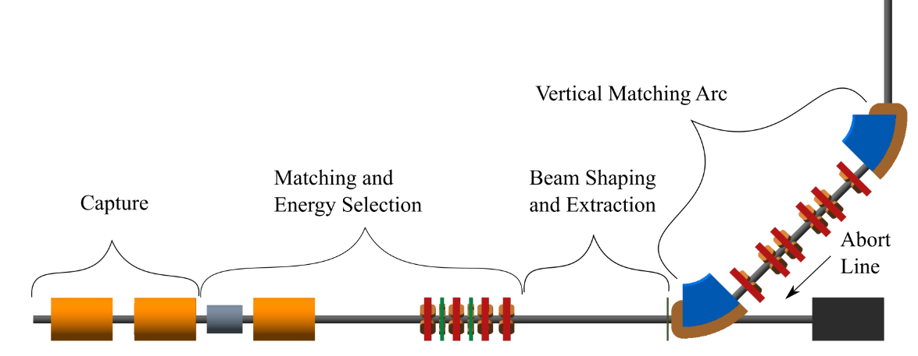
Beam transport – Stage 1
Optics design: BeamOptics and MADX.
Particle tracking simulations: BDSIM and GPT.
Energy deposition in the end station: BDSIM.
Alternative design

Slide 10
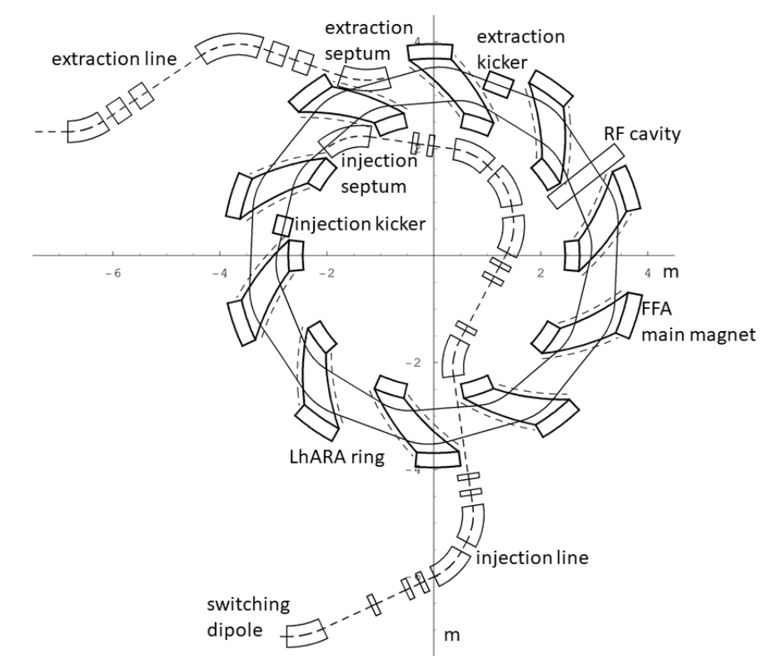
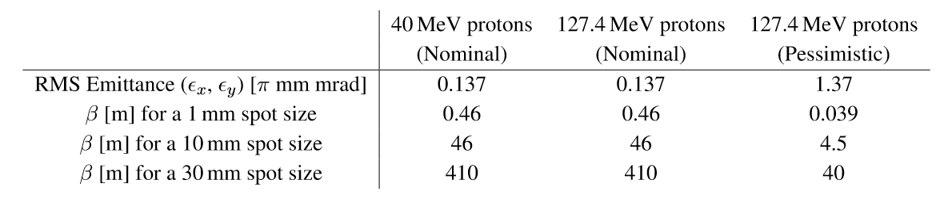
Beam transport – Stage 2
Post acceleration done using a spiral scaling fixed field accelerator (FFA).
Injection and extraction lines for the FFA.
High energy arc for in vitro end station.
In vivo beam line.
  Cavities for longitudinal phase space manipulation.

Slide 11
Instrumentation
Beam diagnostics.
  Low energy.
    Novel detectors.
  High energy.
    Conventional methods.
Dosimetry.
  Online dosimetry of high intensity beams.
  Calibration.
Fast feedback and control.

Slide 12
Schedule
Radiobiology programme.
System/near clinical aspects and outreach.
5 year R&D plan.
Construction
  2 years for Stage 1.
  5 years for Stage 2.

Slide 13
Five year R&D plan
Aims to address the technical challenges highlighted in the pre-CDR and deliver technical designs for the LhARA facility.

Slide 14
Five year R&D plan
Facility design.
  Development of conceptual design.
  Development of technical design.
  CDR (detailed for Stage 1).
  TDR Stage 1.
  TDR Stage 2.
Gabor lens.
  First generation prototype.
  Second generation prototype.
  Theoretical studies.
  Electron density measurements.
  Alpha source and detector tests.
Laser-driven source.
Laser-capture interface.
Investigation of space charge algorithms.
Stage 1 beam line performance evaluation.
Vertical bend.
Capture technology milestone.

Slide 15
Five year R&D plan
FFA.
  Design and simulation.
  Detailed magnet design.
  Magnet prototype.
  RF cavity design and performance evaluation.
  Injection and extraction design.
Stage 2 performance evaluation.
Longitudinal phase space manipulation design, simulation and prototyping.
Final beam preparation for in vivo end station.
End stations.
  Automation, sample handling, imaging.
  Simulation of the end stations.
Instrumentation.
  Low-energy beam diagnostics.
  Online dosimetry and dose profile.
  Absolute dosimetry at ultra-high dose rates.
  Fast feedback and control.
  High-energy beam diagnostics.
Software and Computing.
  Development of a global data acquisition and processing system.
  Development of the controls and monitoring system.

Slide 16
Summary
LhARA has the capability to provide unique beams for the study of radiobiology.
Two stage approach will aim to maximise scientific output whilst optimising the machine performance.
  Stage 1: protons up to 15 MeV.
  Stage 2: protons up to 127 MeV and C⁶⁺ ions up to 33MeV/u.
Conceptual design and initial simulations show the required performance can be achieved in principle.
Technical challenges will be addressed by the R&D plan.

