Slide 1

Introduction
Pre-publication review of the LhARA pre-CDR

Slide 2
Background
Centre for the Clinical Application of Particles:
  Imperial centre of excellence; established October 2017
  Mission:
    Develop the technologies, systems, techniques and
    capabilities necessary to deliver a paradigm shift in the
    clinical exploitation of particles.
  Key objectives:
    Develop novel, compact, laser-driven accelerator systems for clinical applications;
    Deliver the capability to assess the biological and therapeutic efficacy of different ion species; and
    Develop improved diagnostic, dose-measurement, imaging, treatment-planning, data-processing, andmachine-learning techniques.
LhARA, the Laser-hybrid Accelerator for Radiobiological Applications:
  Central to the CCAP’s research and development programme

Slide 3
Multidisciplinary collaboration
Further interest from:
Groups in the UK and overseas

Slide 4
Radiotherapy; the challenge
Cancer: second most common cause of death globally
  Radiotherapy indicated in half of all cancer patients
Significant growth in global demand anticipated
Today, most radiotherapy delivered with X-rays
  But, interest in proton and ion beam therapy is increasing

Slide 5
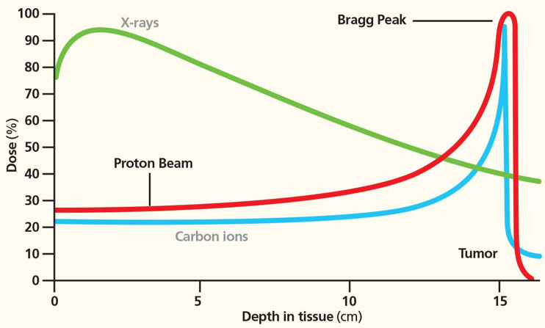
Particle-beam therapy
Proton and ion-beam therapy:
  Bulk of dose deposited in Bragg peak
  Significant normal-tissue sparing (entry)
  Almost no dose beyond the Bragg peak

Slide 6
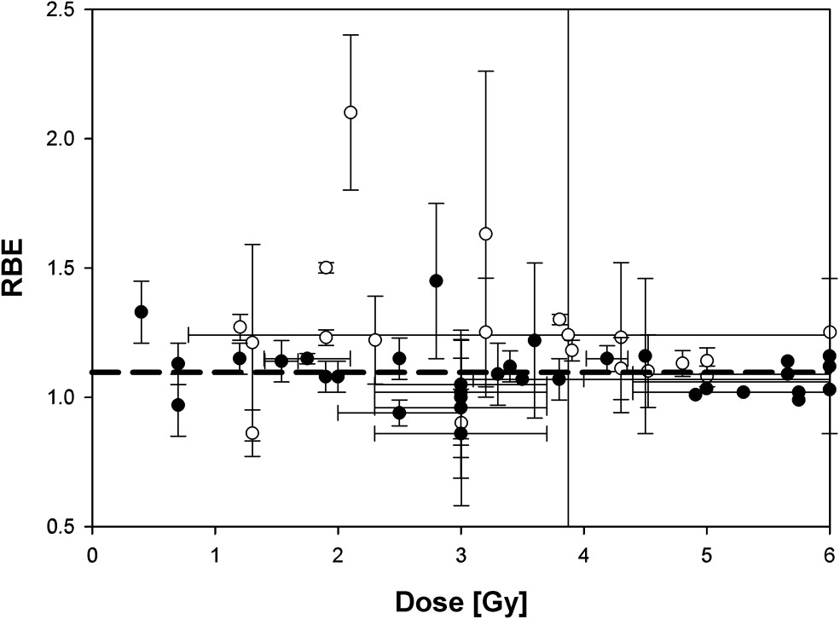
The radiobiology needs to be understood
RBE:
Ratio of dose required to gain
same biological response as
reference photon beam
Treatment planning:
  Based on ‘Relative Biological Effectiveness (RBE)
    Proton-treatment planning uses RBE = 1.1
    Effective values are used for C⁶⁺
Paganetti, van Luijk
Sem. Rad. Oncol (2013)
RBE known to depend on:
Energy, ion species
Dose & dose rate
Tissue type
Biological endpoint
Essential: improved, fundamental, understanding of radiobiology

Slide 7
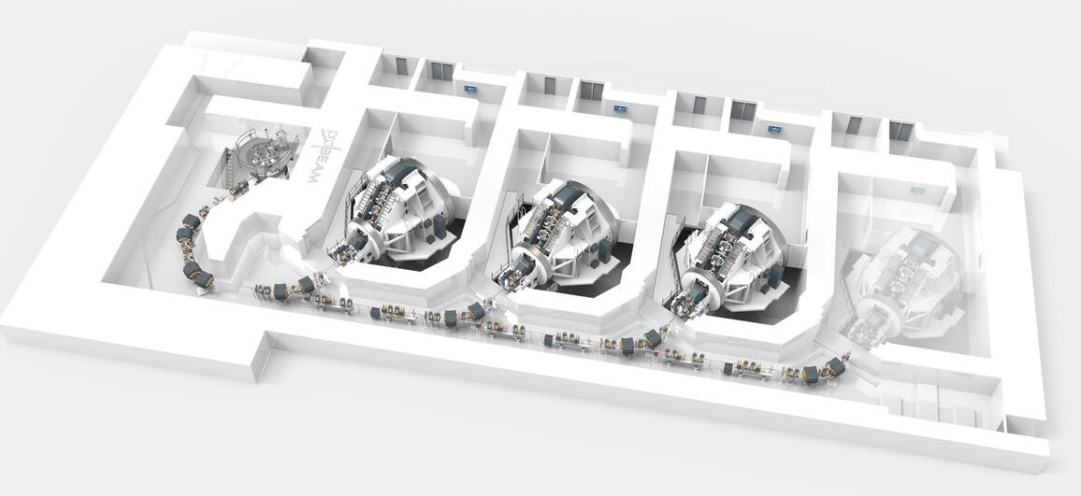
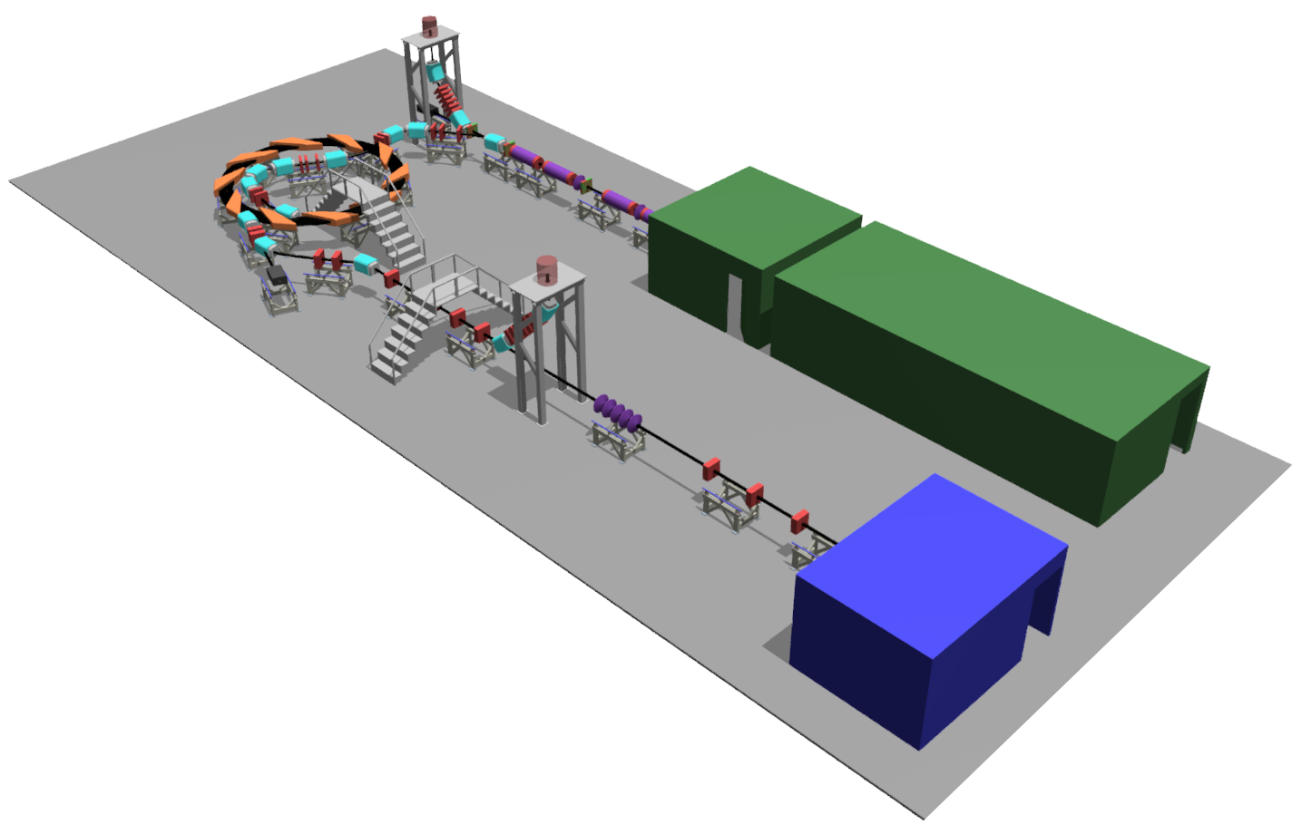
Particle beam therapy today
Cyclotron based:
  Limitations:
    Energy modulation
    Instantaneous dose rate
Synchrotron based:
  Limitiations:
    Complexity
    Instantaneous dose rate
⇒ reduce footprint,
cost and complexity
‘PBT for the many’
Christie Hospital Manchester
⇒ increase flexibility
optimize treatments
MedAustron
Austria

Slide 8
Laser-hybrid Accelerator for Radiobiological Applications
LhARA; a novel, hybrid, approach:
  High-flux, laser-driven proton/ion source:
    Overcome instantaneous dose-rate limitation
    Delivers protons or ions in very short pulses:
      Pulse length 10 – 40 ns
    Can provide arbitrary pulse structure
  Novel plasma-lens capture & focusing
  Fast, fixed-field post acceleration
⇒ compact, uniquely flexible facility
LhARA consortium

Slide 9
Radiobiology in new regimens
Time
domain
Space
domain
Ambition:
LhARA the ideally
flexible beam facility
that can deliver it all!
⇒ substantial
opportunity for a
step-change in
understanding!
Ion
species
Energy
In combination
and with chemo/immuno Therapies

Slide 10
Our vision and our ambition
Vision:
LhARA will be a uniquely-flexible, novel system that will:
Deliver a systematic and definitive radiobiology programme
Prove the feasibility of the laser-driven hybrid-accelerator approach
Lay the technological foundations for the transformation of PBT
  automated, patient-specific: implies online imaging & fast feedback and control
Ambition:
  Develop:
    necessary techniques, technologies, and systems
  Exploit:
    system approach to bring novel techniques into clinical practice as they mature
  Integrate:
    production prototypes in a production system for radiobiological research
  Engage:
    industry and clinical PBT centres
    during development of techniques, technologies, and systems

Slide 11
Pre-publication review

Slide 12
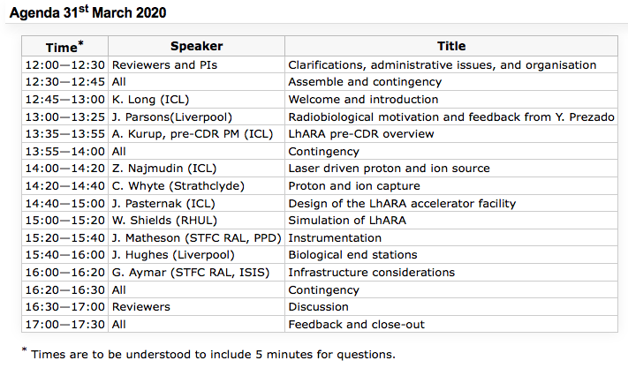
In conclusion
Many thanks for taking part in the review
Many thanks too for your patience and flexibility in the light of the pressures imposed by the Covid-19 pandemic
Agenda for 31Mar20 session of the review:

