Slide 1


Overview of the LhARA Facility
Review of the LhARA pre-CDR
Ajit Kurup
25th March 2020

Slide 2
Introduction
Overview of the design of the facility.
Design parameters.
Accelerator
End stations
Diagnostics
Staging.
R&D plan and project schedule.

Slide 3
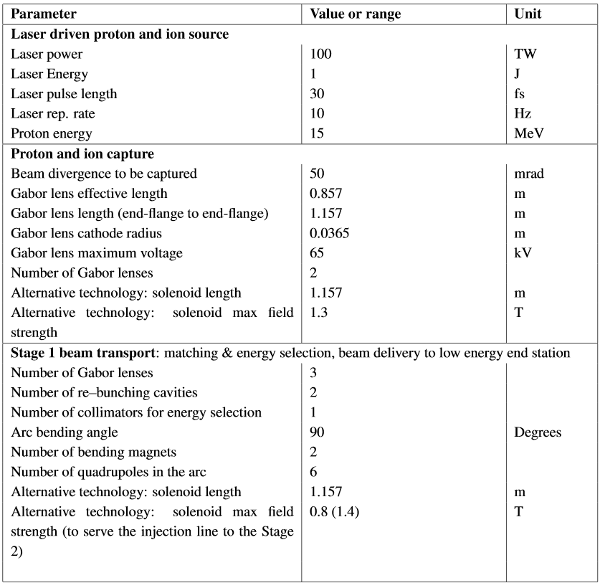
Design parameters

Slide 4
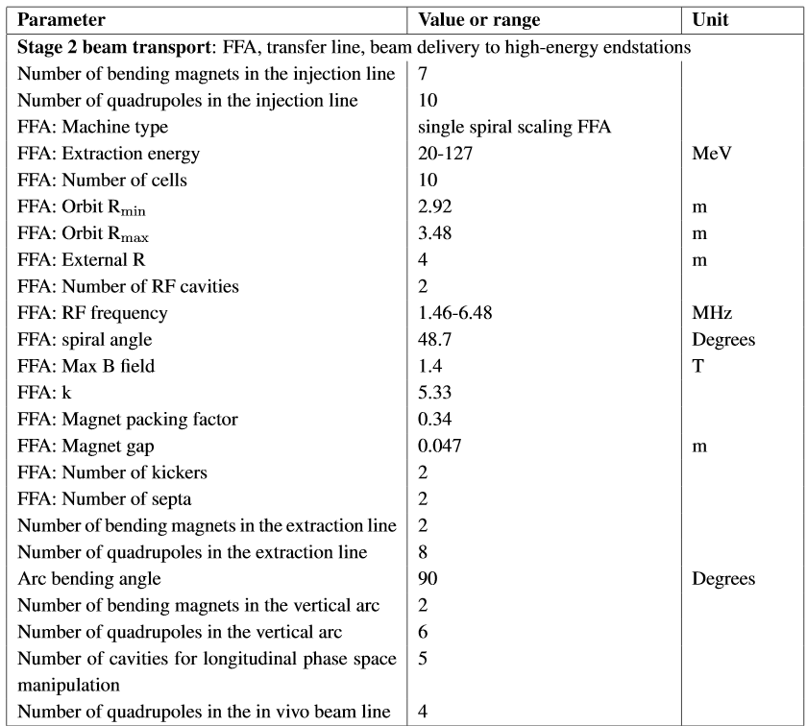
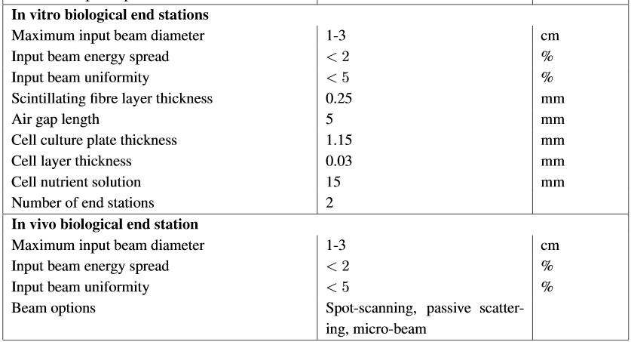
Design parameters

Slide 5
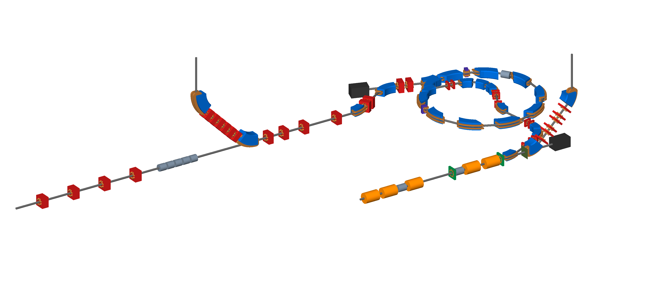
Accelerator
Beam to the high energy in vitro end station
Beam to the low energy in vitro end station
Extraction line
Extraction line matching
BEAM
DUMP
Injection line
Fixed field accelerator ring
BEAM
DUMP
In vivo beam line matching
Beam to the in vivo end station
RF cavities for longitudinal phase space manipulation
Beam from the laser target
Matching and energy selection
Capture

Slide 6
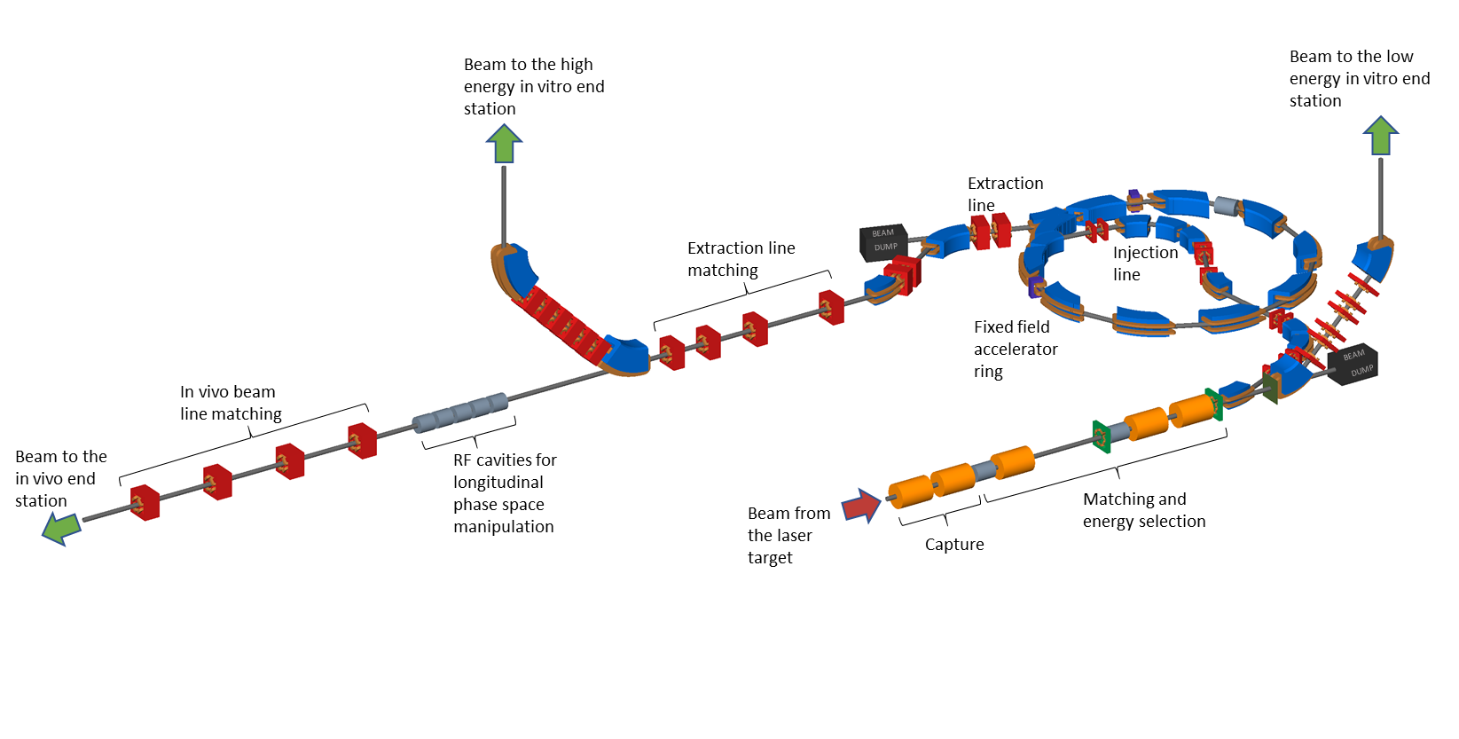
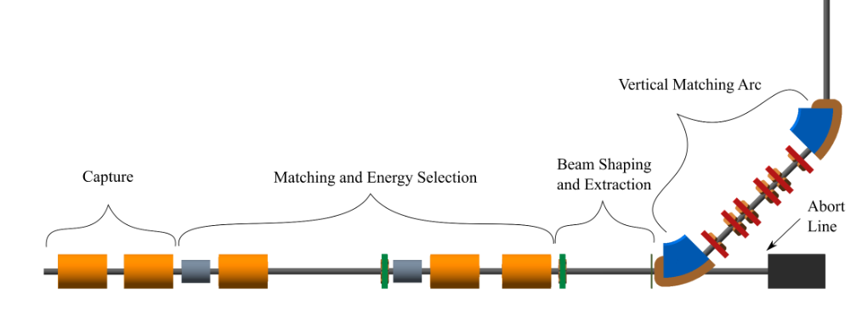
Staging
Construction will be done in two stages.
The goal is maximise scientific output.
Generate scientific output during construction of Stage 1.
Radiobiology programme using Stage 1 whilst constructing Stage 2.
Beam from laser source
Stage 1
Stage 2

Slide 7
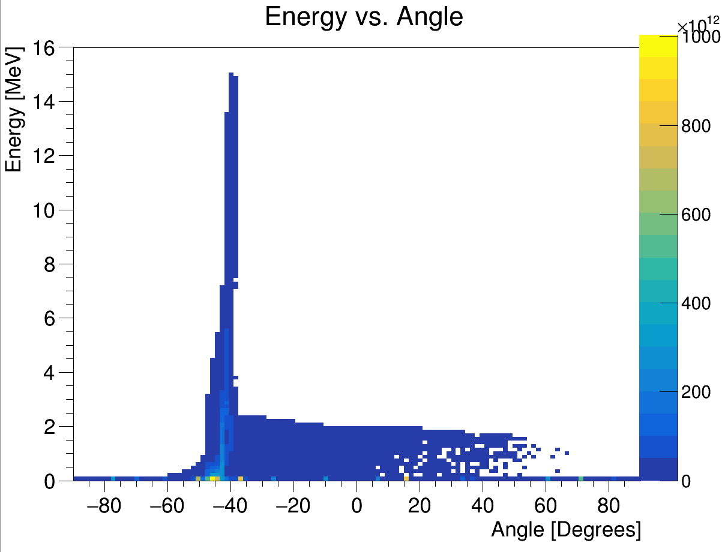

Laser source
Positive ions from hydrocarbon contamination on the target surface
Energy vs angle with respect to laser beam direction
LASER
45$°$
+
+
+
+
+
+
+
+
+
+
-
-
-
-
-
-
-
-
Ion beam
Electron sheath generated by the laser accelerates positive ions from the target
Principle of target normal sheath acceleration (TNSA).
Produces intense beams and multiple species, e.g. proton and carbon ions.
Overcome space charge limit of conventional sources since beams are produced with energies O(10) MeV.
Issues to consider
Large energy spread.
Large divergence.
Beam stability, especially if laser operated near the limits of its specifications.
Laser driven ion beam simulation using EPOCH.
Notes:
At the start we have a laser which is fired at a thin metal target at an angle of 45 deg. This then generates an ion beam from the surface of the target.
Using this method we can produce very intense beams but with a very large angular spread.
Simulations used a beam generated from the same parameters used in the optics design. Beta means small spot size and with this emittance that means you have a beam with a very large divergence.
Need a strong focusing element to prevent the beam being lost.

Slide 8
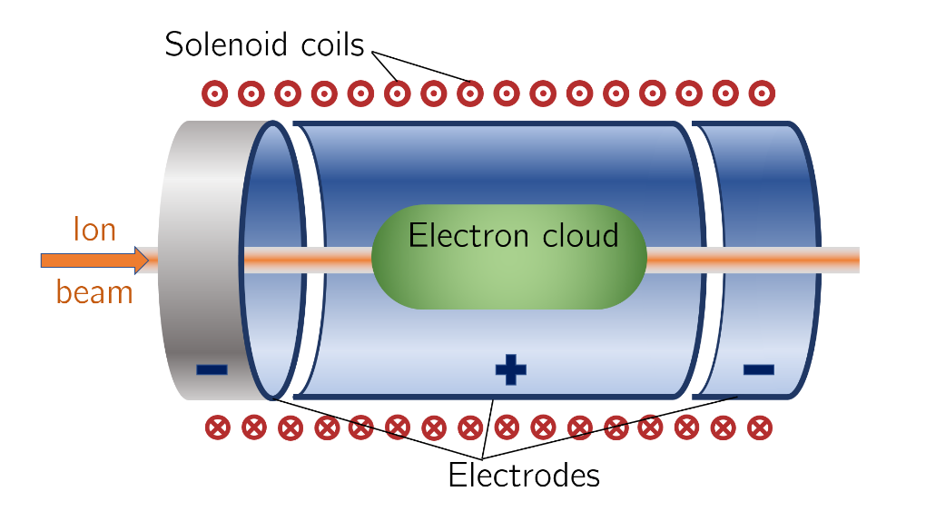
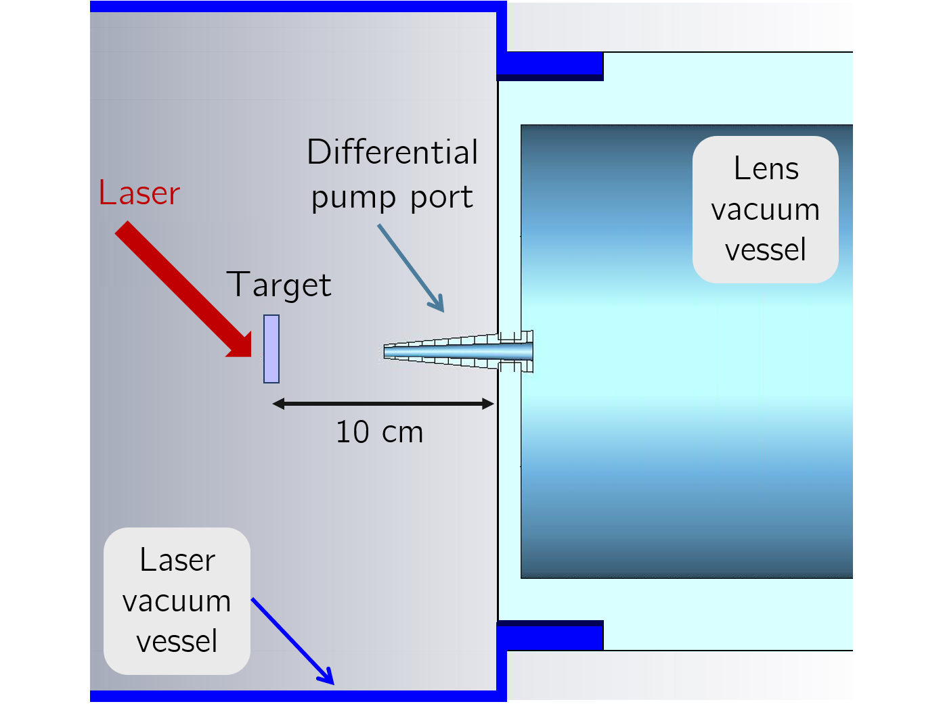
Capture
Solenoid coils
cylindrical
anode
Grounded
end plate
Space to insert diagnostics
       
       
Grounded
end plate
Ion beam
Electron cloud
       
       
The Gabor lens uses a plasma to generate a strong electro-static focusing field.
Focal point is energy dependent.
Prototype development to study plasma stability, electron density and verify operation in relatively high vacuum.
Original Gabor lens prototype was to be tested with the Cerberus laser at Imperial.
Notes:
What we plan to use to capture these particles is a a Gabor lens. This can provide a very strong focusing field in a short space by utilizing a confined electron plasma.
Schematic of the principle and a prototype at Imperial that we plan to test with a laser-ion beam.
To model in BDSIM
Lines from Jaroslaw’s beam optics code shows Beta_x and Beta_y (a measure of the beam envelope) are on top of each other. The points from BDSIM show the particle tracking simulations are well matched to the optics design.

Slide 9
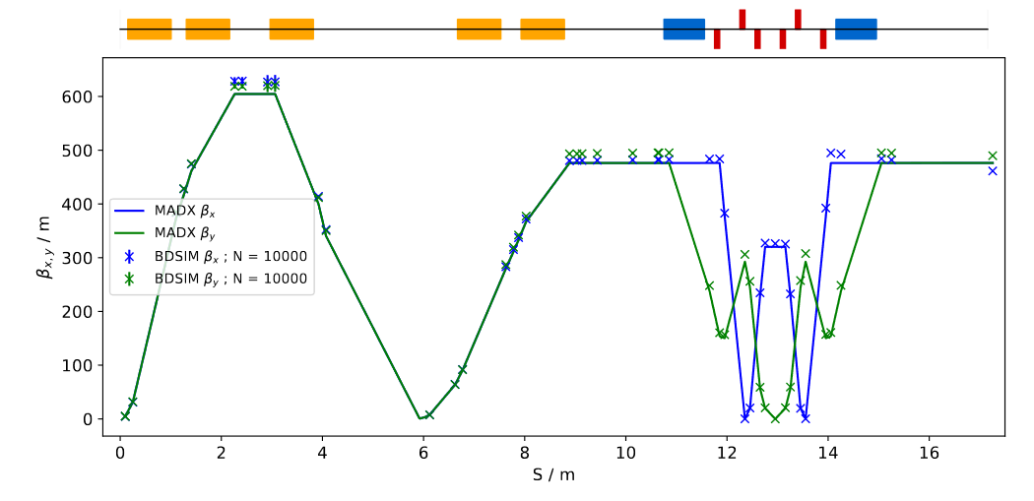
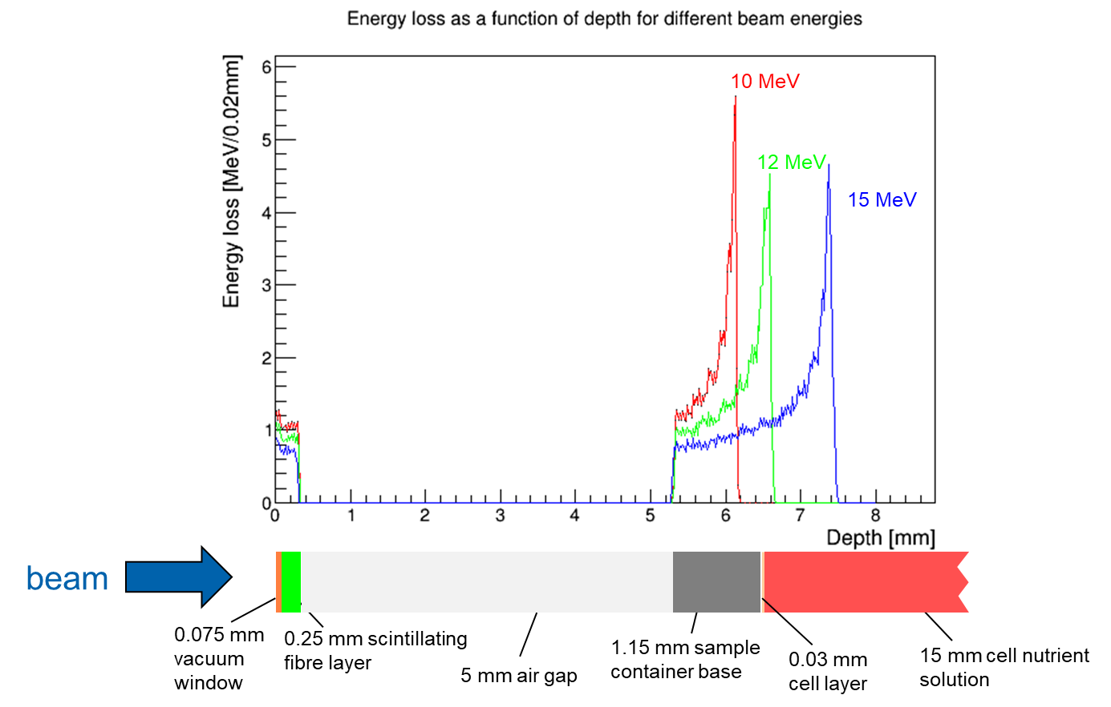
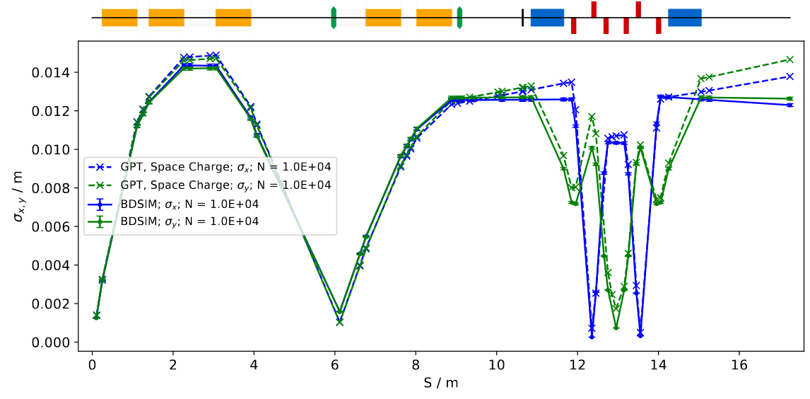
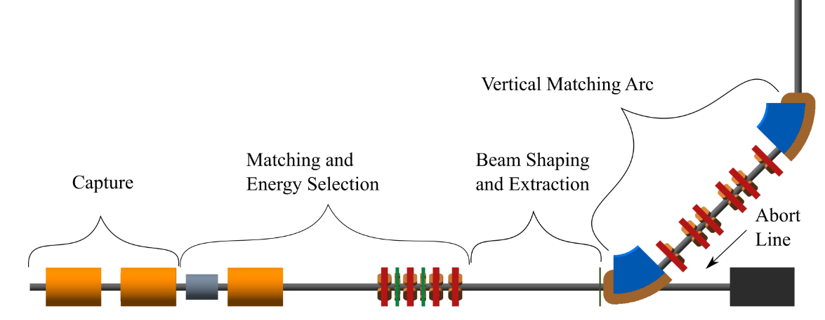
Beam transport – Stage 1
Optics design: BeamOptics and MADX.
Particle tracking simulations: BDSIM and GPT.
Energy deposition in the end station: BDSIM.
Alternative design

Slide 10
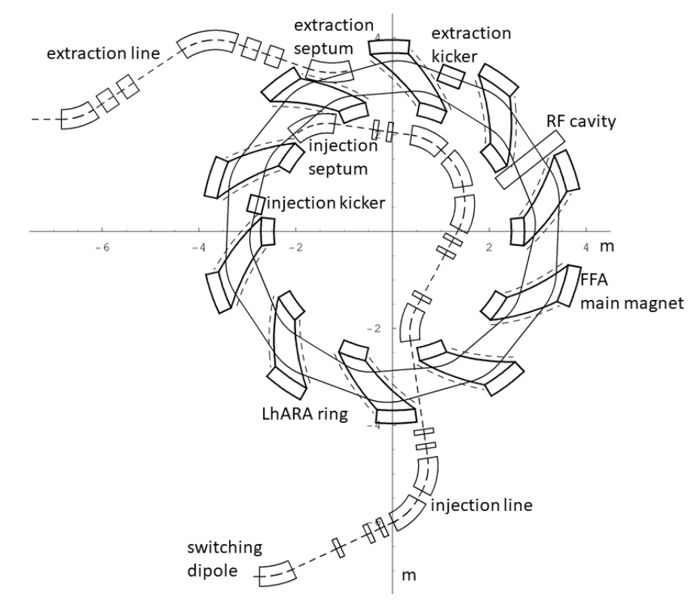
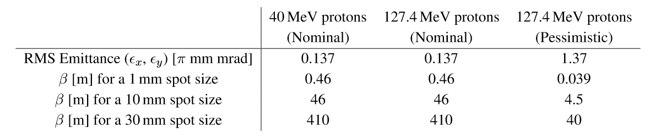
Beam transport – Stage 2
Post acceleration done using an Fixed field accelerator (FFA).
Spiral FFA.
Injection and extraction lines for the FFA.
High energy arc for in vitro
end station.
In vivo beam line.

Slide 11
Schedule

Slide 12
Five year R&D plan

