Slide 1
Instrumentation for LhARA
John Matheson
Rutherford Appleton Laboratory
Layout of the facility
Stage 1 end station
  SciWire
  Thin ceramic monitors
SmartPhantom
Dosimetry
Laser instrumentation
Stage 1 beamline Instrumentation
FFA Instrumentation
Research Plan
(Not including instrumentation beyond the interaction of the proton beam, e.g. secondary particles and photons)

Slide 2
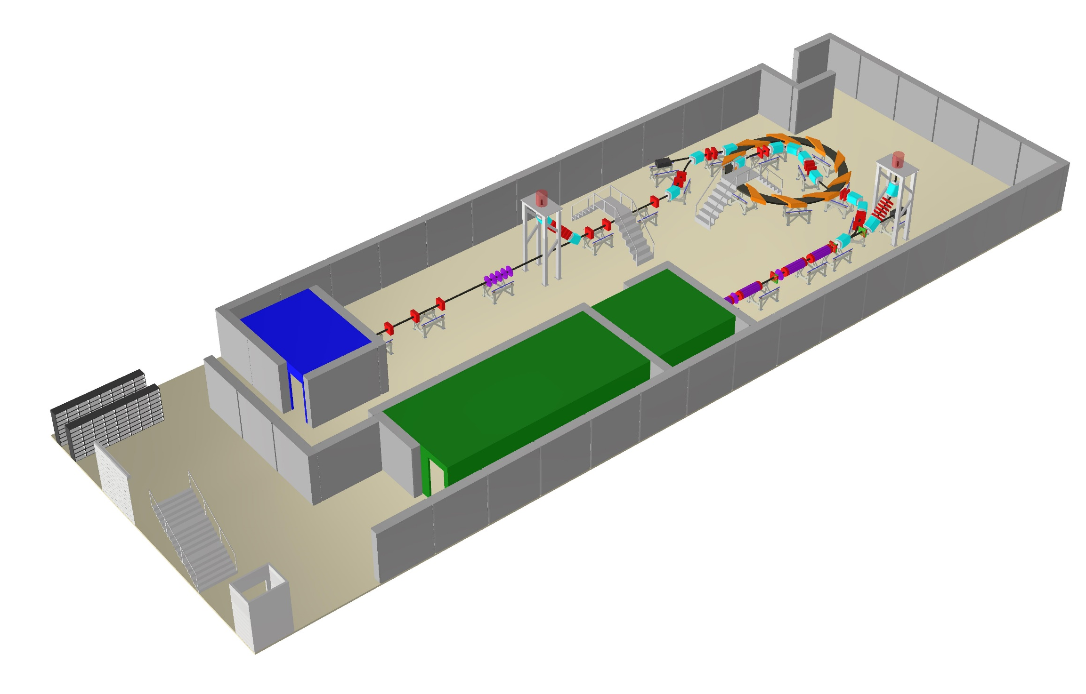
Layout of the facility – Overall
High energy in vitro end station
In vivo end station
Low energy in vitro end station
Laser target
Laser

Slide 3
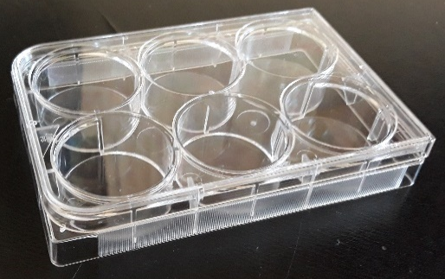
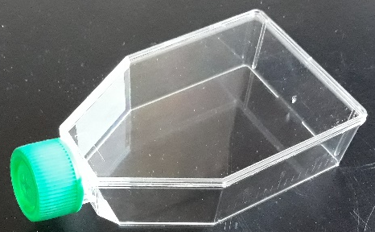
Stage 1 end station
10 mm
Material budget determines required beam energy.
  More material increases cost of laser.
  Consider cell sample containers.
Energy deposition and dose calculation very important for the design of the end station.
  Want the Bragg peak in the cell layer.
  Ensure efficient delivery of dose to the cells (i.e. minimize the time needed to irradiate a sample).
  Dose verification.
15 mm cell nutrient
solution.
0.03 mm cell layer.
1.15 mm sample
container base.
5mm air gap.
0.25 mm scintillating fibre layer.
0.075 mm vacuum window.
beam

Slide 4

SciWire - Scintillating Fibre Detector
STFC Impact Acceleration Account grant to develop scintillating fibre detector for low-energy ion beams.
  Energy measurement.
  Intensity profile.
Plane made of fibres arranged in two layers perpendicular to each other.
250$μ$m
5cm
Detector consists of multiple planes.
Scintillation light from all planes is read out from one side for each orientation.
5cm
Step a Sr⁹⁰ source across face of the detector, positioning the source at the centre of a pair of x and y fibres.
Measure position resolution and cross-talk.
Further tests with the laser driven ion beam.
Possibility of dose profiling.
Sr⁹⁰

Slide 5
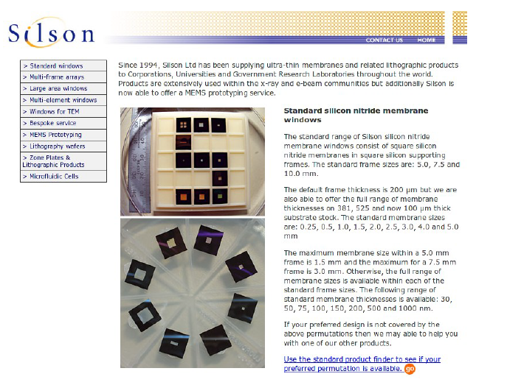
Thin ceramic monitors
AlN or SiN membrane 50-150 micron
Chemically etched and metal electrodes deposited
Beam induces currents on the electrodes
Needs some work to define diameter, thickness, mechanics, electrode geometry, readout
Available from industry (Silson, Ametek/HSFoils)
Thanks to Alex Howard

Slide 6
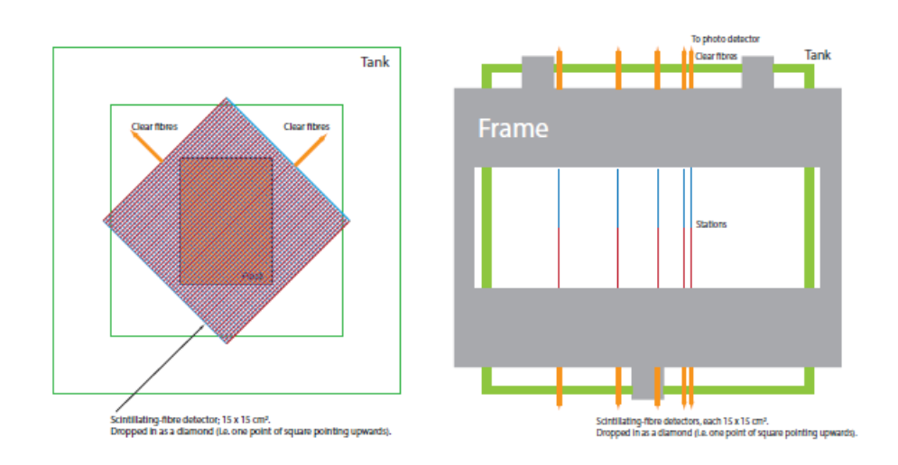
SmartPhantom Concept
Water phantom with scintillating fibre planes
250 um scint fibre Saint-Gobain BCF-10
250 um clear fibre
Readout 1: bundle coupled to CMOS camera
Readout 2: OptoDiode ODD-B1, Texas Instuments LMP7712, Analog Devices AD7779

Slide 7
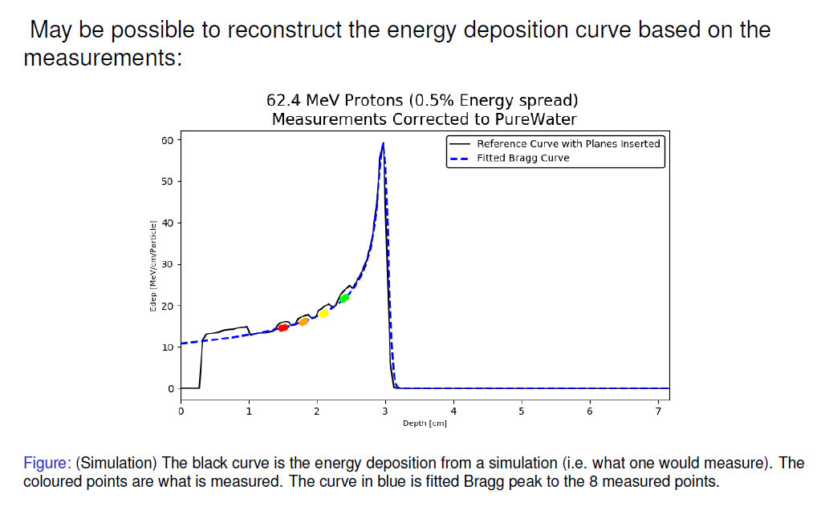
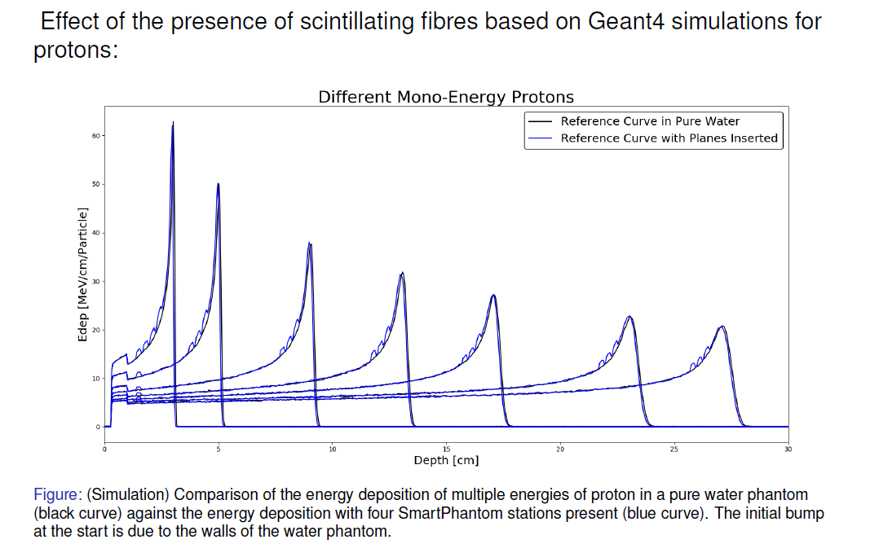
SmartPhantom simulations
Thanks to H.T. Lau

Slide 8
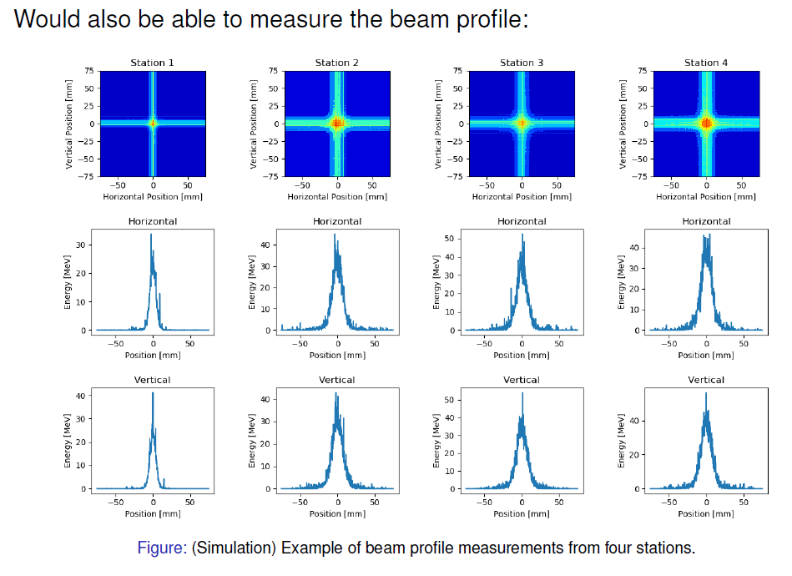
SmartPhantom simulations

Slide 9
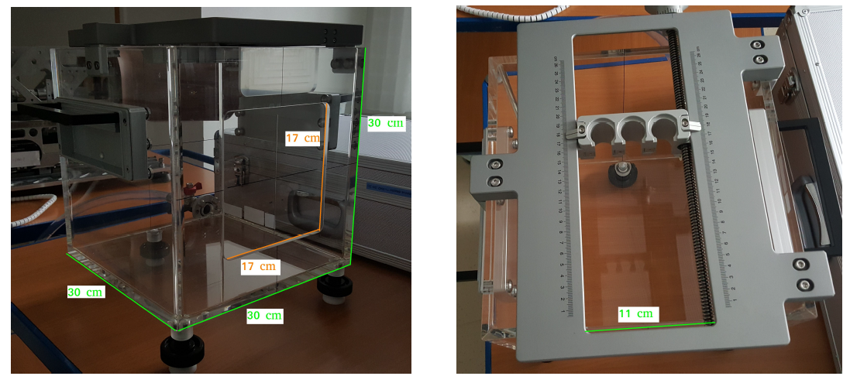
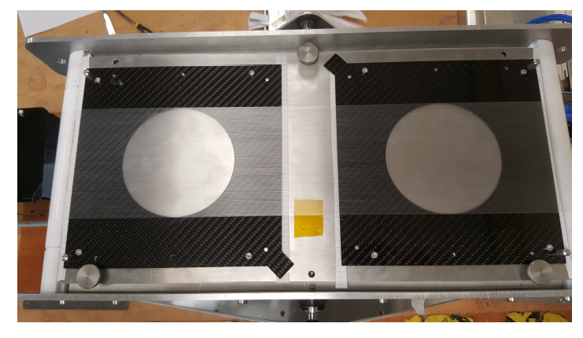
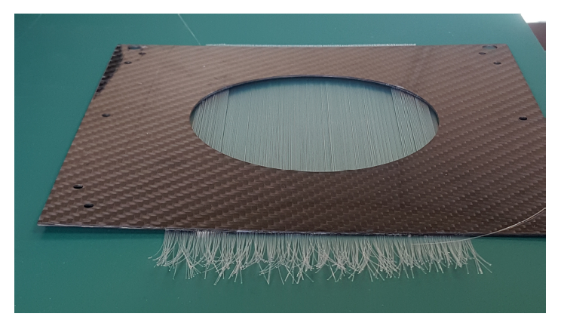
SmartPhantom Prototyping
SmartPhantom water tank
Support for planes and phials
Planes on fibre winding jig
Finished plane prototype
To be beam tested at MedAustron

Slide 10
SmartPhantom Next steps
SmartPhantom is being simulated in GEANT4
Simulations will be used to develop analysis scripts, to fit the data and find the position of the Bragg peak
Then calculate beam profile, LET and dose delivered in real time.
Derive these parameters from measurements taken shot by shot, not purely from Monte Carlo simulations.
Collaboration with the Technical University of Vienna
Test first prototypes of the SmartPhantom at MedAustron (Austrian national facility for research into proton and carbon-ion radiotherapy)

Slide 11
Dosimetry
Aim to have online dosimetry pulse by pulse
Based on SciWire, SmartPhantom
How to calibrate against a standard ?
May use:
Nuclear track detectors (NTDs) or radiochromic films (RCFs)
CR39 plastic (chemical etch)
Al2O3:C,Mg crystals (fluorescence microscopy)
Or:
Radiochromic films (RCFs)
Gafchromic – monomer microcrystals, polymerised by radiation (scanner)
Significant dose under-response in some Gafchromic film types, with increasing LET in the vicinity of the Bragg peak. We will enlist help from NPL to characterise suitable NTDs and RCFs in known beams.

Slide 12
Laser instrumentation
Ti:Sapphire laser emitting at 800nm
1J of energy per 30fs pulses
Repetition rate of 10Hz
Laser to be supplied as a turn-key unit
The laser focal spot will be characterised using a camera-based system and high speed wavefront measurements
The techniques to be used are well understood and it is intended to buy the necessary equipment from commercial vendors

Slide 13
Example Instrumentation at PSI Proscan
250 MeV cyclotron:
Space for instrumentation in a cyclotron is very limited
RF fields inside the machine are problematic
One probe is available, inserted radially and with 2 interchangeable heads
One head measures total beam current
One head uses scintillating screen & CCD camera => beam profile and position
For initial setup of the cyclotron, test foils were placed in the beam
Beamlines:
Beam current and profile are measured by ionisation chambers
Full-area electrodes => beam current
Segmented electrodes => beam profile.
Chambers may be mounted on pneumatic actuators
High beam current => use SEM
Position and Halo Monitor:
ionisation chamber with open bore
intercepts beam halo => position & transverse dimensions
Beam profile - fluorescent screen & camera (destructive)
Beam loss monitors - downstream of bending magnets
Multi-layer Faraday cups (destructive) - absolute beam current & Bragg peak (in copper).
Placement of monitors needs input from machine designers
DAQ
Electronics with wide dynamic range
FPGAs => fast fitting and pattern recognition of beam profiles
Store calibration, apply corrections in real time.
Find beam centre from non-Gaussian/asymmetric profile

Slide 14
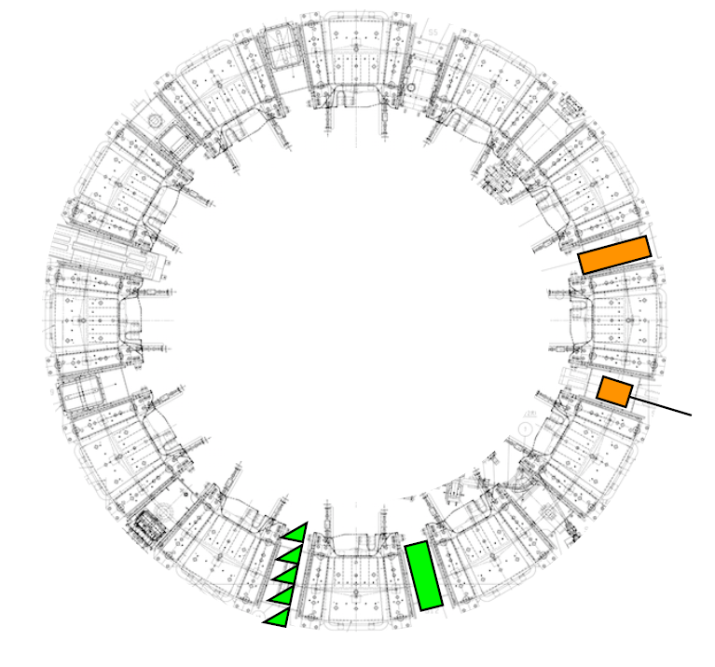
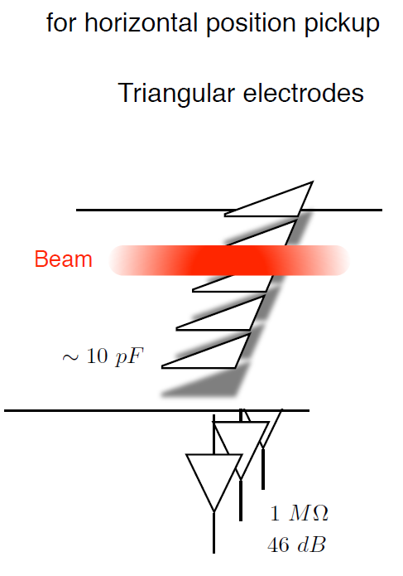
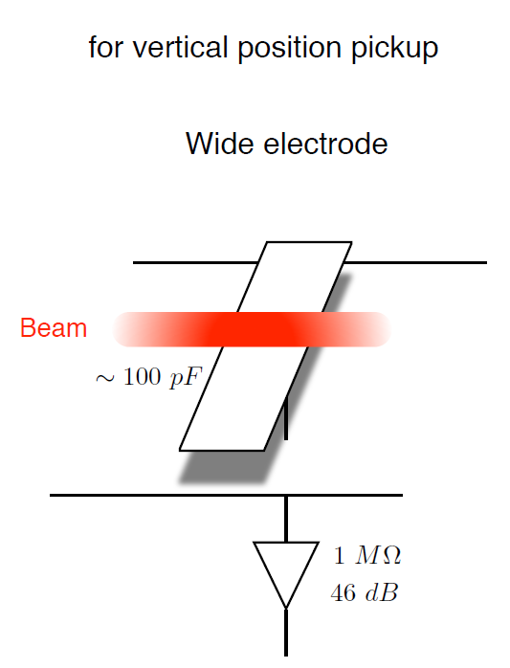
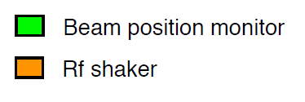
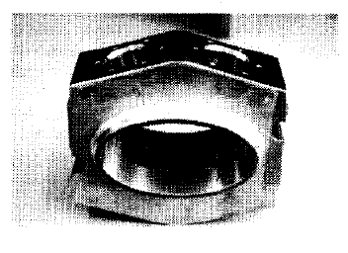
FFA Instrumentation
KURNS FFA main ring
LhARA FFA based on RACCAM, 10 cells
Beam position measured at injection and extraction septa
Position measurement at least every second cell
Beam pickups will require calibration
KURNS = Institute for Integrated Radiation and Nuclear Science, Kyoto University

Slide 15
Research Plan
Low energy beam Conventional diagnostics
Beam position – capacitive button pickups
Beam current - BCT
Beam current and energy - multi-layer Faraday cups (destructive)
Emittance - slit-grid/slit scanners or pepper-pot emittance monitors
Low energy beam diagnostics
SciWire - online beam profile measurement
Thin ceramic monitors - online beam profile measurement
Fast feedback and controls
Initial R&D for the fast feedback system will focus on Stage 1
Depends on details of the low energy beam instrumentation
Development of an automated system for tuning the beam
Monte Carlo simulation of the LhARA beam line in firmware
Later extend to include Stage 2
High energy beam diagnostics
Develop beam position measurement for the FFA
Investigate conventional diagnostics for beam current, position and profile measurement in the transfer lines
Bunch length is important in the transfer line to the in vivo end station
Emittance measurements by conventional instruments
Online dosimetry and dose profile
Development of SciWire - dose profile at low energy end station
Development of thin ceramic monitors - dose profile at low energy end station
Development of SmartPhantom - online dose measurements in the high energy end stations
Absolute dosimetry at ultra-high dose rates
Characterisation of nonlinear response of film detectors at high dose rates
Investigate use of films for calibrating the online dose monitors

Slide 16
Spare Slides

Slide 17
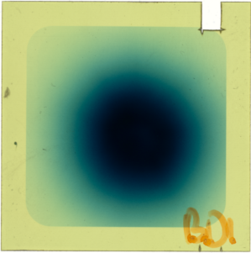
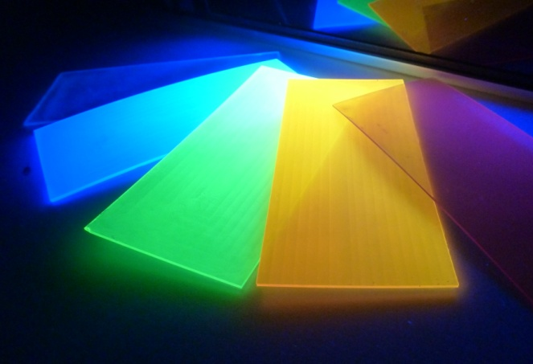
Requirements
Ion Instrumentation – Ceri Brenner
Established detectors
Radiochromic Film
CR-39 Track detectors
Image Plate
In-situ measurement of:
  Ion energies
  Ion species distribution
  Beam profile
  Fluence / Conversion Efficiency
EMP Resistance
High repetition rate operation
Robust – radiation and laser damage
Calibrated and Characterised
Minimal user intervention
In-situ detectors
MCPs
Scintillators
Phosphor screens
TOF detectors
Notes:
What do we need from our Ion diagnostics for current and future experiments?
Requirements – what we want to measure for our ion beams. Also general characteristics for future operations
Years of established methods with “Passive”, low rep rate detectors - RCF, CR-39, Image Plate
Need to update our diagnostic techniques with “Active” detector mediums, i.e. Microchannel Plates, Scintillators, Phosphors, TOF Detectors (Diamond, Silicon)

Slide 18
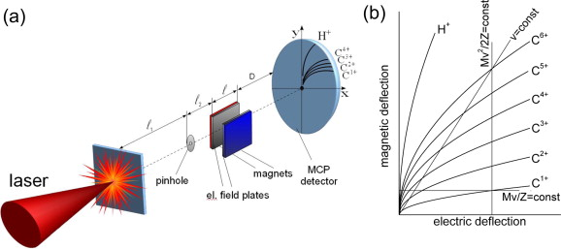
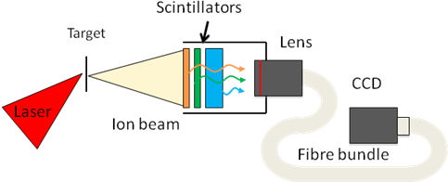
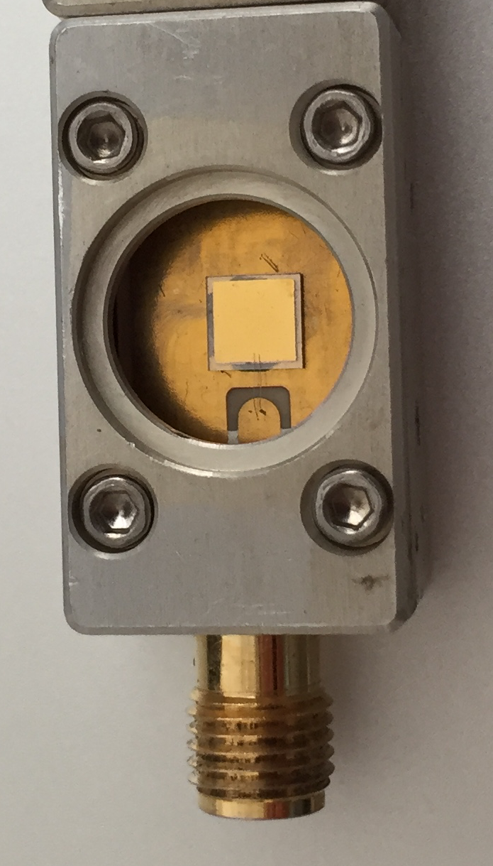
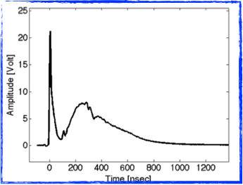

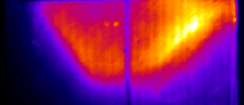
Ion Instrumentation
Thomson Parabola
Beam profiler
1D Multi-species ion spectrometer
MCP or Scintillator detector
P. Bolton et al. Phys. Med. 30 (2014)
2D ion beam profiler
Organic scintillator detectors
3 spectral channels
Time of Flight
Diamond / SiC detectors
80-350 ps time resolution
Photo-peak
Protons
Ions
RCF
Scintillator
J.S. Green et al. Proc. SPIE 8079 (2011)
V. Scuderi et al. J. Inst 12 (2017)
Ceri Brenner
Notes:
Overview of more recent focus of our developments of Active Ion diagnostics at CLF
Beam Profiler – 2D profile of laser-accelerated ion beam, with up to 3 spectral channels by using multi-colour scintillators
Thomson Parabola – Workhorse of HPL ion experiments, magnet + electic field to produce energy spectrum as function of species. Have operated with MCP and Scintillator detectors
TOF – More suitable for high energy protons. Good time and energy resolution, radiation hardness. Work in conjunction with ELI-beamlines

Slide 19
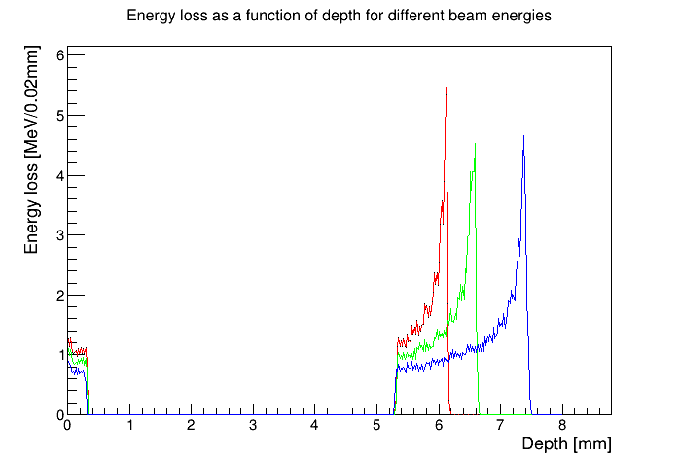
Stage 1 end station
Energy loss in the end station using the beam tracked from after the capture section.
10 MeV
12 MeV
10 MeV
12 MeV
15 MeV
15 MeV
beam
0.075 mm vacuum window
0.25 mm scintillating fibre layer
5mm air gap
1.15 mm sample
container base
0.03 mm cell layer
15 mm cell nutrient
solution

Slide 20
Instrumentation in other FFAs
EMMA (Daresbury Laboratory)
42 F-D cells with 81 BPMs
BPM:
4-button pickup
2 front end modules
VME module – ADCs + 4000 turns memory
US neutrino factory FFA
1 x 4-button BPM per quadrupole magnet
(OTR) foils
phase probes for beam-RF comparison
wall-current monitor
wire scanners
integrating current toroid or Faraday cup
transverse deflection cavity & fluorescent screen (bunch shape)
Extraction line has dispersive region => momentum
“pepper-pot” emittance monitor

Slide 21
Fast feedback controls and monitoring
PROSCAN facility at PSI
Signals from beam instruments digitised and fed back to the machine control system (MCS)
BPM currents fed to LogIV unit (logarithmic transimpedance amplifier and ADC)
LogIV outputs digitised signals, accessible via the VME backplane
Digitised signals read by a VPC digital back end electronics module, which contains 2 FPGAs
System FPGA runs the common firmware
User FPGA implements the local storage and processing algorithms
RAM provided for lookup tables
User FPGA is used to calculate quantities derived from raw pickup data, such as total beam current, beam vertical position, beam horizontal position, beam sizes, etc.
Limits can be set on parameters which can be used in an interlock system, via fast optical data links.
BPM data is sampled at 5kHz and fed back to the MCS for applying beam corrections

Slide 22
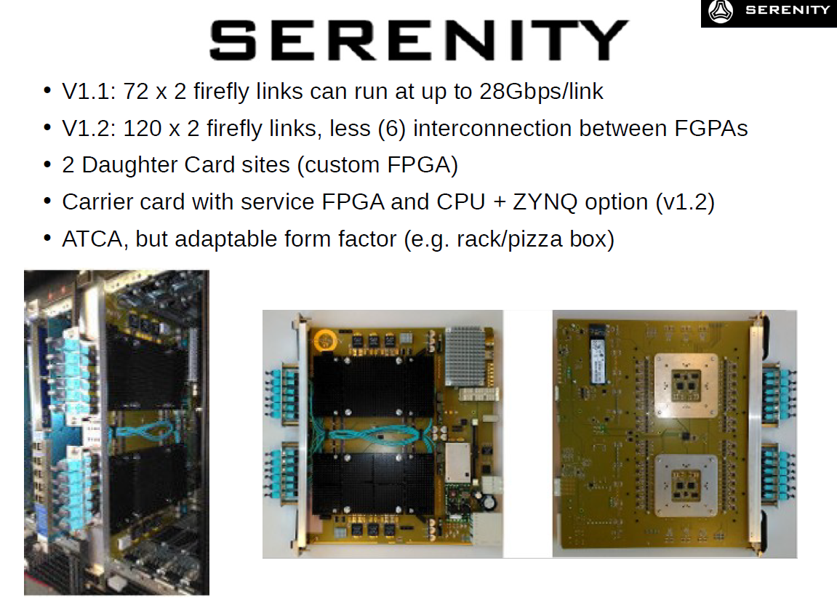
Alex Howard

Slide 23
Proton Tomography
Note that other approaches to this include proton tomography, as researched by the PRaVDA collaboration, who have built a prototype silicon tracker for proton tomography: http://www.pravda.uk.com/index.php/78-pgeneral/71-phone. See also Burker et al. (Vienna Conference on Instrumentation 2019) – developing a similar detector system to PRaVDA, in this case for ion tomography.
In proton radiotherapy, secondary neutrons from the proton interaction lead to unwanted dose in healthy tissue. Gioscio et al. ( Vienna 2019) have built a prototype 250 micron scintillating plastic fibre tracker with a SPAD array (from LFoundry).
Secondary particles

Slide 24
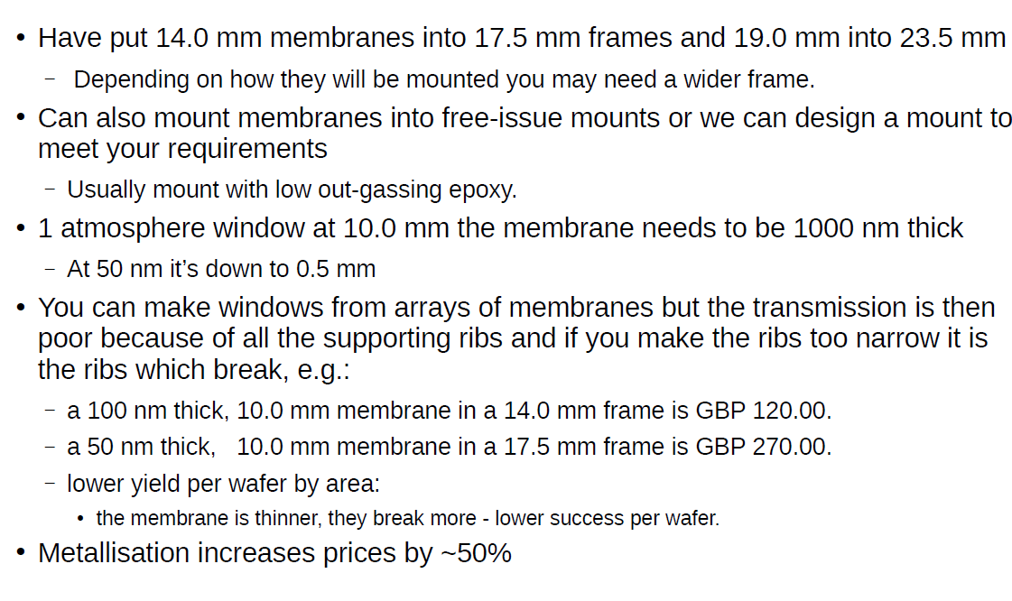
Thin Ceramic monitors (Silson)
Alex Howard

Slide 25
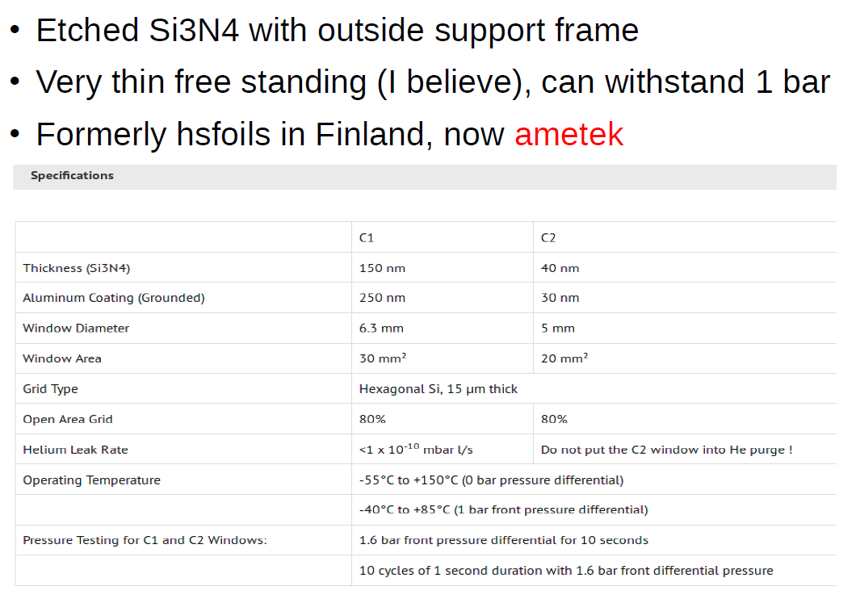
Thin Ceramic monitors (Ametek)
Alex Howard

