Slide 1


Overview of the LhARA Facility
Review of the LhARA pre-CDR
Ajit Kurup
31st March 2020

Slide 2
Introduction
Overview of the design of the facility.
Design parameters.
Staging.
Accelerator.
Instrumentation.
Project schedule and R&D plan.

Slide 3
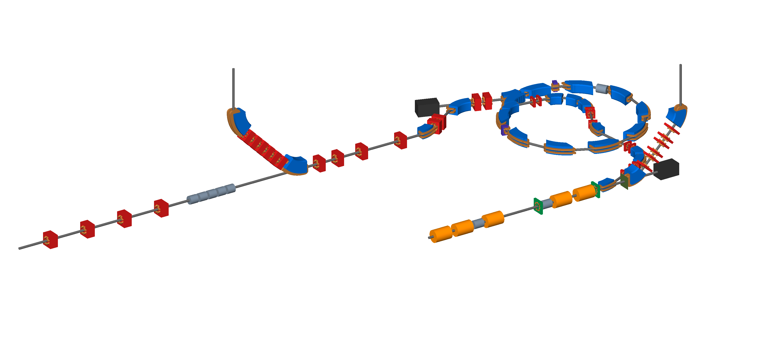
Accelerator
Beam to the high energy in vitro end station
Beam to the low energy in vitro end station
Extraction line
Extraction line matching
BEAM
DUMP
Injection line
Fixed field accelerator ring
BEAM
DUMP
In vivo beam line matching
Beam to the in vivo end station
RF cavities for longitudinal phase space manipulation
Beam from the laser target
Matching and energy selection
Capture

Slide 4
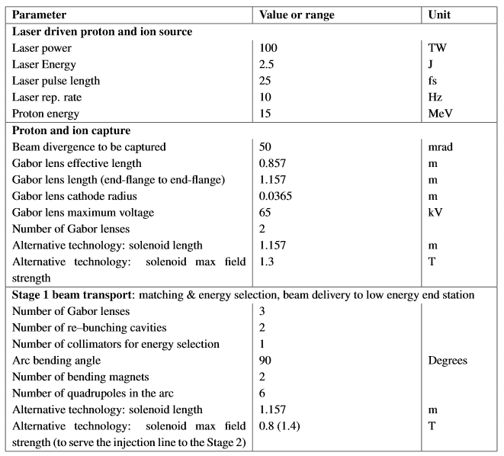
Design parameters

Slide 5
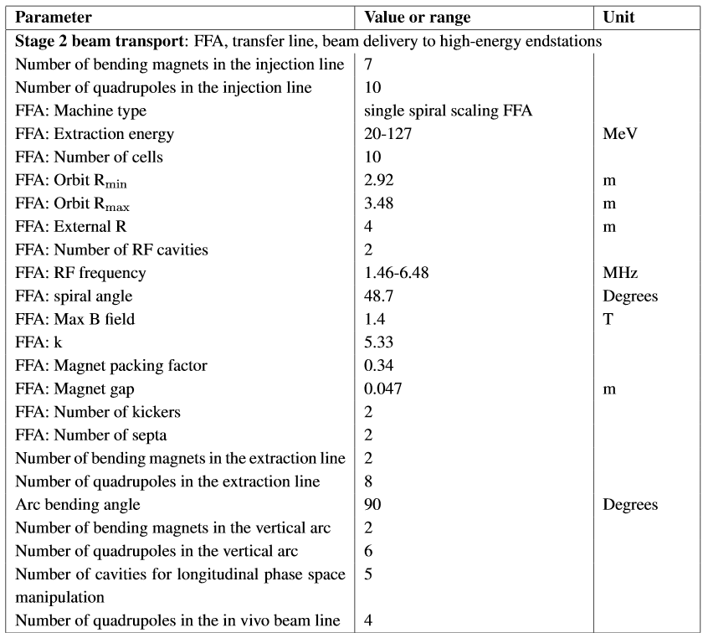
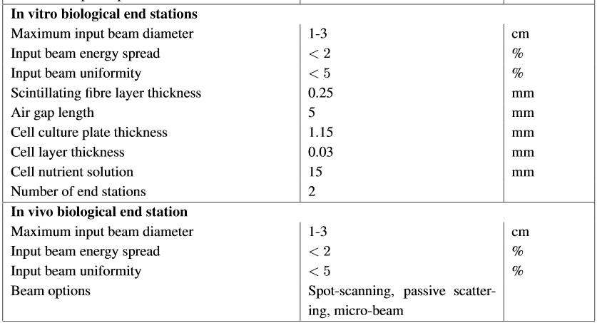
Design parameters

Slide 6
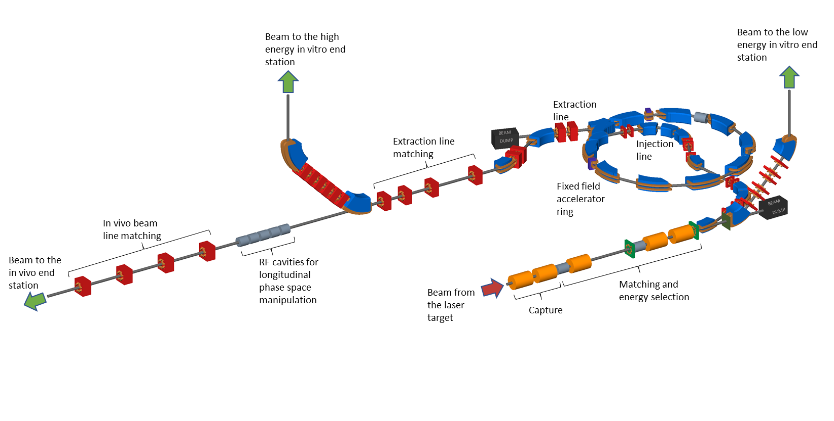
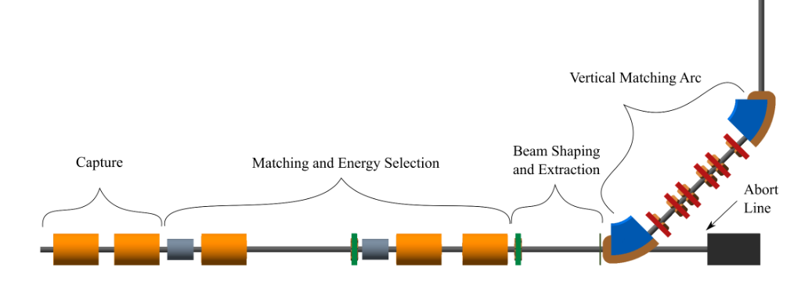
Staging
Construction will be done in two stages.
The goal is maximise scientific output.
Generate scientific output during construction of Stage 1.
Radiobiology programme using Stage 1 whilst constructing Stage 2.
Beam from laser source
Stage 1
Stage 2

Slide 7
Schedule
10 year programme.
Radiobiology.
At other facilities.
Experiments whilst Stage 2 is being constructed.
System/near clinical aspects and outreach.
Spin offs.
PPI.
Outreach.
5 year R&D plan.
Construction.
2 years for Stage 1.
5 years for Stage 2.

Slide 8
Five year R&D plan
Aims to address the technical challenges highlighted in the pre-CDR and deliver technical designs for the LhARA facility.
Facility design.
Development of conceptual design.
Development of technical design.
CDR (detailed for Stage 1).
TDR Stage 1.
TDR Stage 2.
End stations.
Automation, sample handling, imaging.
Simulation of the end stations.

Slide 9
Five year R&D plan
Gabor lens.
First generation prototype.
Second generation prototype.
Theoretical studies.
Electron density measurements.
Alpha source and detector tests.
Laser-driven source.
Laser-capture interface.
Investigation of space charge algorithms.
Stage 1 beam line performance evaluation.
Vertical bend.
Capture technology milestone.

Slide 10
Five year R&D plan
FFA.
Design and simulation.
Detailed magnet design.
Magnet prototype.
RF cavity design and performance evaluation.
Injection and extraction design.
Stage 2 performance evaluation.
Longitudinal phase space manipulation design, simulation and prototyping.
Final beam preparation for in vivo end station.
Instrumentation.
Low-energy beam diagnostics.
Online dosimetry and dose profile.
Absolute dosimetry at ultra-high dose rates.
Fast feedback and control.
High-energy beam diagnostics.
Software and Computing.
Development of a global data acquisition and processing system.
Development of the controls and monitoring system.

Slide 11
Summary
LhARA has the capability to provide unique beams for the study of radiobiology.
Two stage approach will aim to maximise scientific output whilst optimising the machine performance.
Stage 1: protons up to 15 MeV.
Stage 2: protons up to 127 MeV and C⁶⁺ ions up to 33MeV/u.
Conceptual design and initial simulations show the required performance can be achieved in principle.
Technical challenges will be addressed by the R&D plan.

