Slide 1





LhARA endstation requirements for in vitro radiobiology research
Dr Jason Parsons
Cancer Research Centre
Department of Molecular and Clinical Cancer Medicine

Slide 2
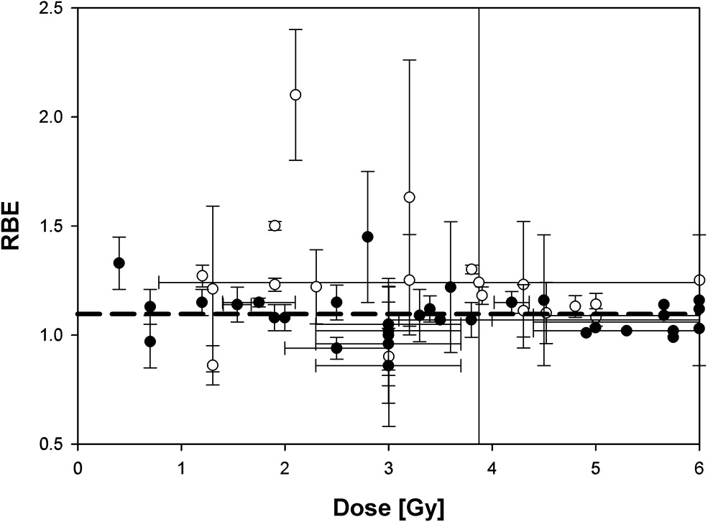
Particle beam therapy (PBT) radiobiology
Tumour
Bragg peak
Distal fall-off
Relative dose
LET
Particle energy
Depth in tissue
Vitti and Parsons (2019) Cancers
Taken from Paganetti and van Luijk (2013) Sem Rad Oncol
A constant relative biological effectiveness (RBE) value of 1.1 is used in clinical practice. However, there is a large uncertainty with using this approach as RBE is variable and dependent on many factors, including:-
Proton energy (therefore linear energy transfer, LET) and dose.
Radiosensitivity/radiobiology of the tissue.
Biological end-point examined (e.g. clonogenic survival, tumour growth delay).
Therefore, further research exploiting the biological impact of particles is vital for investigating RBE, and thus improving clinical use of PBT.

Slide 3
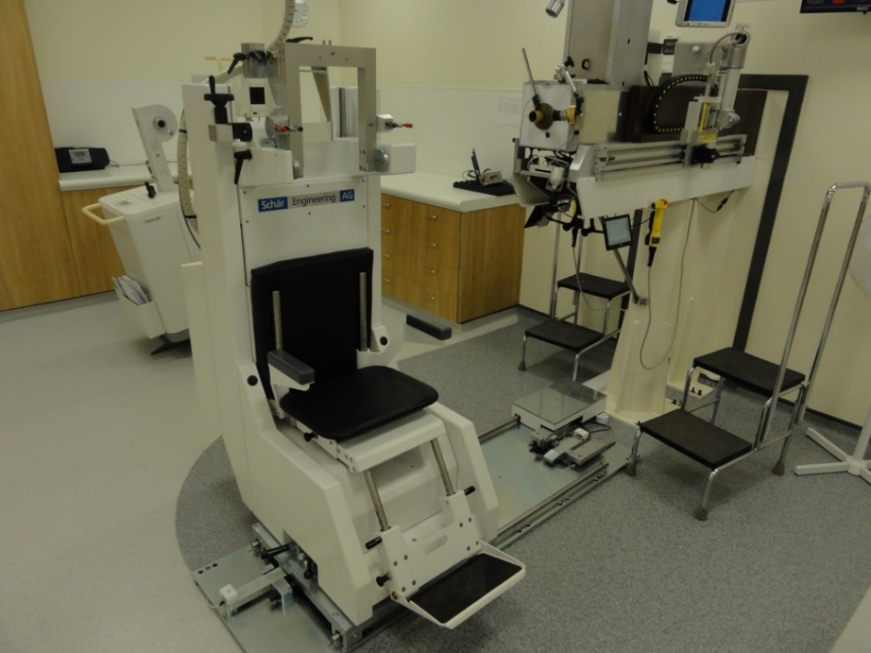
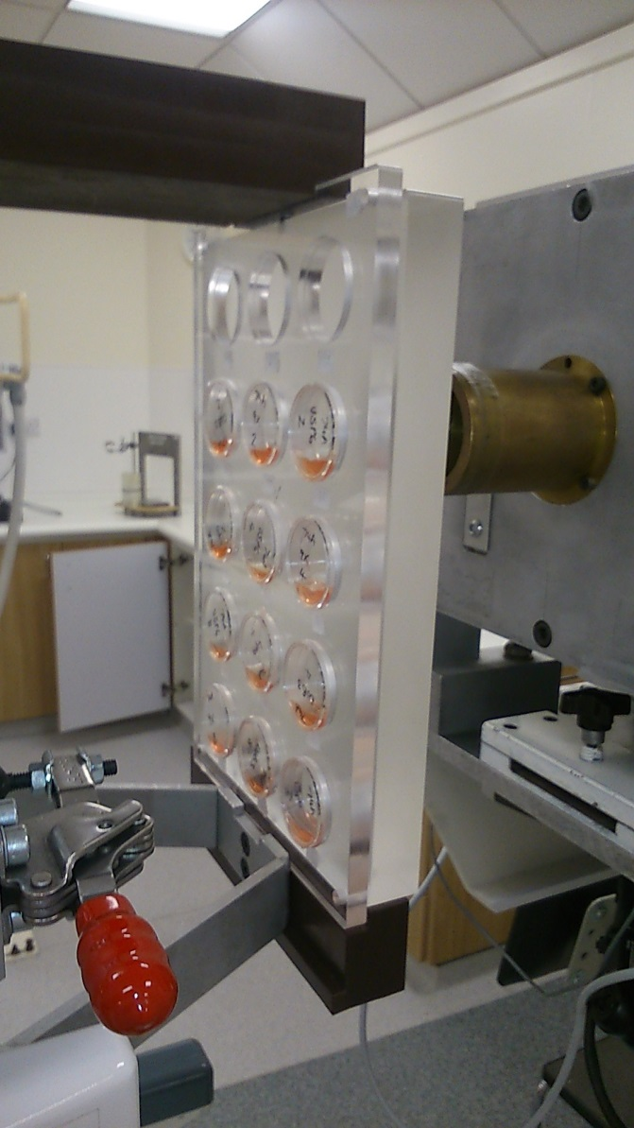
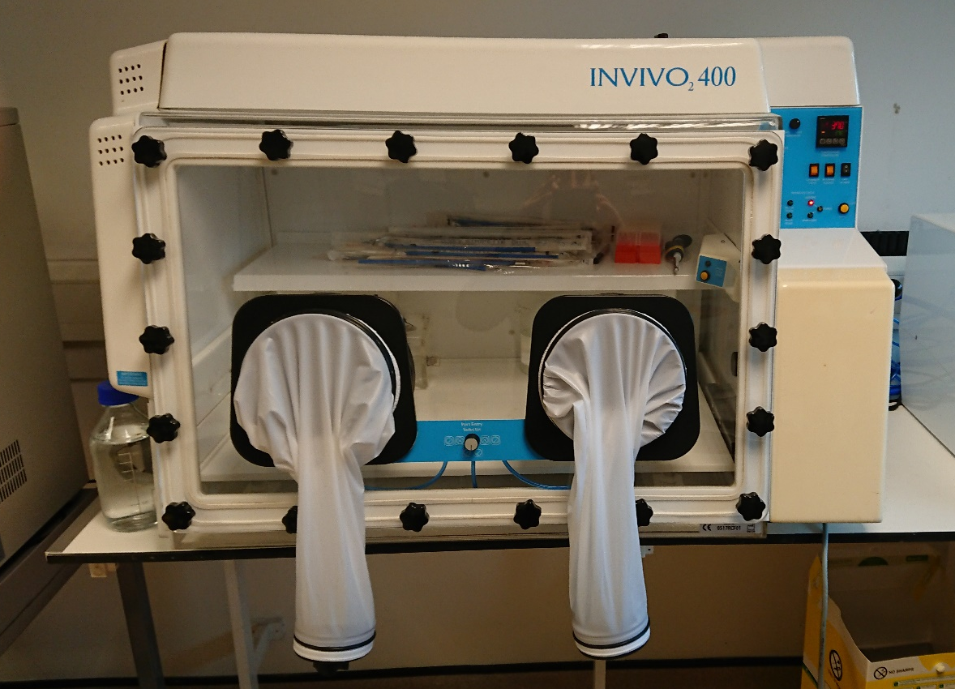
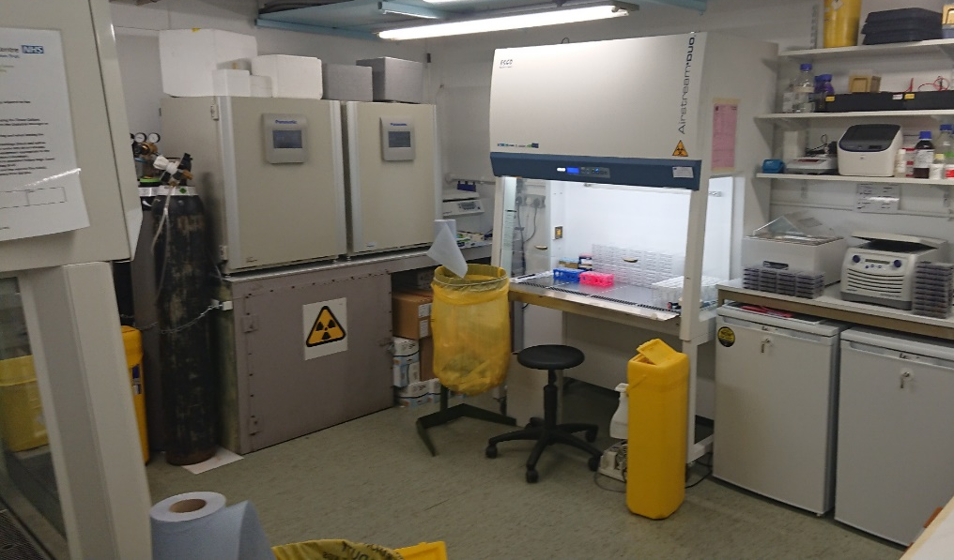
60 MeV Proton beam and radiobiology facilities at the Clatterbridge Cancer Centre (CCC)

Slide 4
Impact of PBT on cell survival and CDD
****
58MeV
58MeV (mod.)
11MeV
HeLa
UMSCC6
CDD
11MeV (mod.)
*
***
**
SF2, p<0.02
SF2, p<0.01
DUB siRNA screen analysing changes in survival post-irradiation.
11 MeV
11 MeV
USP6
Low energy (relatively high-LET) protons cause significantly reduced cell survival versus high energy (low-LET) protons.
Low energy protons cause increases in CDD formation that persist for >4 h post-irradiation.
siRNA screen for deubiquitylating enzymes (DUBs) revealed that USP6 is required for survival following low energy protons.
Carter et al, (2018) IJROBP; Carter et al, (2019) IJROBP

Slide 5
Model for the recognition and repair of CDD in chromatin
DNA damage -
High-LET IR
Site-specific histone modifications
RNF20/40
MSL2
Ub
USP6
Chromatin remodelling/DNA repair protein recruitment
PARP-1
PARG
OGG1
Restoration of DNA integrity
BRCA2
Carter et al., (2018) IJROBP; Carter et al., (2019) IJROBP

Slide 6
Benefits of FLASH radiotherapy
Using ultra-high dose rates (>100 Gy/s).
The underlying mechanism(s) of the FLASH effect are unclear (oxygen depletion, role of DNA damage and repair?).
Lack of radiobiology research into FLASH PBT (LET impact?) and facilities to perform this.

Slide 7
In vitro end-station requirements
Reliable beam with accurate dosimetry (low and FLASH dose rates).
Automation to allow rapid irradiation of large sample numbers.
Precise irradiation relative to the Bragg peak (with increasing LET).
Irradiation in different oxygen conditions (hypoxia; important for FLASH).
Microscopy, particularly enabling time lapse experiments (e.g. DNA damage markers/foci).
Radiobiology research facilities enabling cellular/molecular biology approaches for processing of samples in real-time (minutes-hours).

