Slide 1
Time resolved correlated imaging

Slide 2
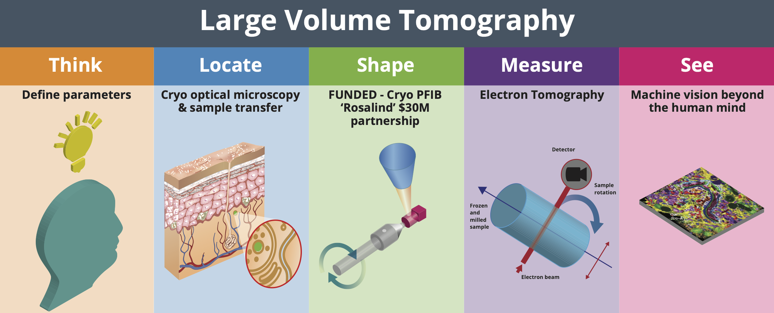
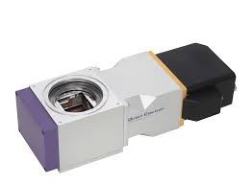
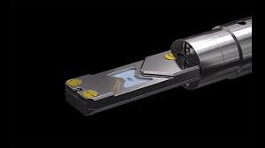
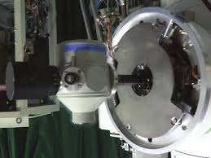
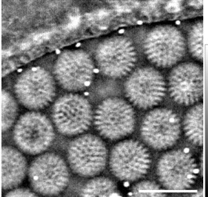
Instrumentation development for Correlated Imaging
Define new imaging modes for light elements and radiation sensitive samples
Precision x,y,z stage design across instrumentation
New sample environments close to in vitro
Quantitative imaging and spectroscopy
Multimodal high resolution imaging with high phase sensitivity
Time resolved electron optical columns and novel C_{c} correction
Cryostage transfer and correlation of Instruments for different radiations
New detectors

Slide 3

The Franklin Factor of 10
From mm to pm & From s to ns
“In Vitro” cells for all radiations (molecular movies)
Improved phase sensitivity (fewer particles for SPA)
Structures below 50kDa
Integrated Imaging of Structure, Chemistry and Mass

Slide 4
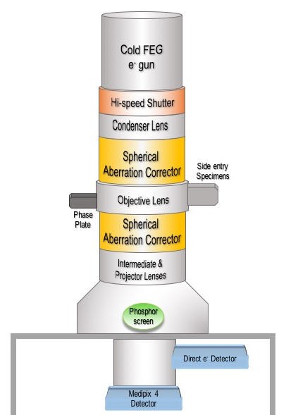
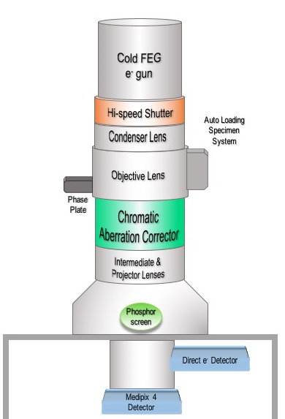
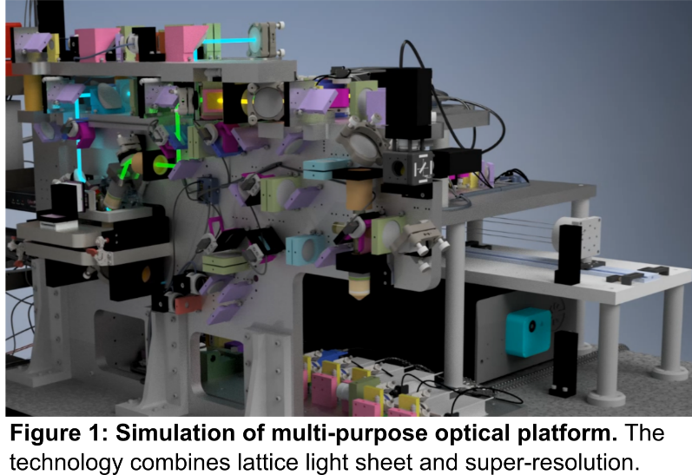
Disruptive Instrument Development; Core Projects
EM.
Optical.
Ruska
Knoll
BioCOP
Detectors.
Optimised 100kV direct detector for electrons (with SB)
High speed optical camera (10⁸ fps)

Slide 5
Disruptive Instrument Development; External Projects
EM (RFI, Daresbury, Liverpool).
X-Ray. (RFI, Southampton)
Relativistic Ultrafast Electron Diffraction and Imaging
3.5MV, fs timing, nm resolution.
Fast (μs) soft X-Ray and EUV imaging
Liquid cells (RFI, Manchester, UCL)
Graphene based static and flow cells for electron and X-Ray imaging

