Slide 1
K. Long, Imperial College London and STFC
Laser-hybrid Accelerator for Radiobiological Applications
Welcome, introduction and aims

Slide 2
Welcome

Slide 3
Thanks
Rosalind Franklin Institute:
Meeting jointly organized to:
Seek to identify research topics of mutual interest
Begin to explore areas for future collaboration
Organisers:
Laura Holland (RFI), Ruth McLauchlan (CXH), Tony Price (Brm)
Speakers and all who have engaged

Slide 4
Vision
The execution of the LhARA programme will:
Create the capability to deliver particle-beam therapy in completely new regimens
Flexibility!
Combine a variety of ion species in a single treatment fraction, exploiting ultra-high dose rates in novel spatial- and spectral-fractionation schemes
Make "best in class" treatments available to the many
Automated, triggerable system → reduce (remove) requirement for large gantry:
System incorporating dose-deposition imaging in fast feedback-and-control system; track movement, deliver dose at optimum tissue alignment

Slide 5
Laser-hybrid Accelerator for Radiobiological Applications
A novel, hybrid, approach:
Laser-driven, high-flux proton/ion source
Overcome instantaneous dose-rate limitation
Capture at >10 MeV
Delivers protons or ions in very short pulses
Bunches as short as 10—40 ns
Triggerable; arbitrary pulse structure
Novel “electron-plasma-lens” capture & focusing
Strong focusing (short focal length) without the use of high-field solenoid
Fast, flexible, fixed-field post acceleration
Variable energy
Protons: 15—127 MeV
Ions: 5—34 MeV/u

Slide 6
LhARA performance: doses and dose rates

Slide 7
Delivering the vision
Require:
New triggerable/flexible accelerator techniques
Study initiated
Instrumentation, diagnostics, computing:
Novel techniques to enhance:
Radiobiological capability
Interpretation/simulation of biophysics
Research and clinical system:
Real-time imaging of object, tissue, and dose
Image processing and dose re-evaluation
Integration of fast-feedback and control system

Slide 8
Aims
Initiate discussion of areas of mutual interest …
An important first target:
Proposal to the EPSRC against the “Transformative Healthcare Technologies” call

Slide 9
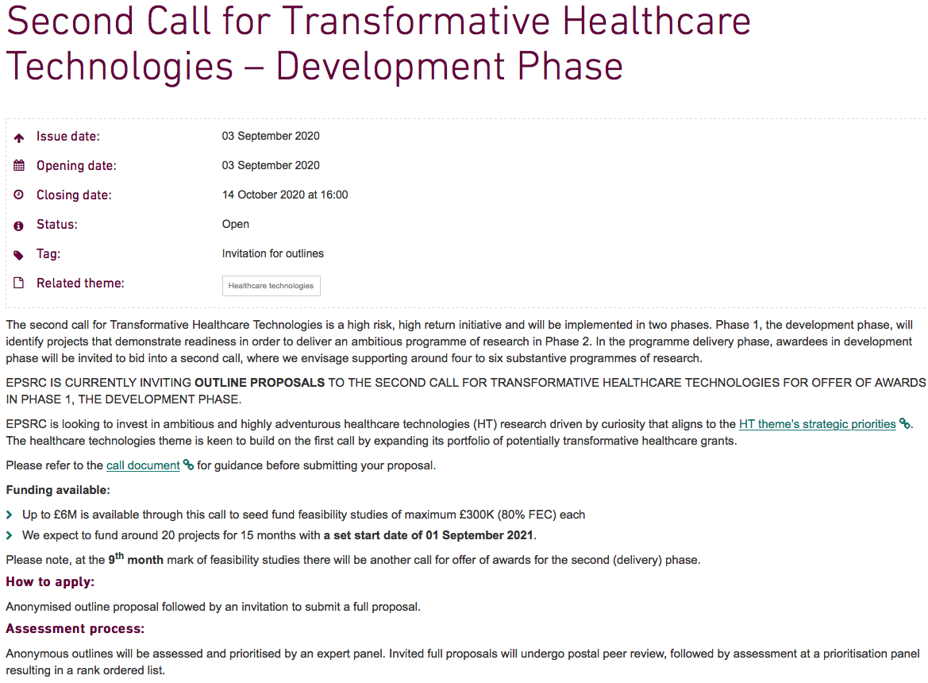
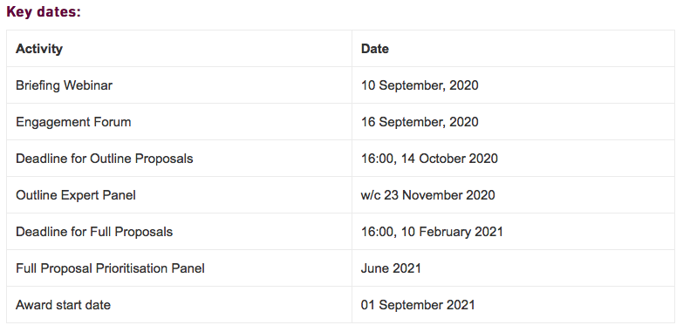
The call

Slide 10
Observations
Phase 1: comparable mission to STFC Opportunities 2019 call
Must present full LhARA vision; rbio and PBT paradigm shift
£300k over 15 months for Phase 1:
Implies need for a “creative” approach;
Must position collaboration to drive forward through Phase 2
Possible approach:
Focus EPSRC THT bid on end-station & impact on PBT
Approach STFC to co-fund if EPSRC THT bid is successful:
STFC funds 15 month essential (risk mitigating) accelerator R&D programme
Contact with STFC initiated
Seek to identify elements of EPSRC THT proposal today

Slide 12
Acknowledgements
The LhARA consortium

