Slide 1
The LhARA programme, its organisation, and alignment with the ITRF

Slide 2
Long-term vision
To transform the clinical practice of proton- and ion-beam therapy by creating a fully automated, highly flexible system to harness the unique properties of laser-driven ion beams.
Develop LhARA to serve the “Ion Therapy Research Facility” (ITRF) to explore the vast “terra incognita” of the mechanisms by which the biological response to ionising radiation is determined by the physical characteristics of the beam.
Present mission

Slide 3
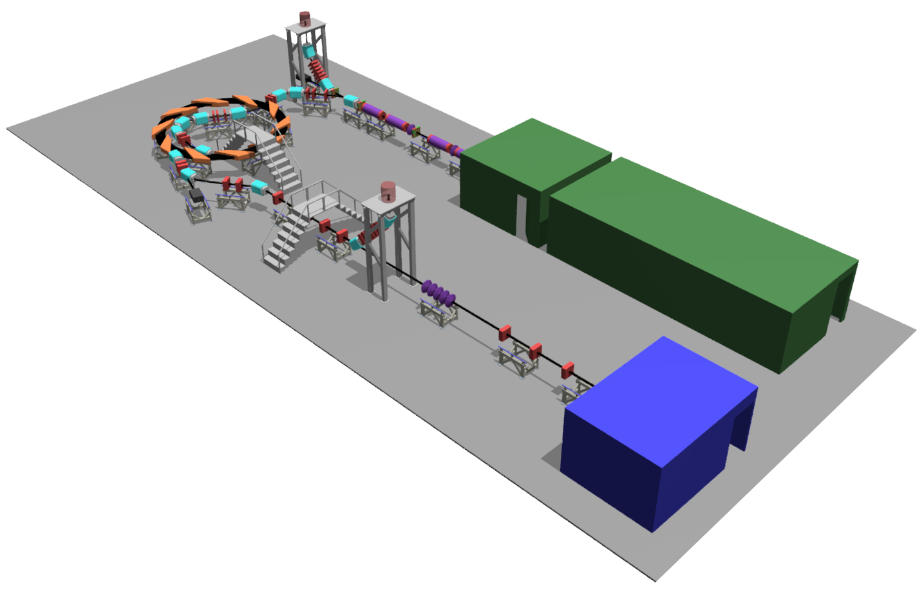

Front. Phys., 29 September 2020; DOI: 10.3389/fphy.2020.567738

Slide 4
Laser-hybrid Accelerator for Radiobiological Applications
A novel, hybrid, approach:
Laser-driven, high-flux proton/ion source
Evade current instantaneous dose-rate limitation
Capture at 15 MeV
Delivers protons or ions in very short pulses
Bunches as short as 10—40 ns
Triggerable; arbitrary pulse structure
Novel “electron-plasma-lens” capture & focusing
Strong focusing (short focal length) without the use of high-field solenoid
Fast, flexible, fixed-field post acceleration
Variable energy
Protons: 15—127 MeV
Ions: 5—34 MeV/u
Front. Phys., 29 September 2020; DOI: 10.3389/fphy.2020.567738

Slide 6
Co-chairs: T. Greenshaw (Liv)
Y. Presado (Inst. Curie)
Co-spokes: A. Giacca (OIRO)
K. Long (IC/STFC)
Co-PMs: J. Parsons (Liv)
C. Whyte (Strath)
C. Whyte
J. Parsons

Slide 7
K. Long
A. Giacca
C. Whyte
D. Kordopati

Slide 8
Work Package managers
Project Management:
C. Whyte (Strathclyde)
Laser-driven proton and ion source:
N. Dover (Imperial/JAI)
R. Gray (Strathclyde)
E. Boella (Lancaster/CI)
Proton and ion capture:
W. Bertsche (Manchester/CI)
C. Baker (Swansea)
Ion-acoustic dose mapping:
J. Bamber (Institute of Cancer Research)
E. Harris (Institute of Cancer Research)
J. Matheson (Particle Physics Department, STFC RAL)
Novel end-station development:
R. McLauchlan (Imperial Healthcare NHS Trust)
T. Price (Birmingham)
Design and integration:
N. Bliss (Technology Department, STFC DL)
J. Pasternak (Imperial/JAI)

Slide 9
Ion Therapy Research Facility

Slide 10
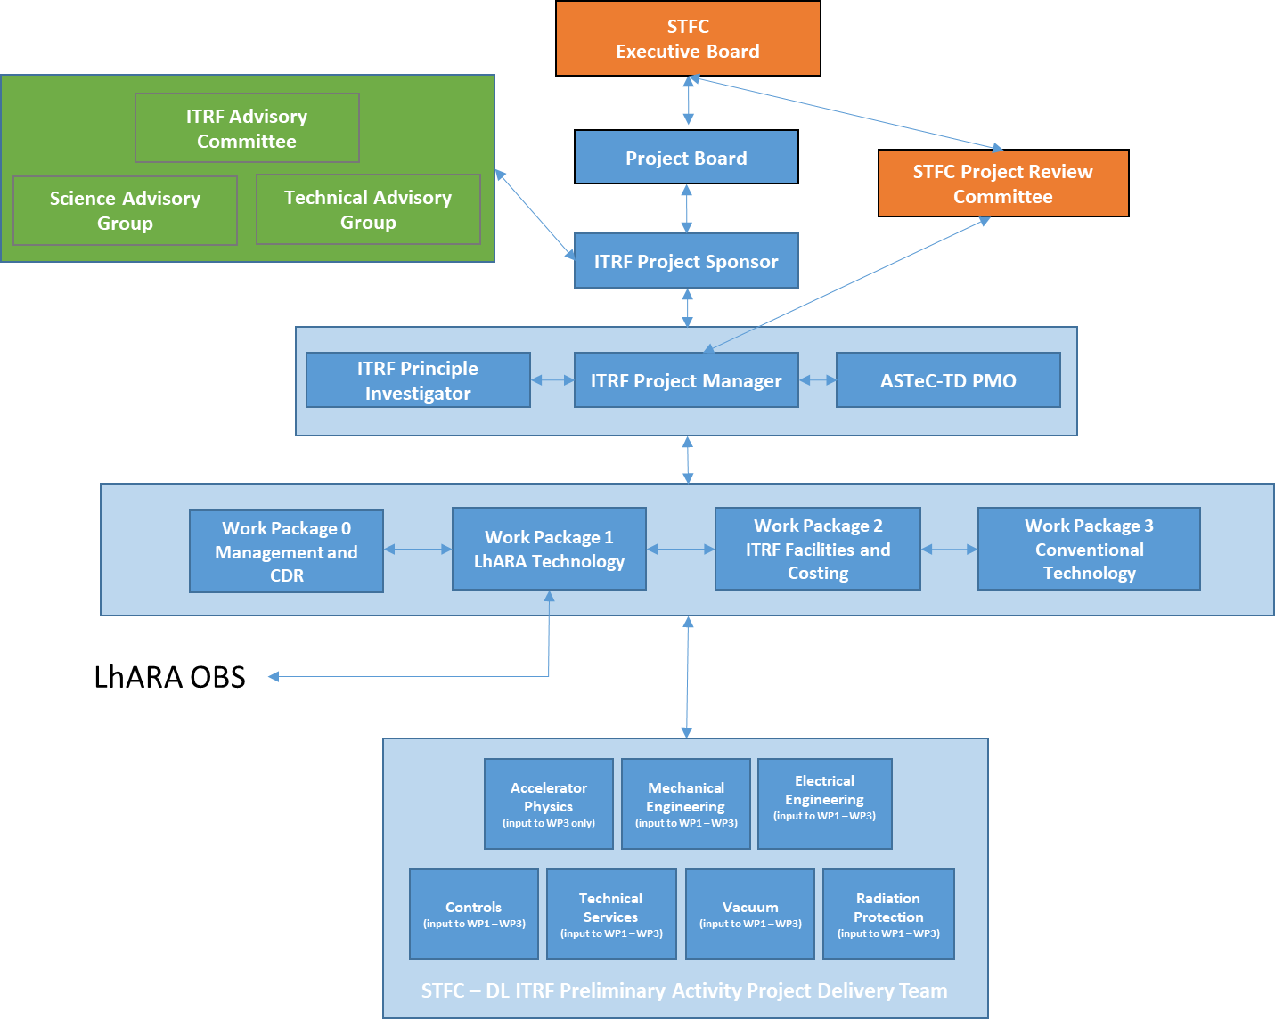
(ITRF) Governance
For discussion

Slide 11
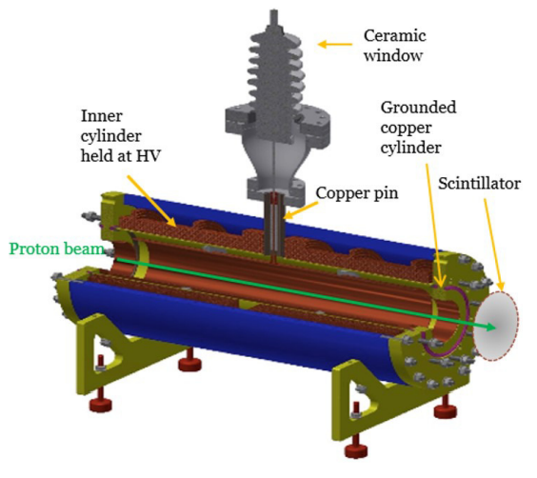

WP1 – LhARA
WP1 has 6 sub-packages. The substantive goals are:
WP1.2: Optimising the plasma source for proton and ion production
WP1.3: Plasma lens testbench for Gabor lens capture and transport
WP1.4: Understanding ion-acoustic methods to measure ultra-high dose rate
WP1.5: Technologies for an ultra-high dose rate delivery and use
WP1.6: Stage 2 accelerator (FFAG) costing and scope
STFC has a remit to leverage technology developments for future infrastructures
IAC recommended novel LhARA technology should be considered and de-risked as part of any preliminary activity – high dose rate
LhARA collaboration has wider scope than preliminary activity, and has re-scoped its collaboration proposal in its first 2 years to align with the ITRF goals and PA
We benefit from considerable background of work in this collaboration
Principle goals of WP1 are:
De-risk key technology challenges
Understand the scope and costs of ITRF based on LhARA technology
65 kV

Slide 12
Mapping onto ITRF proposal
Multidisciplinary collaboration comes together to create proposal
Lab (ASTeC, CLF, PPD, TD), HEIs from across the 4 nations, accelerator institutes, key international partners
CDR/TDR development – WP6
End-station specification, design – WP5
Exploit/benefit from Brm ambition to create vertical beamline
Scientific measurement and prototype test and commission
Programme to address key technical risks – WP2, WP3, WP4:
WP2: Source
WP3: Capture
WP4: Realtime, shot-by-shot, non-destructive dose-mapping

Slide 13
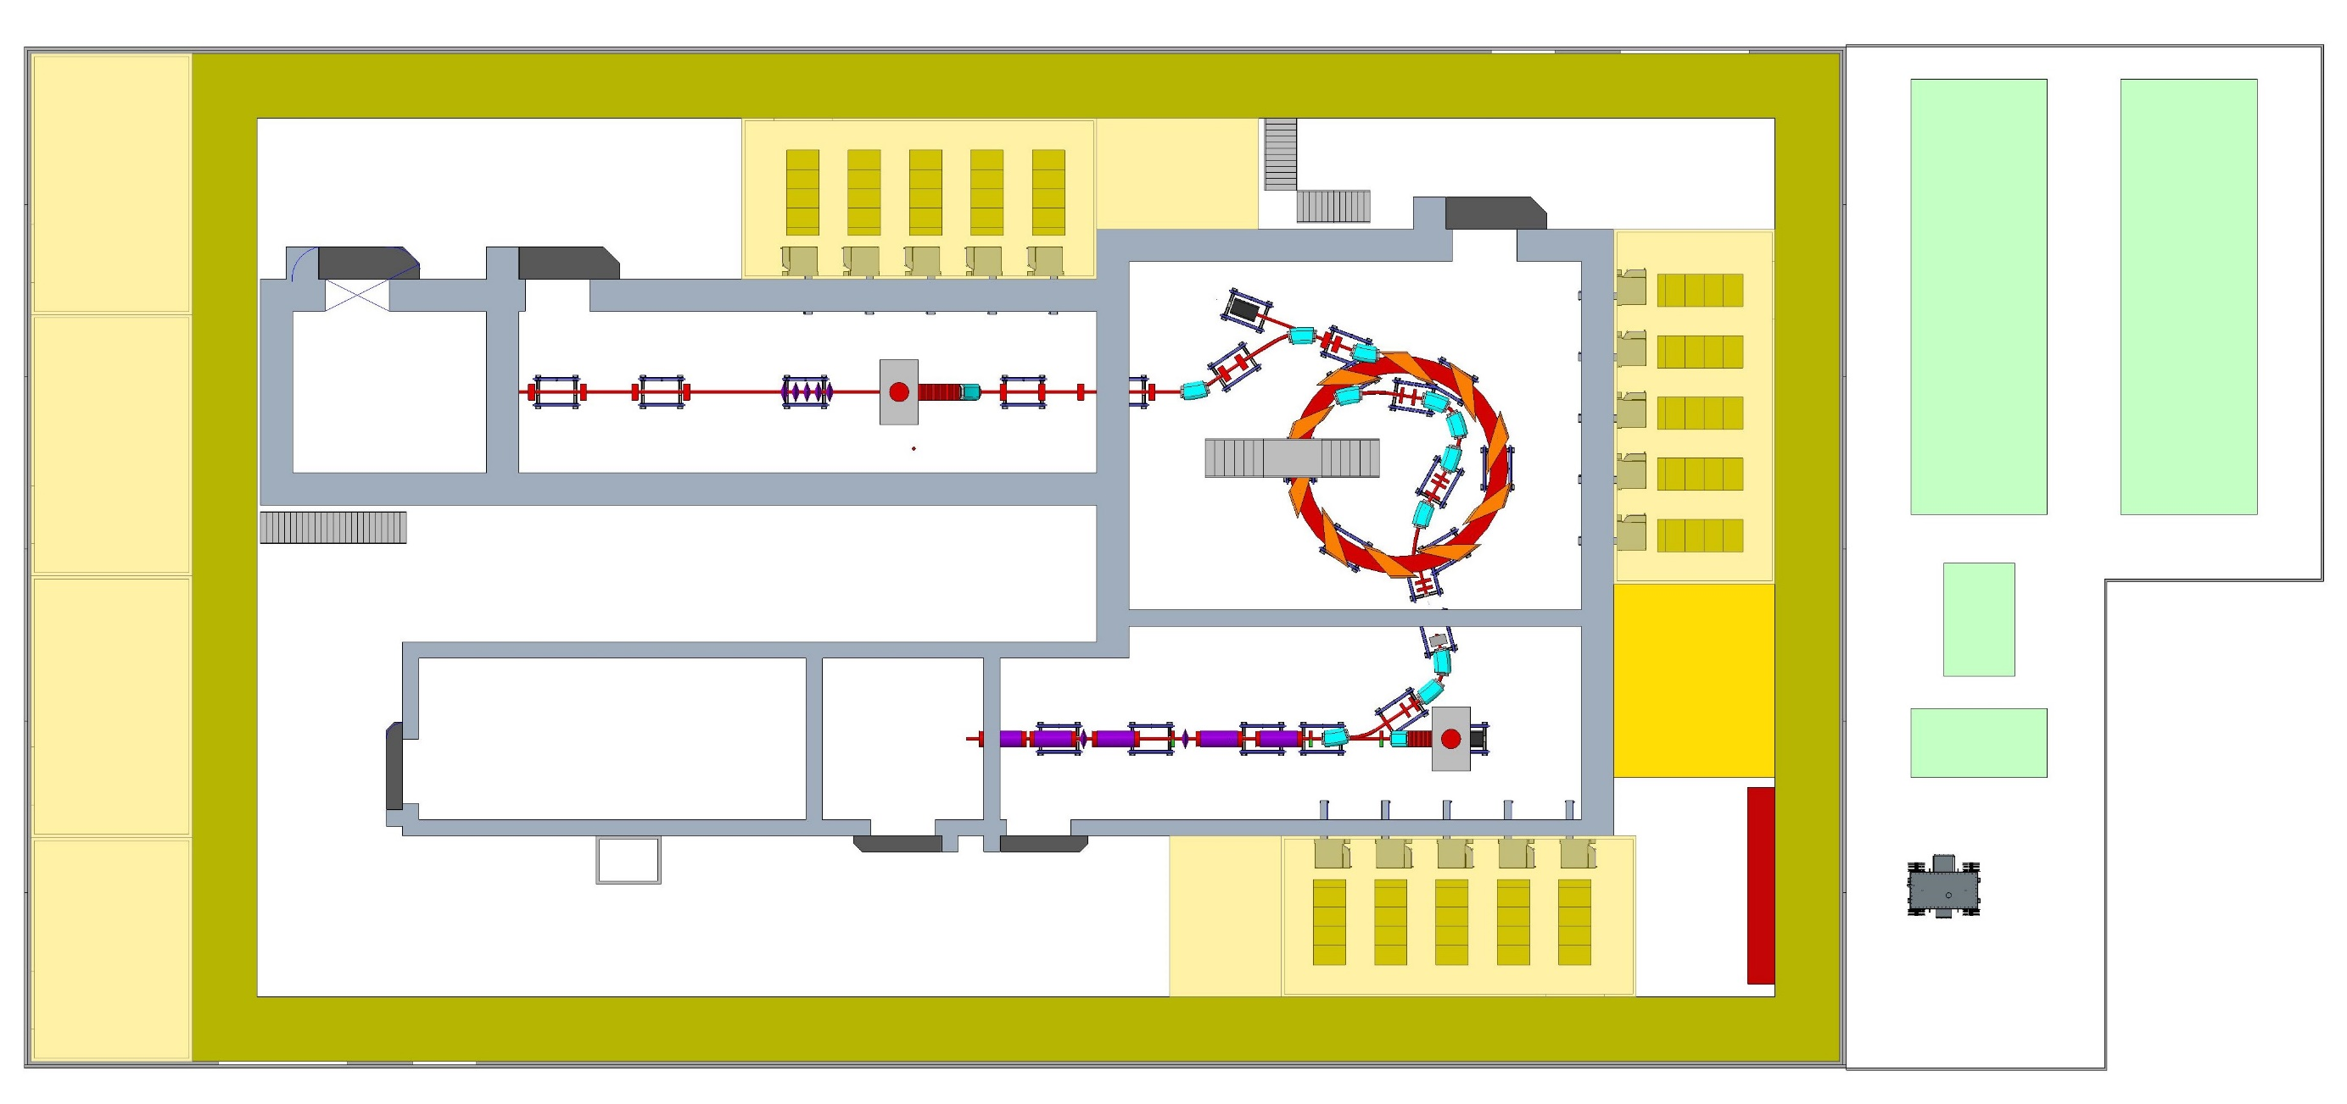
WP2 – Facilities and Costing
WP2 Facilities & Costing
Work Package Management | N Bliss, PQM, Technology (Temp.) | 0.500 | 0.125 | 0.250 | 0.125
Mechanical engineering design specification | C Hill, P&ME (DL), Technology | 1.200 | 0.300 | 0.600 | 0.300
Electrical engineering design specification | S Griffiths, EE, Technology | 0.650 | 0.100 | 0.450 | 0.100
Controls specification | G Cox, CS&SI, Technology | 0.350 | 0.050 | 0.250 | 0.050
Technical services specification | R Buckley, BP&F, ASTeC | 0.450 | 0.050 | 0.350 | 0.050
Vacuum specification | A Vick, VS, ASTeC | 0.250 | 0.050 | 0.150 | 0.050
Radiation protection specfication | A Goulden, BP&F, ASTeC | 0.100 | 0.015 | 0.070 | 0.015
WP2 Staff Total |  | 3.500 | 0.690 | 2.120 | 0.690
WP3 Conventional Source
Accelerator Physics | M Johnson, AP, ASTeC | 0.400 | 0.100 | 0.200 | 0.100
ITRF PA must produce a coherent and robust costing and planning for an infrastructure.
STFC have carried out such costings numerous times
WP2 will involve STFC working with partners to iterate building and accelerator concepts and designs, to create the costing and to optimise the layout
CDR will also present the operating model and usage

Slide 14
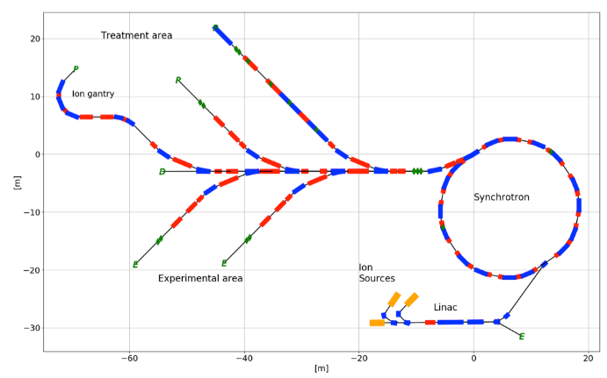

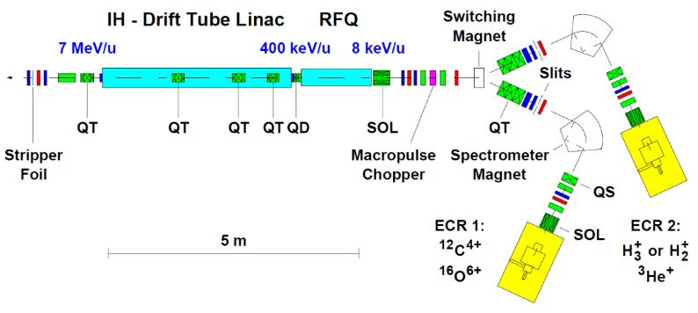
WP3 – Conventional Technology
Conventional technology (e.g. synchrotron) is:
Proven
Already available at other facilities
For costing and preparation, we need:
Parameters and layout
Understanding of the end station design
Will use STFC staff to translate existing CERN designs on PIMMS and NIMMS
STFC/CERN Framework Agreement signed; access to design information and collaboration
Dedicated PhD student to work on beamline/end station (intending to start in Jan 2023)
Will review linac as 3rd option

Slide 15
Conclusion
LhARA initiative initiated 2020:
pre-CDR & publication in Frontiers in Physics (Med. Phys. & Imag.)
LhARA basis of Ion Therapy Research Facility proposal; June 2021
The LhARA R&D proposal for the reliminary, pre-construction phases; June 2022
UKRI Infrastructure Fund approval of ITRF Preliminary Activity; July 2022
ITRF & LhARA Preliminary Activity project start; October 2022
Negotiation of detailed scope of LhARA project in ITRF Preliminary Activity close to completion
This review critical feedback on planning of LhARA initiative and project

