Slide 1
News/Update

Slide 2

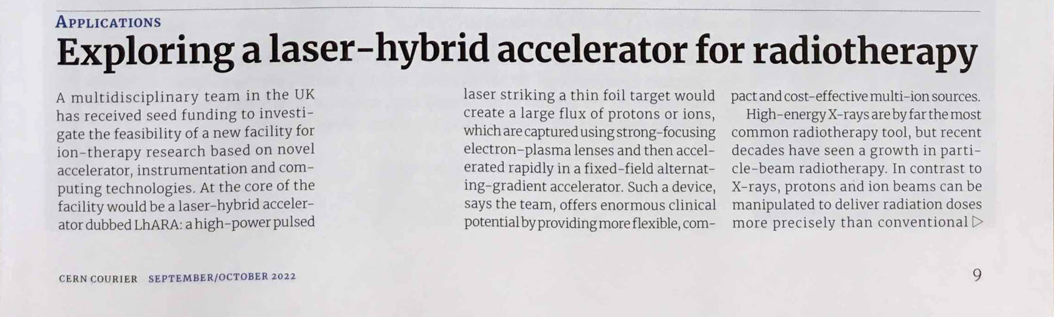
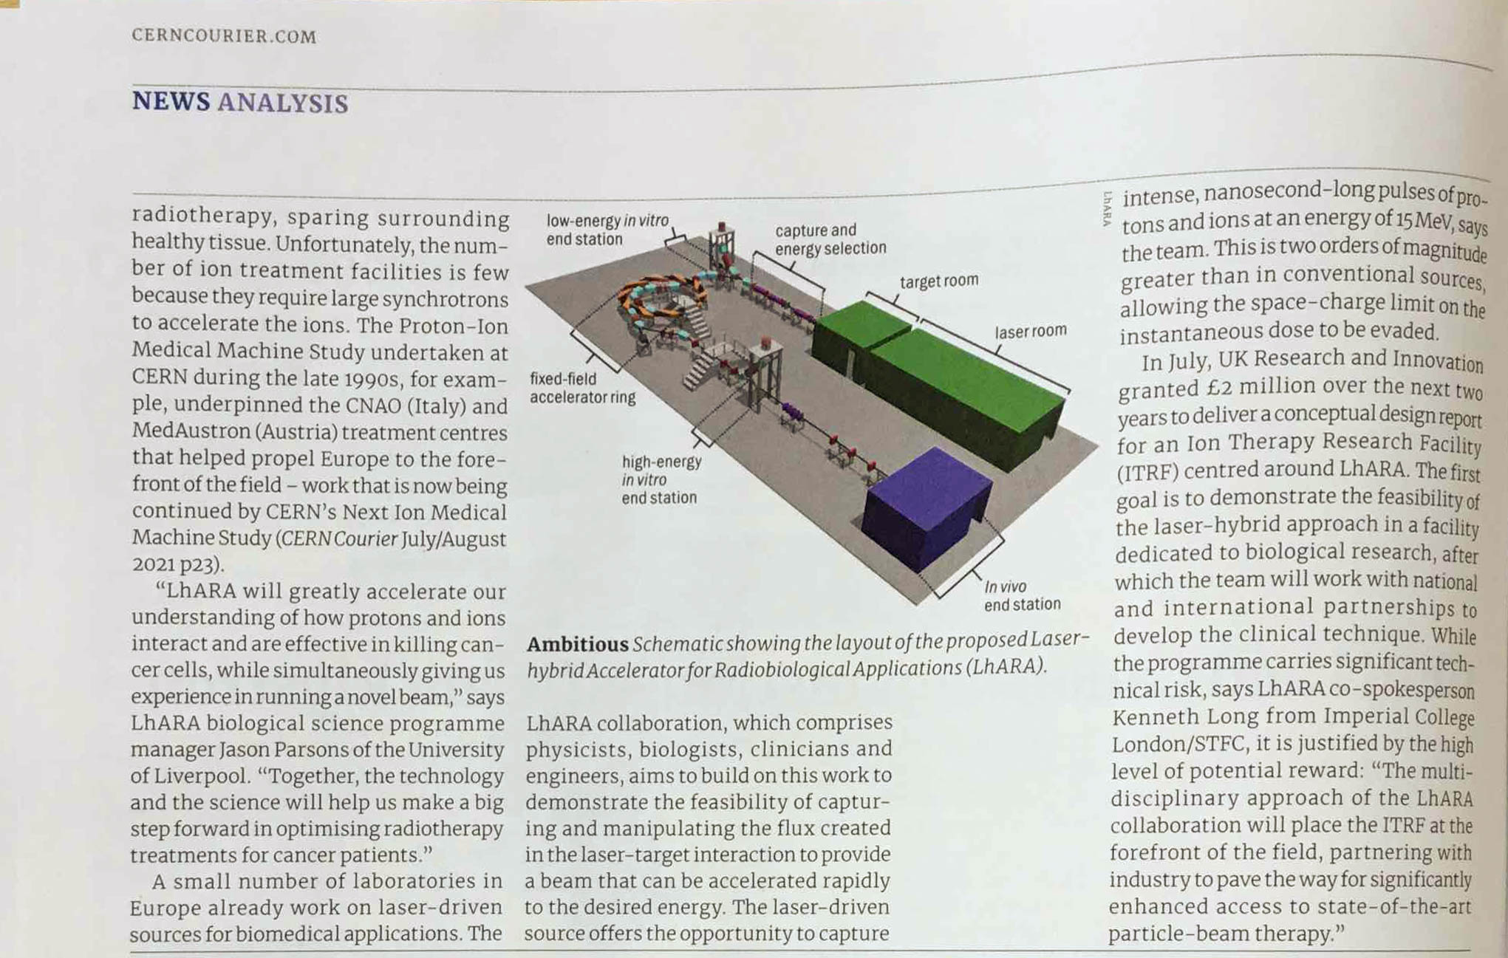

Slide 3
Progress with documentation
Coming together …
Text from each WP now in
Costing using “proper” staff costs:
  Taking shape:
    Still some staff-cost updates required
Overall cost “a little hot”
  Managable
JeS preparation underway
Tim Greenshaw to consult IB to fill in “partner institutes”; considering letter of support from IB
Has to be finished by the end of Aug22 …
… work to do!

Slide 4
Next steps/reminders
Review – first session today! 30Aug22; 16:30:
  Expecting more detailed review sessions: 29 & 30 September 2022
ITRF kick off meeting; DL: 20Sep22
For your diaries:
  Next LhARA collaboration meeting; 14Oct22
    Liverpool
  Subsequent collaboration meeting pattern:
    Feb23 -- Birmingham
    Then six monthly

