Slide 1
Analytical designs for the LhARA solenoids (normal-conducting) LhARA fortnightly meeting
16th August 2022
Titus Dascalu

Slide 2
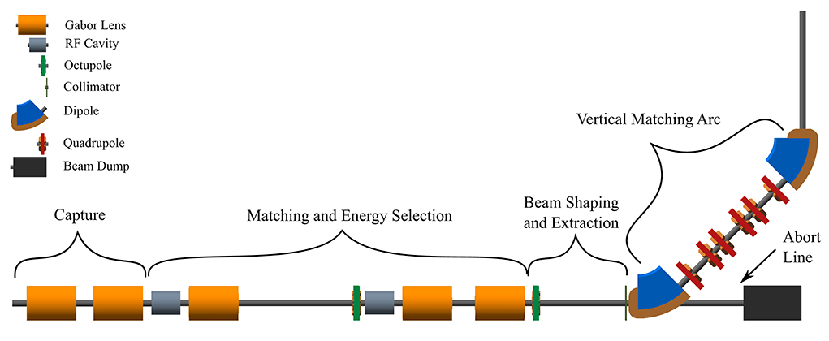
Risk mitigation: alternative capture system based on conventional solenoids
LhARA Stage 1

Slide 3
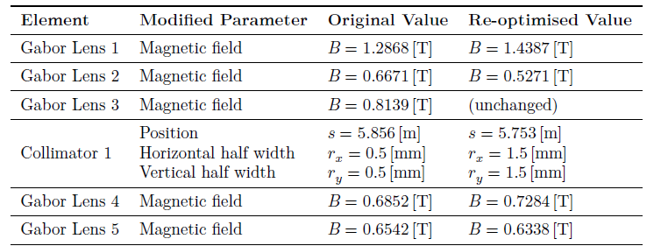
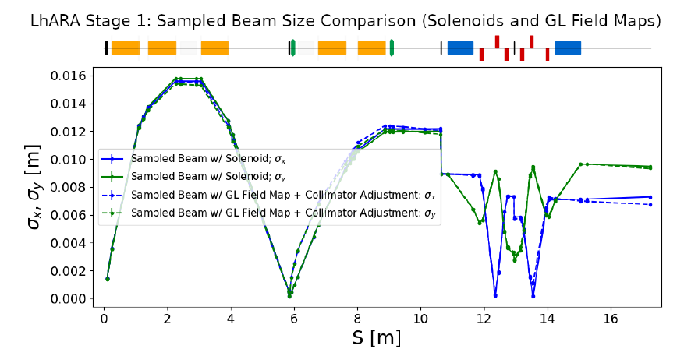
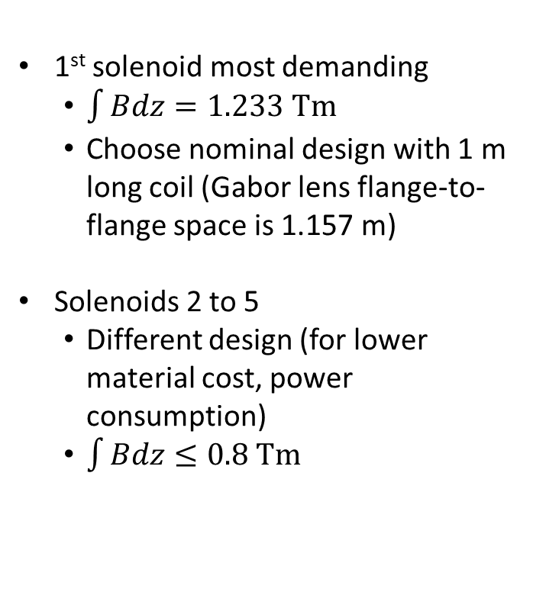
Solenoid requirements
1st solenoid most demanding
$\int{Bdz=1.233 Tm}$
Choose nominal design with 1 m long coil (Gabor lens flange-to-flange space is 1.157 m)
Solenoids 2 to 5
Different design (for lower material cost, power consumption)
$\int{Bdz≤0.8 Tm}$
Equivalent field of a solenoid

Slide 4
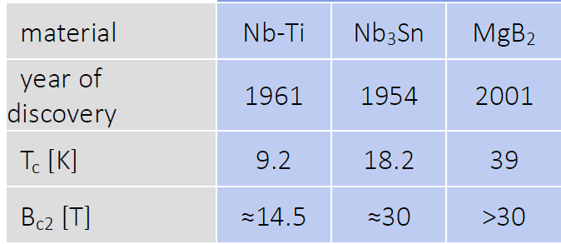
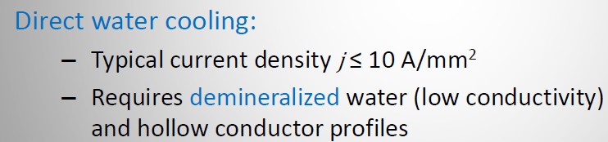
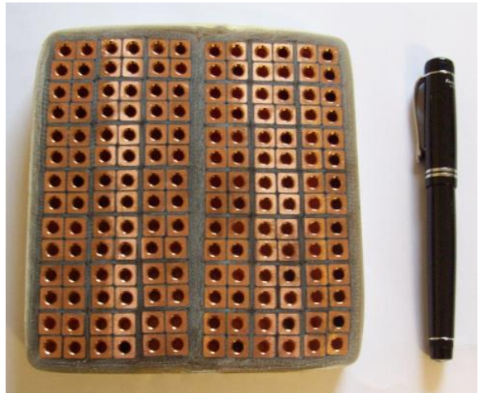
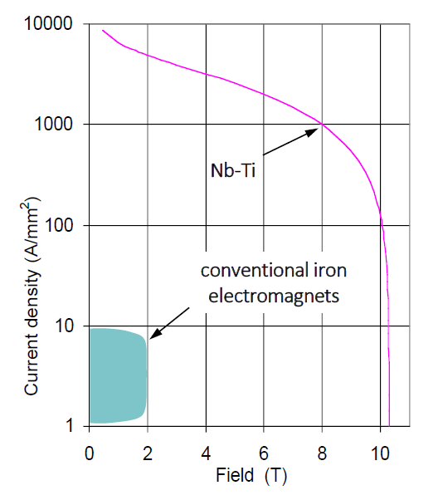
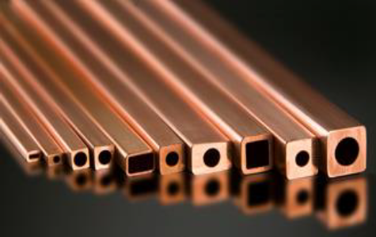

Choice of material
Normal conducting
Superconducting
Most frequent choice of coil material

Slide 5
Choice of material
Normal conducting
Superconducting
(Hollow copper conductor)
Very common design in many accelerator magnets
Efficient cooling
water in direct contact with the source of heat
Coils potted in resin are typically very robust
Each cable has to be insulated
adds complexity and requires more space
Weight of the coils is typically high
Cooling and electric circuits are interwoven, but need separation at the their ends
pressure drop leads to complex cooling circuits for large coils + increased risk of water leakages
Very high current density compared to conventional conductors
Negligible power consumption
Complicated structure: rigid coil former + insulating cryostat (large space requirement around the coil)
The cryostat/cooling infrastructure needs careful maintenance
Cost of superconducting coils is significantly higher than the cost of conventional conductor
Aim of this design exercise: evaluate the requirements and performance of a normal-conducting solenoid that is suitable for LhARA

Slide 6
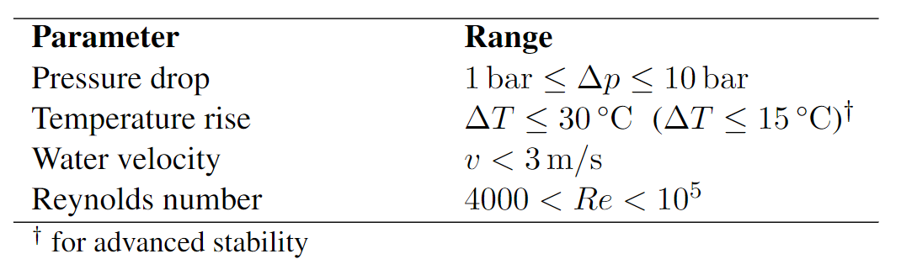
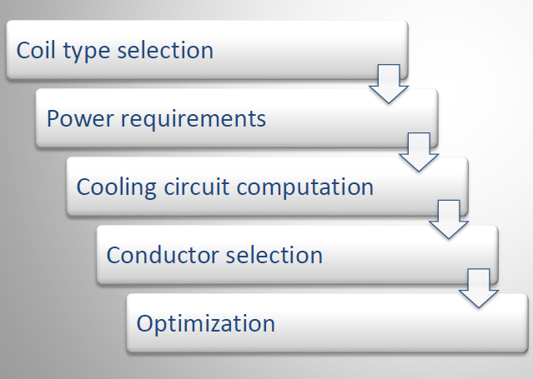
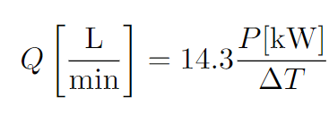
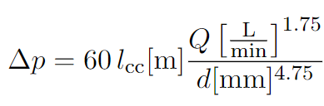
Design procedure
Canonical values
Most frequent choice of coil material
Hydraulics calculations
…
Different layers have different cooling requirements

Slide 7
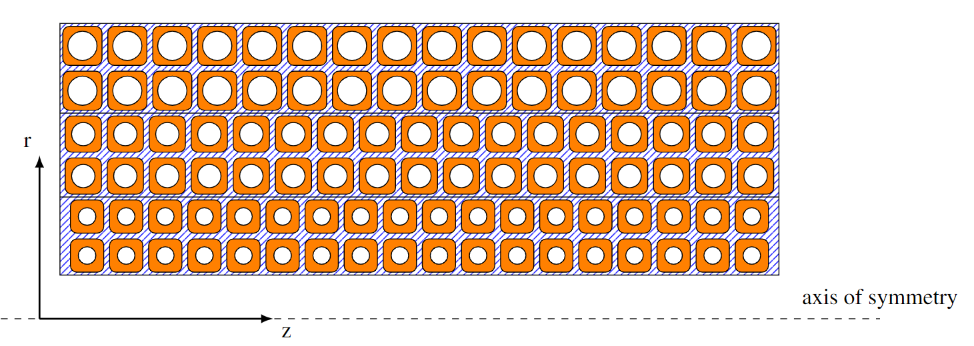
Graded coil design
C
A
B
Use more than one transverse size for the copper cable
Increase the diameter of the cooling channel in the layers further away from the bore
by keeping the conducting area constant
2 layers, cable size C
2 layers, cable size B
2 layers, cable size A

Slide 8
The solenoid for LhARA

Slide 9
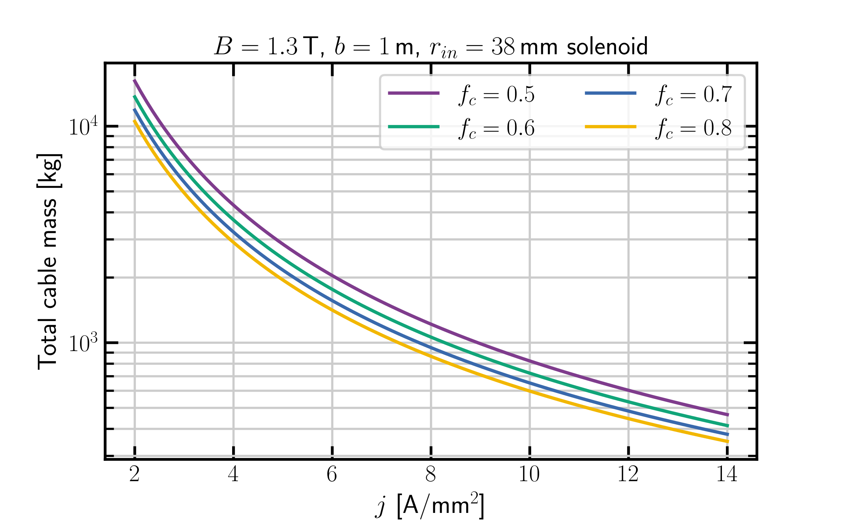
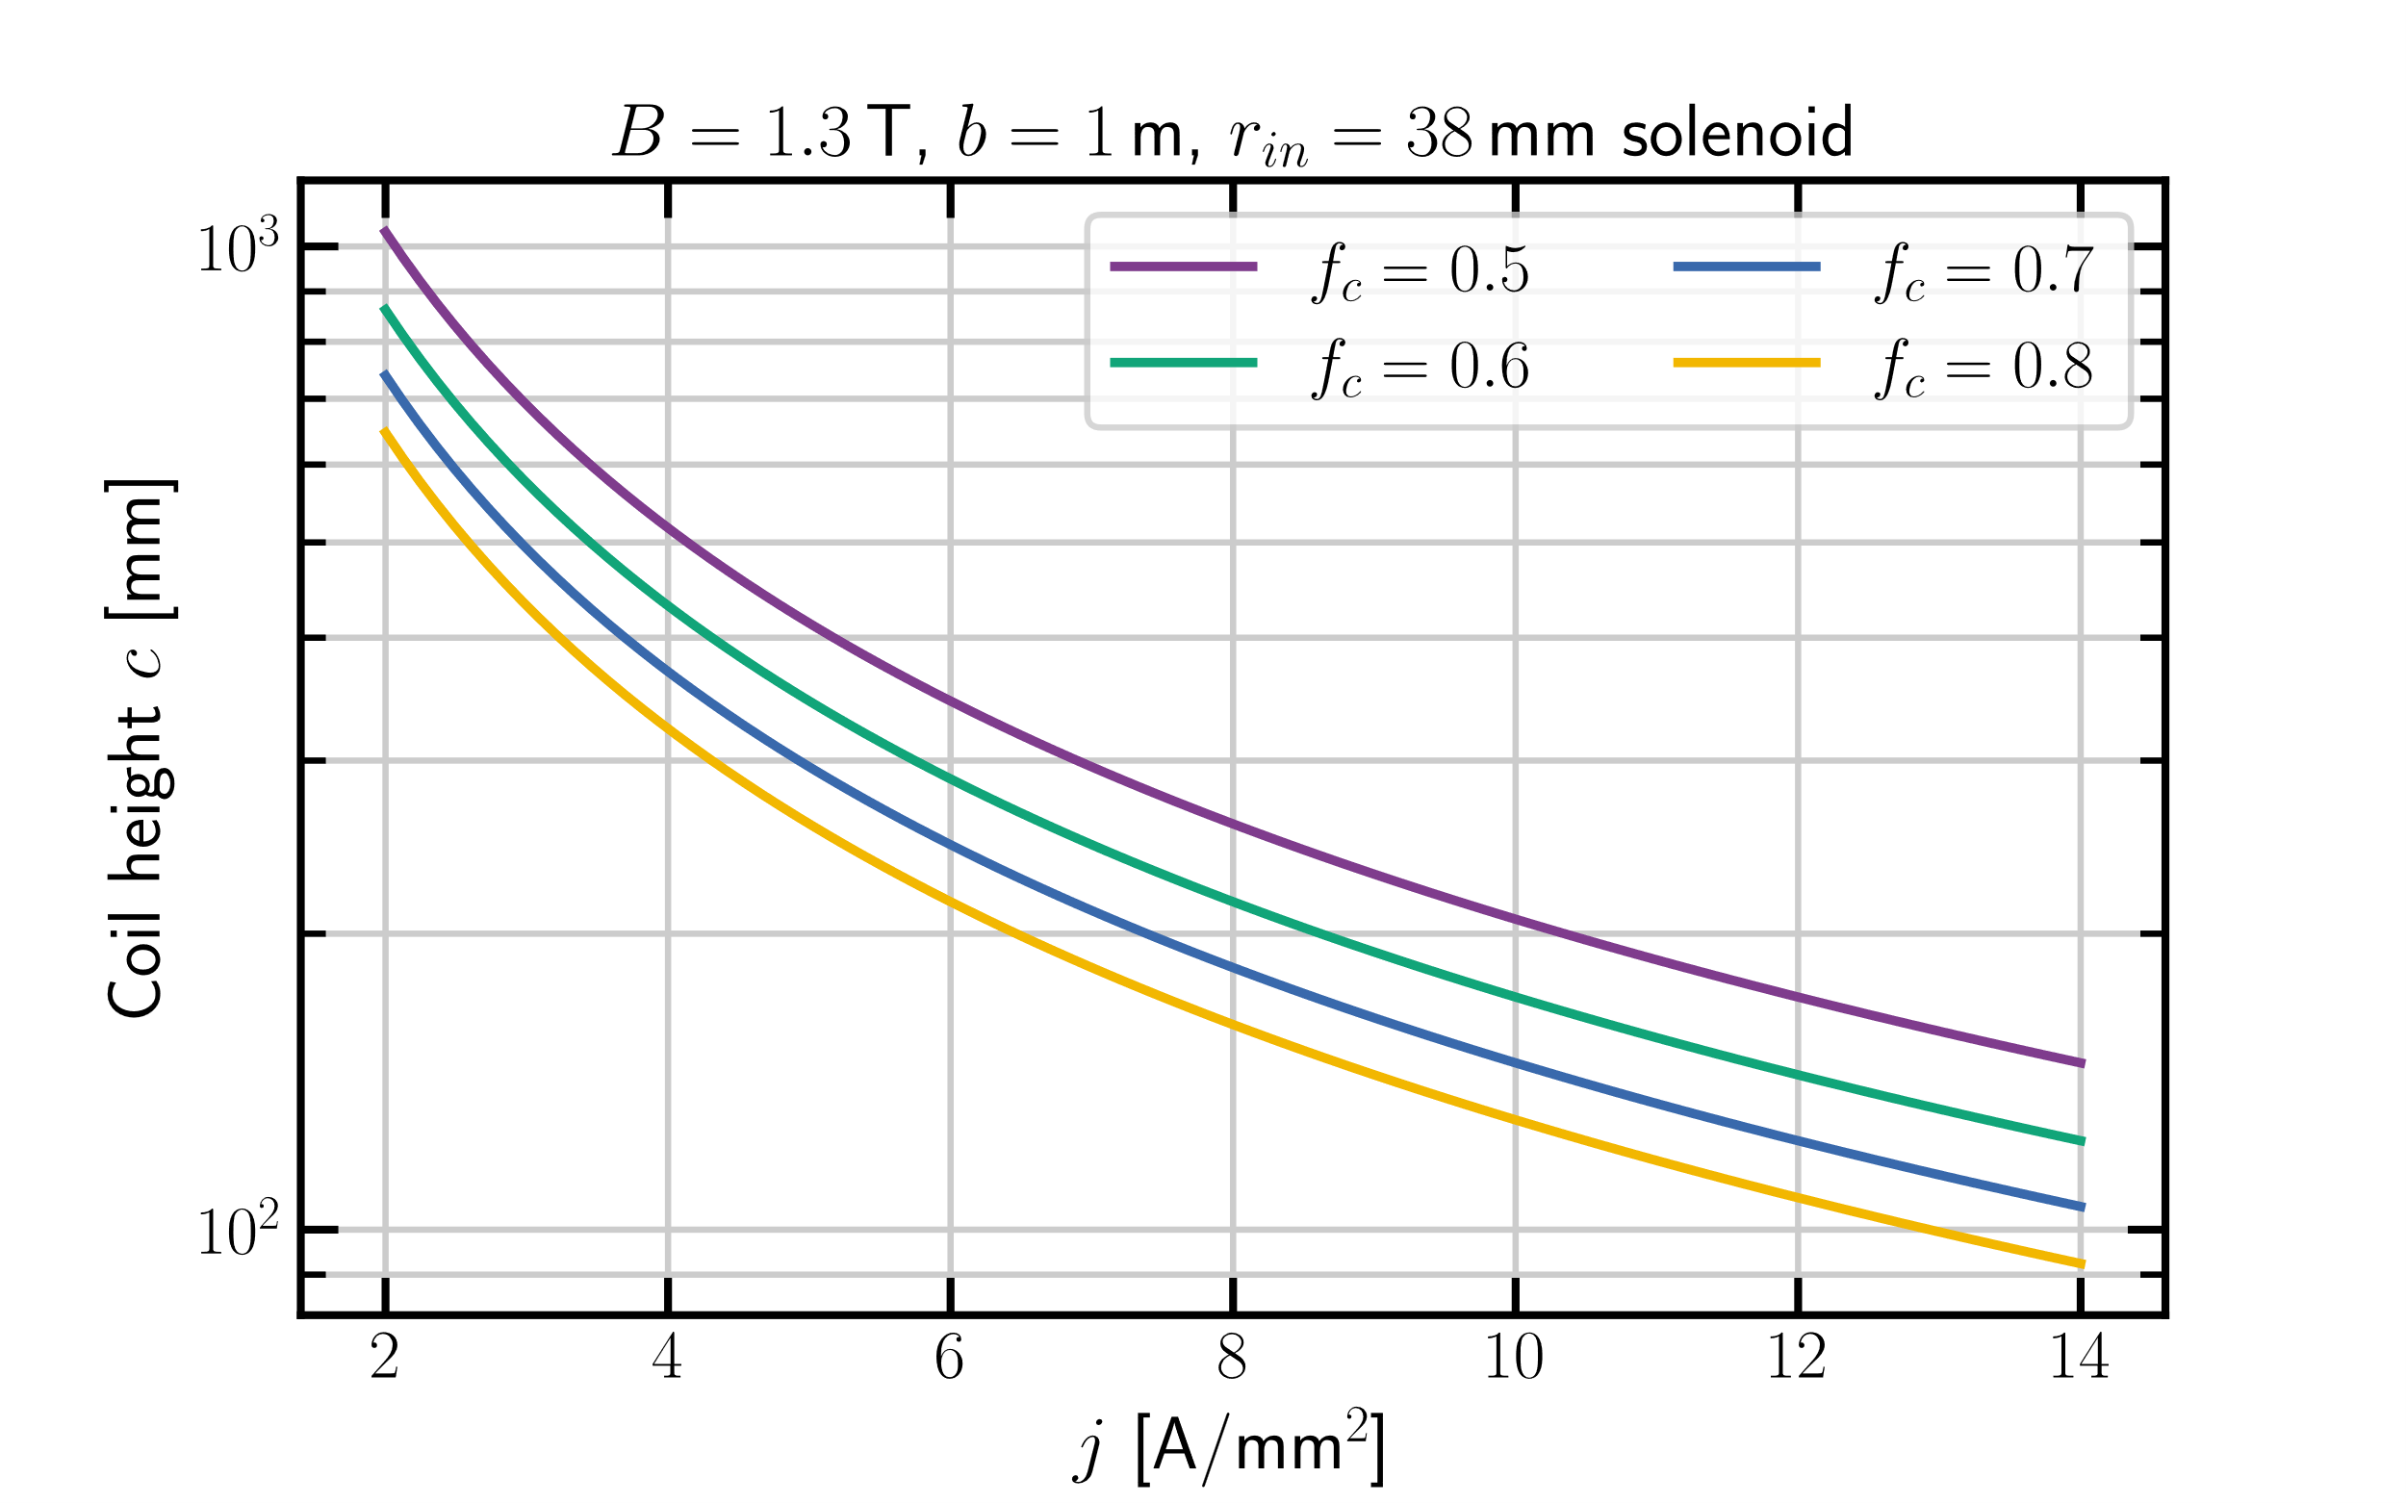
Scaling studies: magnet size
c
Filling factor $f_{c}=\frac{net conductor area}{coil cross section}$ (typically $0.5≤f_{c}≤0.8)$

Slide 10
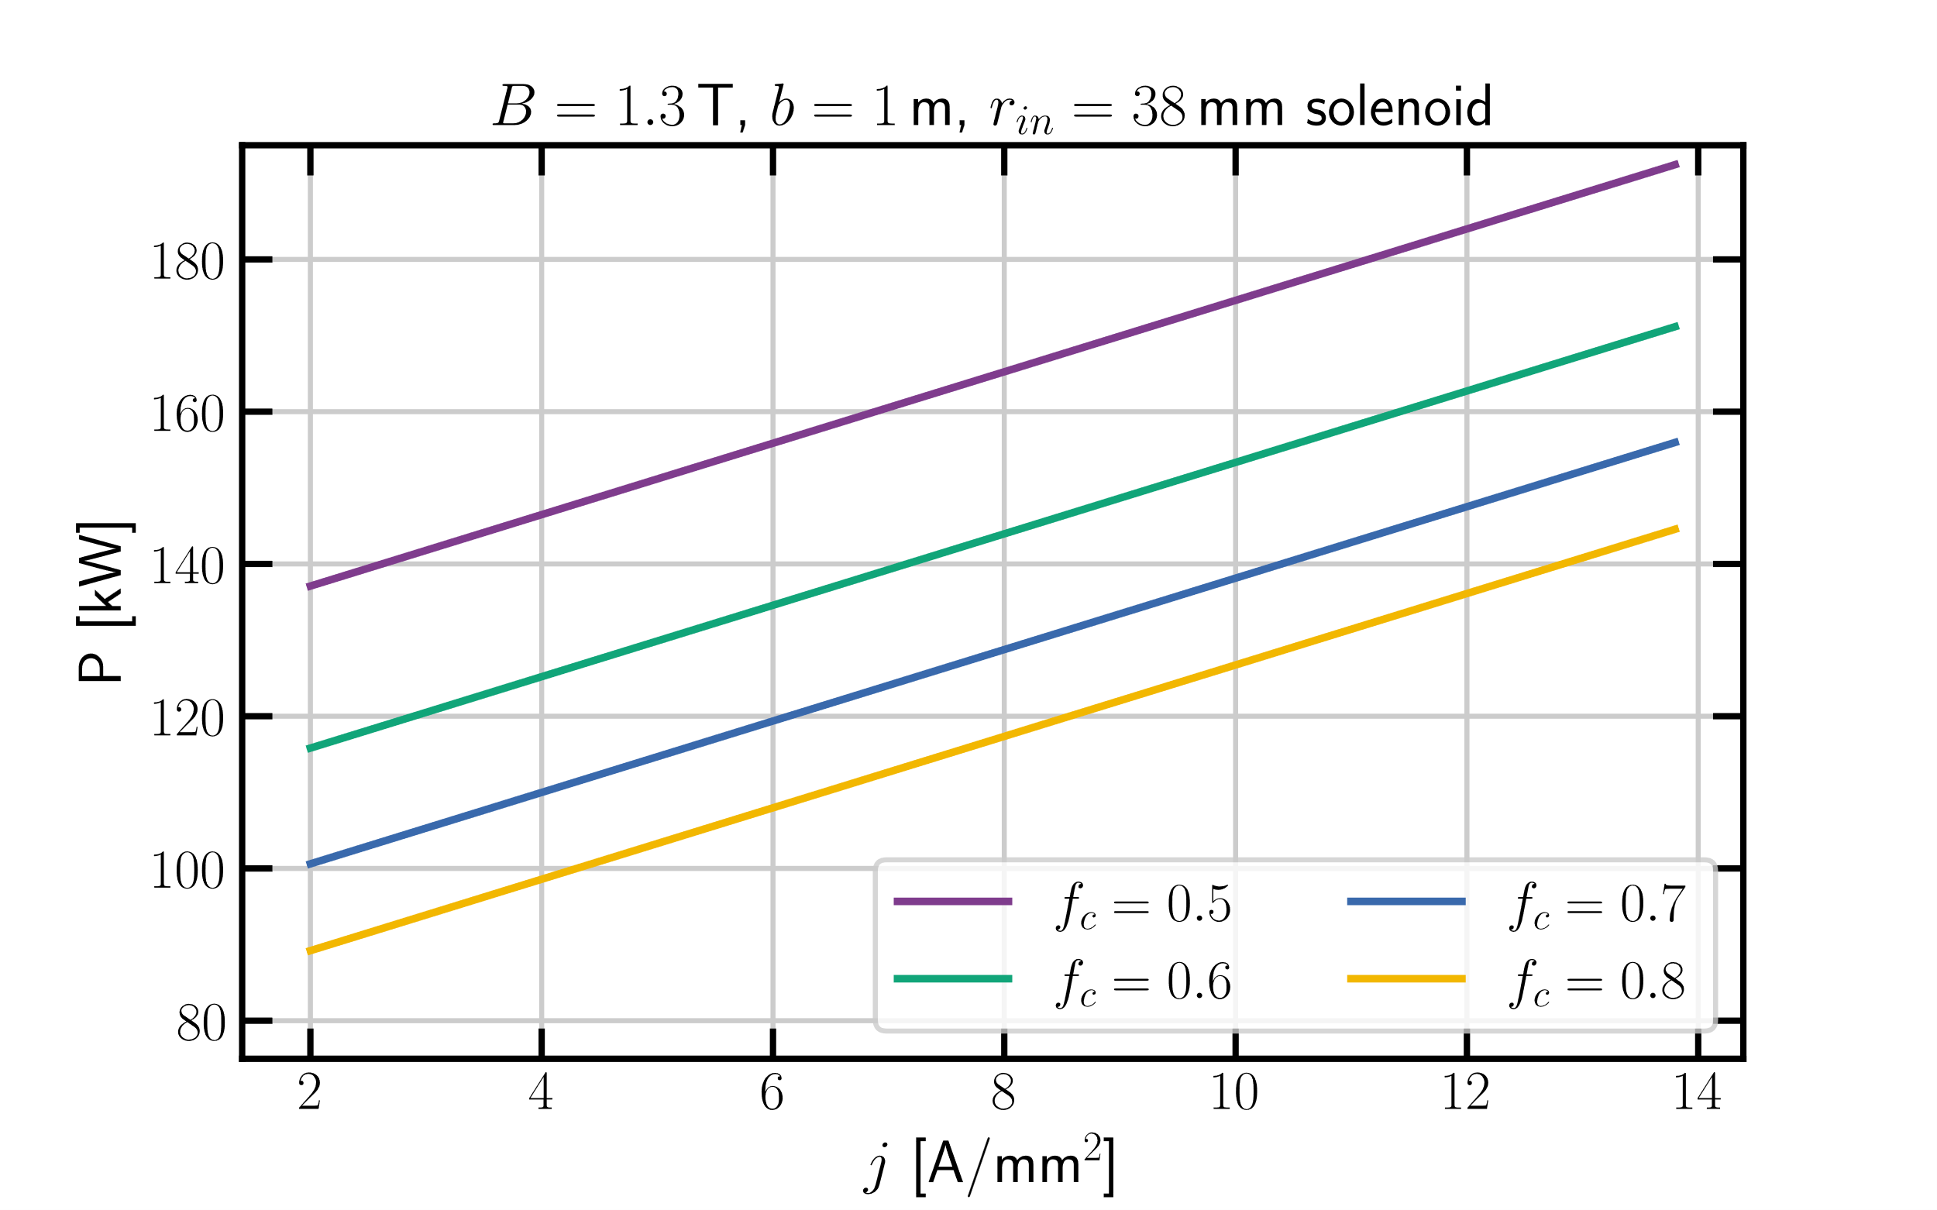
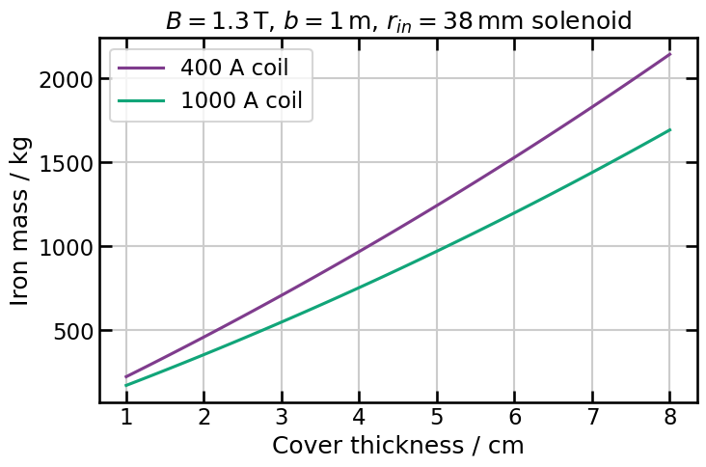
Scaling studies: iron cover mass + power consumption

Slide 11
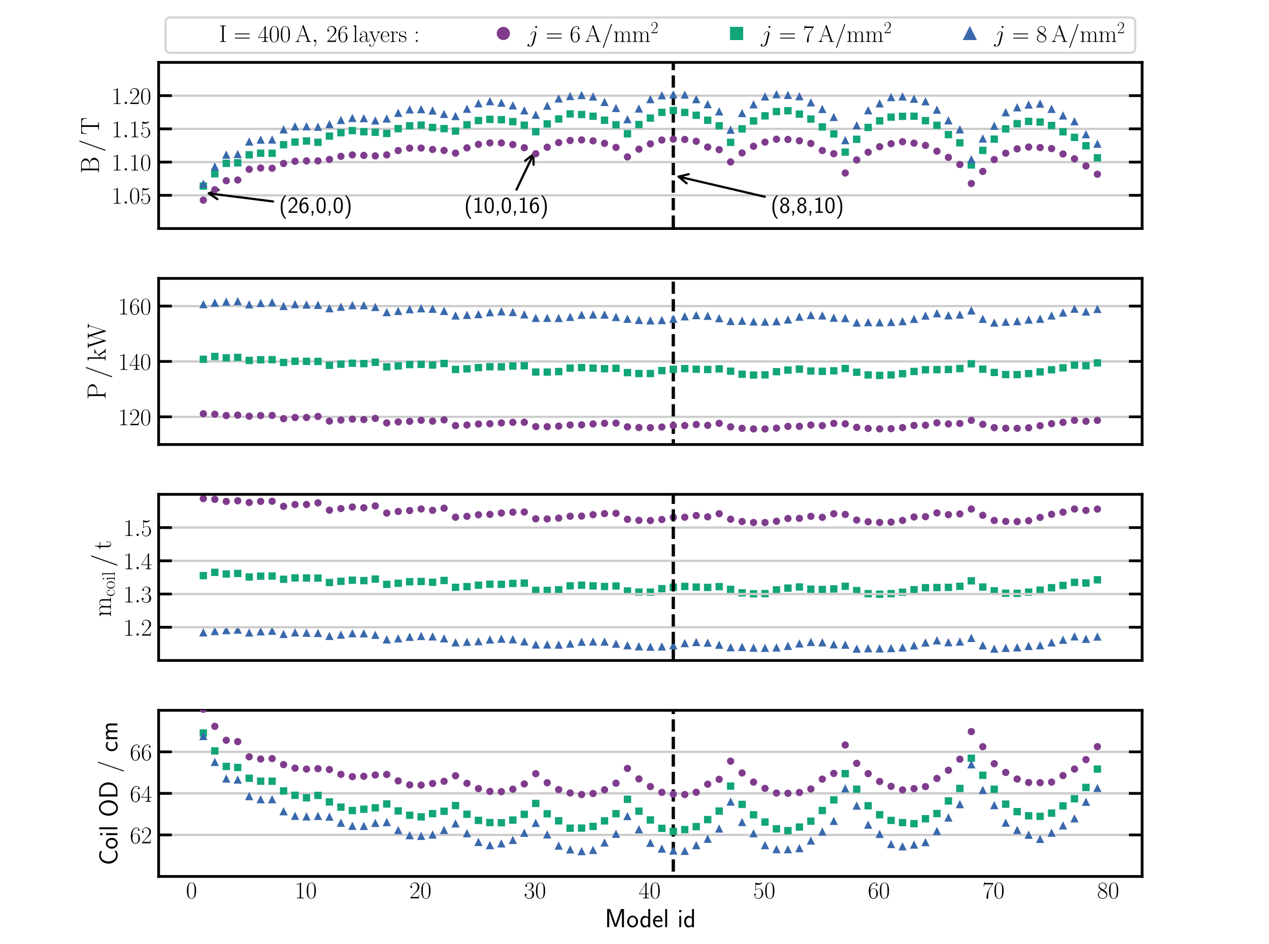
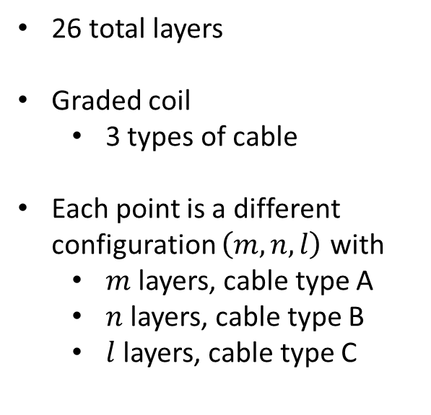
400 A magnet design
26 total layers
Graded coil
3 types of cable
Each point is a different configuration $\left(m,n,l\right)$ with
$m$ layers, cable type A
$n$ layers, cable type B
$l$ layers, cable type C

Slide 12
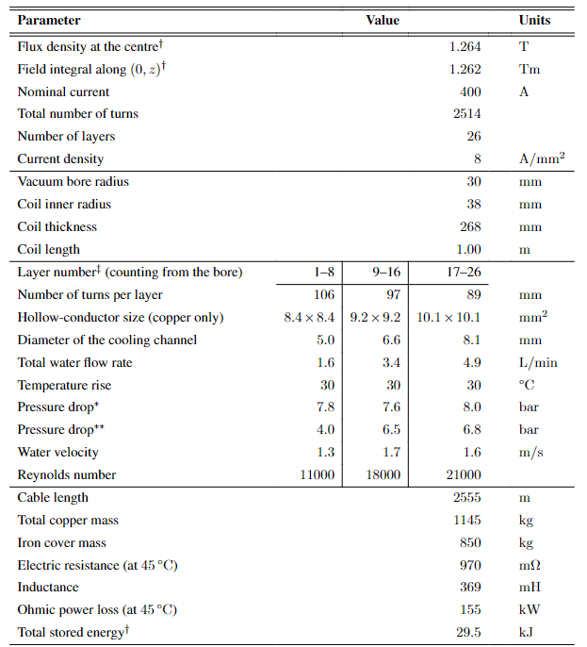

400 A magnet design–specifications
$B=1.26$ T
27 cm thick coil
1150 kg
155 kW

Slide 13
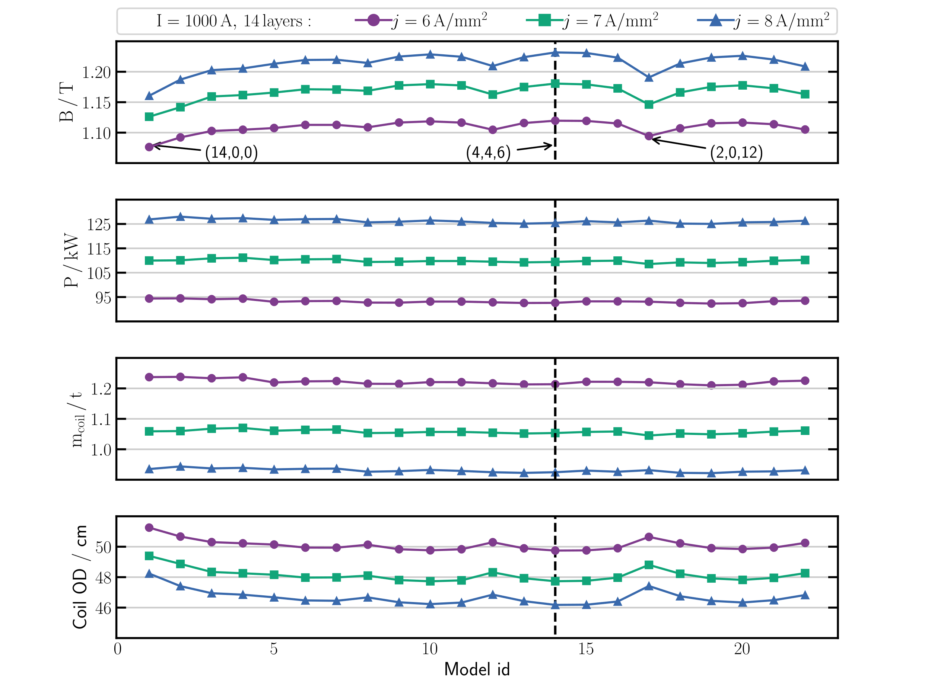
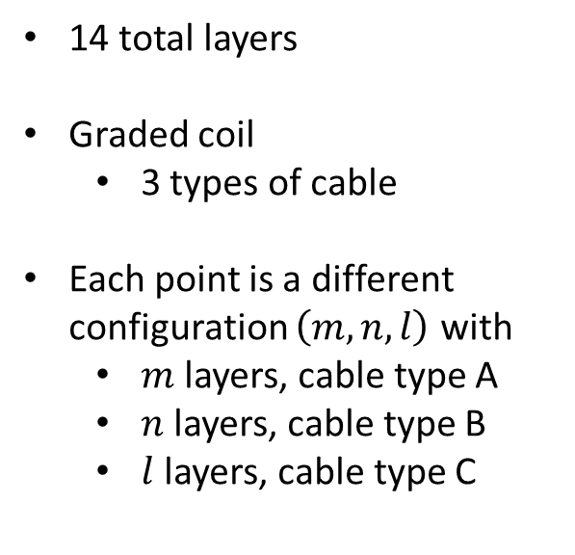
1000 A magnet design
14 total layers
Graded coil
3 types of cable
Each point is a different configuration $\left(m,n,l\right)$ with
$m$ layers, cable type A
$n$ layers, cable type B
$l$ layers, cable type C

Slide 14
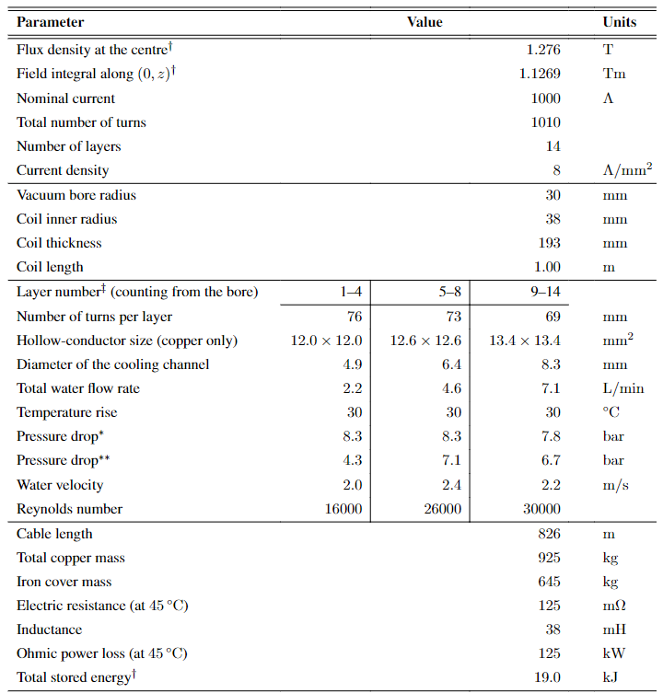

1000 A magnet design–specifications
$B=1.28$ T
19 cm thick coil
925 kg
125 kW

Slide 15

2000 A magnet design–specifications
$B=1.28$ T
20 cm thick coil
1173 kg
105 kW

Slide 16
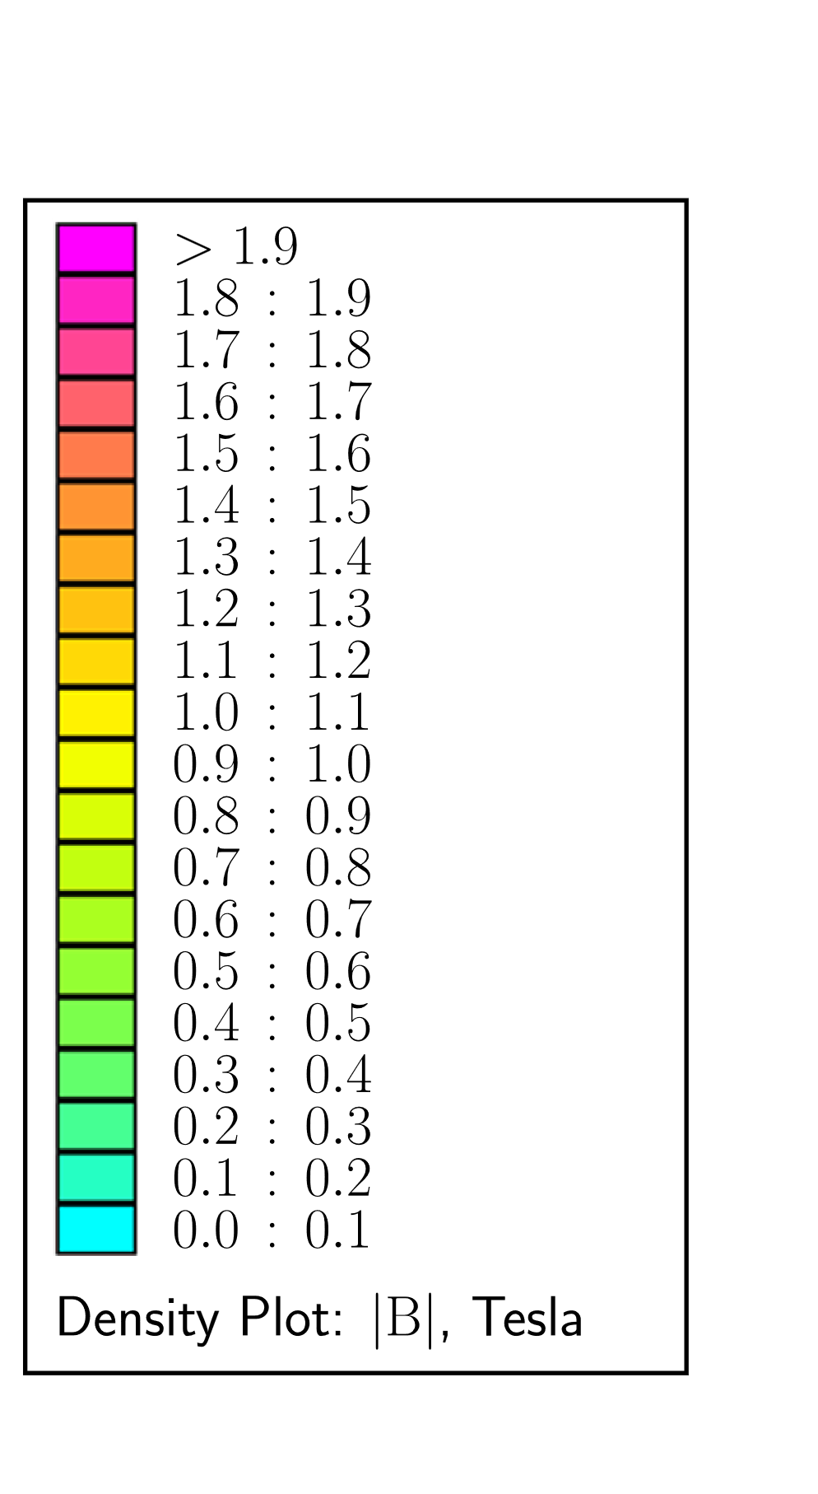
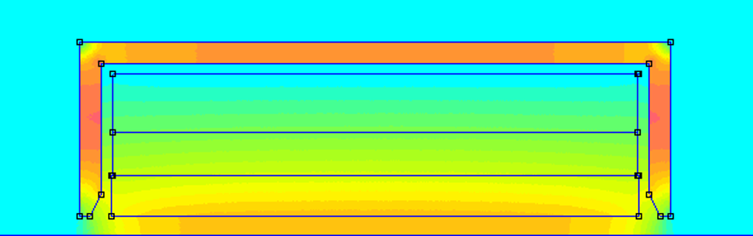
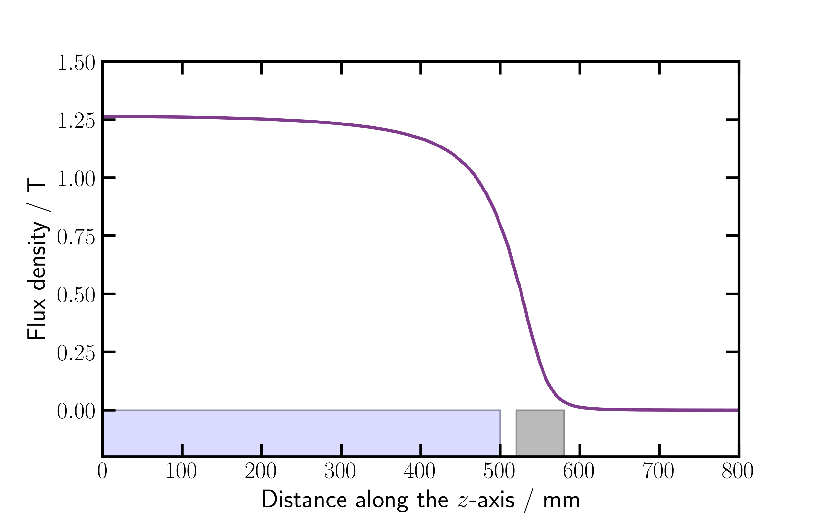
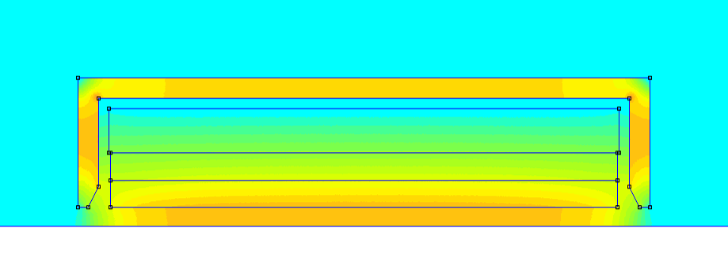

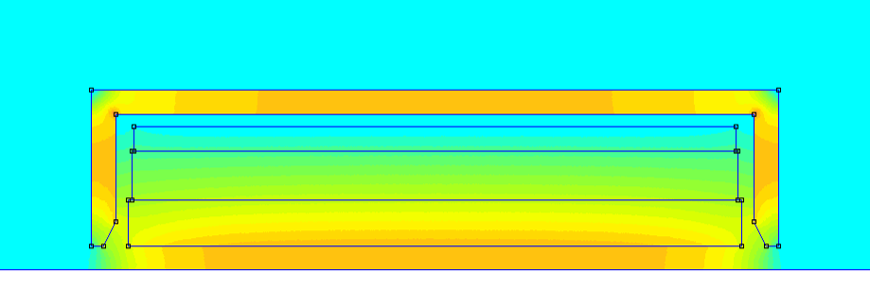
2D FEMM Models
Field on axis
400 A
400 A
coil
cover
1000 A
1000 A
2000 A

Slide 17
Possible issues

Slide 18
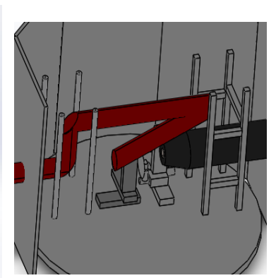
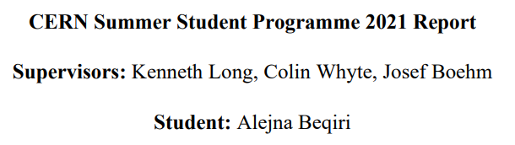
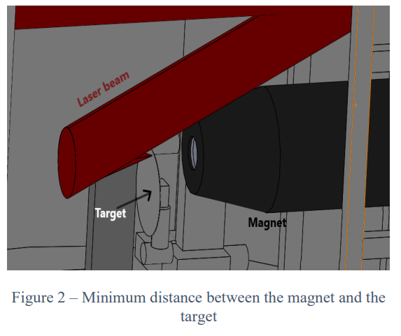
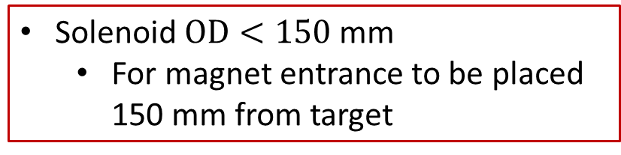
Space constraints for the 1st solenoid in the beamline
Solenoid $OD<150$ mm
For magnet entrance to be placed 150 mm from target
Different laser incidence angle envisioned for LhARA
Design will probably allow for more space downstream of target

Slide 19
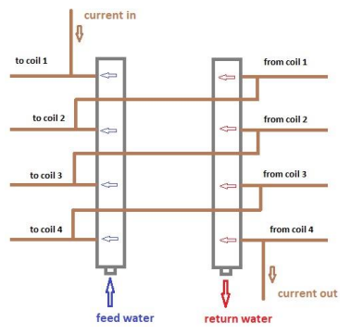
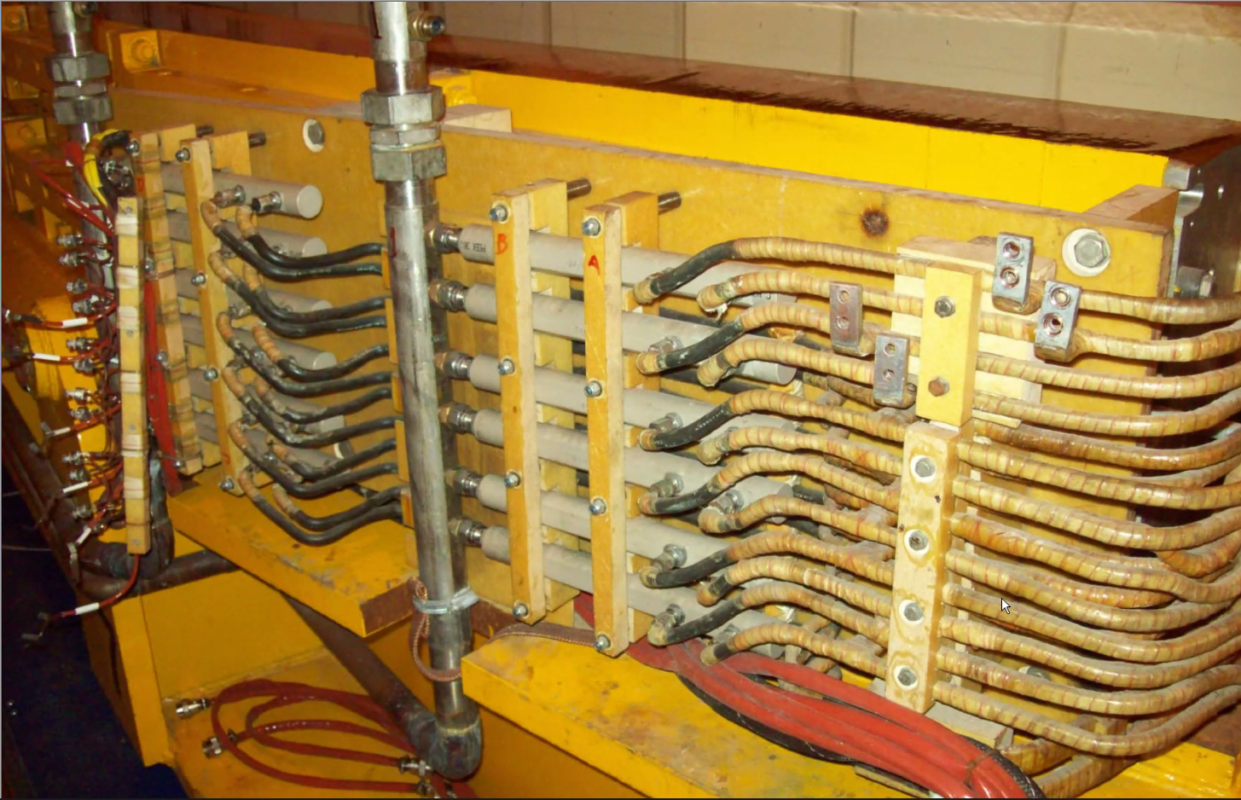
Coolant manifold and electricity separation
CERN-SHiP-NOTE-2019-004

Slide 20
Backup

Slide 21
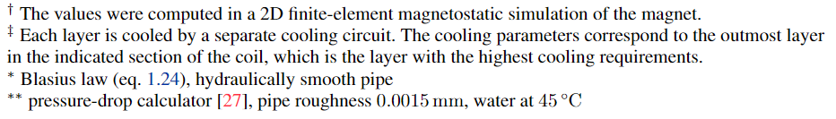
Table legend

Slide 22
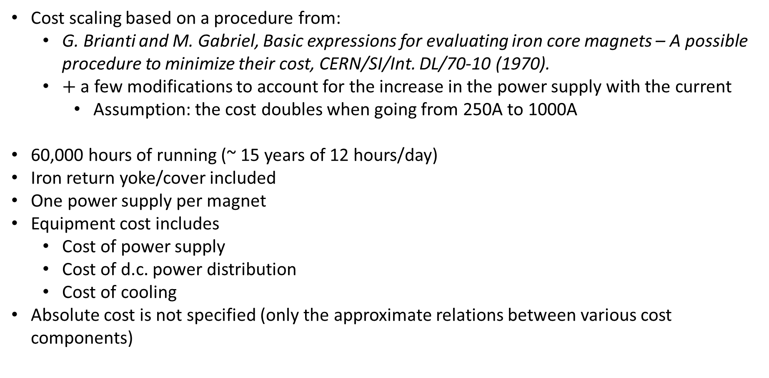
Estimate of the cost scaling
Cost scaling based on a procedure from:
G. Brianti and M. Gabriel, Basic expressions for evaluating iron core magnets – A possible procedure to minimize their cost, CERN/SI/Int. DL/70-10 (1970).
$+$ a few modifications to account for the increase in the power supply with the current
Assumption: the cost doubles when going from 250A to 1000A
60,000 hours of running (~ 15 years of 12 hours/day)
Iron return yoke/cover included
One power supply per magnet
Equipment cost includes
Cost of power supply
Cost of d.c. power distribution
Cost of cooling
Absolute cost is not specified (only the approximate relations between various cost components)

Slide 23
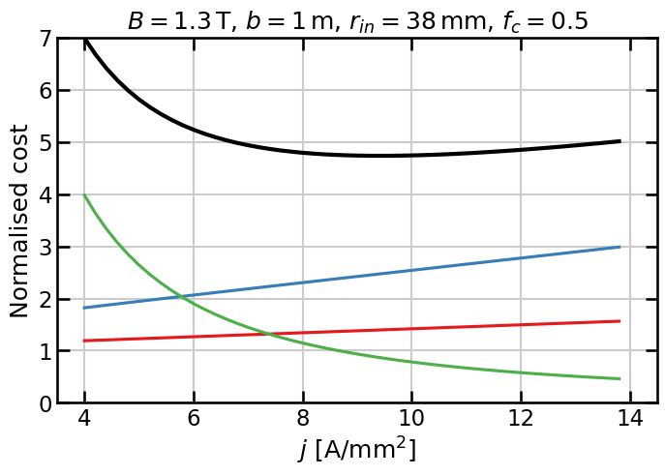
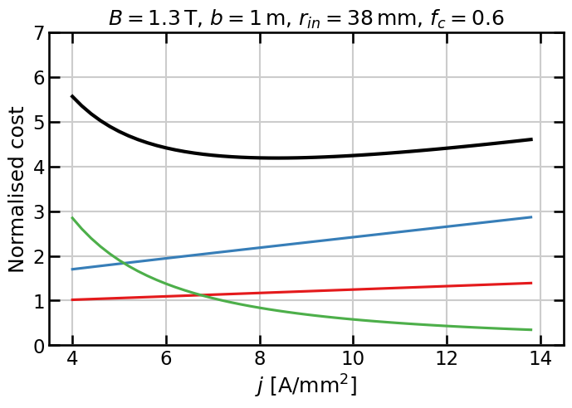
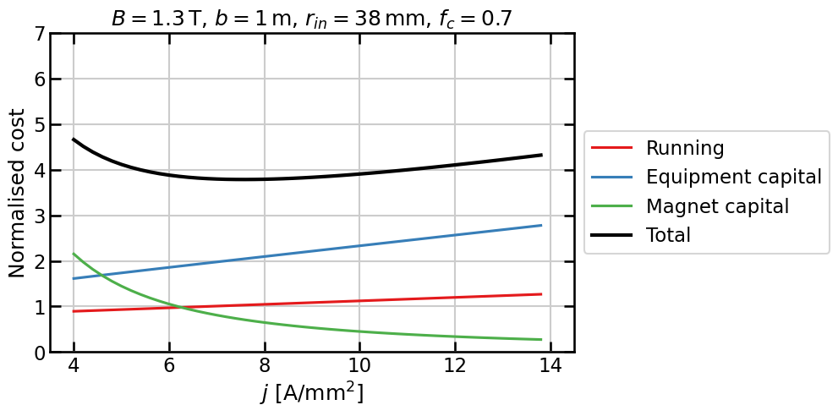
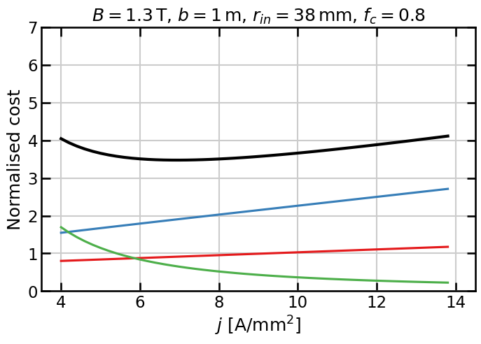
Estimate of the cost scaling (per magnet)

Slide 24
Alternatives

Slide 25
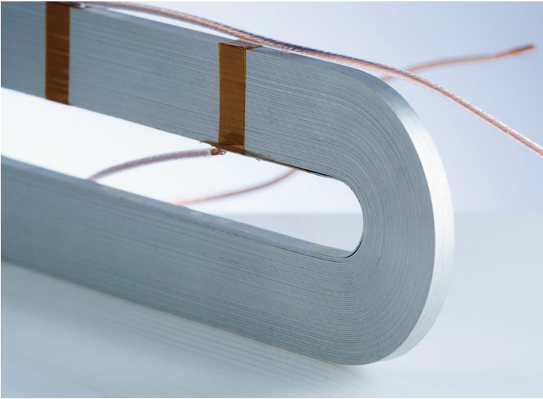
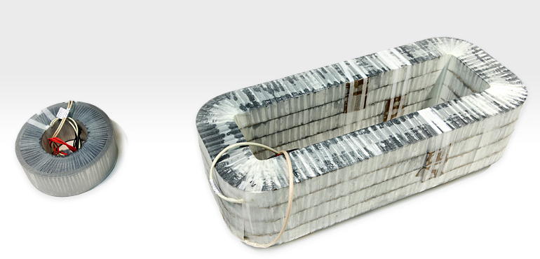

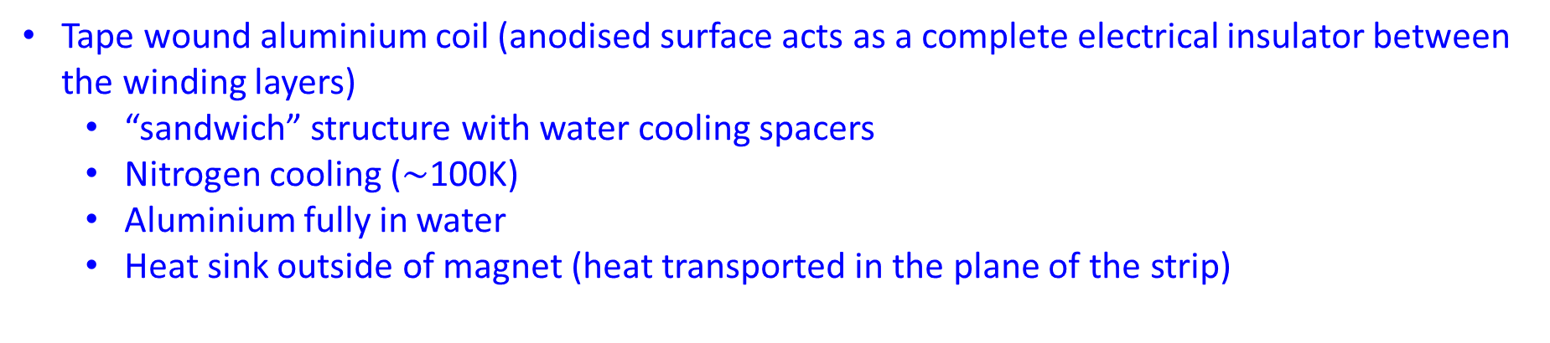
Alternative designs
Tape wound aluminium coil (anodised surface acts as a complete electrical insulator between the winding layers)
“sandwich” structure with water cooling spacers
Nitrogen cooling ($\sim$100K)
Aluminium fully in water
Heat sink outside of magnet (heat transported in the plane of the strip)

Slide 26
Alternative designs
Tape wound aluminium coil
Pros
Save space and complexity
Heat exchanger/cooling circuit is simpler and independent of the electric conductor
Coil is about 1/3rd of the weight of copper
Coils of very large size (4m x 1.5m) have been made, but not necessarily with the external cooling facility
Cons
Lower electrical conductivity, so larger coil is needed
Strip structure needs to be rigid in the region of contact with the heat sinks to avoid damage to the interface
Use of very large Al coils is not as well established as the more conventional copper coils

Slide 27
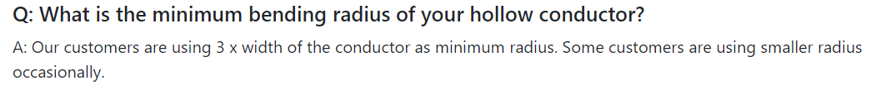

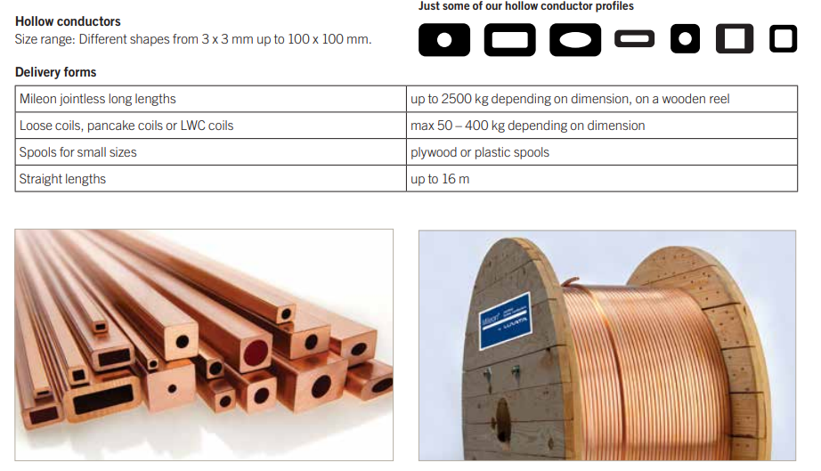
Manufacturer

