Slide 1
WP5 Beamline Instrumentation
23/11/2021

Slide 2
0-2 Year Plan
Deliverables
List of R&D requirements to enable development of monitors during years 3-5
Endstations designed for integration with beam line, monitoring systems and acoustic imaging with automated stages for cell irradiations
Wishlist/requirements from imaging group to study cellular level changes
Commisioned beamline for phase 2 experiments
3-5 Year Plan
Deliverable
Layout of Lhara beam delivery system with BPMs, magnets, dosimetry equipment locations identified and technology developed
Proven technology developed and tested which capable of monitoring Lhara beams on a pulse-by-pulse basis in real time with a plan for integration into the accelerator feedback
Demonstrate experiments using end stations including cells and dose monitoring from WP4
Cell imaging capabilities identified and room designed to encorporate these
UoB beam line development to enable a vertical beam line with chopped/pulsed beams
Identify Phase III requirements and technical challenges.

Slide 3
Methodology (0-2 Years)
Assess current beam monitoring technology and identify the required R&D for Lhara beams
SciWire 1D planes (JM)
Gas profiler (CW)
IRRAD BPM (FR et al @ CERN)
Pot of money for emerging groups (UoB testing)
Dosimetry such as alanine, calorimeters etc. (NPL/TP)
Design environmental end stations for cell irradiations and automated handling which allow hypoxia, gas changes, automation, integration with beamline, monitoring with ionacoustic imaging (JP)
Engage with Cell Imaging community to specify requirements on in vivo cell imaging via two workshops and a white paper (RFI)
Design and construct vertical beam line and beam delivery system for testing. Will require funding external to this proposal (TP/CW/TzW)

Slide 4
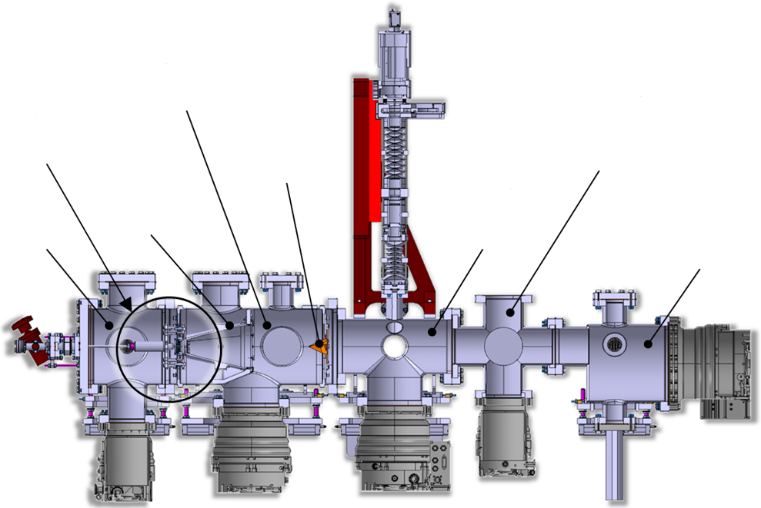
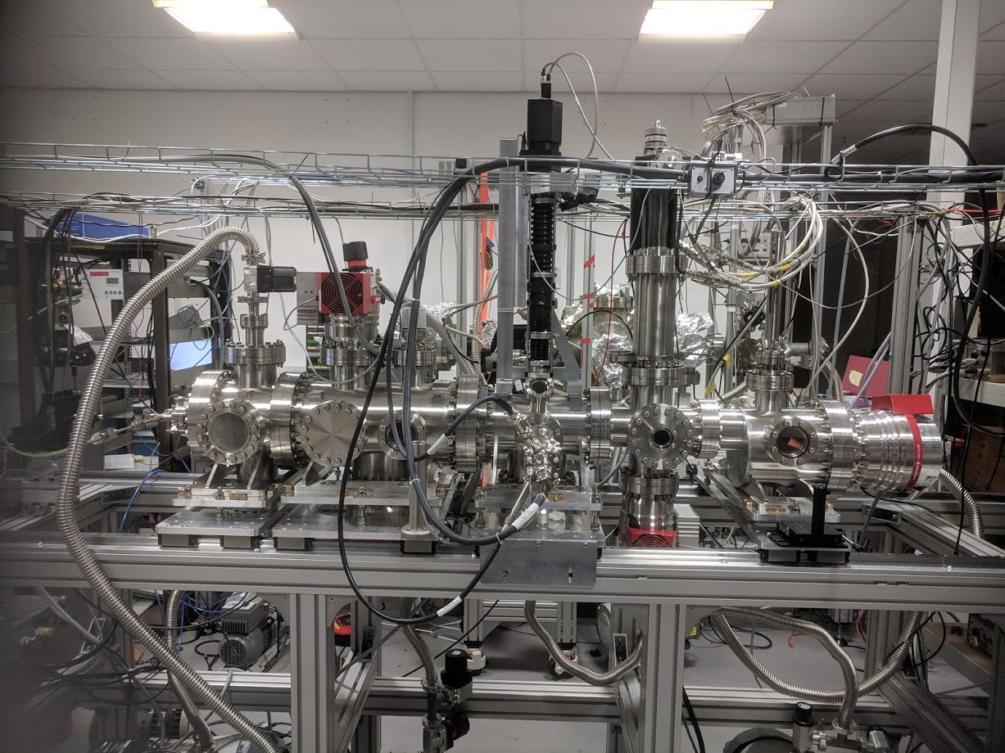

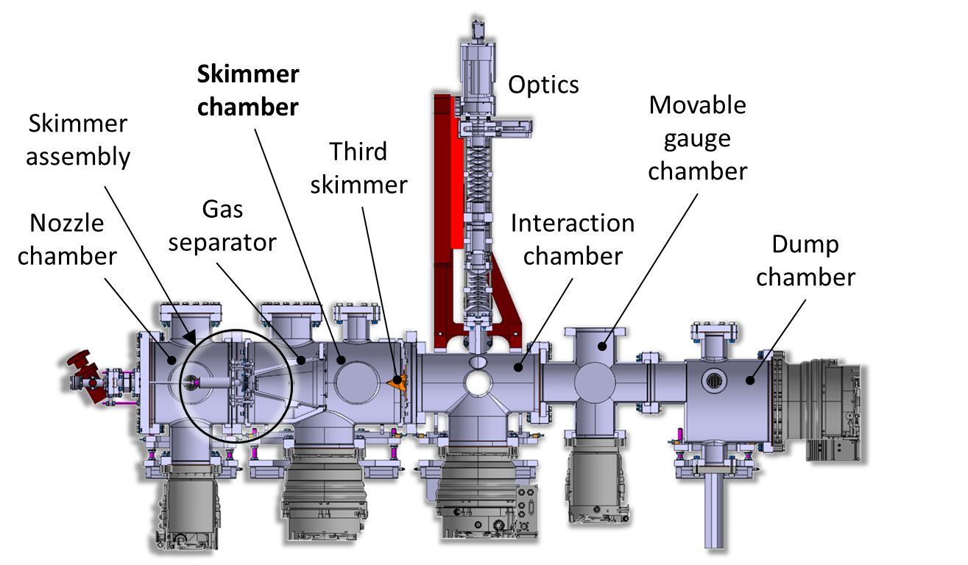



Baseline monitor for HLLHC
Skimmer Chamber
Imaging System
Moveable Gauge Chamber
Skimmer Assembly
Third Skimmer
Nozzle Chamber
Gas Separator
Interaction Chamber
Dump Chamber
~3 m
“Gas jet monitor R&D is world leading” – CI SAC (2019)

Slide 5
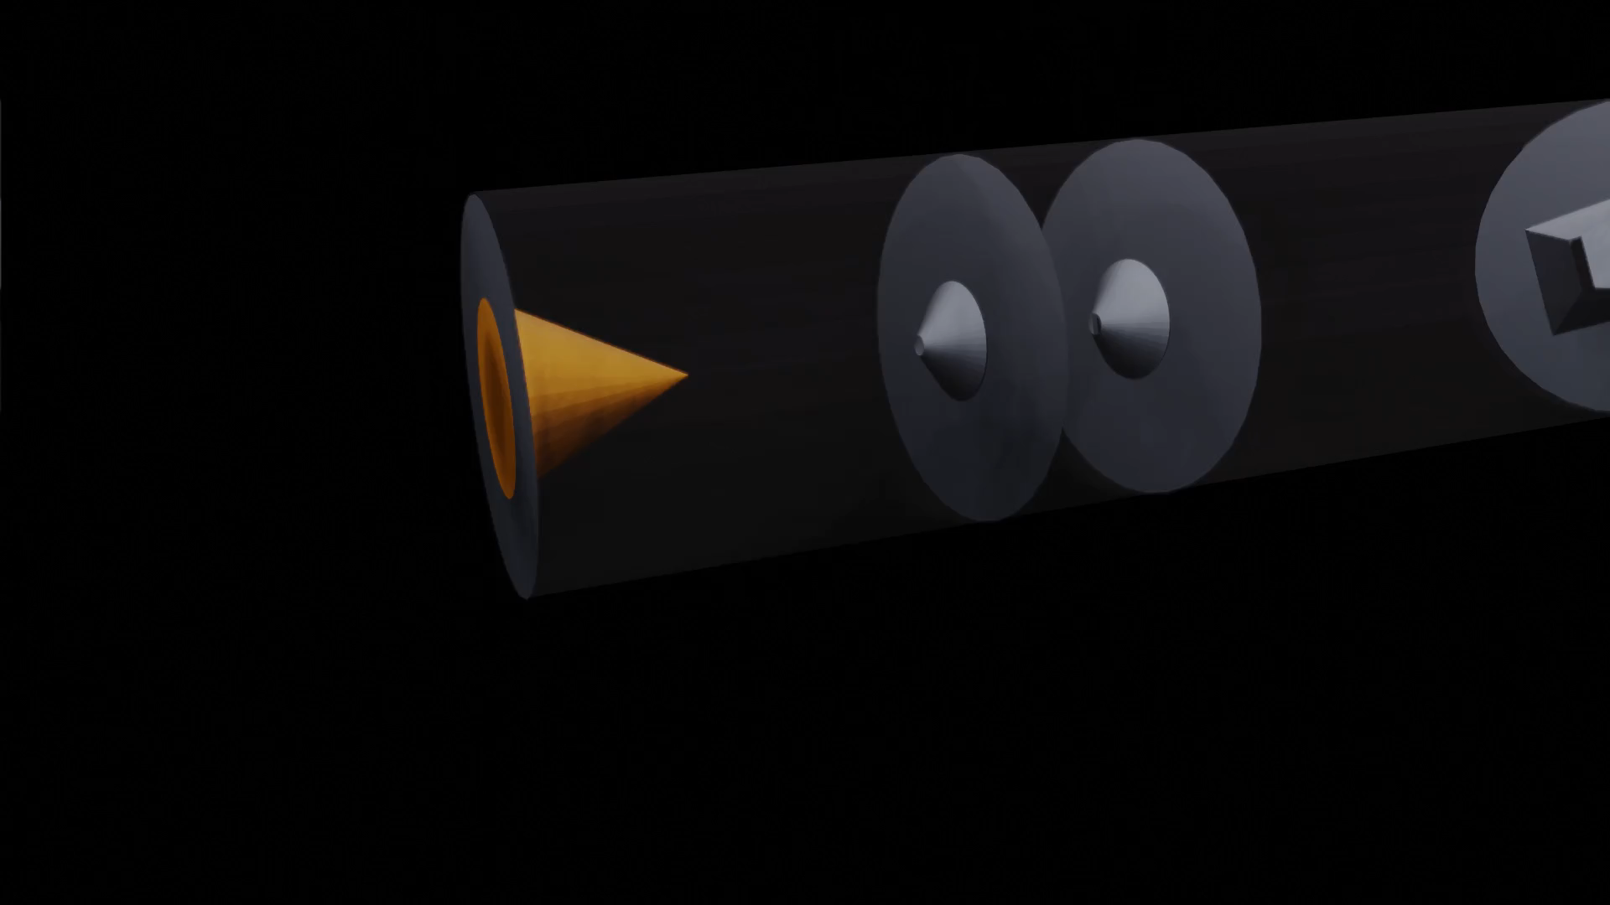
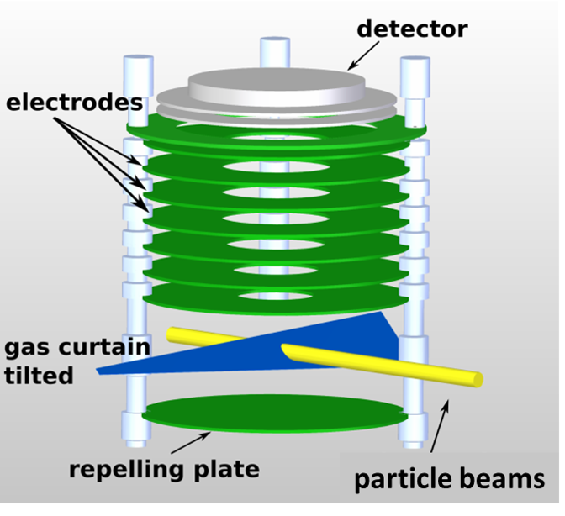
Functioning principle
Detector
Visible light
Phosphor screen
MCP
Ion extraction
Ionization
Gas jet shaping

Slide 6
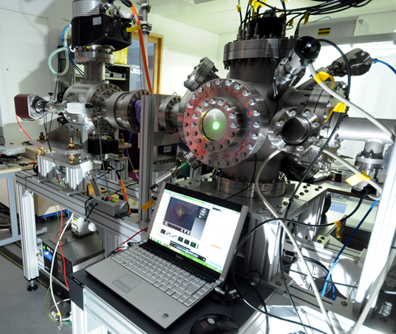
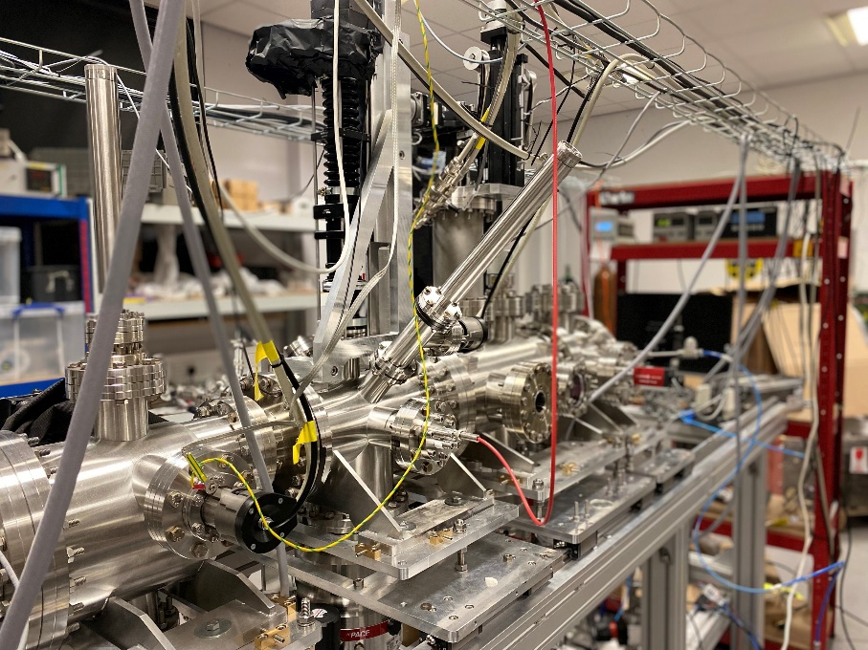
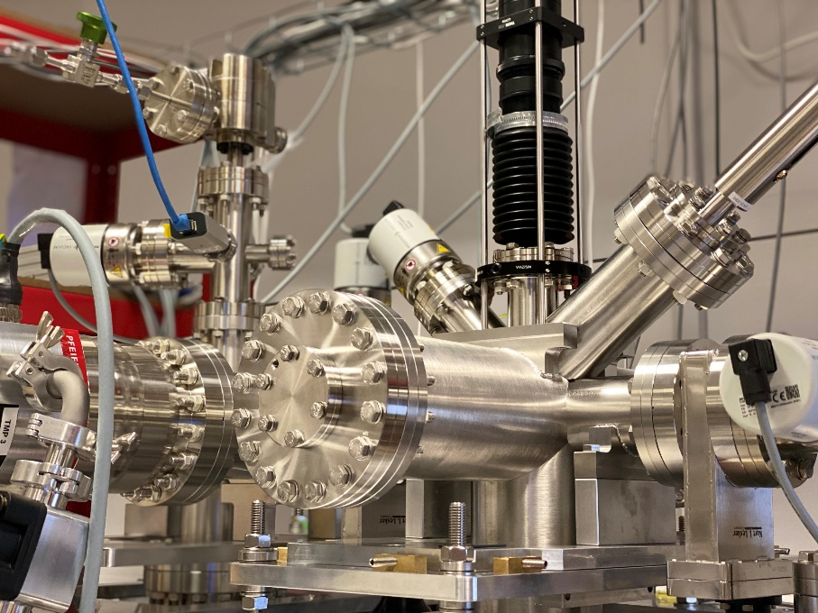
Different setups at the Cockcroft Institute
Monitor for keV beams
HLLHC prototype
HLLHC working instrument

Slide 7
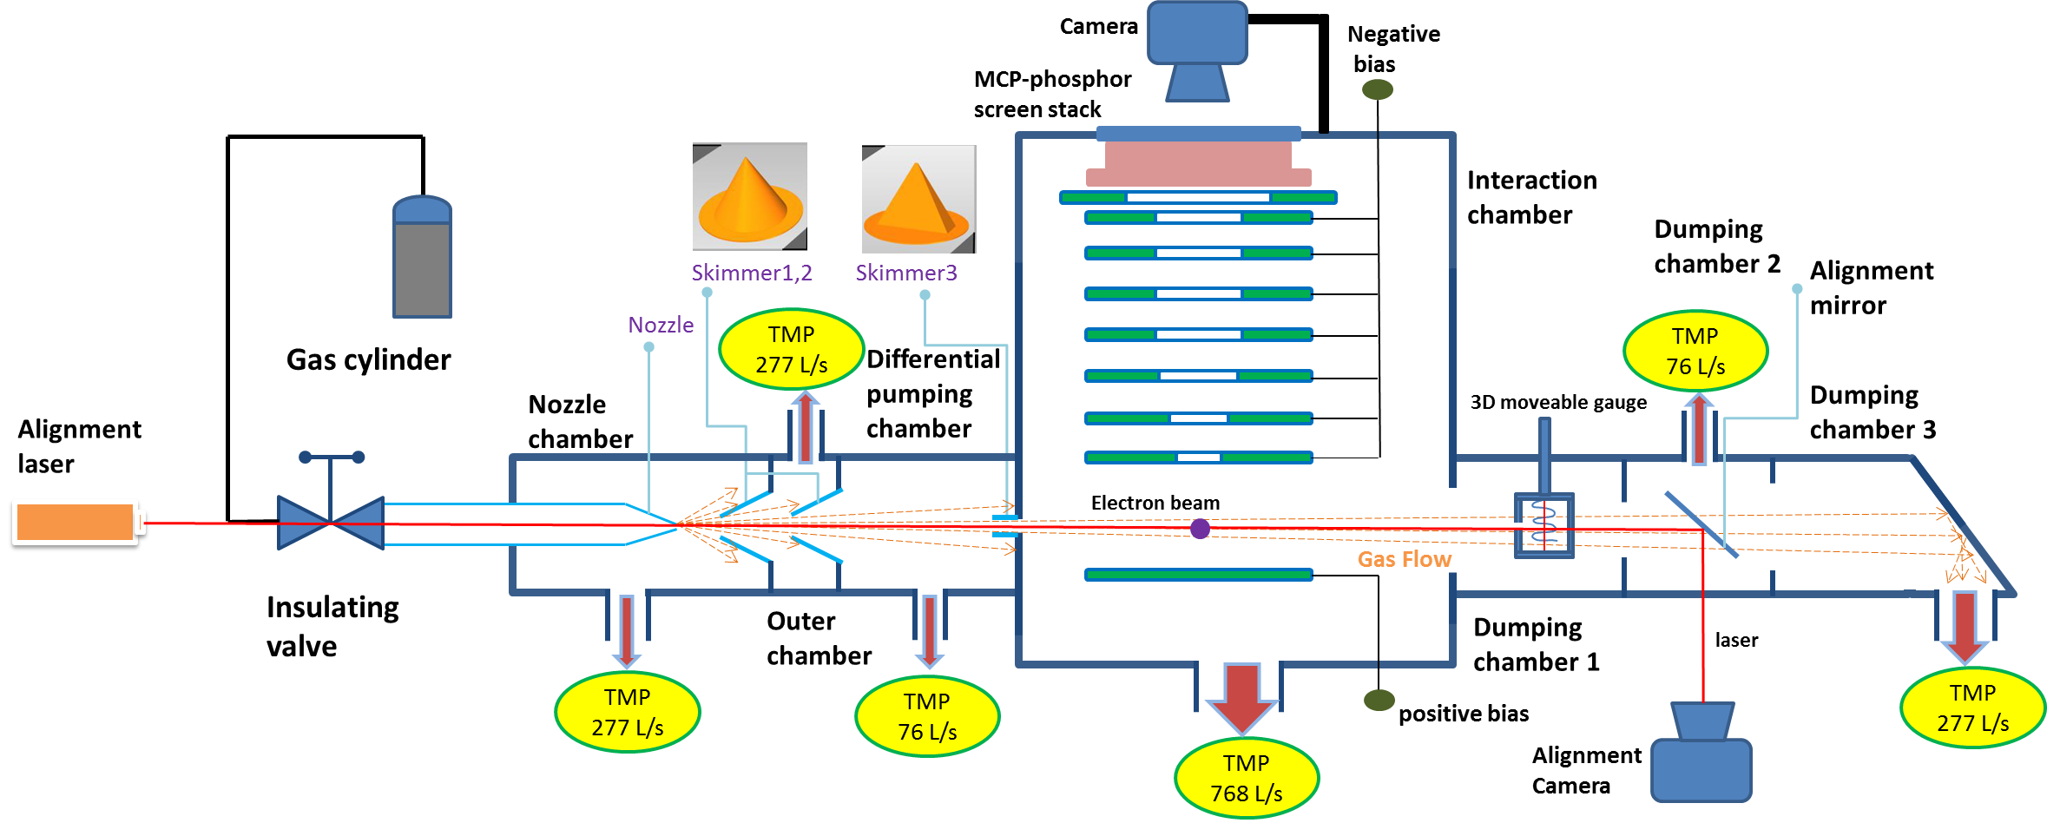
Gas jet monitor - overview
Design and first operation of a supersonic
gas jet-based beam profile monitor
V Tzoganis, H D Zhang, A Jeff and C P Welsch
Phys. Rev. Accel. Beams 20, 062801 (2017)

Slide 8
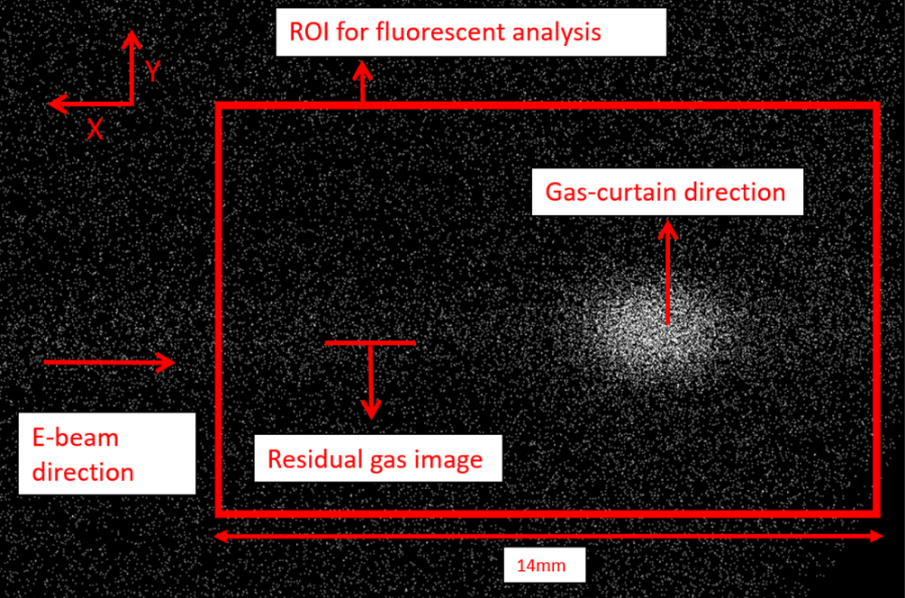
Example measurement

Slide 9
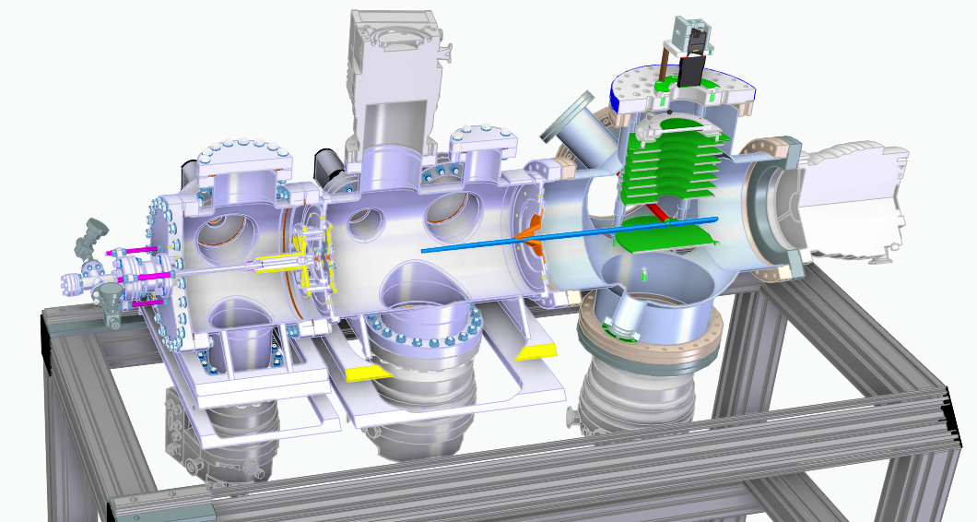
Simplified version (preliminary design)
Camera
Phosphor screen
MCP
Electrodes
Gas jet
Proton beam
High E-field

Slide 10
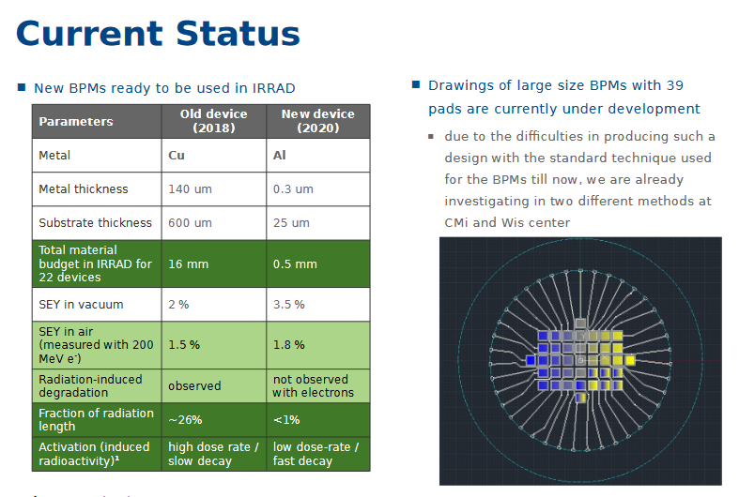
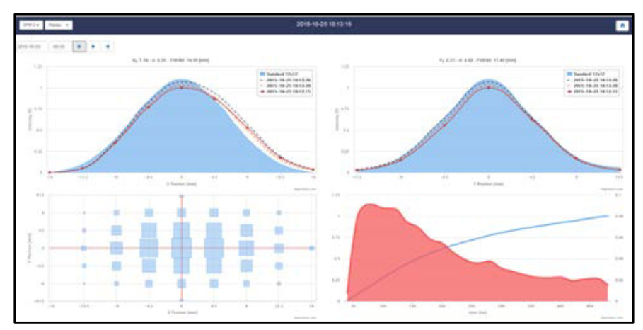
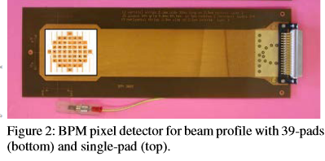
IRRAD BPM
Used to monitor intensity and profile of pulses at the IRRAD irradiation facility at CERN
Relies upon secondary electron emission from a metal when proton beam is incident upon it
Readout of each channel via dedicated electronics

Slide 11
Methodology (0-2 Years)
Assess current beam monitoring technology and identify the required R&D for Lhara beams
SciWire 1D planes (JM)
Gas profiler (CW)
IRRAD BPM (FR et al @ CERN)
Pot of money for emerging groups (UoB testing)
Dosimetry such as alanine, calorimeters etc. (NPL/TP)
Design environmental end stations for cell irradiations and automated handling which allow hypoxia, gas changes, automation, integration with beamline, monitoring with ionacoustic imaging (JP)
Engage with Cell Imaging community to specify requirements on in vivo cell imaging via two workshops and a white paper (RFI)
Potential of TP to apply for some funding through UoB to work with RFI
Design and construct vertical beam line and beam delivery system for testing. Will require funding external to this proposal (TP/CW/TzW)

Slide 12
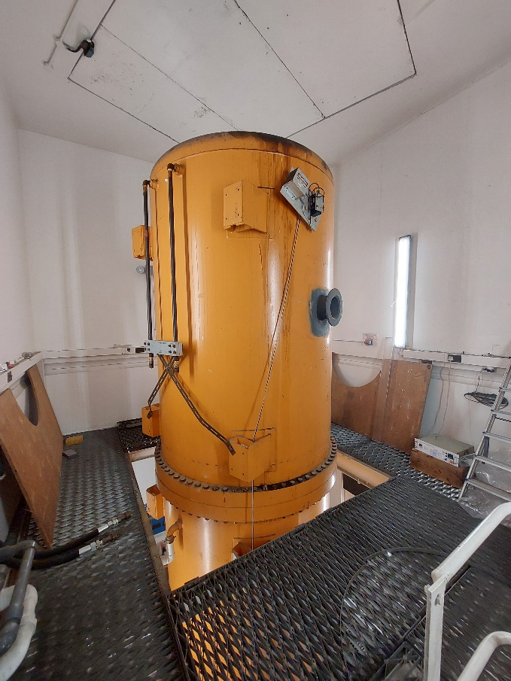
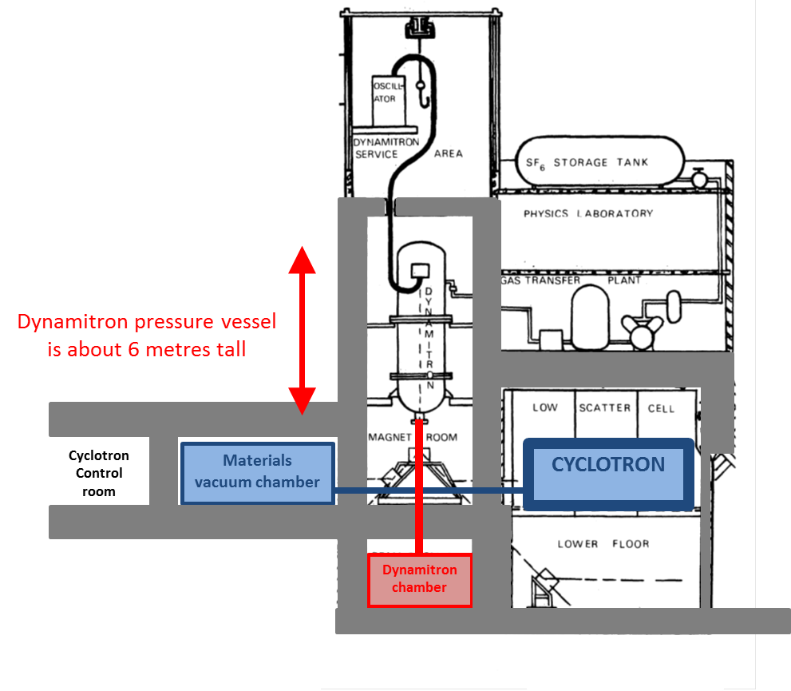
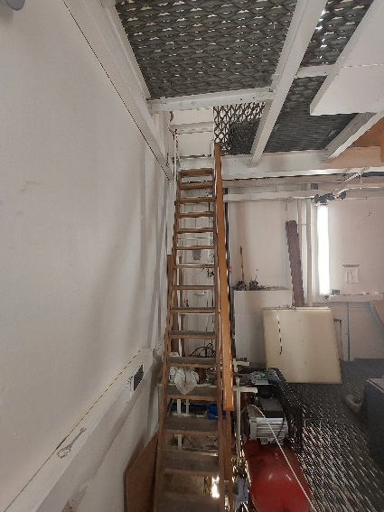
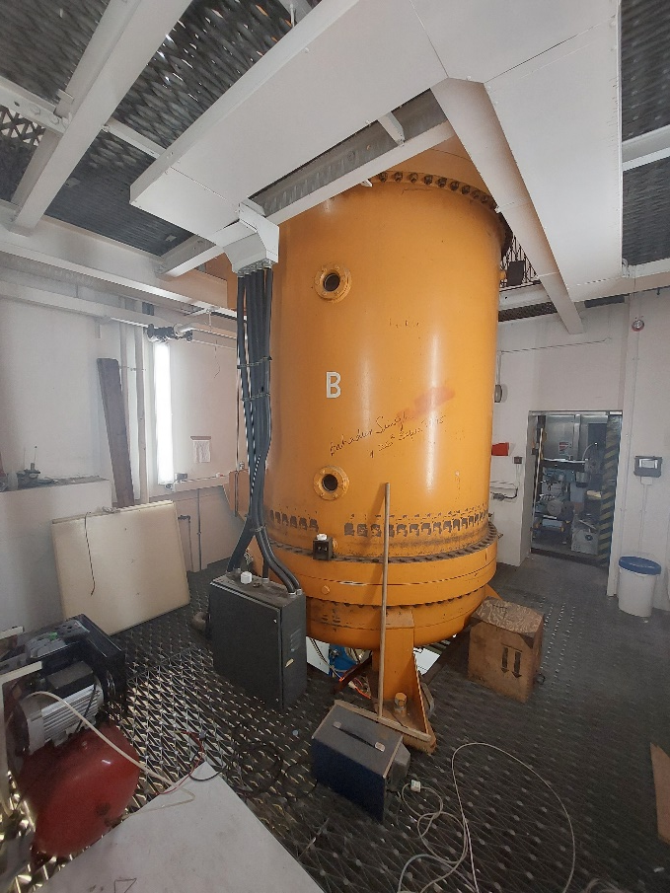
Beamline space

Slide 13
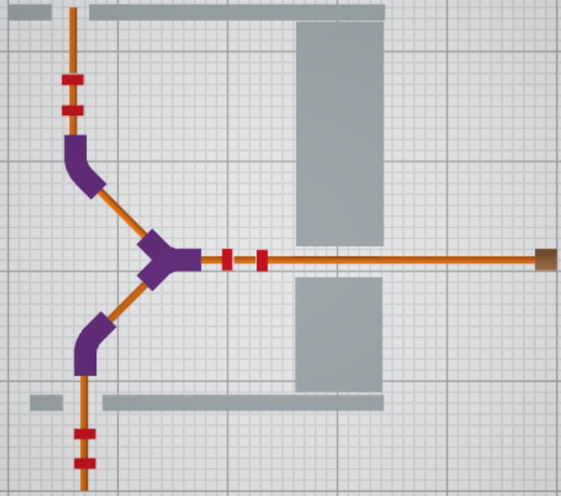
Structure 2
Studies by CERN student Rasim Mamutov
- Quadrupole
- Dipole
Wall
2.6 m
3 m
Wall
1.36 m
Floor
2.86 m
5 m

Slide 14
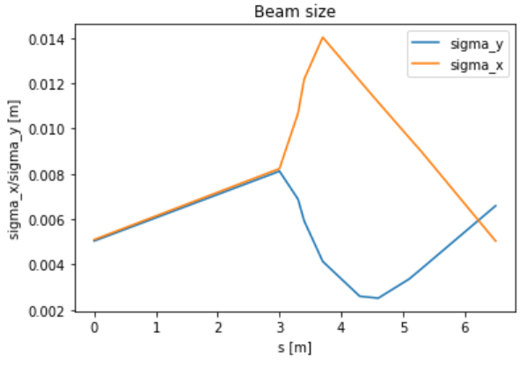
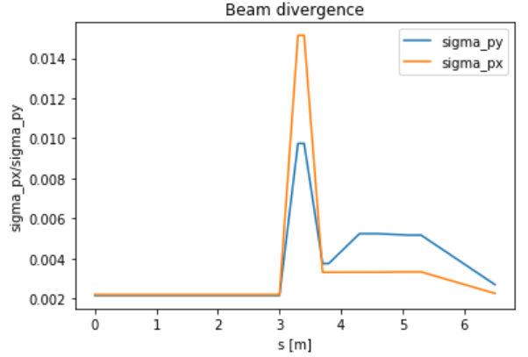
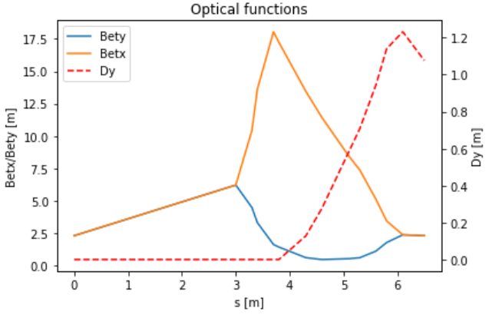
Particle tracking
Studies by CERN student Rasim Mamutov
 | E, MeV | mc, mev | rigidity, T*m | angle 30, rad | field integral, 30 deg | dipole length, m | dipole field, T | angle 60, rad | field integral 60 deg | beamline length, m | dipole length, m | dipole field, T
proton | 10 | 938.27 | 0.033356 | 0.52359 | 0.01746 | 0.5 | 0.034930 | 1.047197 | 0.034930 | ≈5 horiz + ≈2.6 vertical ±0.5 | 0.5 | 0.069861
alpha particle | 38 | 3727.38 | 0.063377 | 0.52359 | 0.03318 | 0.5 | 0.066368 | 1.047197 | 0.066368 | ≈5 horiz + ≈2.6 vertical ±0.5 | 0.5 | 0.132736
Initially normally distributed with sigma_x/y = 5 mm, relative px/py = 2.2e-3 and ∆p/p = 4.2e-3.

Slide 15
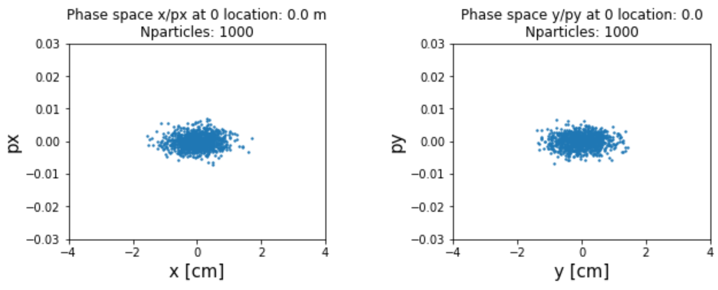
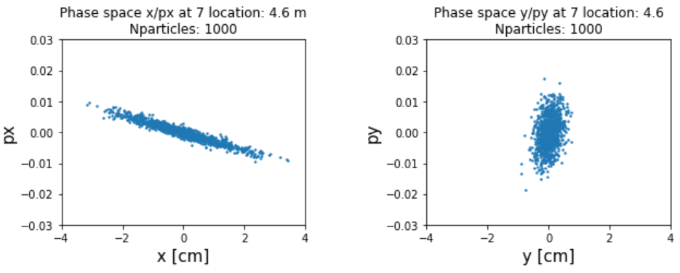
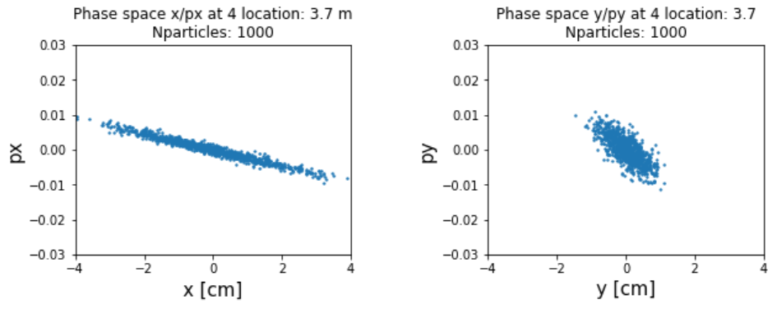
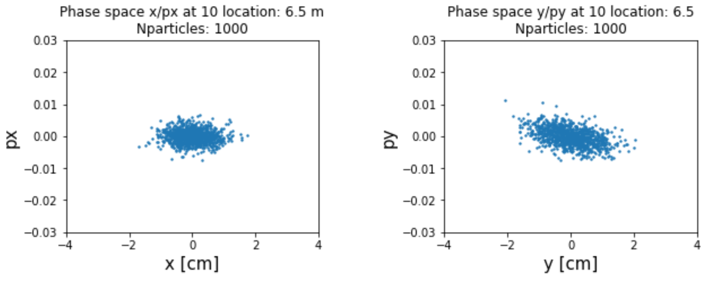
Phase space
Studies by CERN student Rasim Mamutov
Phase space at different locations. 0/10 location stands for start/end.

Slide 16
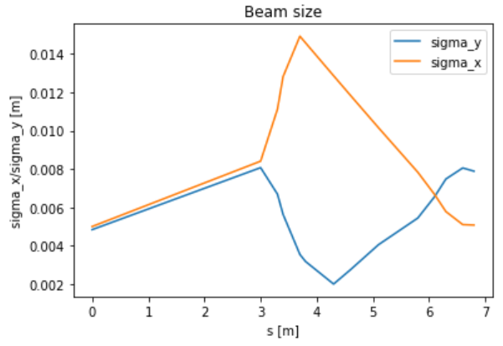
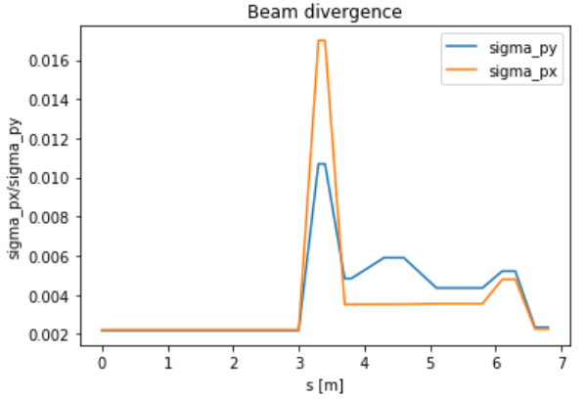
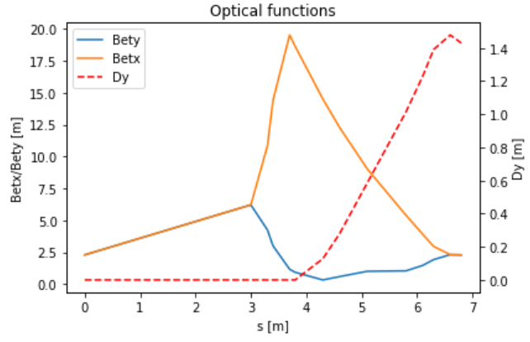
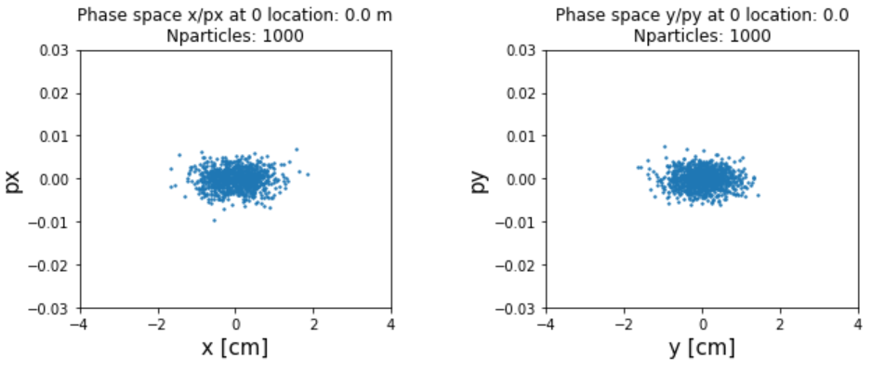
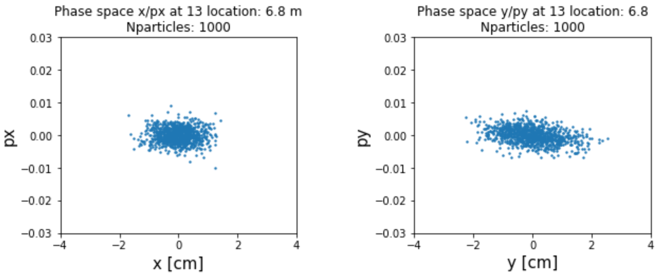
Particle tracking for the downwards beamline
Studies by CERN student Rasim Mamutov

