Slide 1


Proton minibeam radiation therapy
Yolanda Prezado, PhD, HDR
Institut Curie

Slide 2
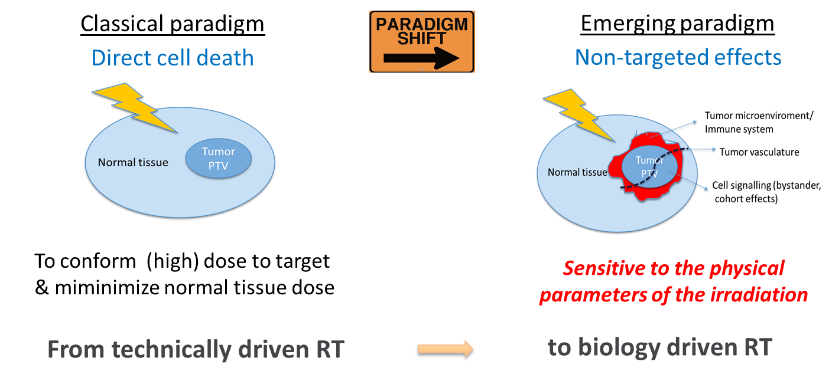
Radiotherapy: a paradigm shift in the 21th century

Slide 3
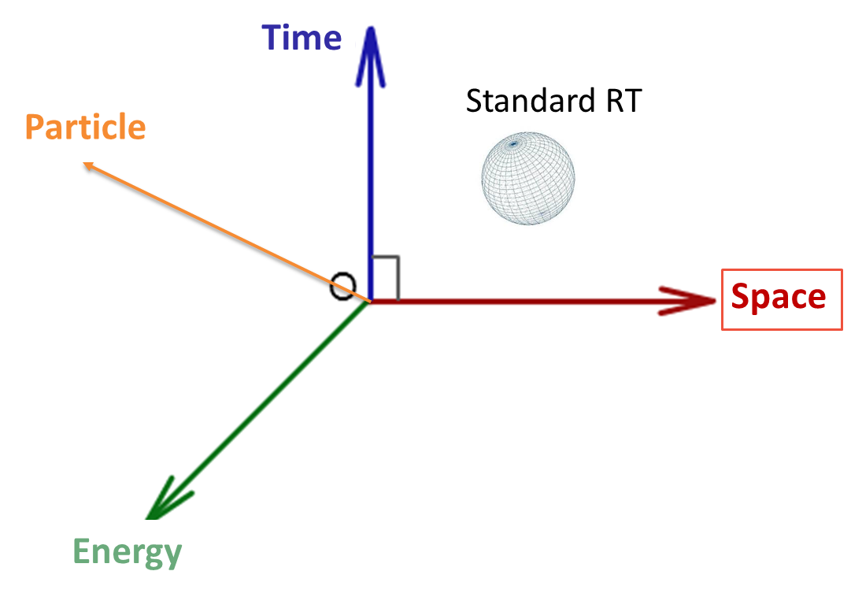
Radiotherapy: a paradigm shift in the 21th century

Slide 4
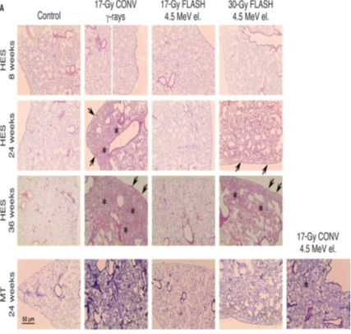
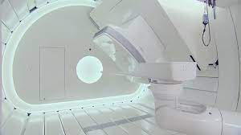
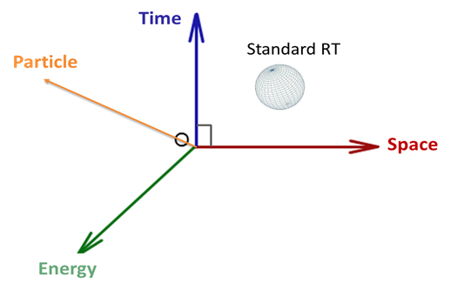
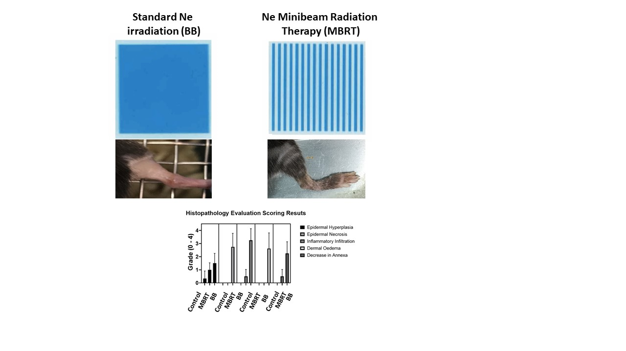
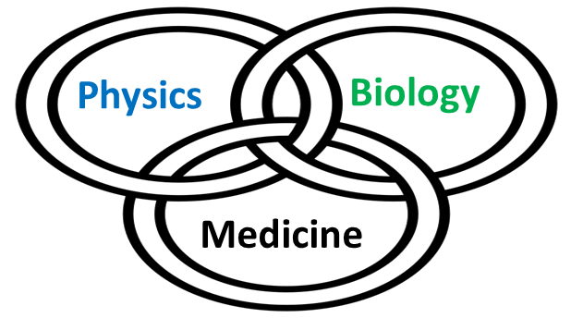
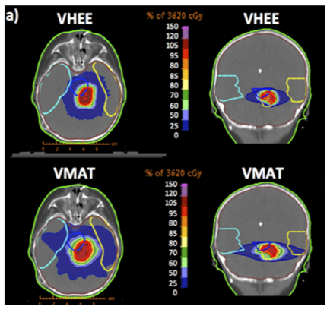
Radiotherapy: a paradigm shift in the 21th century
FLASH therapy
Charged particle therapy
Favaudon 2014
Spatially fractionated RT
Very high energy electrons
Notes:
Nanorain

Slide 5
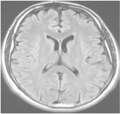
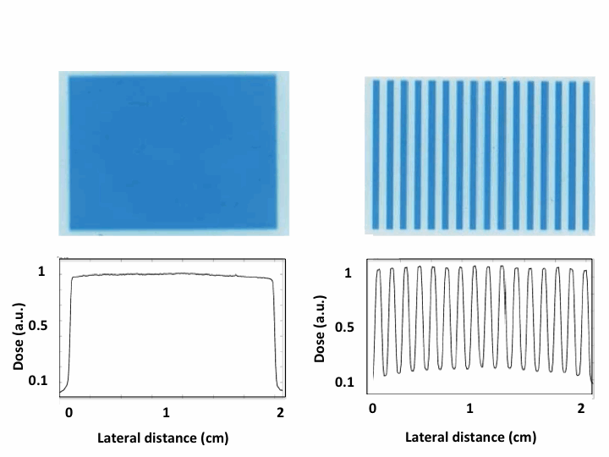
Spatially Fractionated Radiation Therapy (SFRT)
large fields (≥ 1 cm)
laterally homogeneous dose distributions
field composed of smaller beamlets
laterally heterogeneous dose distributions
(peaks and valleys)
➜ increase of normal
tissue tolerance
Standard RT
≥ 1 cm
beamlet
peak valley
SFRT

Slide 6
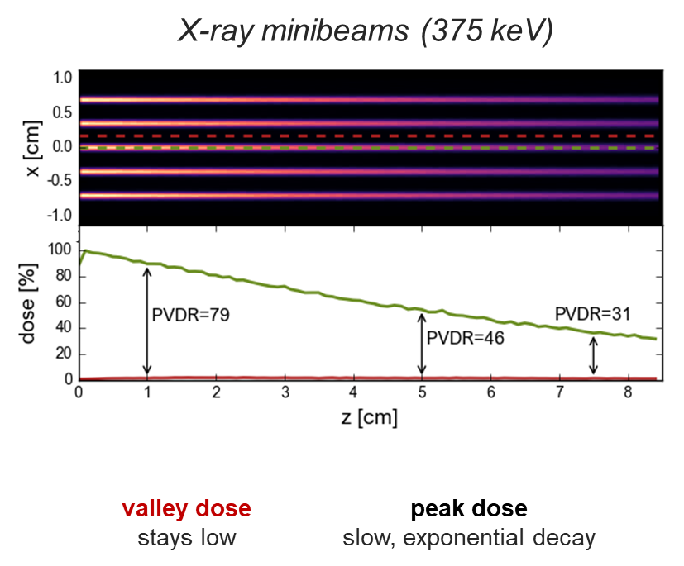
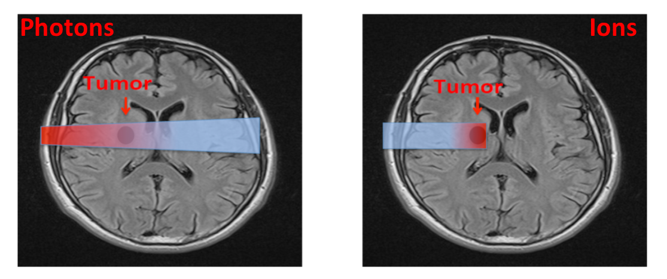
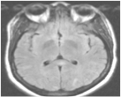
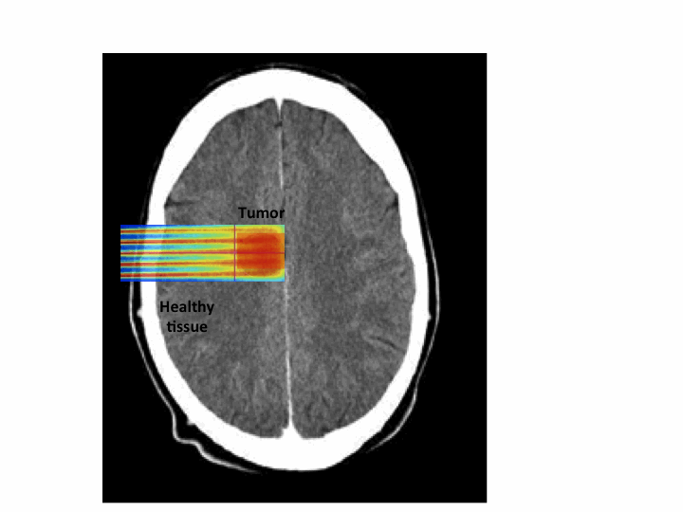
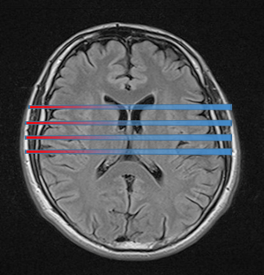
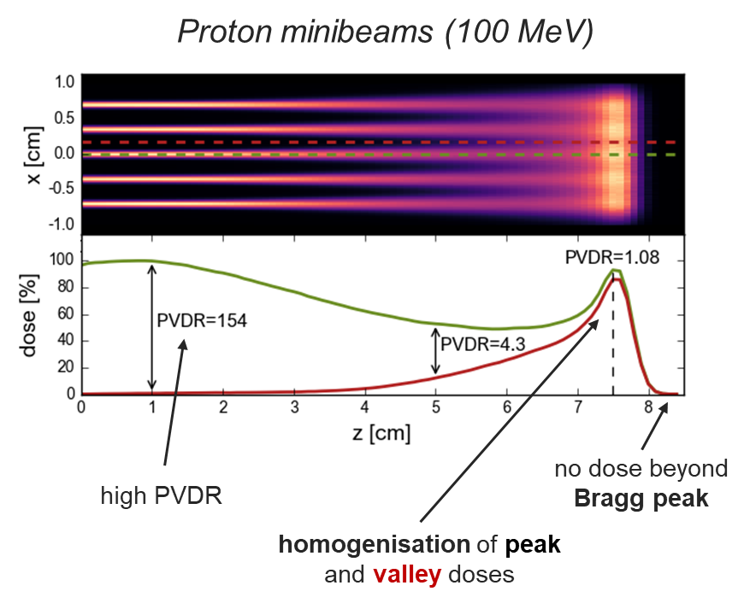
PROTONMBRT: an innovative therapeutic approach
Proton MBRT
Charged particles
Tumor
Prezado et al. 2013
Minibeam radiation therapy (MBRT)

Slide 7
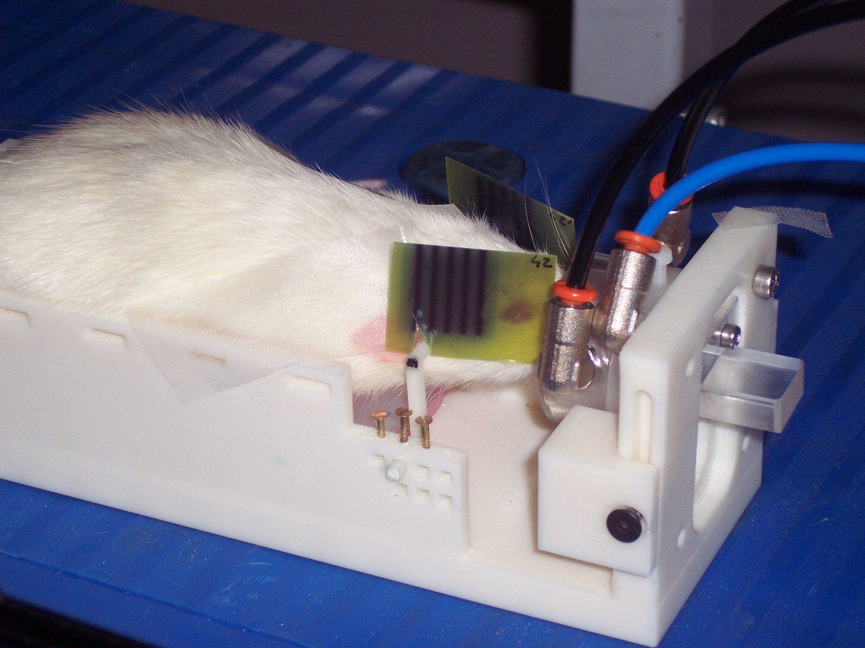
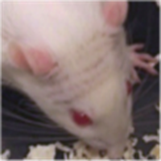
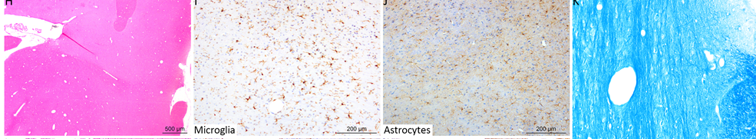
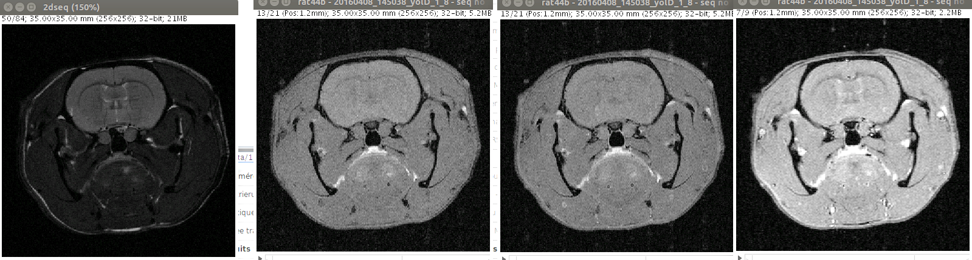
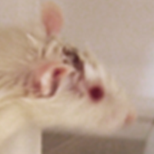
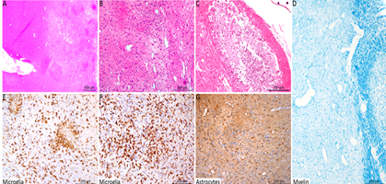
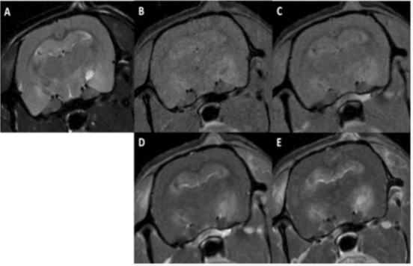
Normal tissue response: brain
First evaluation of normal brain response @ Orsay proton therapy centre (100 MeV protons, clinically relevant conditions)
Whole brain irradiations (normal rats, 7-weeks old). Long-term follow up (6 m)
Width ~ 1mm
Standard PT
(25 Gy/one fraction)
versus
pMBRT
(25 Gy average dose- 58 Gy peak dose/one fraction)
pMBRT
Standard
PT
necrosis
astrogliosis
Inflammation
demyelination
NET REDUCTION IN NEUROTOXICITY
Prezado et al. 2017, Scie. Reports 2017

Slide 8
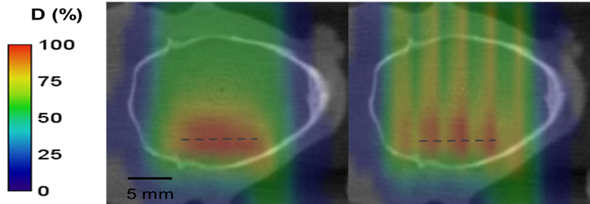
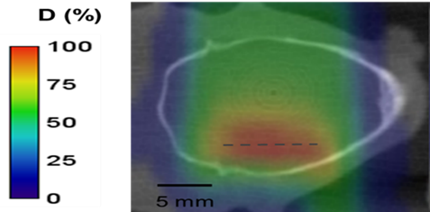
Tumor control effectiveness in glioma (RG2) bearing rats
Standard PT
Tumor
pMBRT
pMBRT → 67 % of long-term survivals (free of tumor).
Among the best results ever obtained with radiotherapy alone
Prezado et al., Red Journal 2019
Tumor
25 Gy/one fraction

Slide 9
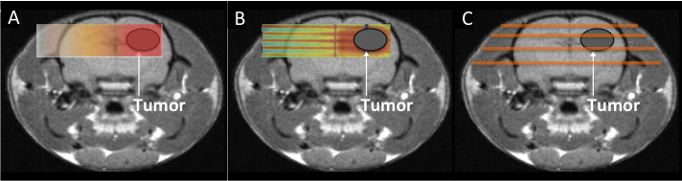
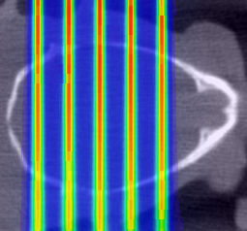
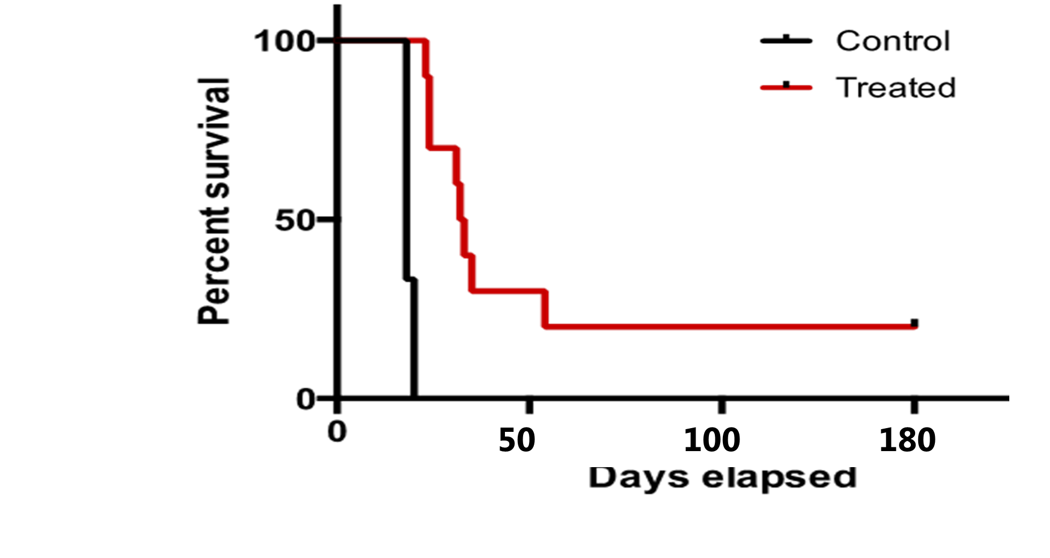
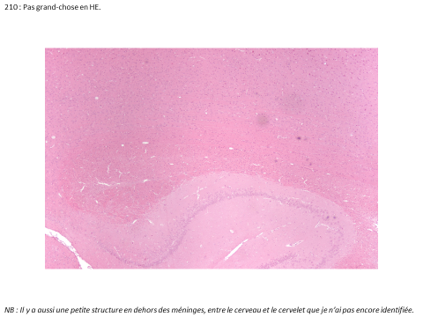
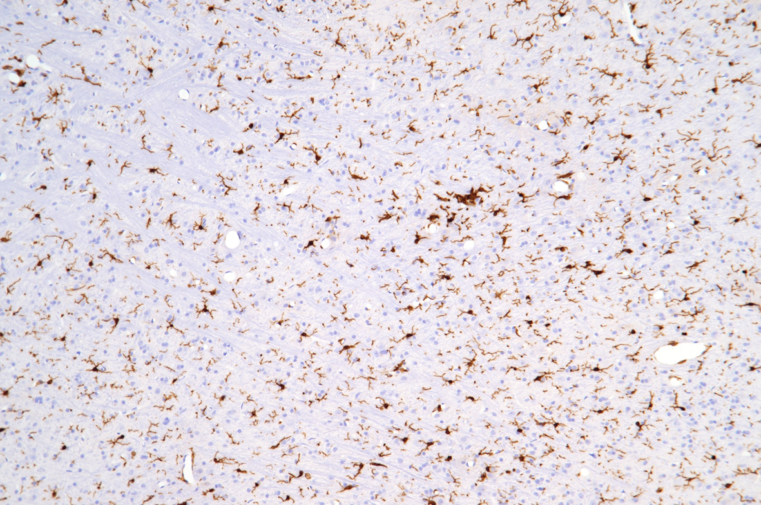
pMBRT provides tumor control even with highly heterogeneous dose distributions
3.5 mm
RG2-glioma bearing rats INHOMOGENOUS dose distribution
70 Gy in the peak, 30 Gy average
Whole brain irradiation (n=10), plateau region
Without significant toxicity
Prezado et al. Scie. Reports 2018

Slide 10
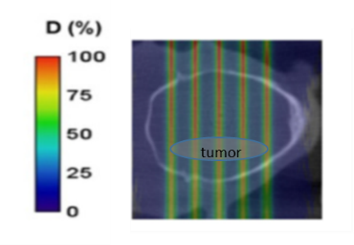
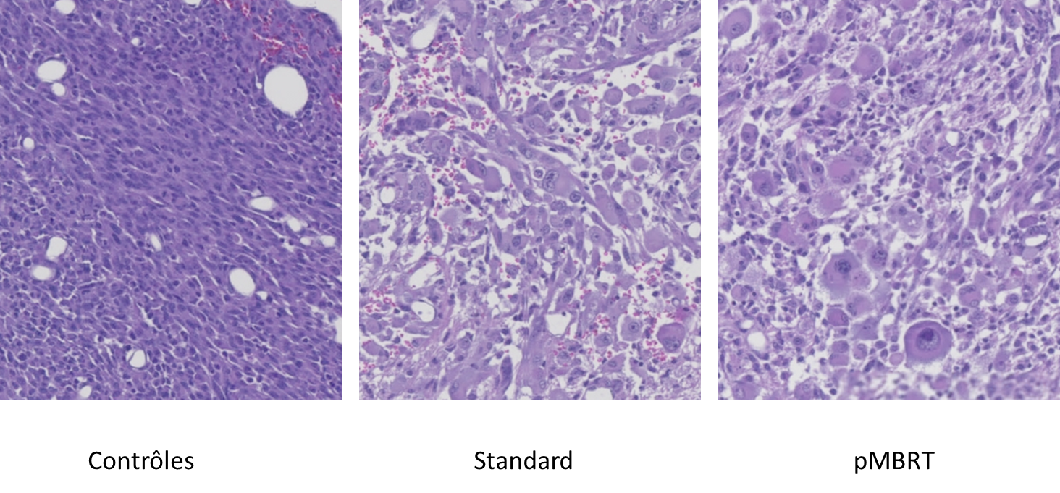
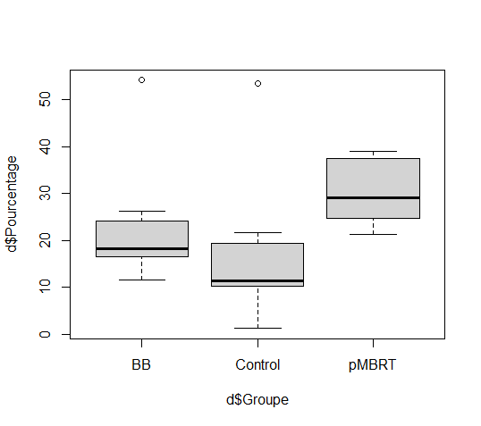
Determinant role of immune system in the anti-tumor response of pMBRT
7 days after IR
% T helpers
Ongoing…
Notes:
Morphologie 2 :
Beaucoup "d'atypies", cellules plutôt rondes avec grande diversité de morphologie cellulaire/nucléaire, mitoses anormales, etc... : 19-0774, 19-0775, 19-0776, 19-0779
Morphologie 3 :
Intermédiaire avec des cellules rondes très "atypiques" et des faisceaux : 19-0777, 19-0778, 19-0780

Slide 11
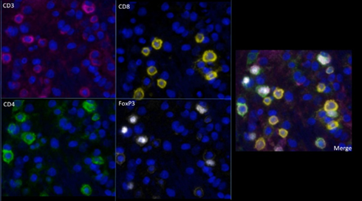
Immune infiltration at 7 days after irradiation
Multiplexing IHC
Flow cytometry
Cells/mg
Ongoing…

Slide 12
PROTONMBRT
A novel radiotherapy concept to solve an urgent medical need
The increase of the tolerance doses of normal tissue by pMBRT offers
  Potential benefit for paediatric oncology → Reduced risk of complications
  Allows dose escalation → Efficient treatment of radioresistant tumors
  Cost reduction:
  -pMBRT enables hypofractionation schemes
  -Reduced requirements of targeting
  Working towards phase I clinical trials

Slide 13
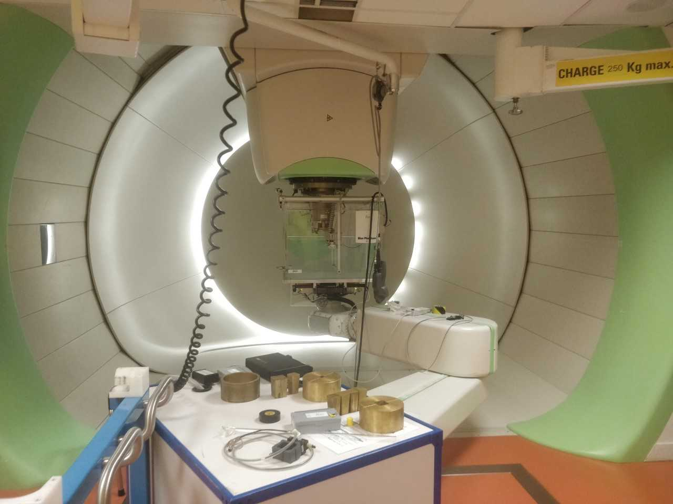
Implementation at a clinical PBSPBS
MC (TOPAS) versus IBA nano RAZOR diode
6 Gy/min
L. De Marzi et al. Med. Phys 2018

Slide 14
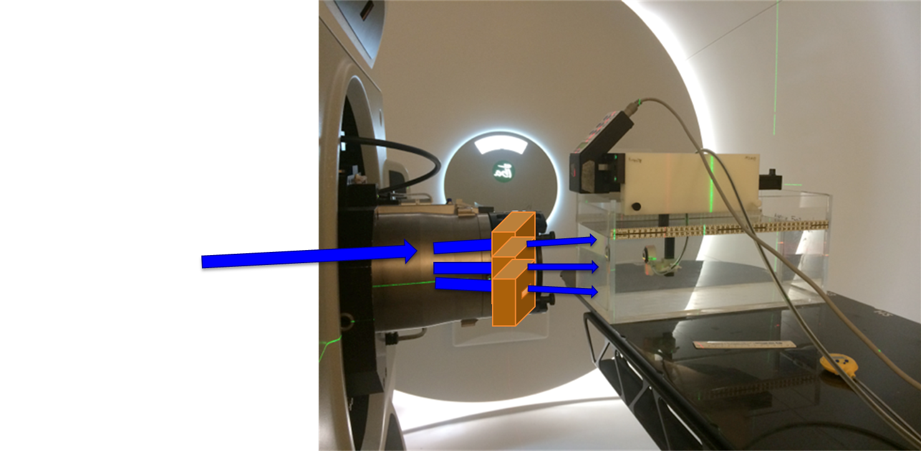
Further optimisations for proton MBRT generation
Magnetically focussed minibeams
Scanning dynamic minibeam collimator
New minibeam nozzle
Compatible with Lhara
T. Schneider et al. Scientific Reports 2020
Patent app PCT/EP2020/08276
M. Sotiropoulos et al. Scientific Reports 2021
European Patent Application number EP21306092

Slide 15
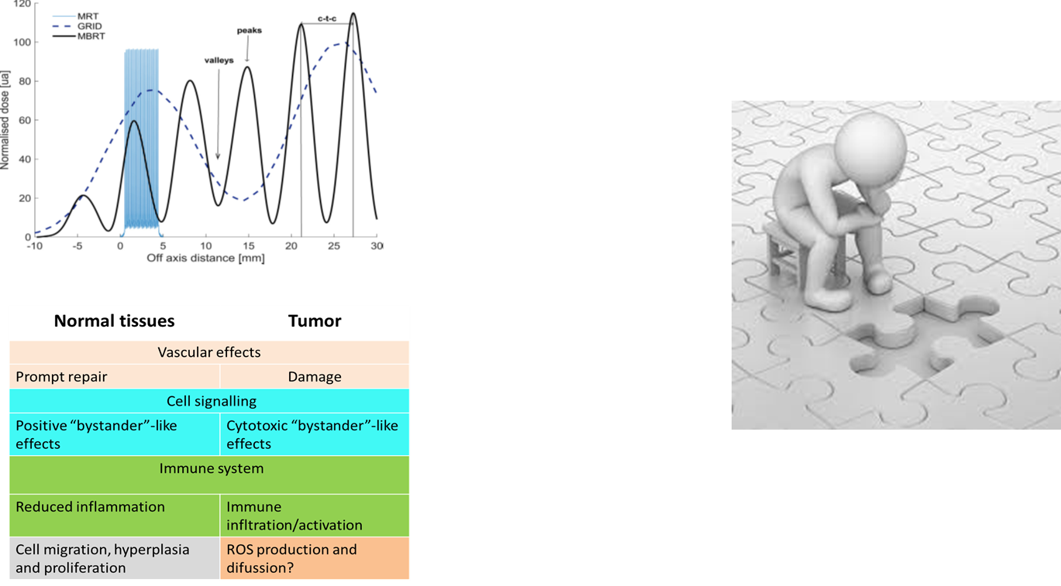
Missing the full picture

Slide 16
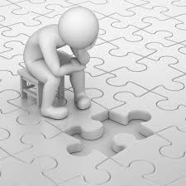
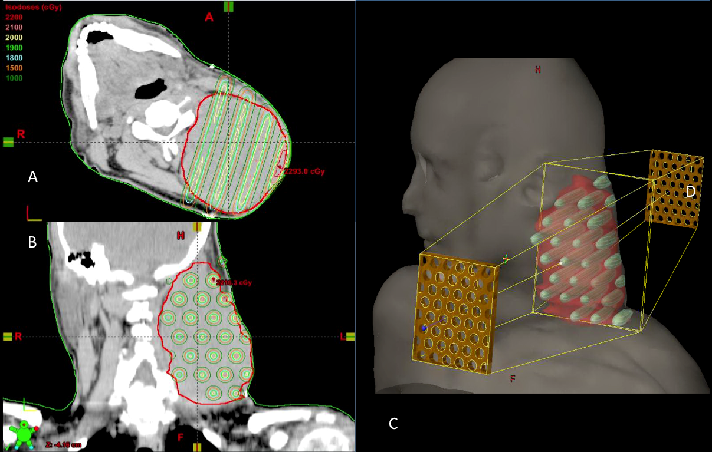
Open questions
What is the « apple to apple » comparison between SFRT and conventional RT?
Dose prescription!
  Mainly peak dose at the entrance!! Interplay between the prescription and the biology, what are the dosimetry parameters that correlate the best with tumor control/normal tissue sparing?
Temporal and spatial fractionation schemes?

Slide 17

Final reflections
The dose delivery method may have an important impact on biological response.
Not need to deposit a lethal dose in each of the tumor cells to kill it.
Non-targeted effects can play a major role in RT treatments
Charged particles (p, heavy ions) allow to fully profit from the advantages of spatially fractionated radiotherapy

Slide 18

Radiotherapy in the 21st century: borromean rings
Large field sizes
Homogeneous dose distributions
Standard RT
Mostly photons
Time fractionaction: 2 Gy/fraction,
1 fraction/day, 30-35 fractions
Particle type
Beam energy
Spatial dose distributions
Dose rate
Temporal fractionation

Slide 19

Radiotherapy in the 21st century: borromean rings
Biology
Physics
RT
Chemistry

Slide 20
Radiotherapy in the 21st century: borromean rings
Challenging dosimetry
Distinct
Biology
RT
Sophisticated
technology

Slide 21
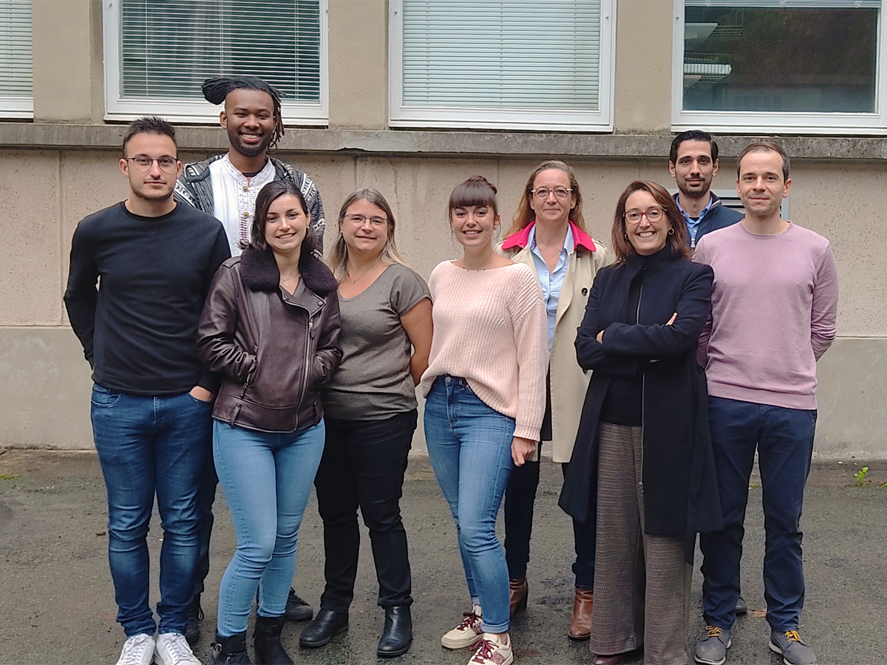

New Approaches in RAdiotherapy team (NARA)

Slide 22
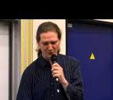
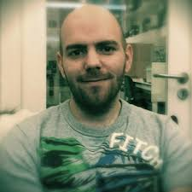
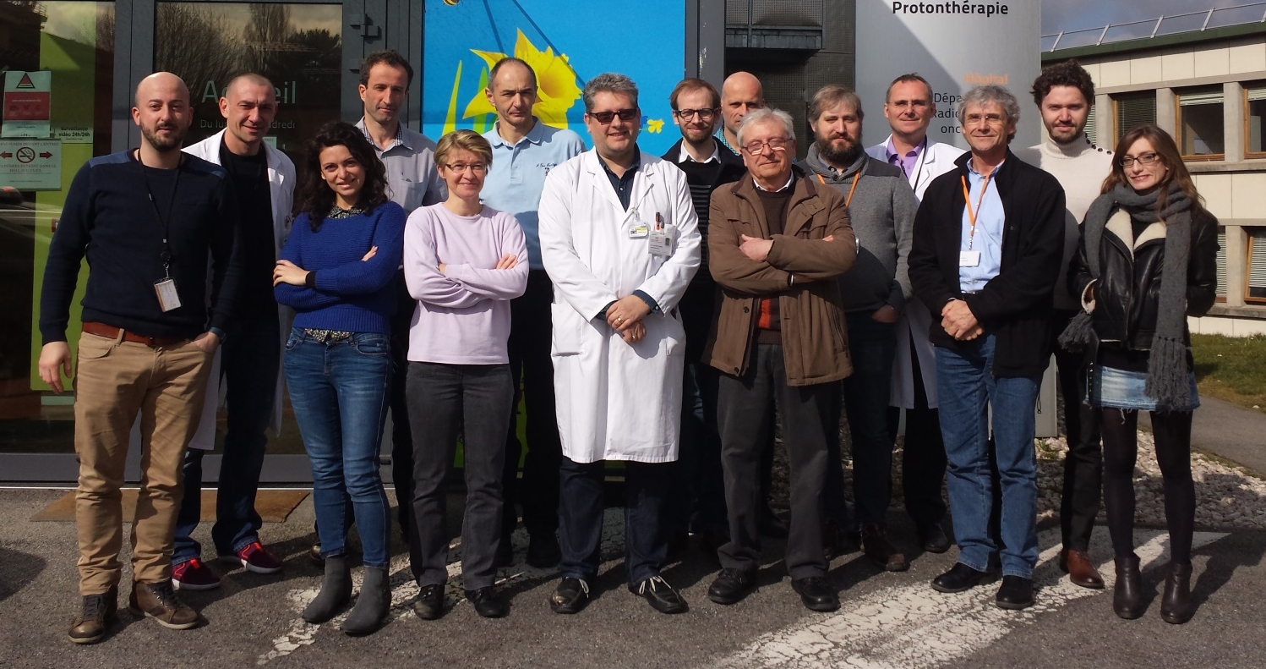

Acknowledgements
Institut Curie
Institut Pasteur
G. Jouvion
D. Hardy
Orsay Proton
therapy Center
A.Patriarca
L. De Marzi
C. Nauraye
R. Dendale
E. Hierso
Experimental RT
platform
F. Pouzoulet
D. Labiod
C. Roulin
IR4M
C. Sebrie

Slide 23
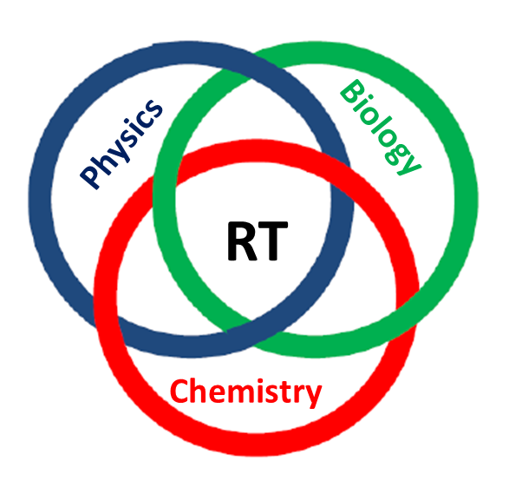
Thank you very much for your attention!
yolanda.prezado@curie.fr

Slide 24
Rabiobiology: posible participants
Differential effect tumor versus normal tissue
Normal tissues | Tumor
Vascular effects
Prompt repair | Damage
Cell signalling
Positive “bystander”-like effects | Cytotoxic “bystander”-like effects
Immune system
Reduced inflammation | Immune infltration/activation
Cell migration, hyperplasia and proliferation | ROS production and difussion?

Slide 25
Light ions MBRT
Monte Carlo evaluation studies
Dilmanian et al 2015
Schneider et al 2019

Slide 26

Moving forward…
Heavy ions minibeam radiation therapy

Slide 27
Heavy ions MBRT: Advantages
Reduced MSC →high PVDR in normal tissue
Narrow beams possible (500 µm)
Gonzalez, Peucelle and Prezado, Med. Phys 2017
Possible synergies of MBRT effects with the higher capacity of ions to inhibit angiogenesis and activate immune system

Slide 28
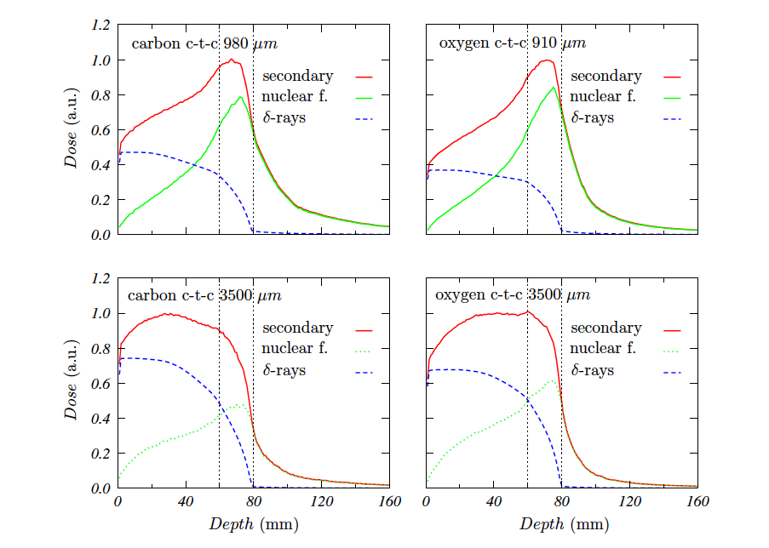
Heavy ions MBRT: impact on valleys
Large beam spacing (ctc) minimize
the contribution of high LET fragments to the valleys
Heavier fragments
are dominant in the valleys at the target position, which might favor tumor control.
Tumor
Larger Beam spacing
Tumor
Gonzalez, Peucelle and Prezado, Med. Phys 2017

Slide 29
Interlaced carbon MBRT
Carbon minibeams, 0.3 mm thick, spaced 1.05 mm on-center. One rabbit
40 Gy in the target
4 Gy in each minibeam
Dilmanian et al 2012

Slide 30
Molecular and cellular effects with infrared microspectroscopy
U87 cells irradiated with Carbon MBRT or conventional broad beams @ HIT
I. Martinez et al., in preparation

Slide 31
Carbon-Ion
Microporous Radiation to Tumor
Hypoxia Area Triggers Robust
Abscopal Effects as Open Field
Radiation
Robust abscopal effect targeting the hypoxic área of the tumor with carbon beam
Huang 2021

