Slide 1
Collaboration meeting #2
Welcome and introduction

Slide 2
Our proposal
Excellent progress, but work still to do:
my congratulations to all, especially WPMs
Looking forward to today’s review of full programme!
Scientific case: ~10% written
Scientific case: ~80% written

Slide 3
Our initiative: Programme and Project

Slide 4
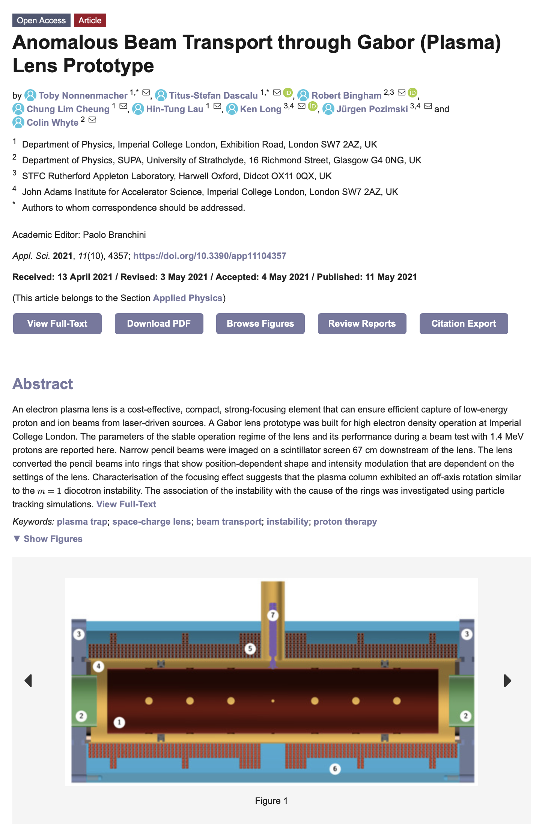
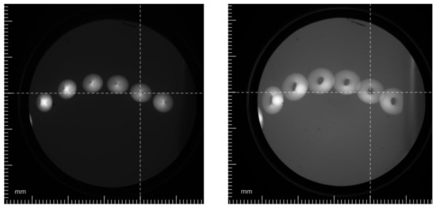
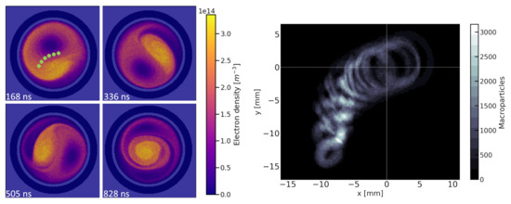
New results

Slide 5
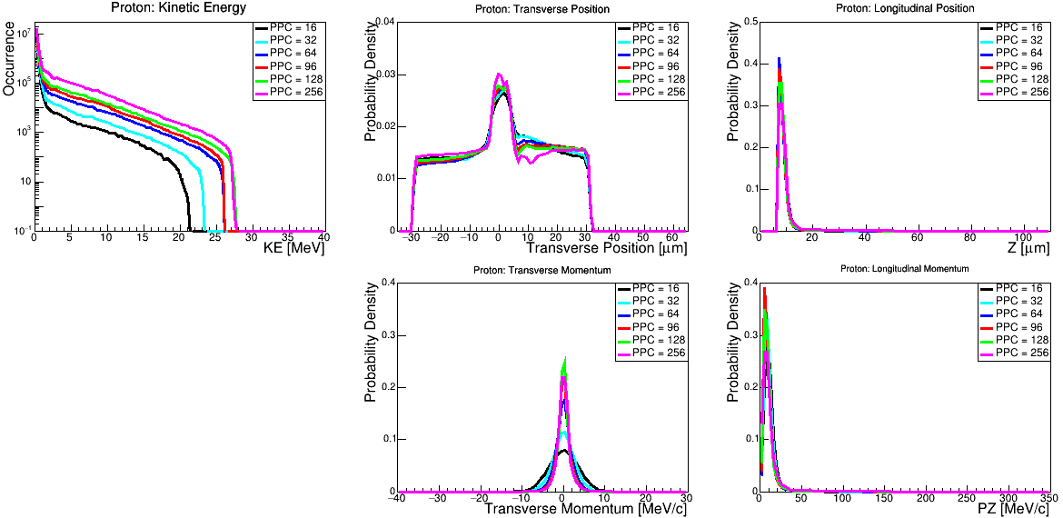
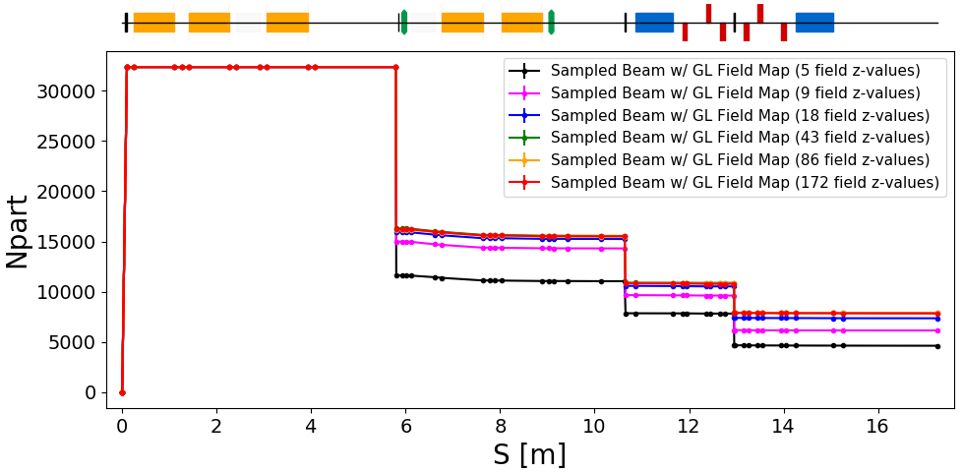
Congratulations
Draft
Submitted

Slide 6
Ion Therapy Research Facility; proposal

Slide 7
Mapping our proposal onto ITRF proposal
Multidisciplinary collaboration [LhARA] comes together to create proposal
Lab (ASTeC, CLF, PPD, TD), HEIs from across the 4 nations, accelerator institutes, key international partners
CDR/TDR development – WP6
End-station specification, design – WP5
Exploit/benefit from Brm ambition to create vertical beamline
Scientific measurement and prototype test and commission
Programme to address key technical risks – WP2, WP3, WP4:
WP2: Source
WP3: Capture
WP4: Realtime, shot-by-shot, non-destructive dose-mapping

Slide 8
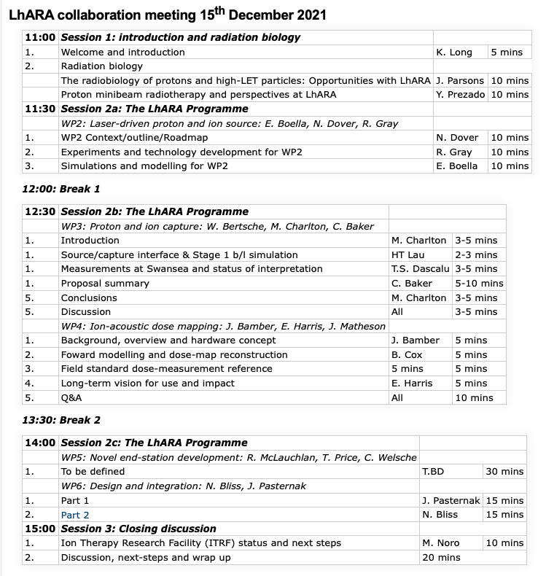
LhARA collaboration meeting #2

