Slide 1
Vertical beamline for the MC40 Cyclotron Facility
Rasim Mamutov
CERN Summer Student

Slide 2
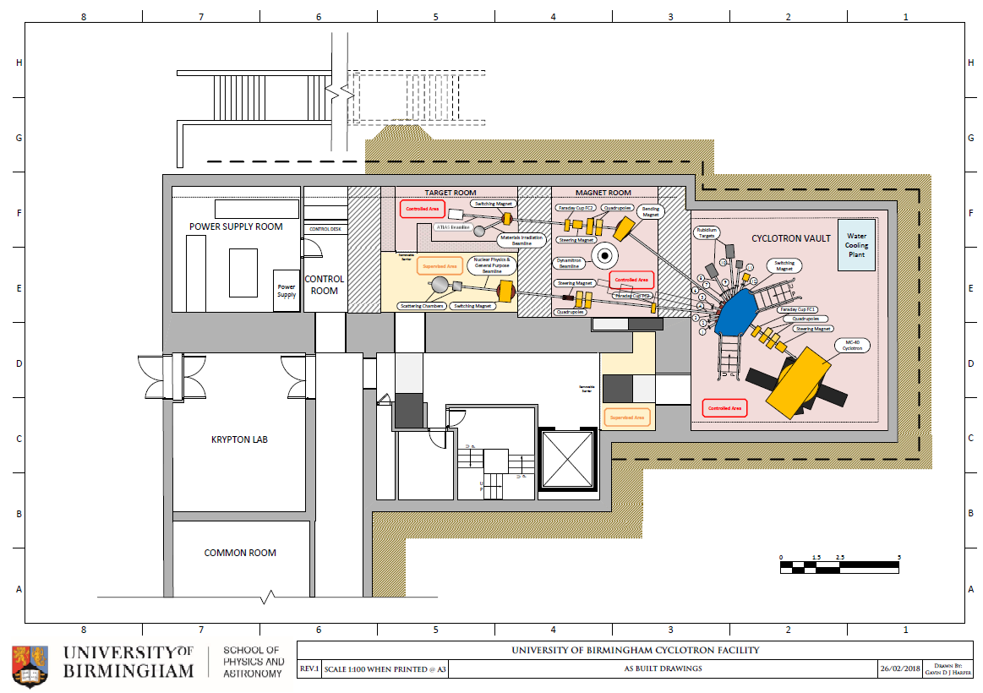

Slide 3
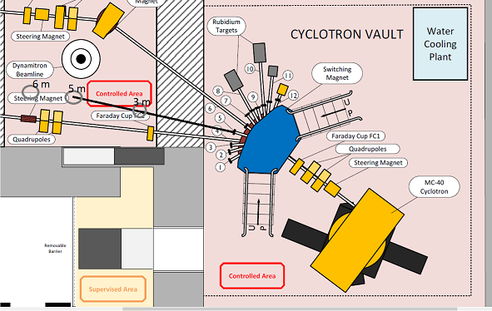
Geometry
3-6 m horizontally available
Max height ≈ 3 m
2x45 degree bends
4-6 quads

Slide 4
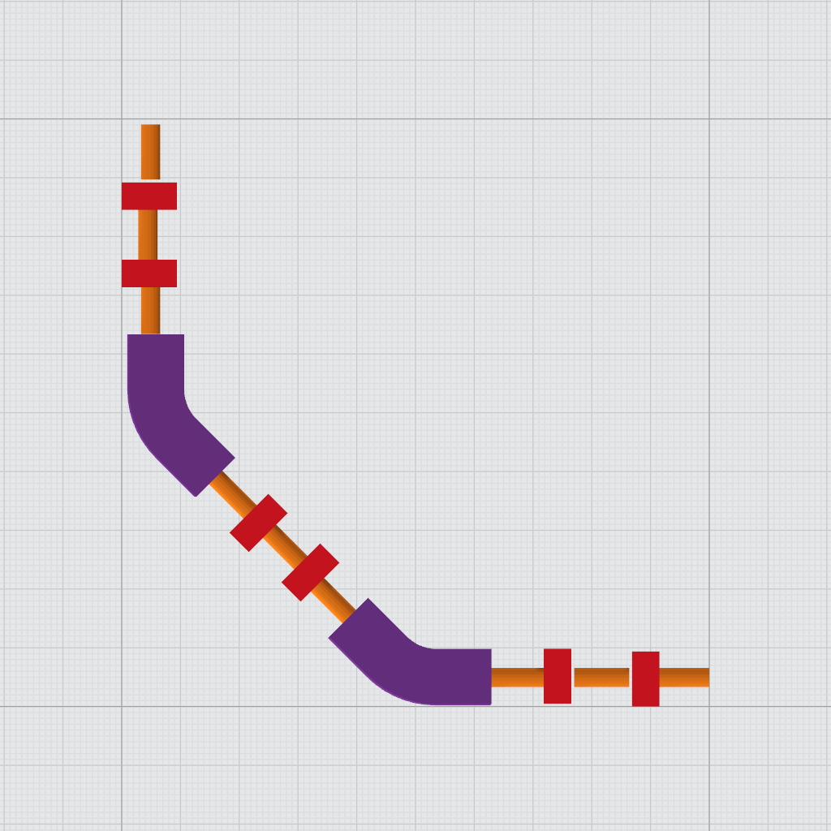
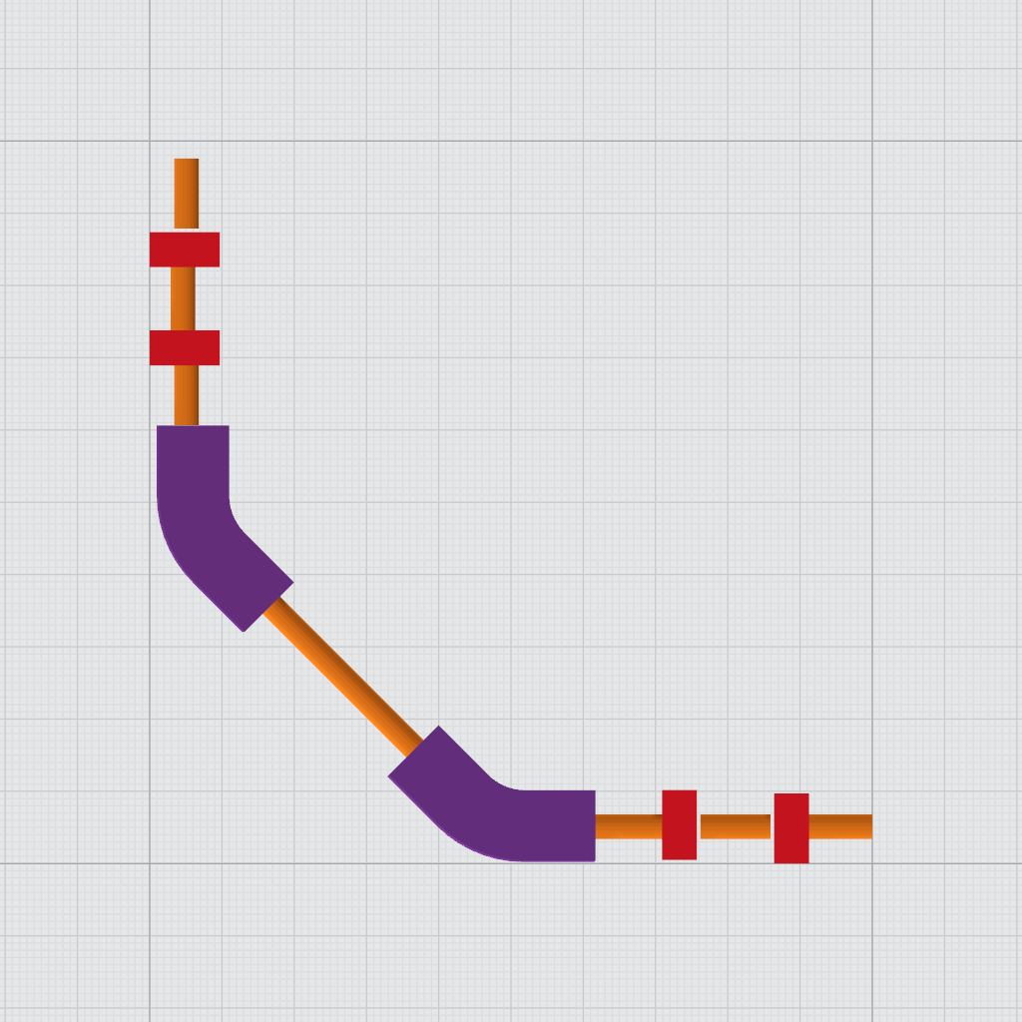
Structure
- Quadrupole
- Dipole
Max Height: 3 m
Max Height: 2.6 m
Max Horizontal Length: 6.3 m
Max Horizontal Length: 5.9 m

Slide 5
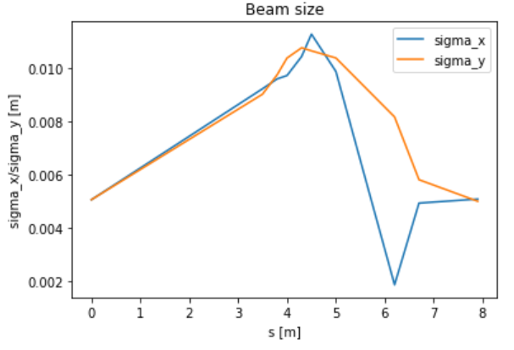
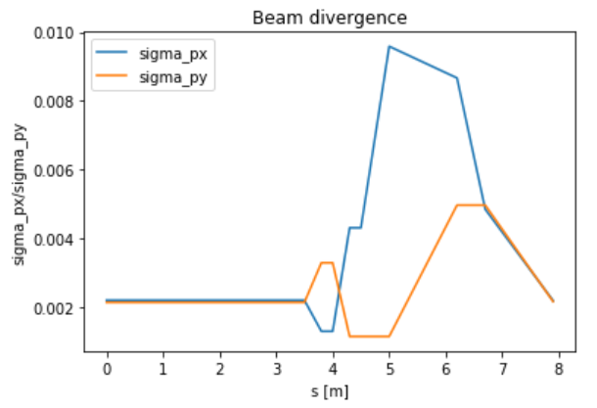
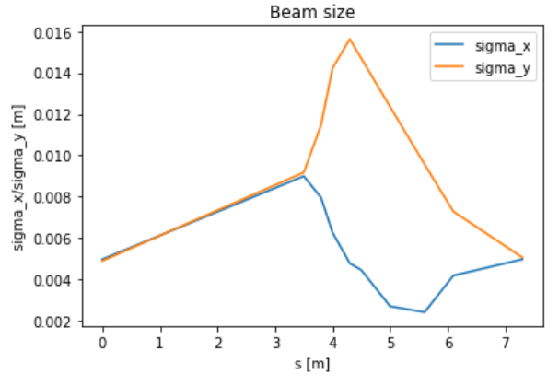
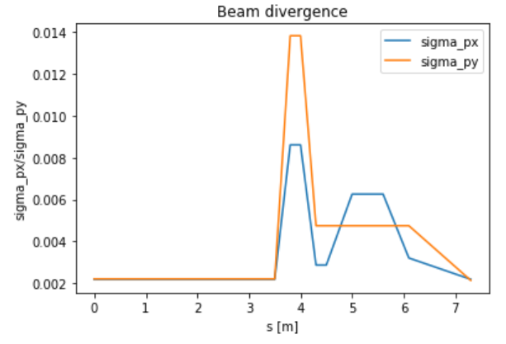
Particle tracking
 | E, MeV | mc, mev | rigidity, T*m | angle 45, rad | field integral 45 degree | beamline length, m | dipole length, m | dipole field, T
proton | 10 | 938.27 | 0.03335641 | 0.785398163 | 0.026198063 | ≈6 horiz + ≈3 vertical ±0.5 | 0.5 | 0.0524
alpha particle | 38 | 3727.38 | 0.063377178 | 0.785398163 | 0.049776319 | ≈6 horiz + ≈3 vertical ±0.5 | 0.5 | 0.0996
Initially normally distributed with sigma_x/y = 5 mm
and relative px/py = 2.2e-3.
Beam quality is maintained.
With 3 quad doublets
With 2 quad doublets

Slide 6
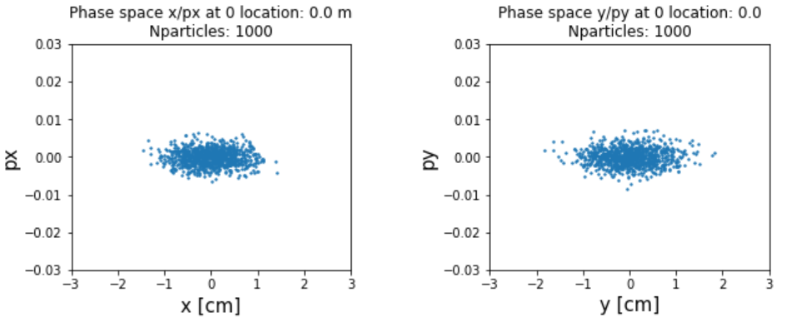
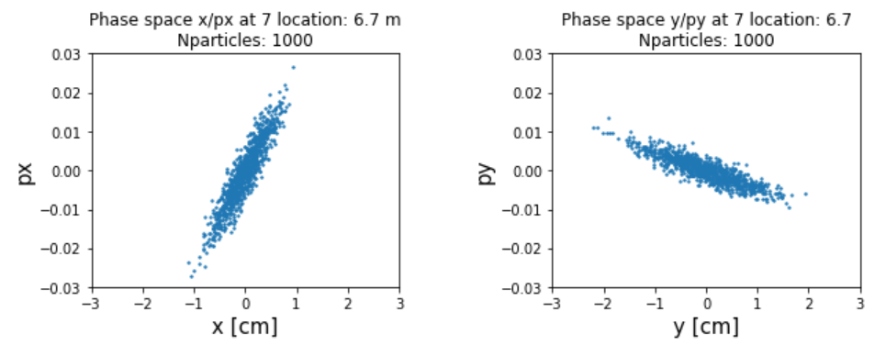
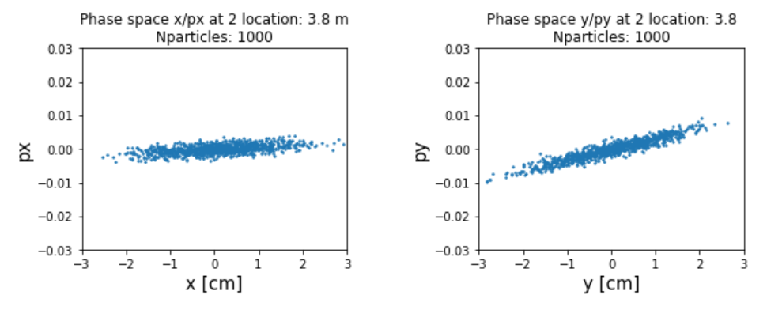
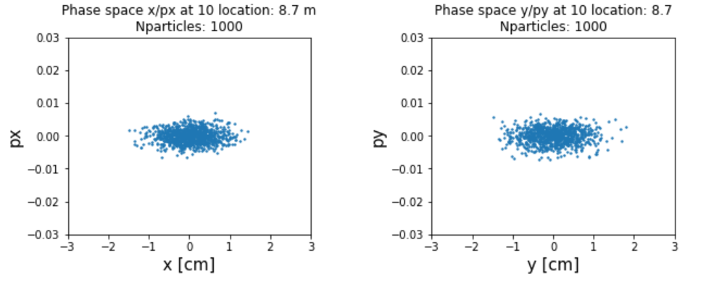
Phase space
Phase space at different locations. 0/10 location stands for start/end.

