Slide 1
Considerations for a laser driven proton source from Target Normal Sheath Acceleration mechanism (TNSA)
Short term source requirement investigations
Longer Term R&D
Proton source optimisation runs via PIC simulations – already ongoing (E. Boella)
Design for TNSA source optimisation experiment on SCAPA using a tape drive target at ~1 Hz operation -- versions of this have already be performed elsewhere (e.g TA2)
Optimise for spectrum, cut-off, spatial profile and beam divergence.
Debris and radiation production measurements
High repetition rate diagnostic design testing/lifetime measurements
Are solid targets sustainable at 10 Hz? What about alternative systems such as liquid jet targets [tape @ 10 Hz ~= 0.3 km/hour]
Novel contrast control techniques (complex pulse shaping, prepulser etc)
Debris mitigation techniques
Diagnostic performance and lifetime issues
Active feedback/control and stabilisation

Slide 2
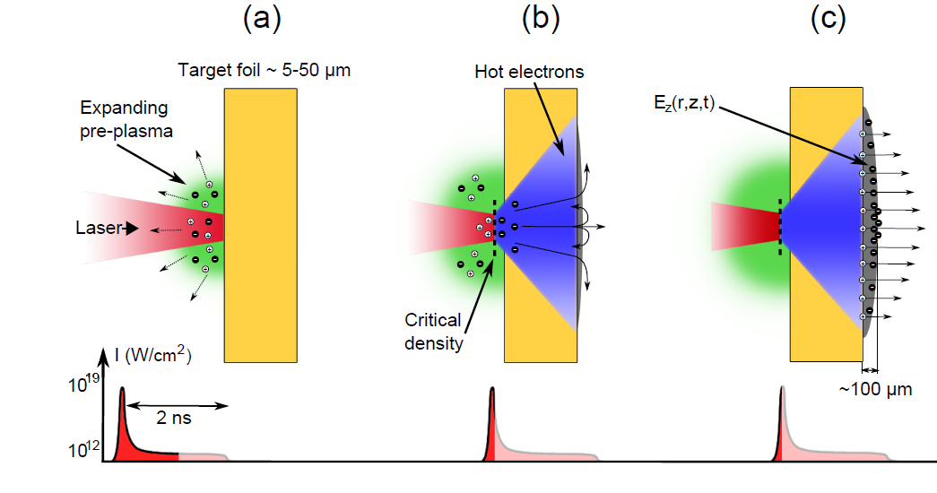
Considerations for a laser driven proton source from Target Normal Sheath Acceleration mechanism (TNSA)
Fast electron temperature and fast electron density and total number at the rear surface drive proton spectral characteristics
Transport physics defined by material, target properties and self generated fields drive proton spatial characteristics
These are sensitive to a wide range of input parameters:
Laser:
Intensity
Energy
Focal spot size
Laser intensity contrast
Polarisation
…
Plasma:
Energy conversion efficiency
Fast electron divergence angle
Z (scattering, resistivity)
Preplasma scale length
Incidence angle
…
Experimental Implementation:
Focusing geometry
Target Design
Laser intensity contrast
Polarisation
Pulse duration
…

