Slide 1
LhARA proposal

Slide 2
LhARA full Conceptual Design Report proposal
Proposal for 2—year programme; + 3 year forward look [coincident with preliminary phase programme]
Scope:
2 year:
Complete Conceptual Design Report for LhARA
Key steps in the initial risk-mitigation programme:
Measurement of spectra produced at laser-driven ion source
And, benchmarking against simulation
Experimental programme leading to specification and manufacture of second plasma-lens prototype
Second prototype to demonstrate plasma dynamics has been understood and controlled; beam test “icing on cake”
Proof of principle of ion-acoustic imaging for in-vitro radiobiological experiments
Plan for next steps in the pre-construction phase R&D programme and considerations of what takes it to a clinical system
Complete design for vertical beam line for end-station system development
And, consultation to lead to specification of end-station developments required
Design and integration of LhARA facility required to:
Deliver completed LhARA CDR
Define next steps in the risk mitigation R&D programme to be carried out in the pre-construction phase (next 3 years)
5 year:
Full technical design report for Stage 1:
Supported by pre-construction phase risk-mitigation programme
Initial technical design for Stage 2:
Risk mitigation programme definition to be carried out in parallel to the Stage 1 build
Programme to deliver full TDR for stage 2
Initial ideas for “Stage 3”:
Roll-out to enhance practice; elements of full system, system prototypes, …

Slide 3
LhARA Conceptual Design Report proposal
LhARA “project organisation”:
Proposed for proposal and Preliminary phase
Summarised below using “particle physics collaboration model”
Co-spokes people:
Giacca (OIRO, Oxf), Long (ICL/STFC/JAI)
Co-project-managers:
Parsons (Liv), Whyte (Str/CI)
Work packages and work-package managers:
Project Management: Parsons (Liv), Whyte (Str/CI)
Project Office: D. Kordopati (ICL)
Laser-driven proton and ion source: Dover (ICL/JAI), + Gray (Str)
Proton and ion capture: Charlton (Swn), Bertsche (Manch/CI)
Real-time dose-deposition imaging: Bamber (ICR), Mattheson (STFC/PPD)
Novel, automated end-station development: McLauchlan (ICL NHS), Price (Brm)
Facility design and integration: Pasternak (ICL/JAI), + TBC
ccap-lhara-wpm <ccap-lhara-wpm@imperial.ac.uk>

Slide 4
Proposal structure
Scientific proposal:
Scientific need:
Clinical drivers, biololgical, medical, accelerator and physical science
Multidisciplinary approach, incremental & transformational impact
Scientific and technological programme
Work package description
With high-level milestones & overview of costs
Management annexes:
Project management:
Including Project organisation, project specification, cost, & financial management plan, schedule, milestones & decision points, critical path, (change control), quality plan, monitoring progress against milestones, risk analysis & risk management plan, safety plan, stakeholder plan, procurement strategy, staffing strategy, document control, evaluation strategy
Work package definitions:
Work-package description including deliverables and milestones, staff, costs analysis

Slide 5
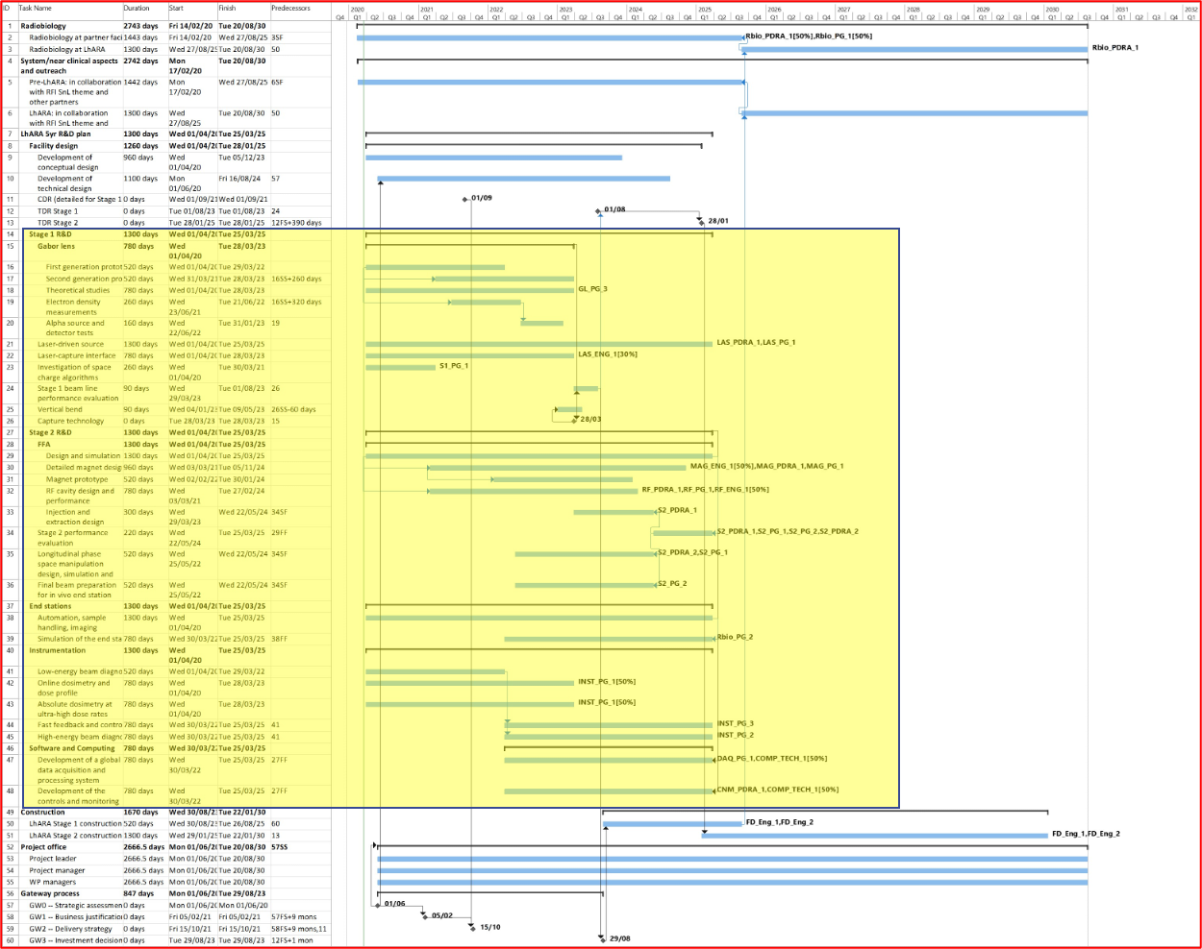
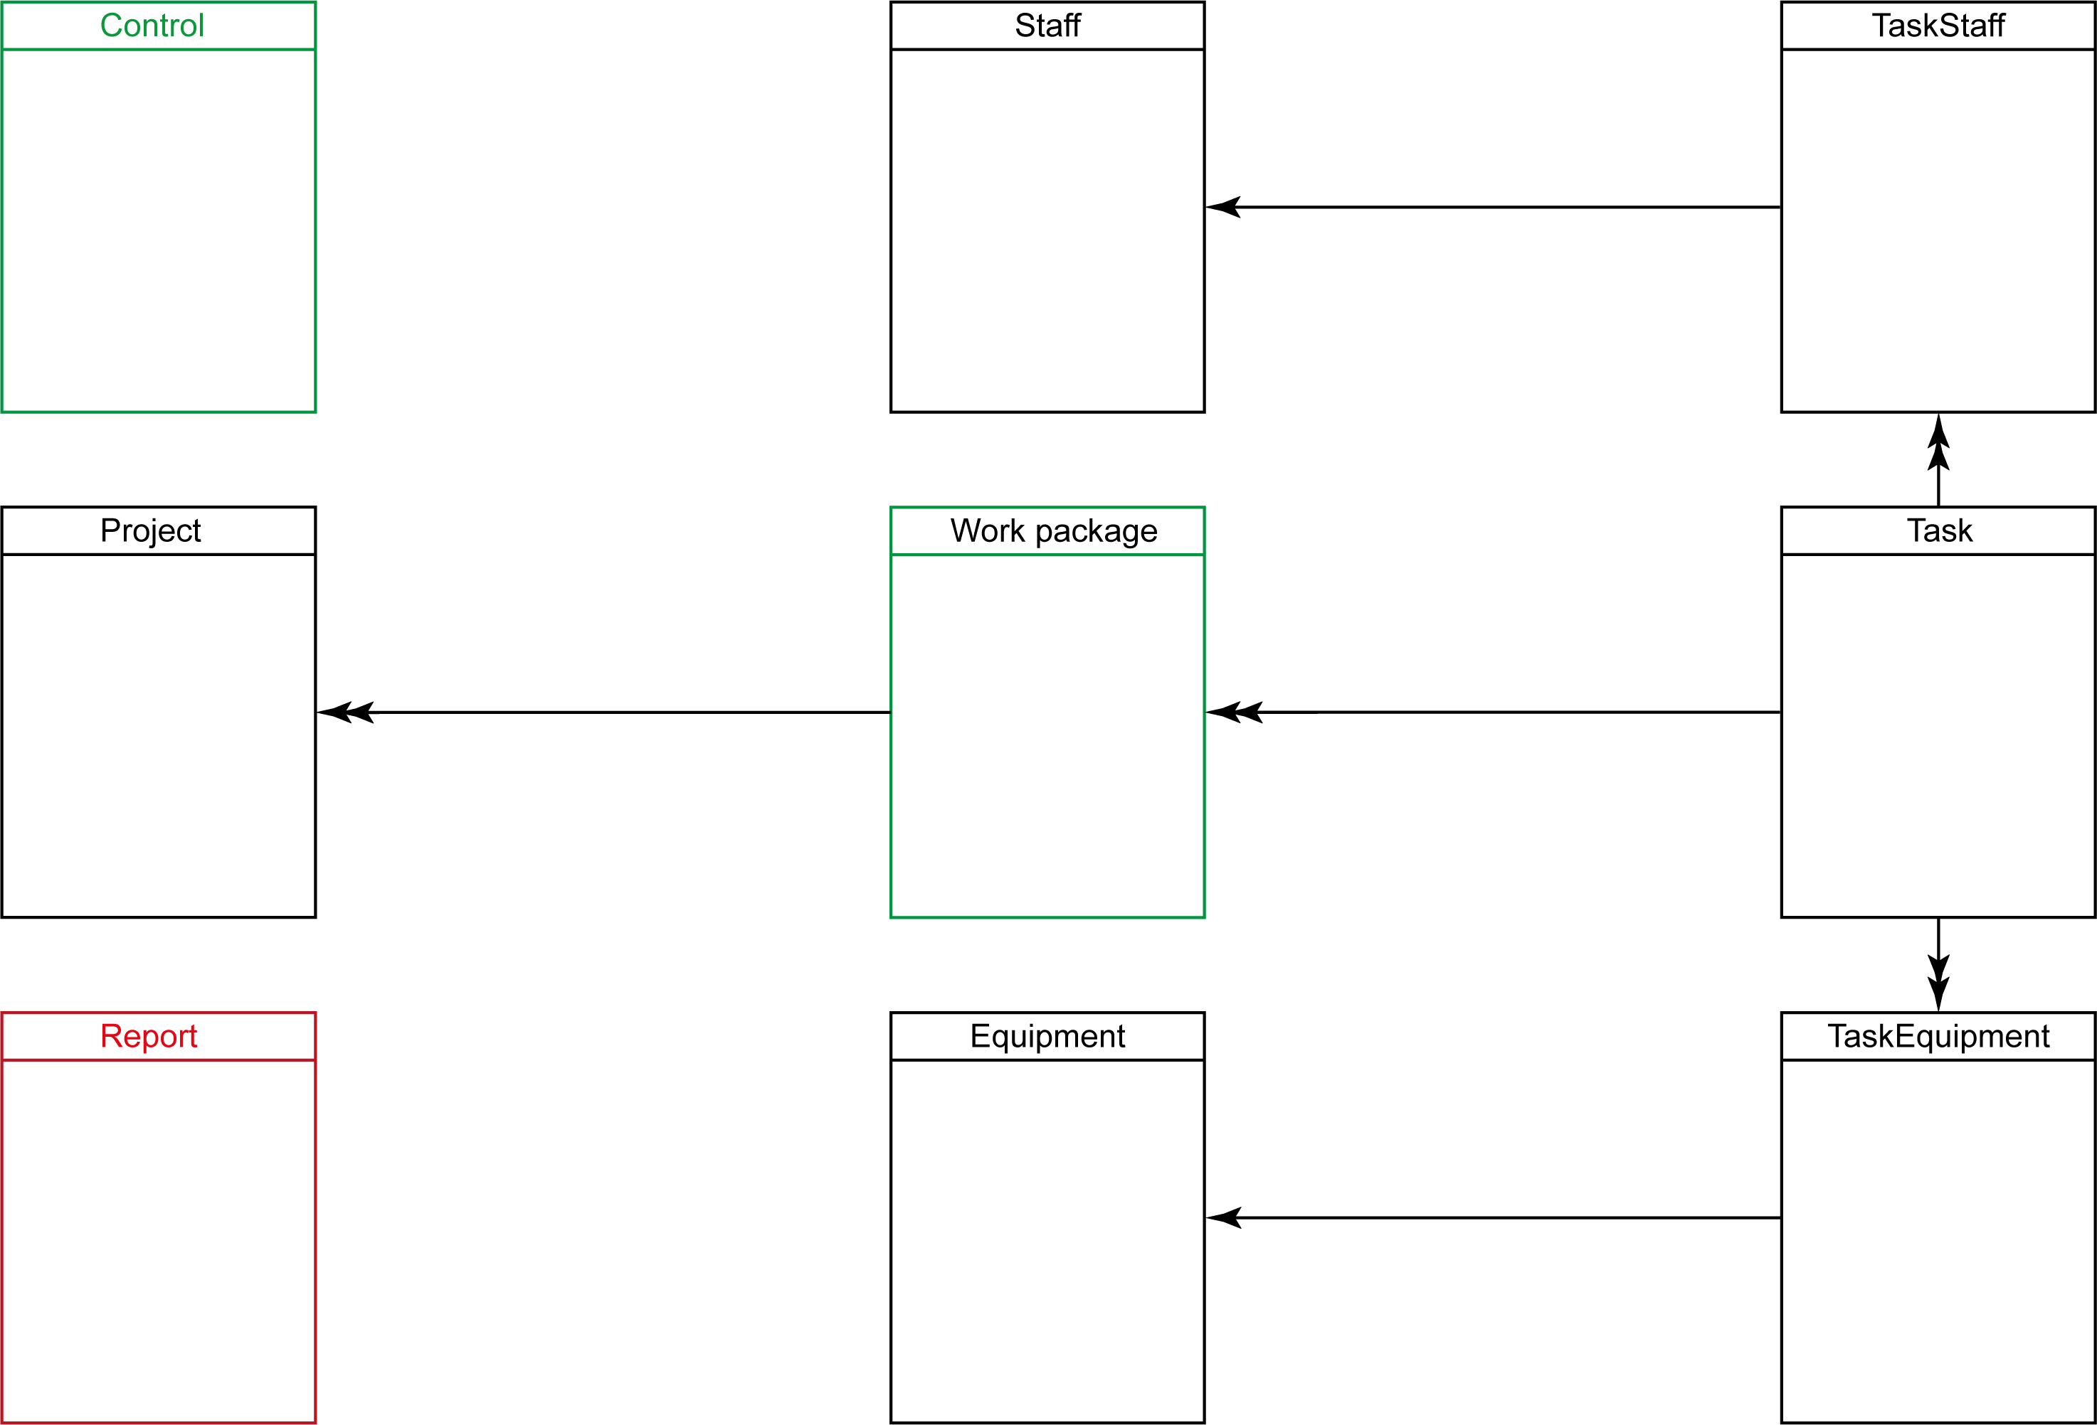
Some preparatory work
Builds on planning done for pre-CDR
WPMs send i/p to “Grand Gantt Chart” (GCC) which will be compiled and managed by Dion
Costing tool will always be under development, but:
For info, this is the “data structure”
Likelihood is only Colin, Dion, and KL need to worry about it

Slide 6
Proposal timeline
Working backwards:
Monday 01Nov21:
Proposal complete (ink drying)
Monday 04Oct21:
First drafts of text of proposal and management annexes complete
Implies iteration of costs and time-line analysis
Monday 13Sep21:
Scope of proposal and w/s define:
Implies initial costing and initial time-line analysis
Tuesday 20Jul21 (today!):
Launch of proposal preparation

Slide 7
Cost sheet
Cost-sheet by work package:
Owned by work-package managers
Python code prepared to automate financial reporting
Daughter of the “big spreadsheet” that some may remember fondly

