Slide 1
News etc.

Slide 2
ITRF proposal

Slide 3
ITRF proposal: page of pictures

Slide 4
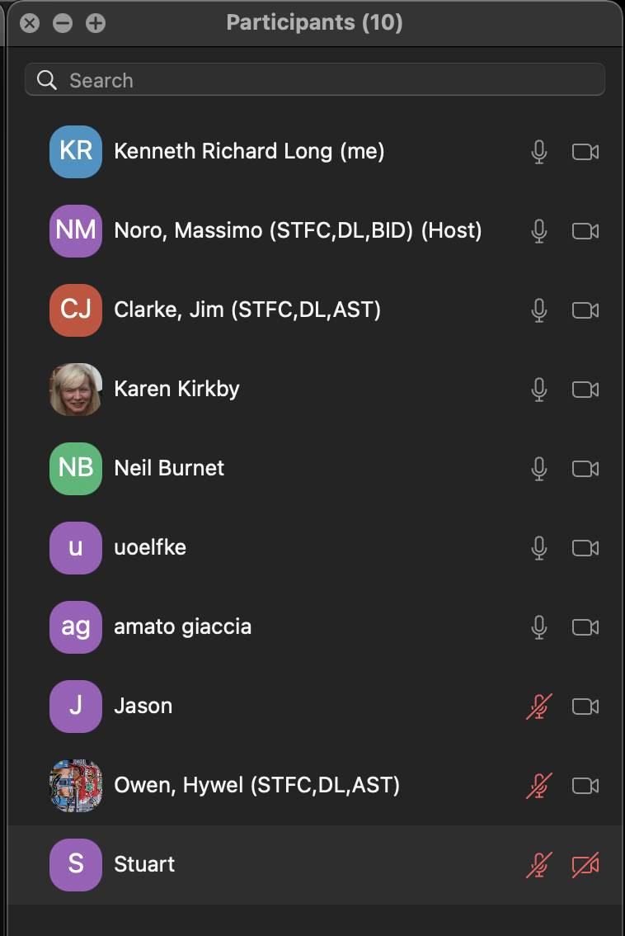
ITRF Advisory Group – first meeting; 16Jun21
Good meeting!
General discussion:
Strong support for vision and programme
Strong engagement with making the case

Slide 5
Proposal development over summer 2021
Proposal for 2—year programme [coincident with preliminary phase programme]
Work packages:
Laser-driven proton and ion source
Proton and ion capture
Real-time dose-deposition profiling
Novel, automated end-station development
Facility design and integration
Possible routes to submission:
As a single, large, proposal
Coordinated submission of several self-contained proposals
As basis of SoI to (e.g.) STFC Science Board

Slide 6
Update …
Project Manager:
Colin Whyte; Strathclyde
Now working to define leads fofr individual work packages
Dion Kordopati (HEP @ Imperial)
Dion has agreed to help us coordinate and manage the project and costing elements of the proposal

