Slide 1






Research plans investigating the radiobiology of protons and high-LET particles
Dr Jason Parsons
Cancer Research Centre
Department of Molecular and Clinical Cancer Medicine

Slide 2
Current and future research goals
Examine the radiobiology of protons and high-LET particles (RBE, DNA damage complexity and repair).
Enhancing the radiosensitivity of tumour models (head and neck focus; also glioblastoma) following protons, high-LET particles and comparisons to photons.
Determine the impact of hypoxia on effectiveness of protons and high-LET particles versus photons, and strategies to overcome radioresistance.
Examine the radiobiology of protons and high-LET particles delivered at ultra-high dose rates (FLASH) on normal and tumour models.

Slide 3
Head and neck squamous cell carcinoma (HNSCC)
6th most common cancer worldwide.
High incidence in North West UK region (3× national average).
Major contributory factors are smoking and drinking.
Rapid rise in incidence of human papillomavirus (HPV-16) associated cancers of the oropharynx (OPSCC).
HPV-positive tumours are more sensitive to radiotherapy and chemotherapy, thus improved prognosis, than HPV-negative tumours.
Altered efficiency of DNA damage repair is particularly responsible for this effect (Nickson et al, 2017, Oncotarget).
  Zhou and Parsons (2020) Expert Rev Mol Med
  Fabbrizi and Parsons (2020) Cancer Drug Discovery

Slide 4
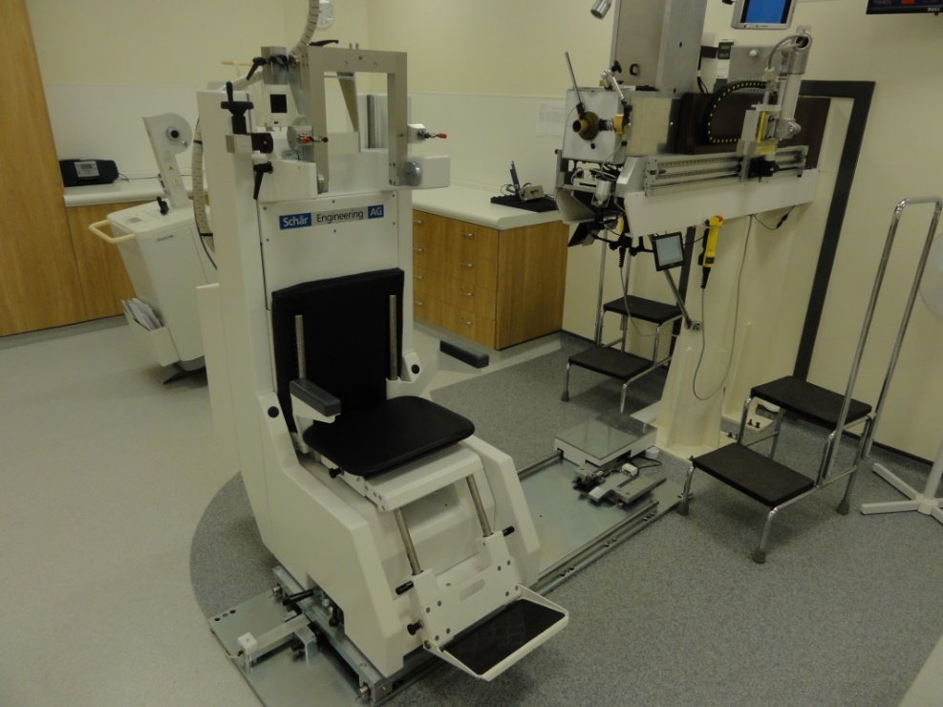
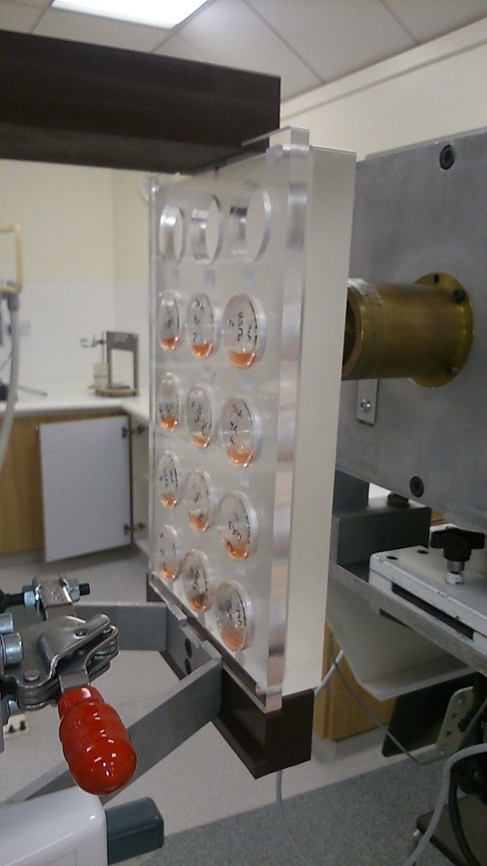
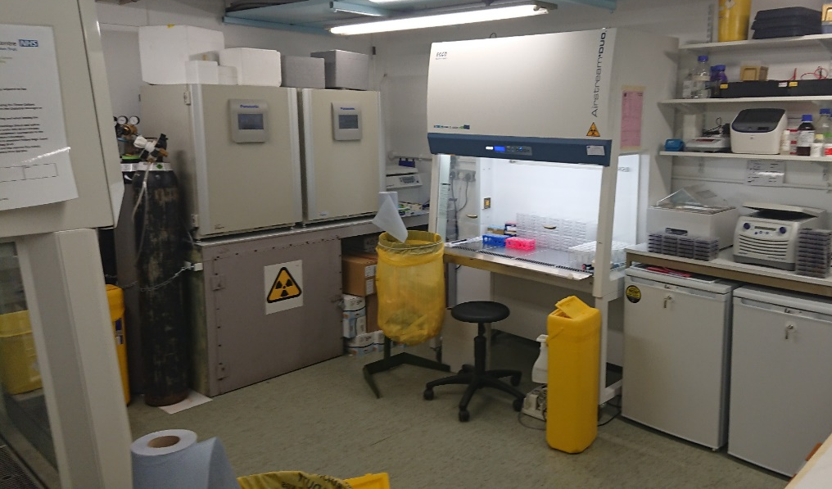
  Proton beam and radiobiology facilities at the Clatterbridge Cancer Centre (CCC)

Slide 5
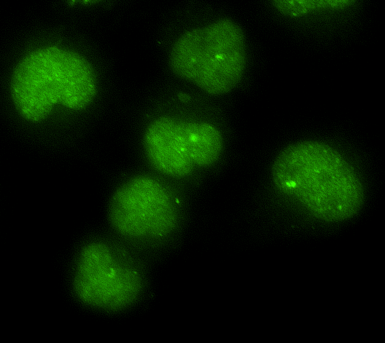
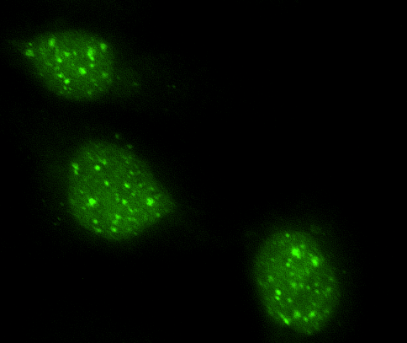
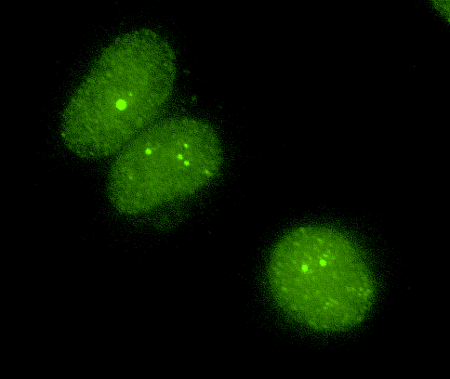
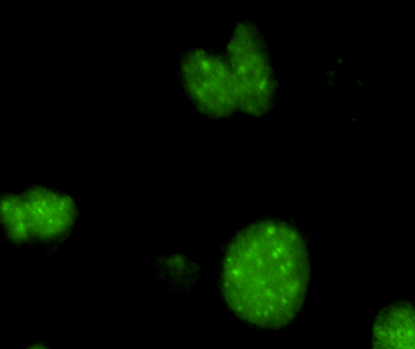
  Relatively high-LET protons cause a decrease in cell survival due to increased complex DNA damage
  HeLa
Control
24 h
  UMSCC6
11 MeV
59 MeV
  SF2, p<0.02; RBE=1.7
  SF2, p<0.01; RBE=1.9
****
PARP-1
PARG
OGG1
BRCA2
*
***
**
  *p<0.02, **p<0.01, ***p<0.005, ****p<0.001

Slide 6
  Model for the recognition and repair of CDD in chromatin
DNA damage -
High-LET IR
Site-specific histone modifications
RNF20/40
MSL2
Ub
USP6
Chromatin remodelling/DNA repair protein recruitment
PARP-1
PARG
OGG1
Restoration of DNA integrity
BRCA2
  Carter et al., (2018) Int J Rad Oncol Biol Phys
  Carter et al., (2019) Int J Rad Oncol Biol Phys
  Fabbrizi, Nickson et al., unpublished

Slide 7
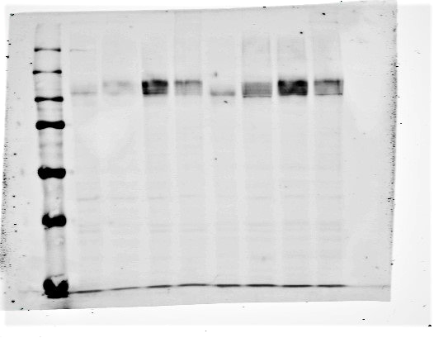
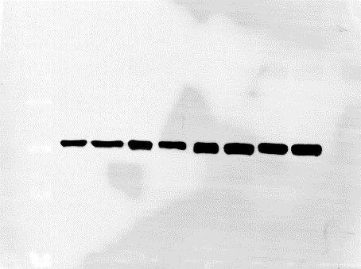
Overcoming the radioresistance of HNSCC cells in hypoxia
UMSCC74A
UMSCC6
UMSCC74A
UMSCC6
UMSCC6
UMSCC74A
N
3
6
24
N
3
6
24
HIF-1α
Tubulin
  Hill et al., unpublished

Slide 8
FLASH radiotherapy
Using ultra high-dose rates (>40 Gy/s; versus ~5 Gy/min).
FLASH stimulates normal tissue sparing.
  Favaudon et al (2014) Sci Trans Med
  Vozenin et al (2018) Clin Cancer Res
  Bourhis et al (2019) Radiother Oncol

Slide 9
Comparison of FLASH and conventional dose rate proton beam therapy in vivo
Model | Dose (Gy) | FLASH Dose-Rate (Gy/s) | Outcome | Reference
Zebrafish embryo | 0–43 | 100 | No survival difference | Beyreuther et al., 2019
Mice (thorax) | 15/17.5/20 | 40 | Normal tissue protection with FLASH | Abel et al., 2017
Mice (thorax) | 15/17.5/20 | 40 | Normal tissue protection with FLASH | Girdhani et al., 2019
Mice (abdomen) | 15 | 78 | Normal tissue protection with FLASH | Diffenderfer et al., 2020
Mice (local intestinal) | 18 | 78 | Normal tissue protection with FLASH | Diffenderfer et al., 2020
Mice, orthotopic engrafted Lewis lung carcinoma (thorax) | 18 | 40 | Improved tumor control with FLASH, increased T-lymphocyte tumor infiltration | Rama et al., 2019
Mice, pancreatic MH641905 flank tumor | 12/15 | 78 | No difference in tumor control | Diffenderfer et al., 2020
Mice, FaDu HNSCC transplantation | 17.4 | >10⁹ | No difference in tumor control | Zlobinskaya et al., 2014
Little evidence of tumour cell killing effect of FLASH.
Mechanism of action unclear (prominent role for oxygen?).
Opportunity for utilisation of FLASH protons/particles.
  Hughes and Parsons (2020) IJMS

Slide 10
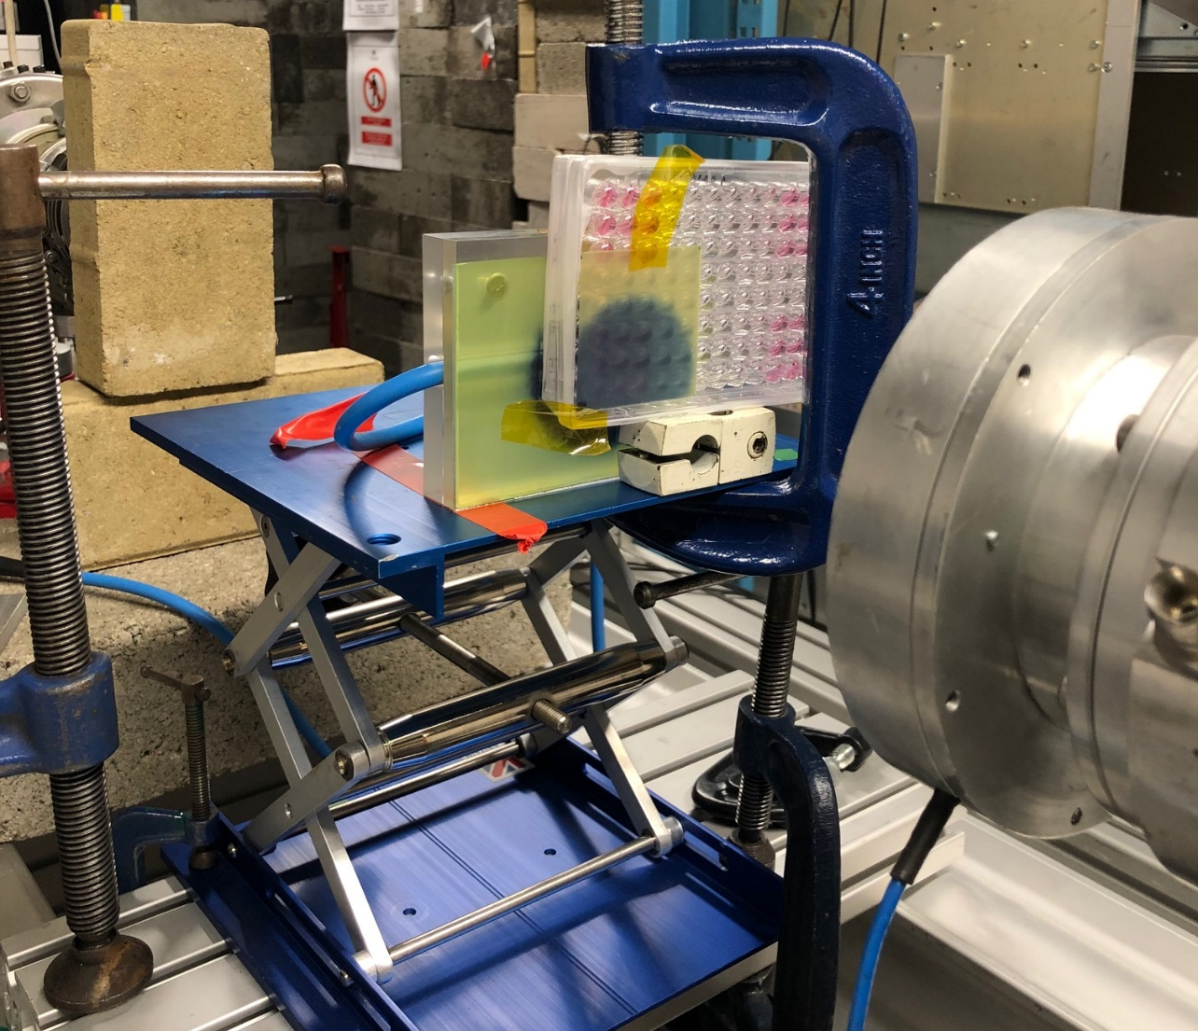
Establishment of FLASH proton facilities
Beam
Collaboration with Stuart Green, Ben Phoenix, Tony Price (University of Birmingham);
Kristoffer Petersson (University of Oxford)

