Slide 1
Towards the specification of a primary beam spectrometry experiment

Slide 2
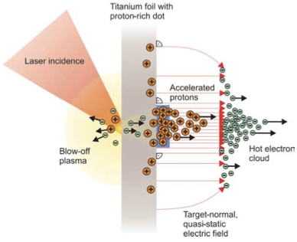
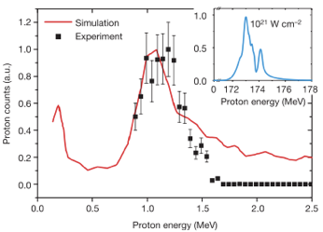
Sheath acceleration
Laser incident on foil target:
Drives electrons from material
Creates enormous electric field
Field accelerates protons/ions
Dependent on nature of target
Active development:
Laser: power and rep. rate
Target material, transport
Schwoerer, H. et al., 2006; Nature, 439(7075).

Slide 3

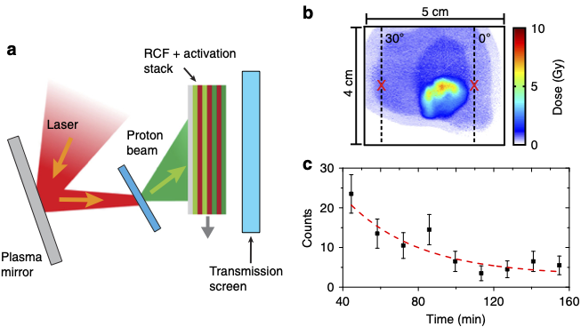
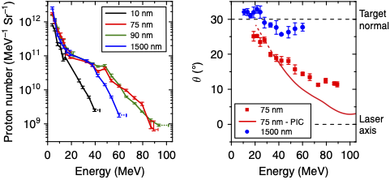
Advances
(2018)9:724 DOI: 10.1038/s41467-018-03063-9
Vulcan
Production: ⁶³Cu(p,n)⁶³Zn
⁶³Zn – β⁺decay
Ultrathin foil irradiated by "long", linearly-polarised laser pulse
Mechanism:
Radiation-pressure/target-normal sheath acceleration
High-energies confined to narrow angular range by radiation-induced transparency

Slide 4
Scientific Reports | (2020) 10:9118 https://doi.org/10.1038/s41598-020-65775-7

Slide 6
Our task
Engage with laser-plasma accelerator colleagues:
Build on their ongoing programme to:
Design spectrometer-based system that can characterise ion species and spectra precisely

