Slide 1
Introduction

Slide 2
ITRF and LhARA
Strong support from STFC Council
Added to that from STFC Executive, Science, and Tech. + Accel. Adv. Boards
Moving now to prepare proposal to:
Infrastructure Advisory Board of UKRI
Deadline: 17:00, Tuesday 15Jun21
Writing team:
Massimo Noro, Jim Clarke, Hywel Owen, Charlotte Jamieson, Ken Long, Ailidh Woodcock, Rosanna Greenop

Slide 3
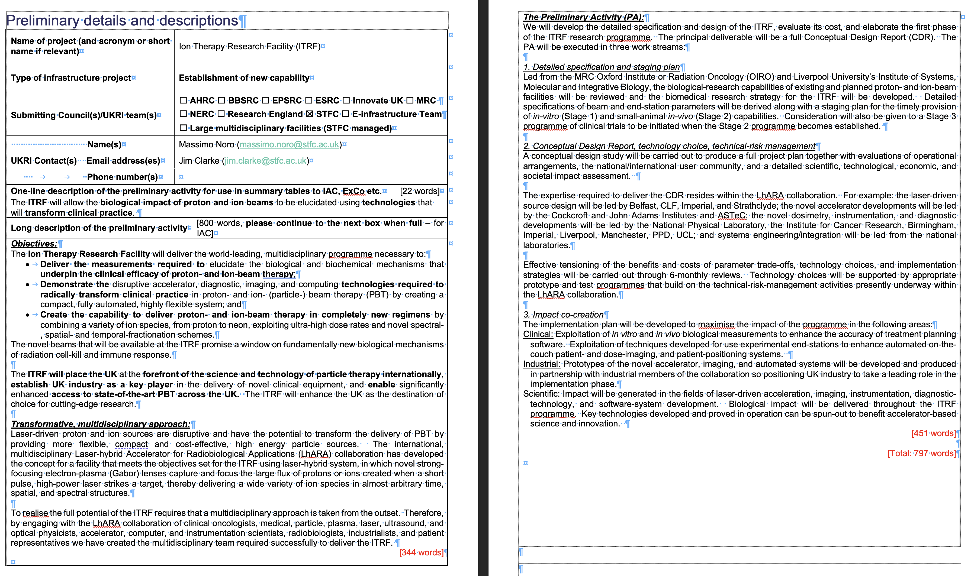
Present top page
Circulated to ITRF Advisory Board &
LhARA SG

Slide 5


Slide 6
Goals for summer 2021
LhARA design revision paper:
Significant progress reviewed today should be published
Preparation to start next month
White paper: P.Price, A.Giacca, J.Parsons, S.Green et al.
Review of biological understanding & LhARA’s unique role
Specification document (PP) circulating; preparation to start soon
Proposal for 2—year programme [coincident with preliminary phase programme]
Work packages:
Laser-driven proton and ion source
Proton and ion capture
Real-time dose-deposition imaging
Novel, automated end-station development
Facility design and integration
Possible routes to submission:
As a single, large, proposal
Coordinated submission of several self-contained proposals
As basis of SoI to (e.g.) STFC Science Board

Slide 7
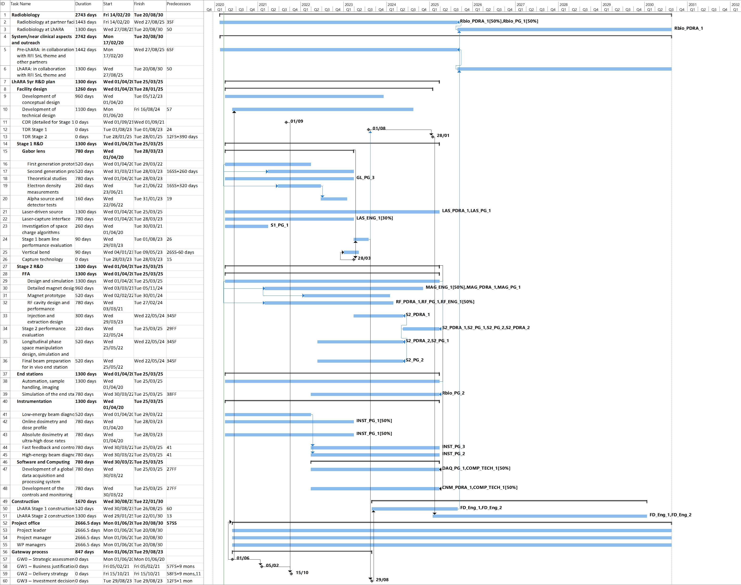
Build on pre-CDR planning

Slide 8
Cost sheet
Cost-sheet by work package
Python code under development to automate financial reporting
Daughter of the “big spreadsheet” that some may remember fondly
More detail to be circulated after the LhARA SG meeting next Monday (14Jun21)

Slide 9
And introducing …
Dion Kordopati (HEP @ Imperial)
Dion has agreed to help us coordinate and manage the project and costing elements of the proposal

Slide 10
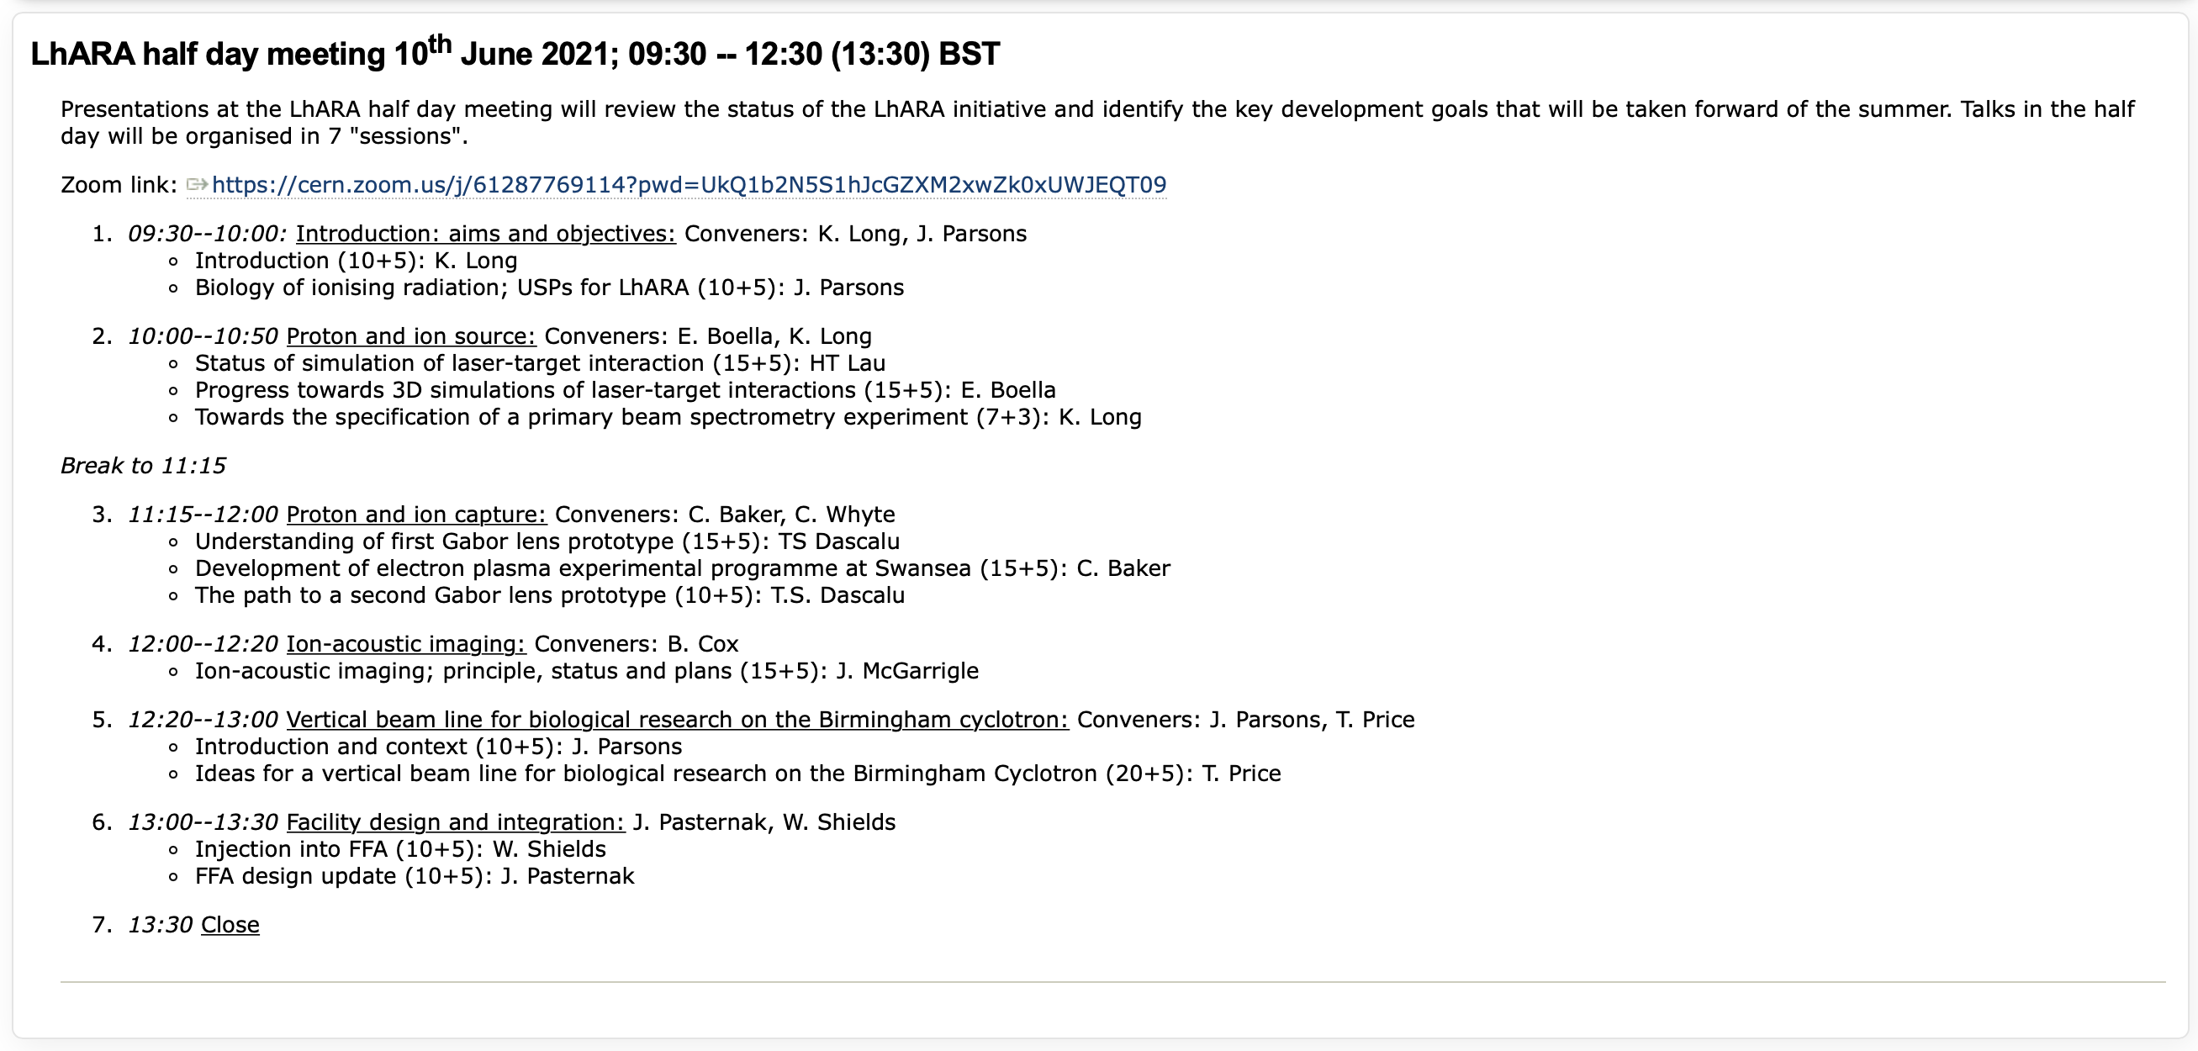
LhARA half day, 10Jun21:

