Slide 1
News … and next steps …

Slide 2
ITRF and LhARA
Strong support from STFC Executive Board
Added to that from STFC Science and Tech. + Accel. Adv. Boards
Moving now to prepare proposal to:
Infrastructure Advisory Board of UKRI
Deadline: 17:00, Tuesday 15Jun21
Writing team:
Massimo Noro, Jim Clarke, Hywel Owen, Charlotte Jamieson, Ken Long, Ailidh Woodcock, Rosanna Greenop

Slide 3
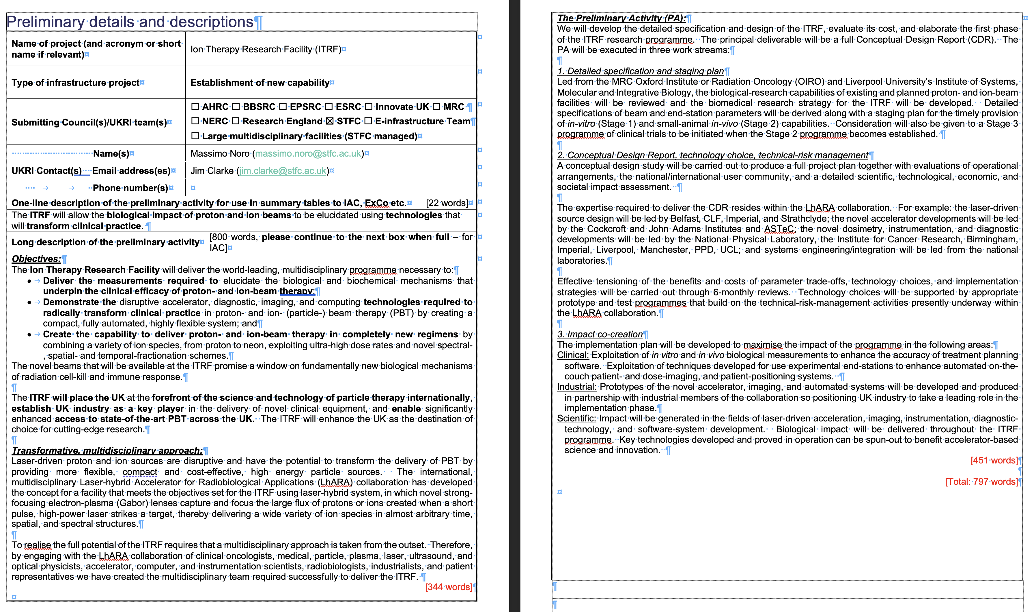
Present top page

Slide 4
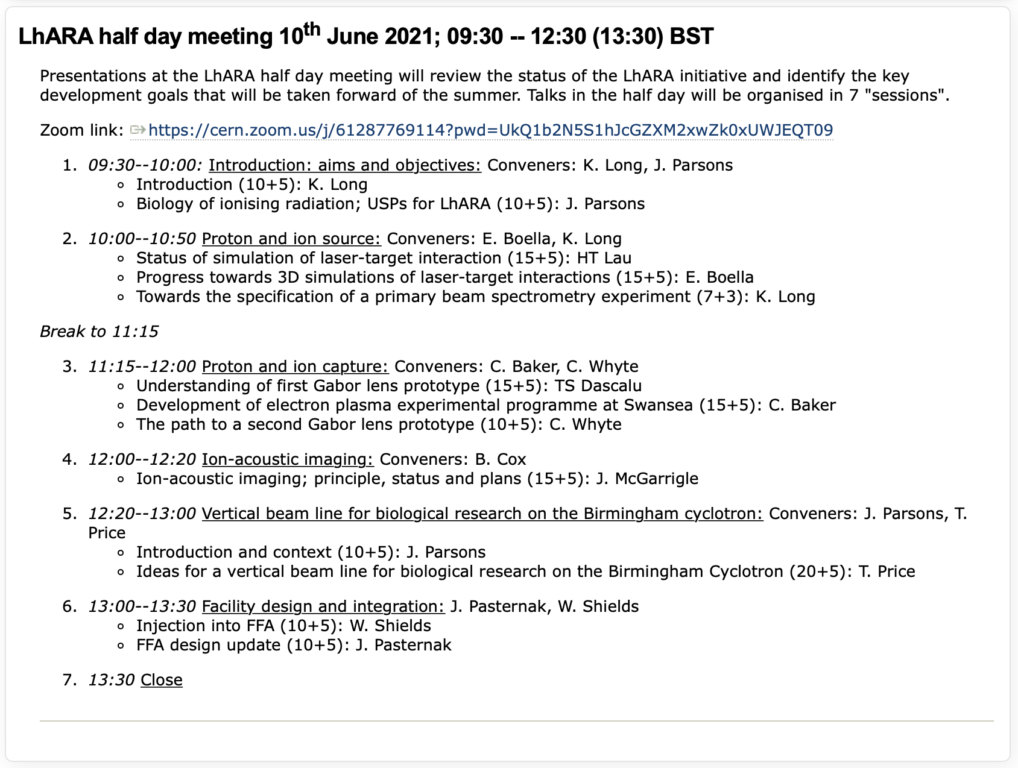
LhARA half day, 10Jun21:

Slide 5
LhARA half day: 10Jun21; morning
Now need to make the agenda …
Goal needs to be to lay foundation of work over summer:
Source experiment design – e.g. source, solenoid, spectrometer
Swansea-based experimental programme as precursor to design of second Gabor lens prototype
Ion-acoustic proof of principle experiment
Continued upgrading of facility simulation, including endstation
End-station design and implementation (see later)
Additional contributions …

