Slide 1
News …

Slide 2
Congratulations!

Slide 3
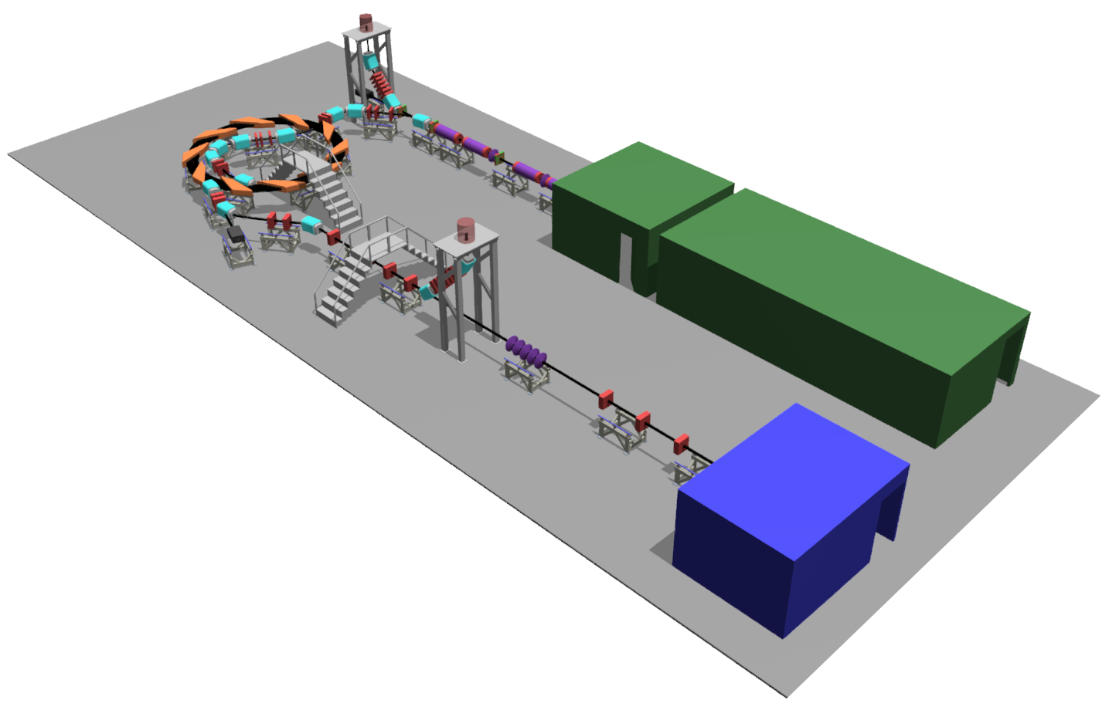

Front. Phys., 29 September 2020; DOI: 10.3389/fphy.2020.567738

Slide 4
LhARA USPs
A novel, hybrid, approach:
Laser-driven, high-flux proton/ion source
Overcome instantaneous dose-rate limitation; remove need for low-energy accel.
Capture at >10 MeV
Delivers protons or ions in very short pulses
Bunches as short as 10—40 ns
Triggerable; arbitrary pulse structure
Novel “electron-plasma-lens” capture & focusing
Strong focusing (short focal length) without the use of high-field solenoid
Fast, flexible, fixed-field post acceleration
Variable energy
Protons: 15—127 MeV
Ions: 5—34 MeV/u

Slide 5

LhARA benefit to individual patient
The fully automated system will:
Exploit triggerable, automated, intelligent system to:
Adjust to changes in patient and disease “on the couch”
Employ novel accelerator/instrumentation/computing technologies to:
Replace large beam-delivery/gantry system with sophisticated s/w-&-control system
As a result, the fully automated system will:
Reduce:
Time from presentation to couch
Time on the couch
Complication rate, thereby reducing recovery time
Cost per patient
Long-term impact: reduce investment cost and cost per treatment to enhance patient access by:
Moving key, time-consuming processes into the feedback-and-control system thereby:
Reducing size and the overall complexity of the facility to decrease investment cost
Increasing throughput thereby reducing cost per treatment
Mission: optimise LhARA programme to maximise incremental impact

Slide 6
Academic benefit of LhARA
Excitement! Pushing frontiers across disciplines:
Physics:
Laser-plasma particle generation/plasma acceleration
Novel, high focal length, low magnetic field axisymmetric focusing
Fixed field acceleration with variable-energy extraction
Real-time dose-deposition imaging
Computing:
Creation of fully automated, real-time system that controls:
Patient position, beam parameters, dose distribution
Accommodating in real time for:
Patient and tissue movement
Potentially also evolution of biomarkers
Requires development of novel real-time systems for:
Image processing, dose-profile reconstruction, feature recognition
Treatment planning incorporating new data and understanding
LhARA: strong & vibrant multidisciplinary collaboration:
“... clinical oncologists, medical, particle, plasma, laser, ultrasound, and optical physicists, accelerator, computer, and instrumentation scientists, radiobiologists, industrialists, and patient representatives ...”
Strong attractor for academic experts:
E.g. all significant UK laser/plasma acceleration groups, all UK accelerator centres, 14 of UK’s strongest instrumentation/diagnostics/dosimetry developers, 3 of principal UK groups in biology of ionising radiation, …
Curie Institut: European (world) leader in FLASH and micro-beam
Strong attractor of PhD, MSc, and u/g students:
3 full time PhDs now, 2 recruited for Oct21, 1 MSc student in post, 3 summer students (1 @ imperial, 2 @ CERN)
2 post-doc applicants for MCSA awards considering making an application; 1 candidate for PhD-level MCSA or equivalent scholarship
One publication in Frontiers; second publication accepted in Applied Sciences
This level of engagement is generated through “managed programme” with significant short-, medium- and long-term ambitions
Explicit support from CERN:
Going forward seek to establish 2-way collaboration
Builds on present involvement in NIMMS 2 (4 students)

Slide 7
Impact (wealth-creation) benefit of LhARA
Overarching ambition to position UK industry at forefront of delivery of next generation PBT
Ab-initio development of programme in consultation with industry partners:
Maxeler and Corerain – s/w and computing
Leo Cancer Care – medical equipment provider
In discussion with Cosylab
Opportunities:
Through ITRF and DL seek stronger partnership with AVO, VARIAN
Develop existing engagement with MedAustron

Slide 8
Moving forward (summer 2021)
General case:
White paper; timeline …
Proposals to manage our technical risks:
Demonstration/characterisation of source
Experimental programme on electron plasma at Swansea
Publication of revision of Stage I beam line:
SMILEI source simulation; Gabor lens parameters from VSIM
Proof-of-principle experiment for ion-acoustic imaging

Slide 9
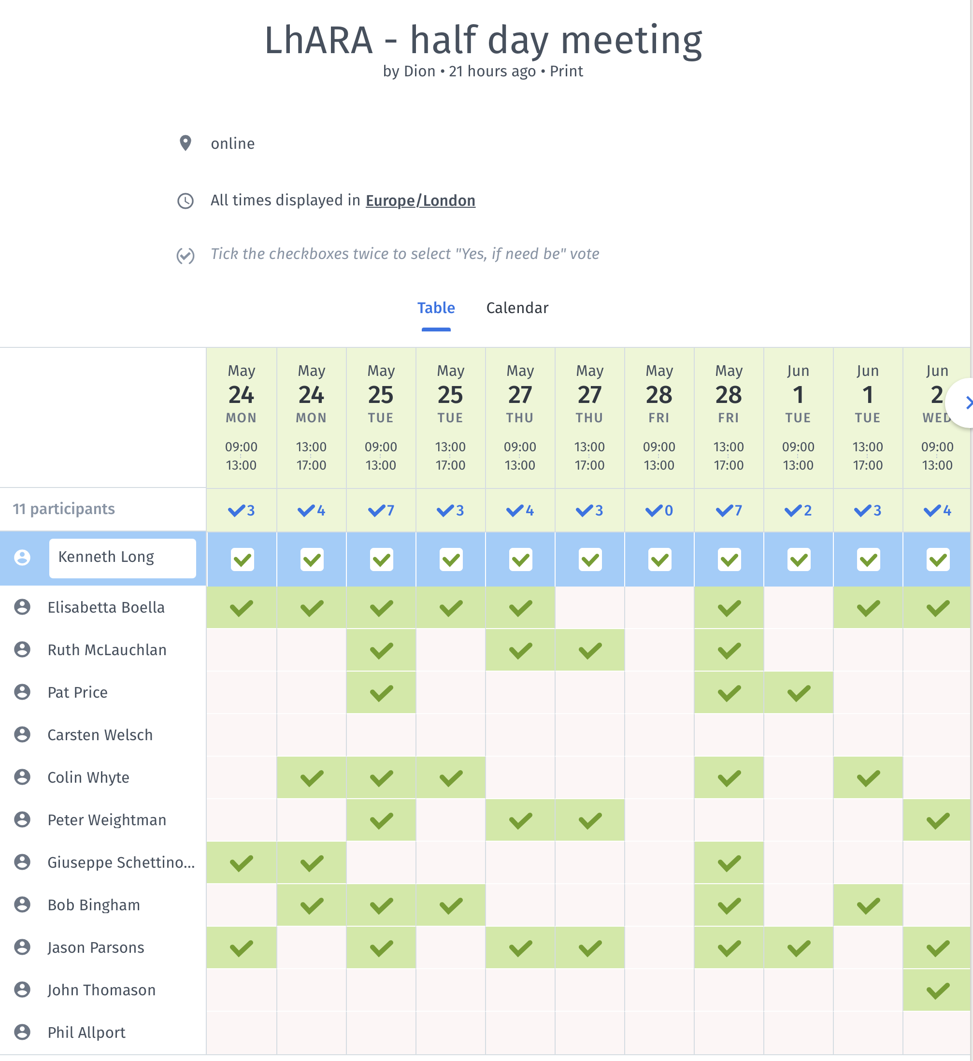
https://doodle.com/poll/u6wya8mw3ue55uxp?utm_source=poll&utm_medium=link

