Slide 1
The Laser-hybrid Accelerator for Radiobiological Applications
LhARA
arXiv:2006.00493

Slide 2
Acknowledgements
The LhARA consortium
To be updated!

Slide 3
Challenges and opportunities
The Laser-hybrid Accelerator for Radiobiological Applications (LhARA)

Slide 4
Radiotherapy; the challenge
Cancer: second most common cause of death globally
  Radiotherapy indicated in half of all cancer patients
Significant growth in global demand anticipated:
  14.1 million new cases in 2012 ⇢ 24.6 million by 2030
  8.2 million cancer deaths in 2012 ⇢ 13.0 million by 2030
Scale-up in provision essential:
  Projections above based on reported cases (i.e. high-income countries)
  Opportunity: save 26.9 million lives in low/middle income countries by 2035
Provision on this scale requires:
  Development of new and novel techniques … integrated in a
  Cost-effective system to allow a distributed network of RT facilities
Atun, Lancet Oncol. 2015 Sep;16(10):1153-86

Slide 5
The benefit of particles
Maximise therapeutic benefit by:
  Maximising damage to tumour
  Minimising damage to healthy tissue
X-ray therapy:
  Modality used in most radiotherapy
  Dose falls exponentially with depth
  Proximity of sensitive organs limits dose to tumour

Slide 6
Particle-beam therapy
Proton and ion-beam therapy:
  Bulk of dose deposited in Bragg peak
  Significant normal-tissue sparing (entry)
  Almost no dose beyond the Bragg peak

Slide 7
The need for a step-change in capability
Growing recognition of benefits of PBT worldwide:
  70 PBT centres in operation;
  40 under construction
‘Incremental’ development
of technique
  Existing suppliers
  New initiatives
Exciting indications of benefits of novel beams …

Slide 8
LhARA … the vision
The execution of the LhARA programme will:
Create the capability to deliver particle-beam therapy in completely new regimes
  Flexibility!
    Combine a variety of ion species in a single treatment fraction and exploiting ultra-high dose rates in novel spatial- and spectral-fractionation schemes.
Make "best in class" treatments available to the many
  Automated, triggerable system:
    Demonstrate in operation a system incorporating dose-deposition imaging in a fast feedback-and-control system thereby reducing the requirement for a large gantry.

Slide 9
Radiobiology
The Laser-hybrid Accelerator for Radiobiological Applications (LhARA)

Slide 10
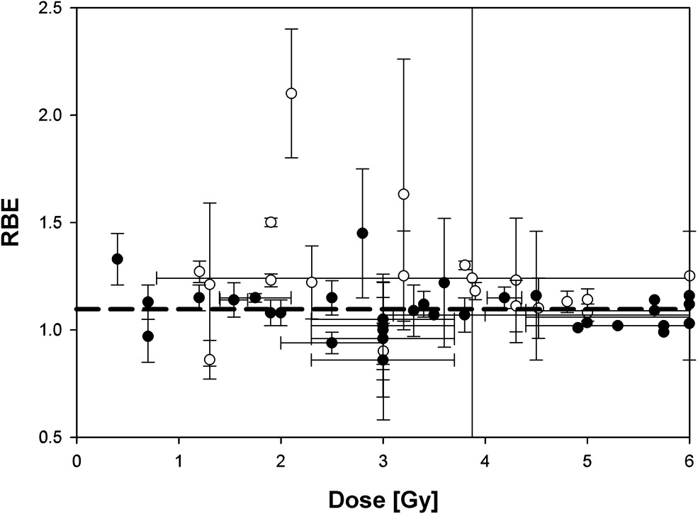
The radiobiology needs to be understood
RBE:
Ratio of dose required to gain
same biological response as
reference photon beam
Treatment planning:
  Based on ‘Relative Biological Effectiveness (RBE)
    Proton-treatment planning uses RBE = 1.1
    Effective values are used for C⁶⁺
Paganetti, van Luijk
Sem. Rad. Oncol (2013)
RBE known to depend on:
Energy, ion species
Dose & dose rate
Tissue type
Biological endpoint
Essential: improved, fundamental, understanding of radiobiology

Slide 11
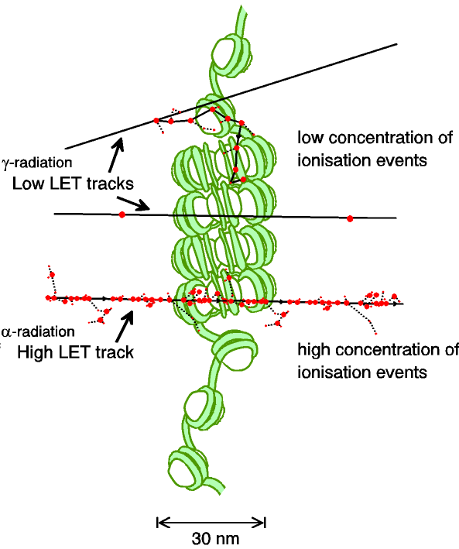
Biological impact ^{from the} physics of ionisation
Low-LET radiation:
  Repairable single/double
  strand breaks
High-LET radiation:
  Complex DNA lesions
    Multiple DNA pathways
    More difficult to repair
    Enhances cell death
Programmatic approach:
  Dynamic studies of impact of radiation
  Interpret with advanced computer models (e.g. G4DNA)

Slide 12
Radiobiology in new regimens

Slide 13
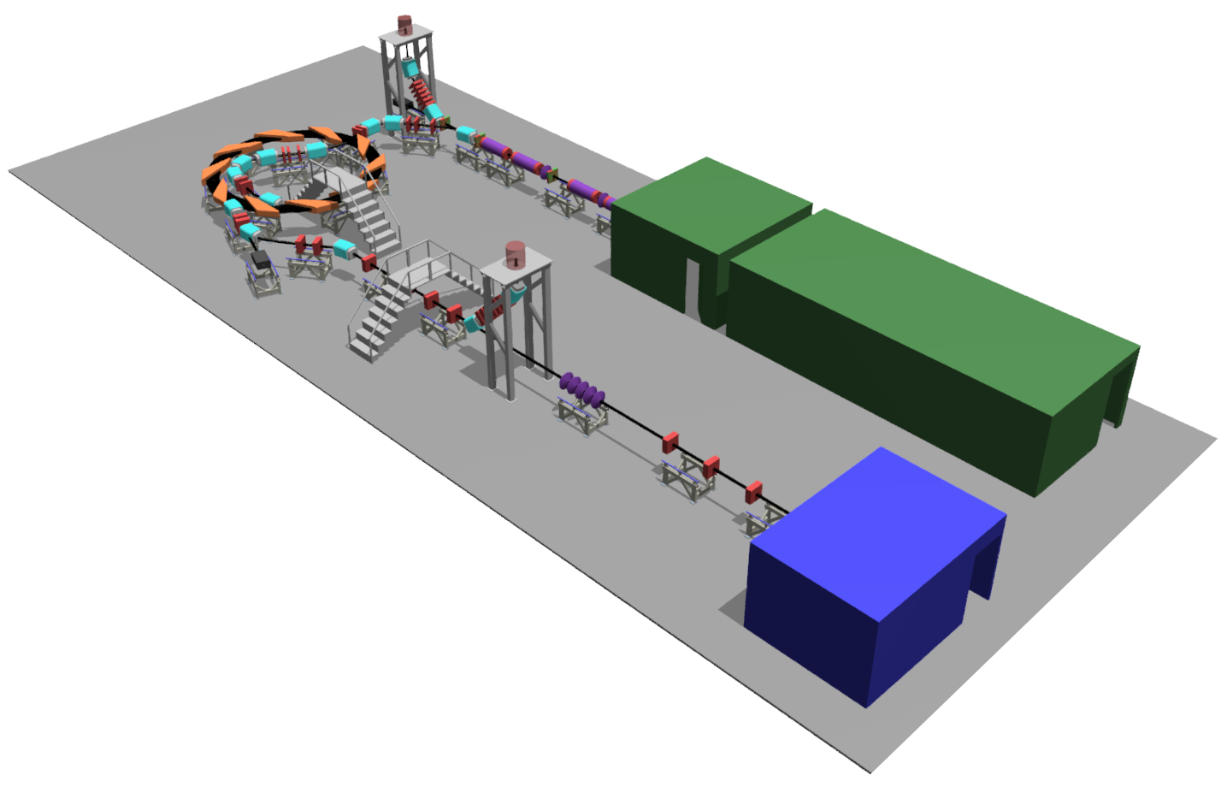

Laser-hybrid Accelerator for Radiobiological Applications
LhARA; a novel, hybrid, approach:
High-flux, laser-driven proton/ion source:
  Overcome instantaneous dose-rate limitation
  Delivers protons or ions in very short pulses:
    Pulse length 10 – 40 ns
  Can provide arbitrary pulse structure
Novel plasma-lens capture & focusing
Fast, flexible, fixed-field post acceleration
  Variable energy
  Protons up to ~15—127 MeV p;
  Ions up to ~5—34 MeV/u
Staged implementation:
  Stage 1: In vitro studies with protons at energies up to 15 MeV
  Stage 2: In vivo & in vitro studies with protons up to 127 MeV and ions up to 34 MeV/u
→ compact, uniquely flexible facility
arXiv:2006.00493
LhARA consortium

Slide 14
LhARA consortium’s ambition
LhARA will be a uniquely-flexible, novel system that will:
Deliver a systematic and definitive radiobiology programme
Prove the feasibility of the laser-driven hybrid-accelerator approach
Thereby lay the technological foundations for transformation of PBT
  automated, patient-specific: implies online imaging & fast feedback and control

Slide 15
LhARA
The Laser-hybrid Accelerator for Radiobiological Applications (LhARA)

Slide 16
LhARA
arXiv:2006.00493

Slide 17
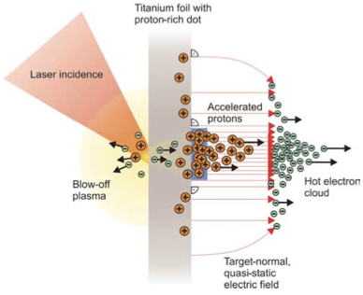
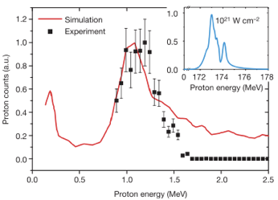
Sheath acceleration
Laser incident on foil target:
  Drives electrons from material
  Creates enormous electric field
Field accelerates protons/ions
  Dependent on nature of target
First observation ~2000
Active development:
  Laser: power and rep. rate
  Target material, transport
Schwoerer, H. et al., 2006; Nature, 439(7075).

Slide 18
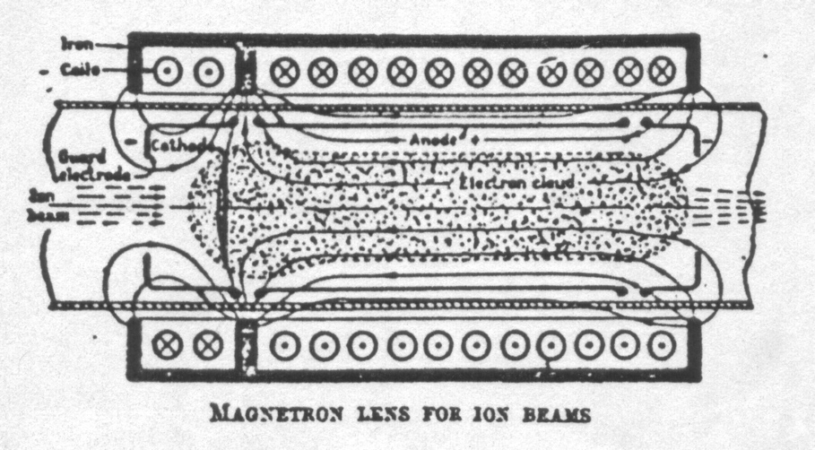
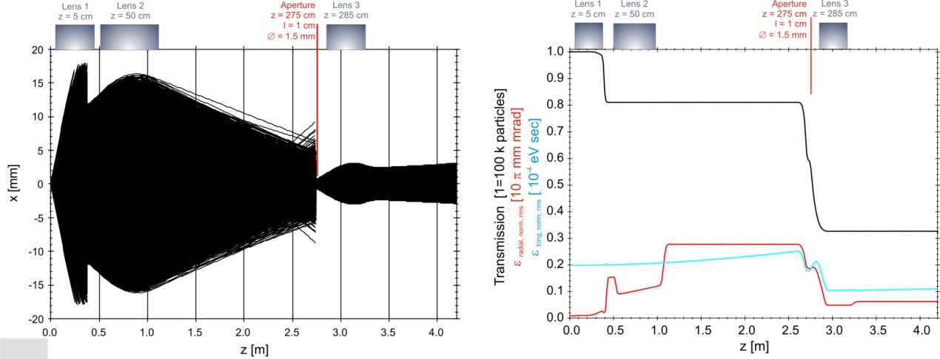
Beam capture/production principle
Posocco, Pozimski
Plasma (Gabor) lens:
  Strong focusing exploiting
  electron plasma in solenoid
Gabor
1957

Slide 19
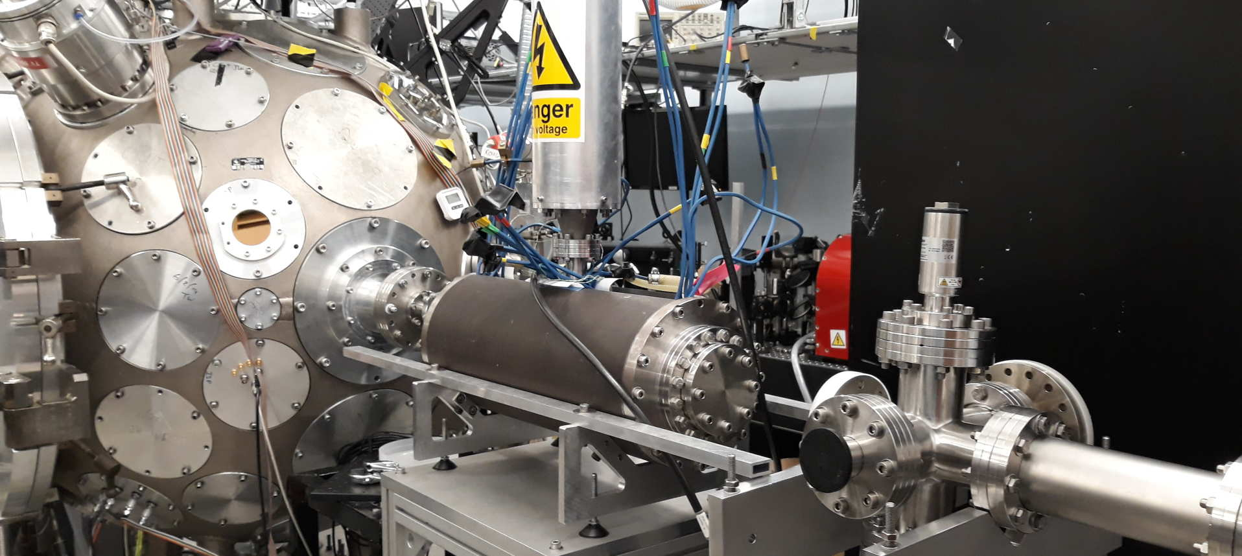
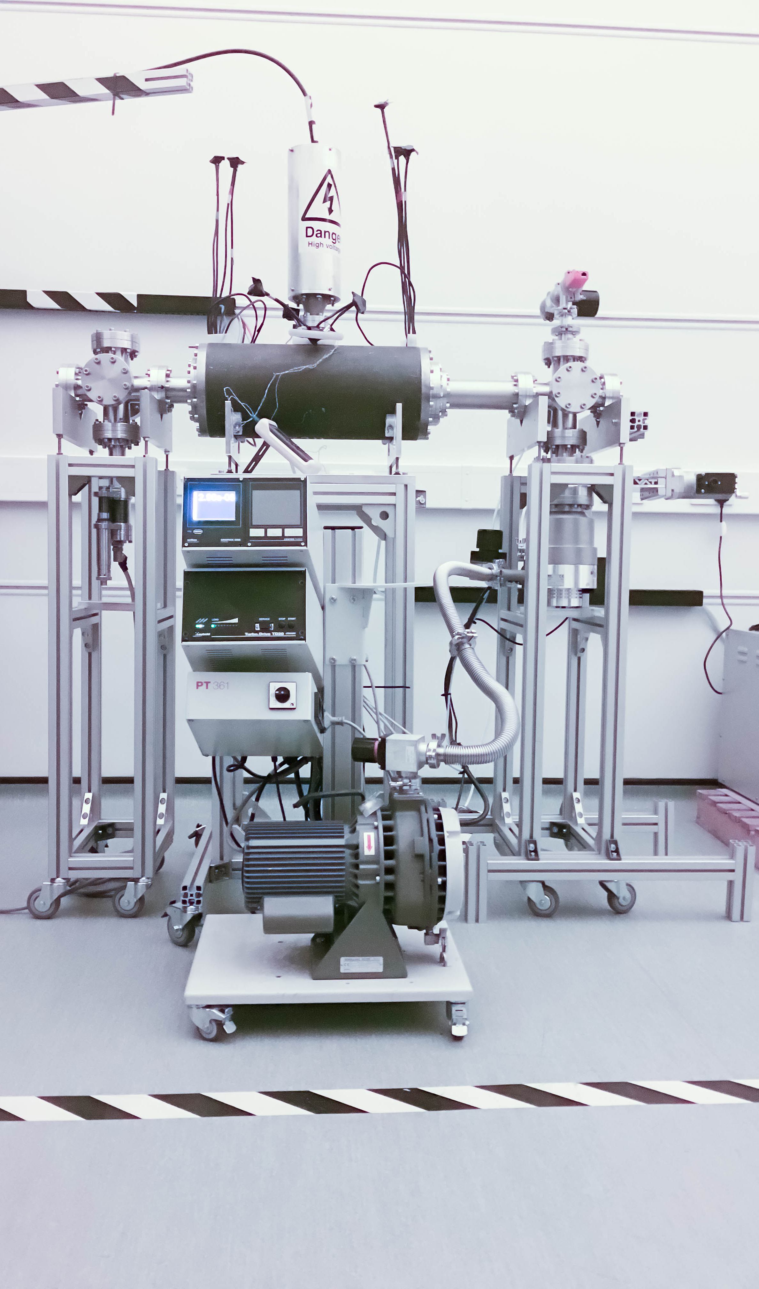
LhARA: ion-source development
Capture
Laser source/capture test
Electron plasma:
  Strong focusing
  of +ve ions
1st prototype:
  1 MeV protons
  Surrey Ion Beam
  Centre
  Aberrations
  observed
Upgraded
prototype:
  Under development
  Imperial
Integration test:
  Integration test on Imperial Cerberus Laser
Plan:
  “Now”: prepare to validate lens with α
  Next: test using laser-driven source

Slide 20
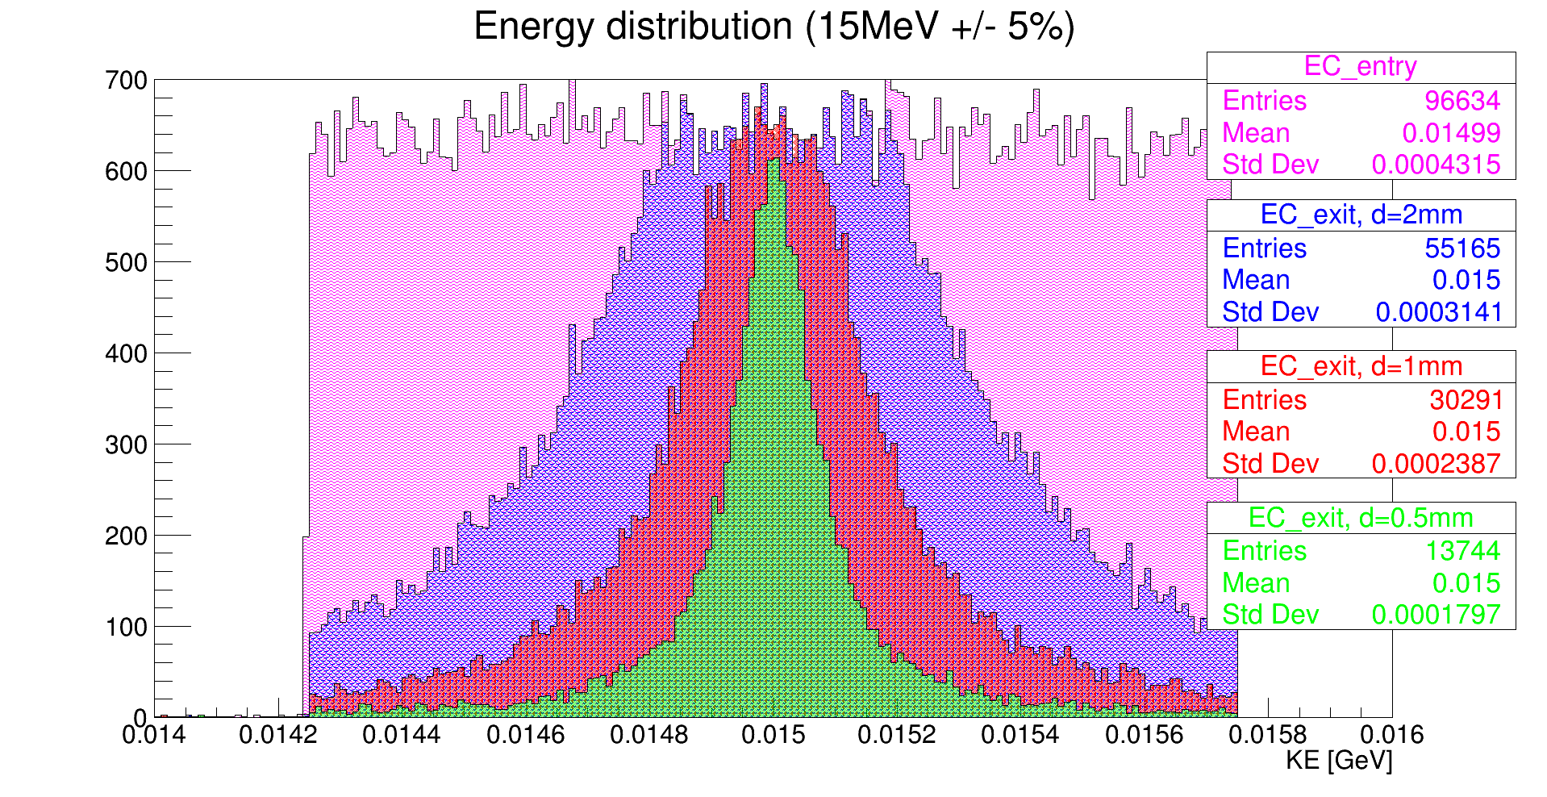
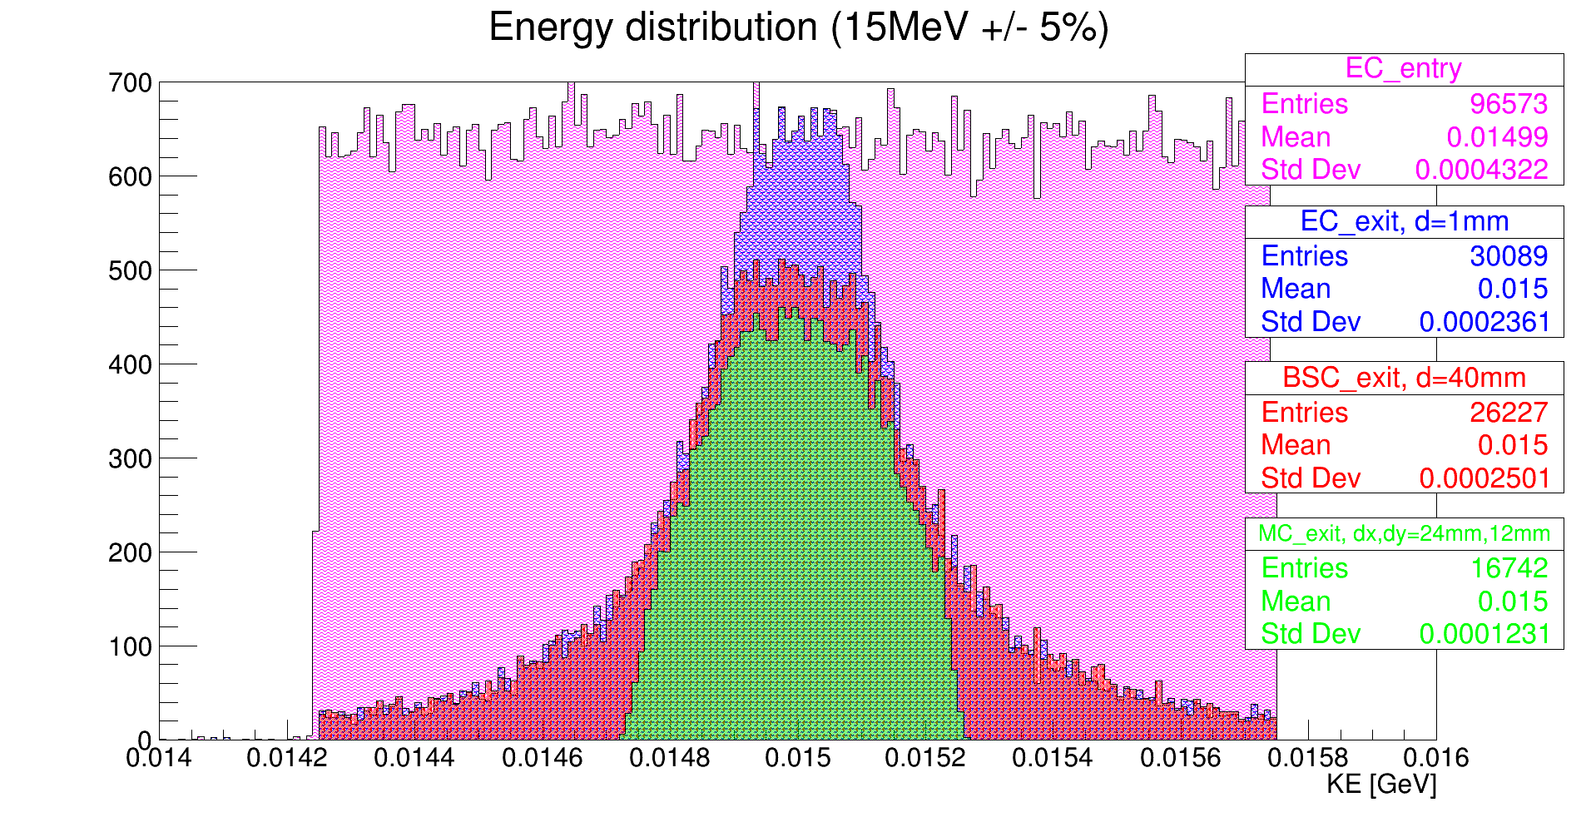

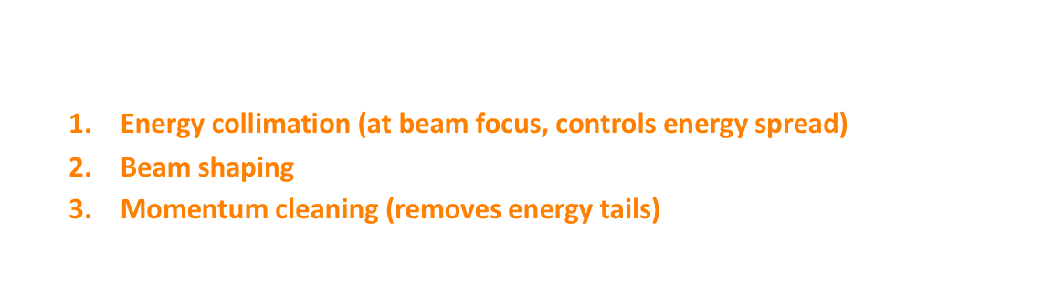
Energy collimation
1
1
0
3
2
$$±2\%$$
Flat initial energy profile $15 MeV±15\%$ (labelled “0”)
3 collimators
  Energy collimation (at beam focus, controls energy spread)
  Beam shaping
  Momentum cleaning (removes energy tails)
LhARA Stage 1 beamline
0

Slide 21
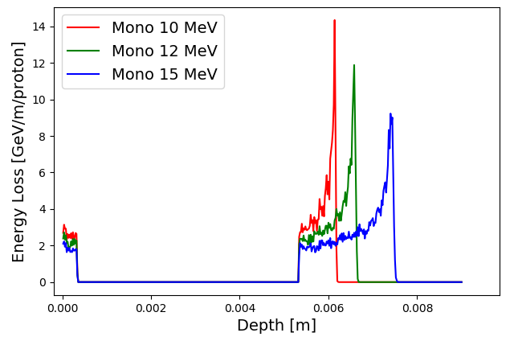
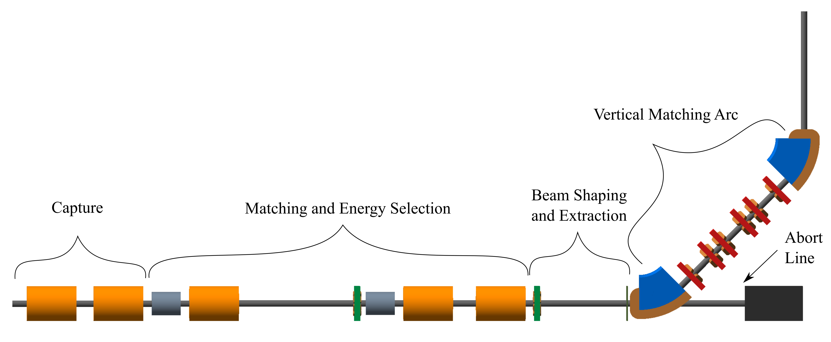
LhARA; stage 1
Pasternak
Dose uniformity
at end station
arXiv:2006.00493
arXiv:2006.00493

Slide 22
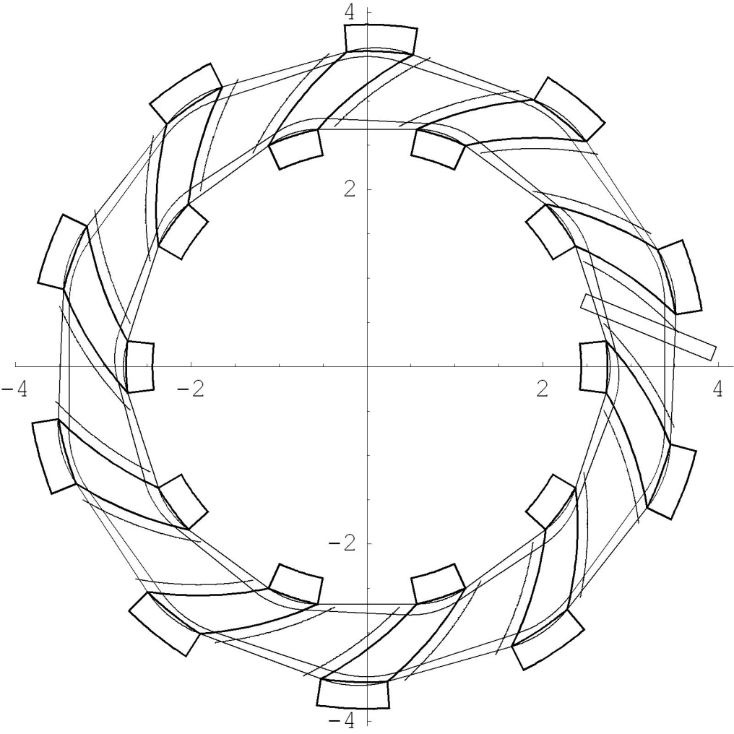
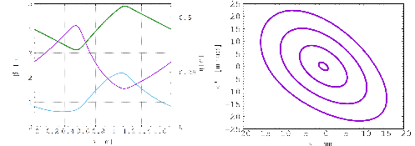
Rapid, flexible acceleration for stage 2
Dimensions in m
Fixed-field alternating-gradient accelerator (FFA):
  Invented in 1950s
    Kolomensky, Okhawa, Symon
  Compact, flexible solution:
    Multiple ion species
    Variable energy extraction
    High repetition rate
    Large acceptance
  Successfully demonstrated:
    Proof of principle at KEK
    Machines at KURNS, Kyoto, Osaka
    Non-scaling pop, EMMA, at DL
LhARA FFA
10 cells
2 MA loaded
RF cavities
arXiv:2006.00493

Slide 23
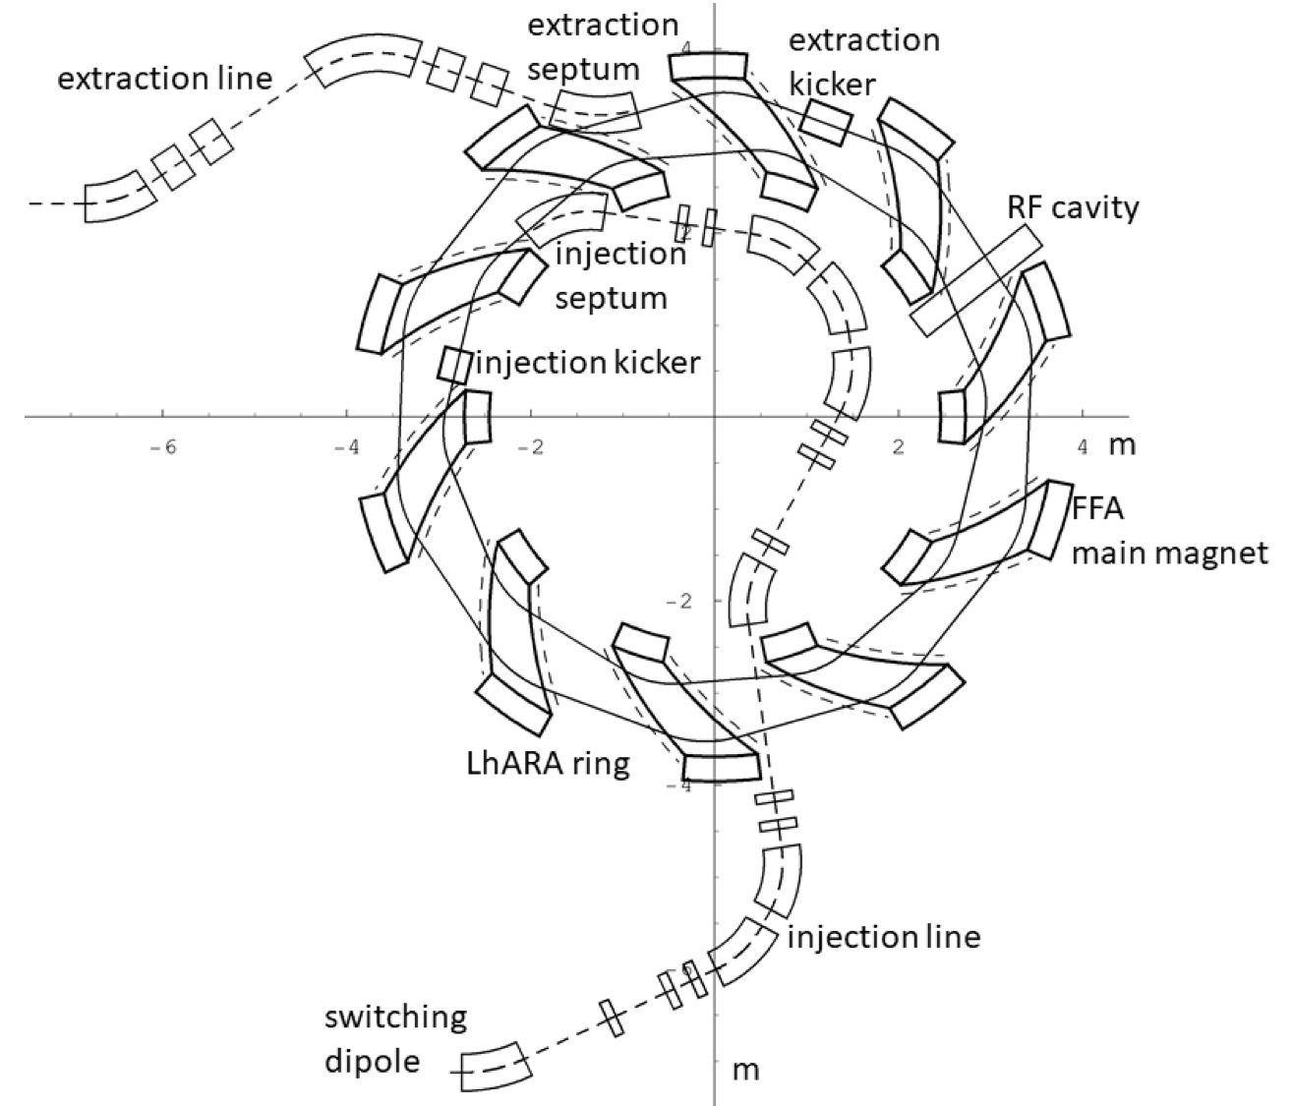
LhARA – Stage 2
In-vitro radiobiology using animal models:
  Post-acceleration required
Baseline: fixed field accelerator:
  x3 increase in momentum
    15 MeV protons accelerated to 127 MeV
    3.8 MeV/u carbon 6+ ions accelerated to 33 MeV/u
arXiv:2006.00493

Slide 24
Next steps; 5-year R&D plan
arXiv:2006.00493
5-year plan presented in pre-CDR designed to:
  Address technical risks presented in pre-CDR
    Especially source and plasma-lens capture
    Instrumentation and diagnostics
  Deliver technical designs for the LhARA facility
  End stations.
    Automation, sample handling, imaging
    Simulation, including impact on tissue/tissue response
→ Capability to start Stage 1 in-vitro programme

Slide 25
Radiobiology in new regimens

Slide 26
Conclusions
The Laser-hybrid Accelerator for Radiobiological Applications (LhARA)

Slide 27
Conclusions
Laser-hybrid approach has potential to:
  Overcome dose-rate limitations of present PBT sources;
  Deliver uniquely flexible facility:
    Range of ion species, energy, dose, dose-rate
  Disruptive/transformative approach to PBT ‘for 2050’ …
Opportunity:
  Develop and prove novel systems in operation;
  Deliver research facility dedicated to radiobiology;
  Contribute to study of biophysics of charged-particle beams
First and next steps:
  Initial concept developed and prototype evaluation underway
  Seeking resources to execute R&D programme laid out in ‘pre-CDR’
  Wonderful opportunity to build novel techniques to ‘spin back in’!

