Slide 1

Welcome and introduction

Slide 2
Welcome!

Slide 3
Medical accelerators; the challenge
Cancer is the second most common cause of death globally
Radiotherapy, indicated in half of all cancer patients
Significant growth in demand anticipated:
14.1 x 10⁶ new cases in 2012 ⇢ 24.6 x 10⁶ by 2030
8.2 x 10⁶ cancer deaths in 2012 ⇢ 13.0 x 10⁶ by 2030
Demographic:
Projections above based on reported cases (i.e. HIC)
Opportunity to save 26.9 x 10⁶ lives in LMIC by 2035
Scale-up in provision:
Requires development of new and novel techniques
Meeting the need will generate substantial economic impact

Slide 4
Medical accelerators; the opportunity
R&D programme:
Incremental development of current practice
System approach: robust, flexible next-generation facilities
Multi-disciplinary R&D to harness novel techniques
‘Spin-in’ opportunity for curiosity-driven science
Opportunity: contribute to underpinning science:
Radiobiology: especially charged particle (p, ion)
In-situ dose-deposition imaging: especially p, ion
Integration of on-treatment imaging, simulation, planning

Slide 5
Laser-hybrid Accelerator for Radiobiological Applications
LhARA; a novel, hybrid, approach:
High-flux, laser-driven proton/ion source;
Novel plasma (Gabor) lens capture & focusing
Post-acceleration and phase rotation: FFA &/or SC RF
Unique features:
Very large flux of p or ions in very short pulses:
Enormous instantaneous dose
Inject at ~15 MeV into first accelerating structure
Overcomes space-charge limit of today’s ion sources
Staged implementation:
In-vitro studies permitted at 15 MeV:
Source, capture, transport
In-vivo studies using post-accelerator (127 MeV p; ~35 MeV/u)
Uniquely flexible radiobiology facility:
Many ions, proton to carbon, in single facility
Wide range of energy and dose rate, allows UHDR/FLASH radiotherapy
Technologies can be developed to create uniquely flexible therapy facility

Slide 6
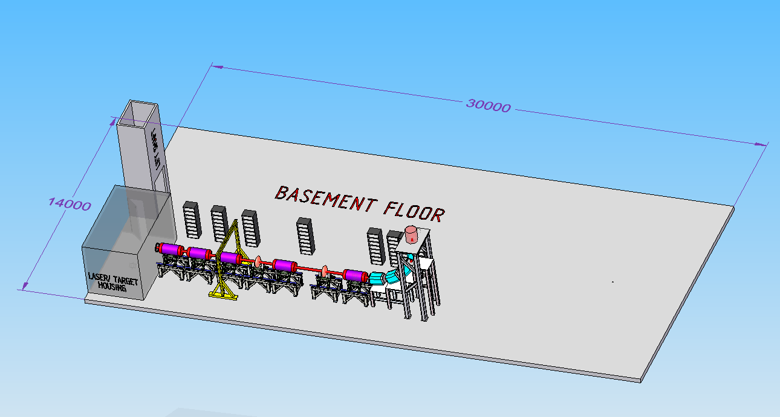
IN-VITRO BEAMLINE

Slide 7
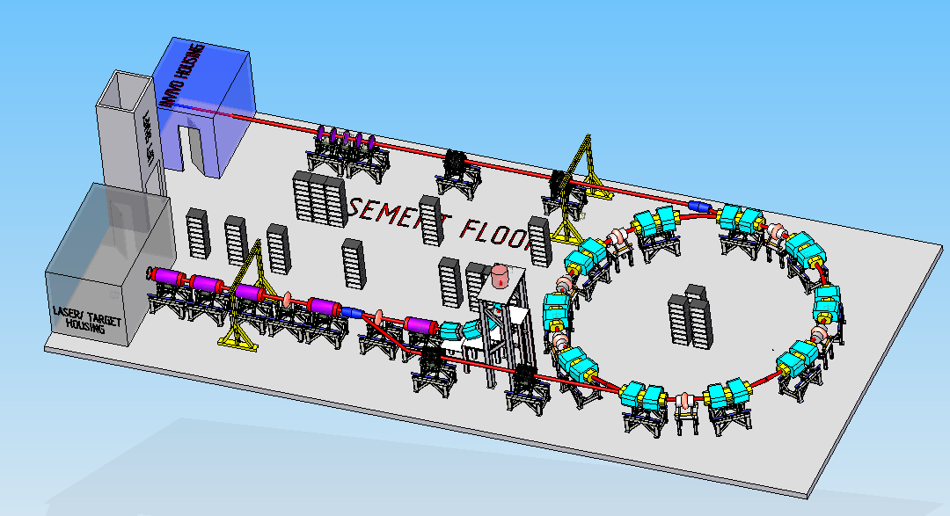
IN-VITRO & IN-VIVO LINES

Slide 8
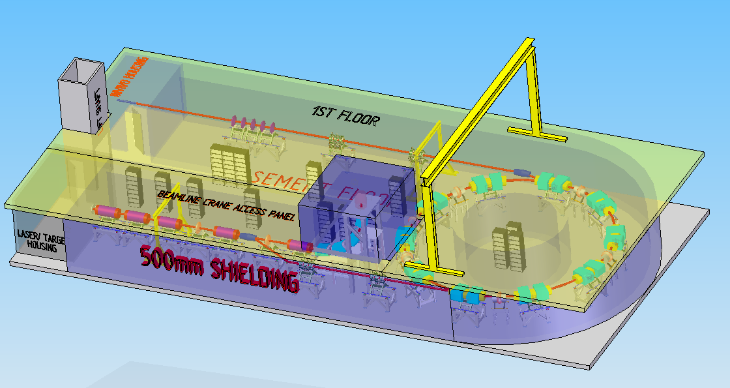
Infrastructure first pass

Slide 9
Project title: Advanced concepts and novel technologies for the study of the impact of ionising radiation on tissue
Programme: Advanced technologies for radiobiology and clinical radiotherapy
Project team: Ab initio a multi-disciplinary collaboration:
Clinical oncology, biology/biophysics, physics (laser, medical, accelerator, instrumentation), computing, laboratory, industry
Aims and objectives:
Outline CDR for the Laser-hybrid Accelerator for Radiobiological Applications:
Spring-board to bid successfully for significant resources to deliver the exciting programme.
Establish advanced-technology test-bed at the Clatterbridge Cancer Centre (CCC):
Early access to FLASH capability and essential test bed for development of LhARA.
Position UK as a force within International Biophysics Collaboration (IBC)
Optimise UK potential to contribute to – and to benefit from – the IBC.

Slide 10
Workpackages, deliverables, and cost
Preparation of initial CDR for LhARA:
Deliverable: initial CDR for LhARA [milestone April 2020]
Resources:
Key enabling investment: 1.75 PDRAs for 6 months
In place; can efficiently become core of effort to deliver initial CDR
Leverage support from participating institutes and project partners
Exploit strong synergy and close collaboration with ISIS Upgrade team
Request:
Staff: Imperial (Physics): £62.70k, Liverpool (Biology): £38.12k
LhARA and radiobiology test facility:
Deliverable: proton-FLASH dosimetry [milestone April 2020]
Resources:
Key enabling investment: 0.25 PDRA for 6 months
In place; existing collaboration with Clatterbridge Cancer Centre (CCC)
Leverage support from CCC, participating institutes, and project partners
Request:
Staff: Liverpool (Biology): £17.24k
UK and the International Biophysics Collaboration (IBC):
Deliverables: Forge UK identity and define UK role in IBC [milestone September 2021]
Resources:
Key enabling investment: UK and European travel for effective networking activity
Request:
Staff: Liverpool (Biology): £6.30k
Travel: £15k
Total cost to STFC: £139.35k In-kind income from project partners: £170.00k

Slide 11
Overview of timeline
Pre-CDR for LhARA:
6 months!
Launching point for preparation of follow-on proposals
Write in parallel to technical and simulation work
Can start now with Stage I documentation
Research beam line at Clatterbridge:
6 months:
More from Jason Parsons
Engagement with International Biophysics Collaboration:
2 years:
Need to engage straight away;
Build to follow-on funding bids

Slide 12
Stop press: Opportunity!

Slide 13

Sound, light, and particles

Slide 14
Opportunity
Presentation of ‘our vision’:
‘Insight’ meeting at the Royal Society 18Nov19
Extended peer-group discussion of ‘Sound and light’ theme:
Presently discussion of expansion to include particles
Opportunity to influence evolution of programme
Start preparation for this presentation now!

