Slide 1
Preparation of simulation for LhARA CDR
Modules and deadlines
… a provocation

Slide 2
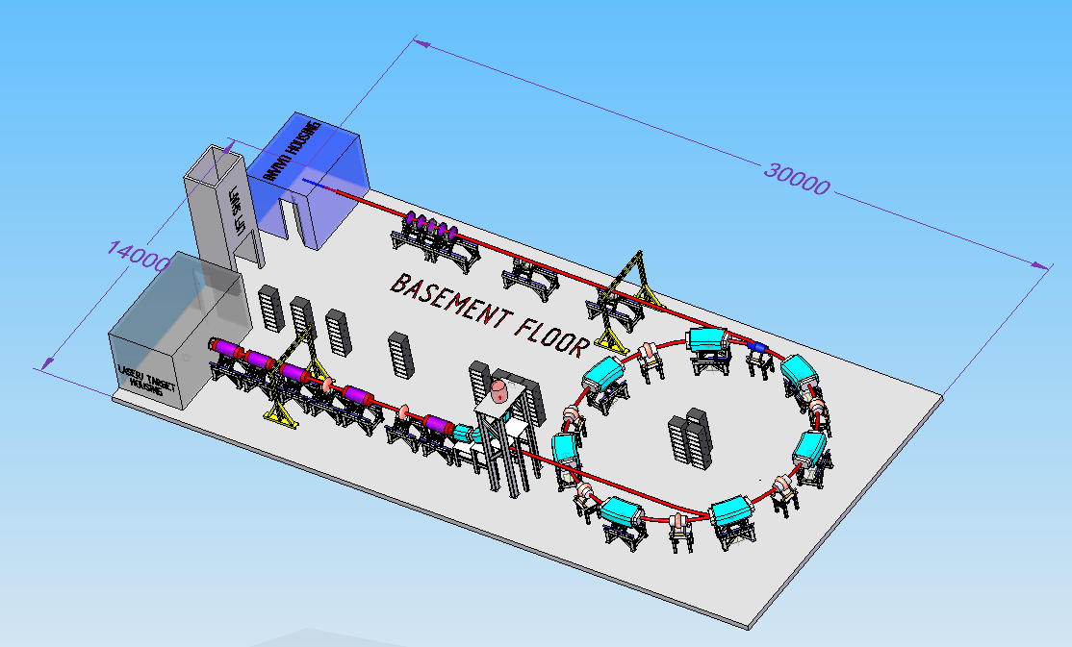
In-vivo end-station
High-energy beam transport
In-vitro end-station
Laser particle
source
Fixed-field accelerator
Low-energy beam transport
In-vitro beam-delivery system

Slide 3
Milestones
Beam to in-vitro end-station:
30Sep19:
Implies need for magnetic field for the vertical bend: we agree
Fallback: separated function magnets—ready for early September
Baseline: magnets with similar optics to spiral FFA--follows
Laser source:
Proton/electron:
C⁶⁺ and other ion pollution
Agreed: write define definition of i/p
Need to define someone to do the simulation (in Smiley)
Following deadlines to be agreed

