Slide 1
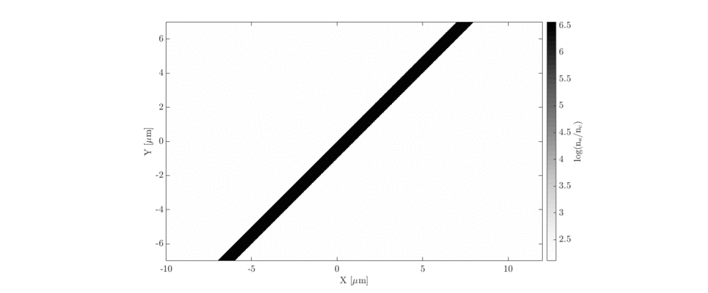
Laser-driven source
Laser:
Ti:Sapphire commercial system >15TW
Short pulse (~35fs), high rep-rate (at least 10Hz) operation
At least 500mJ laser energy - IL ~ 10²⁰ Wcm⁻²; a0 ~ 7
Proton energies > 8.9MeV
bidding for full €1m (£600k) - still in discussion about what this could buy
probably need dedicated laser scientist to operate the laser/fix alignment and more serious issues, etc.
Ion generation:
TNSA sheath acceleration scheme to be employed
Energies > 8.9MeV with charges up to (and perhaps exceeding) 100pC at 8.9±1MeV (>10⁹ particles)
Dedicated target area required - vacuum chamber and accessories, optics, optomechanics, etc.
Will need dedicated scientist to monitor and run this part of the proposal

