Slide 1
Radiobiological Endstation

Slide 2
Aim
Compare the protons genereated in the hybrid accelerator with a) photons (200 kV X-rays) and b) protons generated at MedAustron with a synchotron

Slide 3
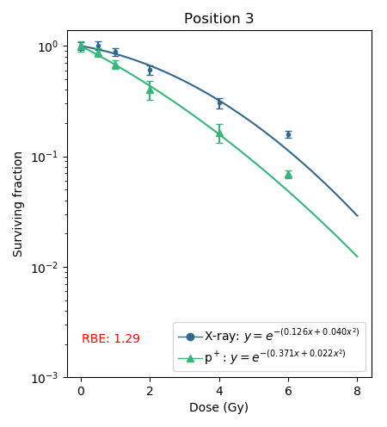
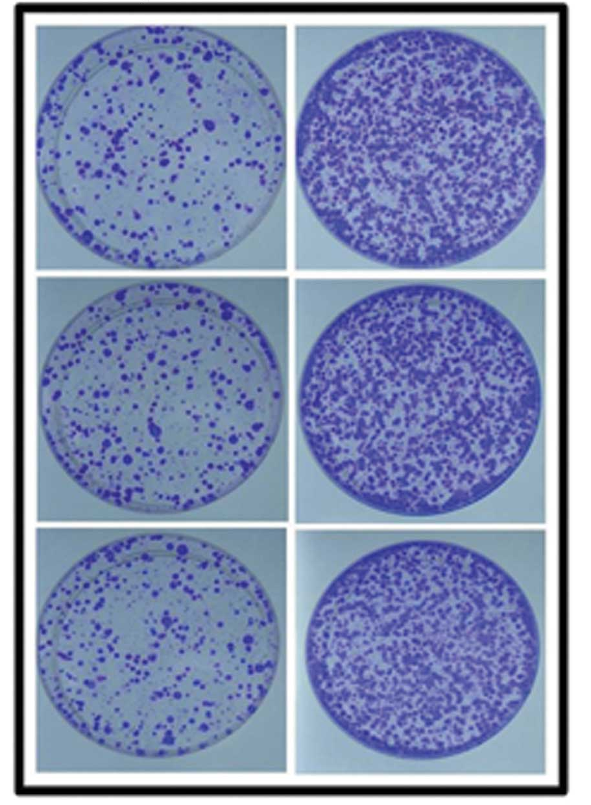
Research Question 1
Are protons from the hybrid acc equally effective compared to synchotron acc protons?
  Analyses of Cell Survival after irradiation
p+
Xray
Gold standard method for the characterization of novel irradiation techniques/sources
Irradiation response to multiple dose levels can be investigated at various levels of cell survival

Slide 4
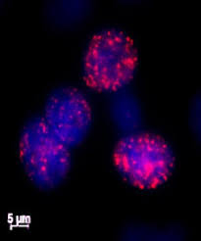
Research Question 2
Is the damage pattern equal to synchotron acc protons given the same dose?
  Analyses of DNA double strand breaks after irradiation
  Efficacy as well as savety

Slide 5
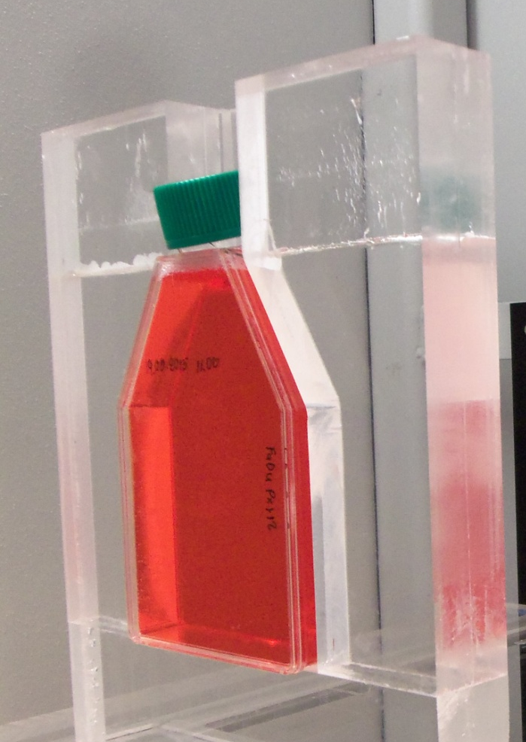
Limitations
Main problem: 5.6 MeV protons delivered by the hybrid acc
Limitation of penetration depth to 0.5mm in water
P+ will already stop in the approx 1-2 mm plastic of the cell culture flask

Slide 6
Mitigation
Trying to grow cells on foile instead of plastic – ongoing experiment at MedAustron
5.6 MeV will most likely not be enough, as also the foile has a certain thickness.

Slide 7
Preliminary Proposal Contributions
M4.1: Equipping the facility for radiobiological research
M4.2: Evaluation of cell survival after reference-, control-, and laser-accelerated ion irradiation.
M4.3: Evaluation of DNA damage and damage clearance after reference-, control-, and laser-accelerated ion irradiation.
M4.4: Evaluation of differential immunogenic signalling after reference-, control-, and laser-accelerated ion irradiation – this endpoint is hard to plan for: if the problems with the energy etc can be overcome easily, the endpoint can be fullfilled, otherwise eventually not
Workpackages (WP) | Year 1 |  |  |  | Year 2 |  |  |  | Year 3 |  |  |  | Year 4 |  |  |  | Year 5
 | Q1 | Q2 | Q3 | Q4 | Q1 | Q2 | Q3 | Q4 | Q1 | Q2 | Q3 | Q4 | Q1 | Q2 | Q3 | Q4 | Q1 | Q2 | Q3 | Q4
WP1: Laser-driven particle source
WP2: Particle capture
WP3: Beam transport and delivery
WP4: Endstation for radiobiological research |  |  |  |  |  | M1 |  |  |  |  |  | M2 |  |  |  | M3 |  |  |  | M4
WP5 System integration
WP6: Project management

Slide 8
experiment | short description | equippment | comment | requirments | company | price (€) | comment
General requirements | necessary for culturing of cells and any following experiments | X-ray referece irradiatior |  |  |  | 200.000 | available at MA
 |  | Cell culture bench |  |  |  |  | require on site
 |  | Pump |  |  |  |  | require on site
 |  | Incubator (37°C, 5% CO2) |  |  |  |  | require on site
 |  | culture plates |  |  |  |  | require on site
 |  | media and supplements | depending on cell lines |  |  |  | require on site
 |  | consumables (pipettes, tips, glassware, etc) |  |  |  |  | require on site
Cell Survival for RBE analyses | The cell survival after irradiation with the plasma-driven acc will be analysed at different dose levels (0.5 - 8 Gy). Resulting cell survival curve will be compared to a) reference irradiaiton (X-rays) and b) MedAustron proton and/or carbon results | cell counter |  |  | Beckman Coulter | 330 | require on site
 |  | Colony Counter | only necessary when many experiments are planned, otherwise analyses by hand is feasible | whole workstation including analysis software | BioSpot | 90.000 | available at MA
 |  | Microscope | either 1 transmitted light and 1 fluorescence or 1 combined |  | Zeiss | 3000 | required on site (transmitted light)
 |  | methanol (4L) |  |  | Thermo Scientific | 151 | required on site
 |  | crystal violet (25g) |  |  | Thermo Scientific | 100 | required on site
DNA damage analyses | DNA damage will be analysed immediatly after irradiation and 24 hours later to compare the levels of non-repairable (hence complex) DNA damage after plasma-dirven acc, X-ray and MedAustron proton and/or carbon irradiation | Nunc™ Lab-Tek™ Flask on Slide | has to be used if MedAustron Setup will be used - if not, other choices cna be made |  | Thermo Scientific | 442 | required on site
 |  | 4 % paraformaldehyde (1L) |  |  | Carl Roth | 10 | required on site
 |  | sodium dodecyl sulfate (25g) |  |  | Sigma Aldrich | 45 | required on site
 |  | Triton X100 (100ml) |  |  | Sigma Aldrich | 45 | required on site
 |  | > 99.8% Ethanol (2.5L) |  |  | Sigma Aldrich | 70 | required on site
 |  | bovine serum albumine |  |  | Sigma Aldrich | 38 | required on site
 |  | normal goat serum |  |  | Jackson Immuno Research | 45 | required on site
 |  | Rhodamine (TRITC)-conjugated AffiniPure Goat Anti-Mouse IgG |  |  | Jackson Immuno Research | 173 | required on site
 |  | anti-phospho-Histone H2A.X (Ser139) antibody |  |  | Millipore | 512 | required on site
 |  | Vectashield hardset with DAPI |  |  | Szabo Scandic | 205 | required on site
 |  | Axioimager fluorescence microscope with automated scanning system Metafer |  | for automated foci counting | MetaSystems | 155.000 | available at MA
 | item can be used at MedAustron
 | item is standard in any bio-research lab - please ask collaboration partners in-house if you can use it
 | has to be purchased

