Slide 1
Beamline Simulation

Slide 2
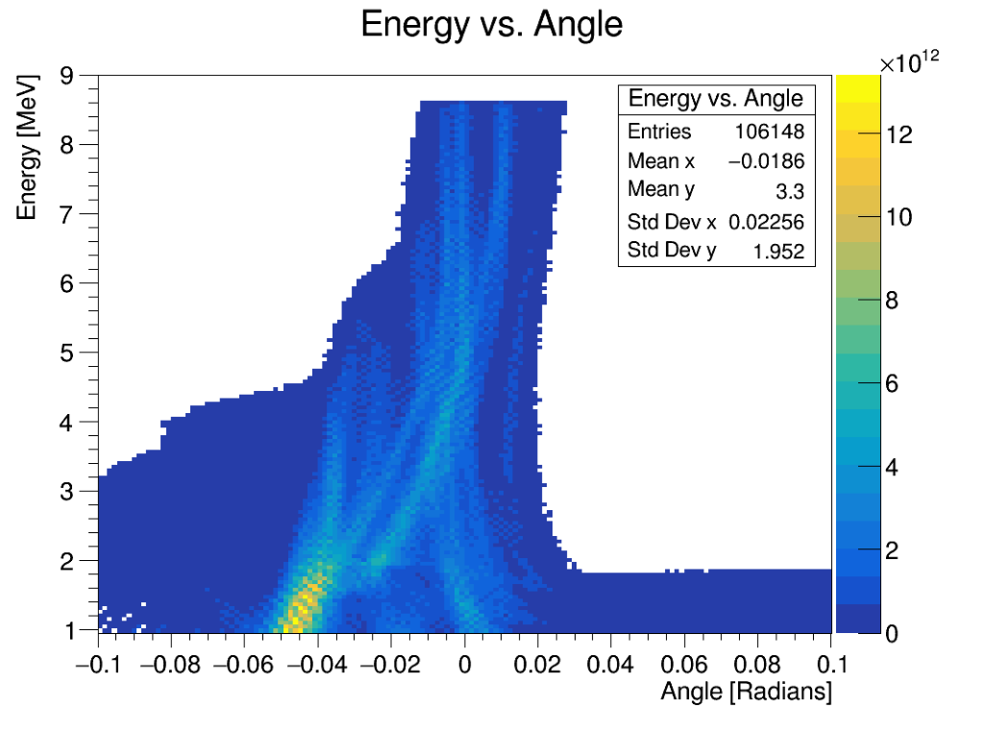
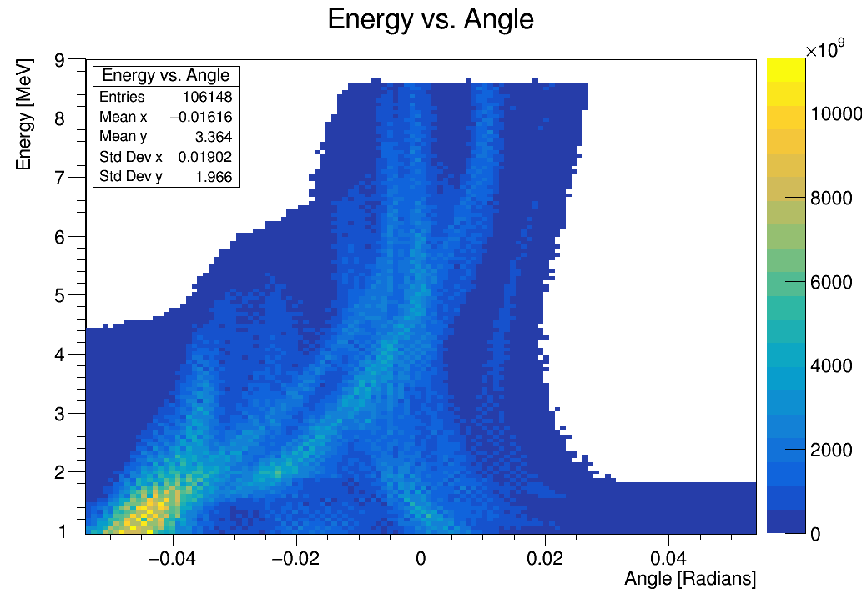
Input Beam Selections

Slide 3
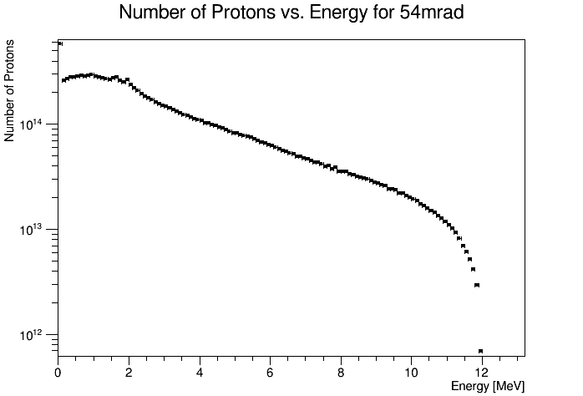
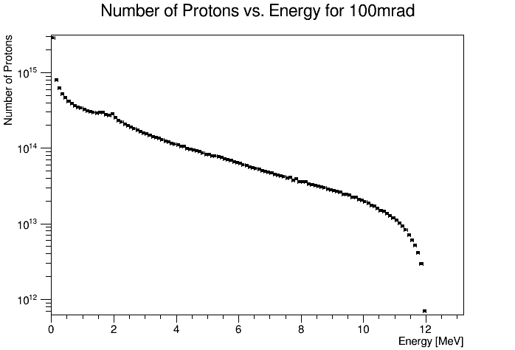
Input Beam Comparison

Slide 4
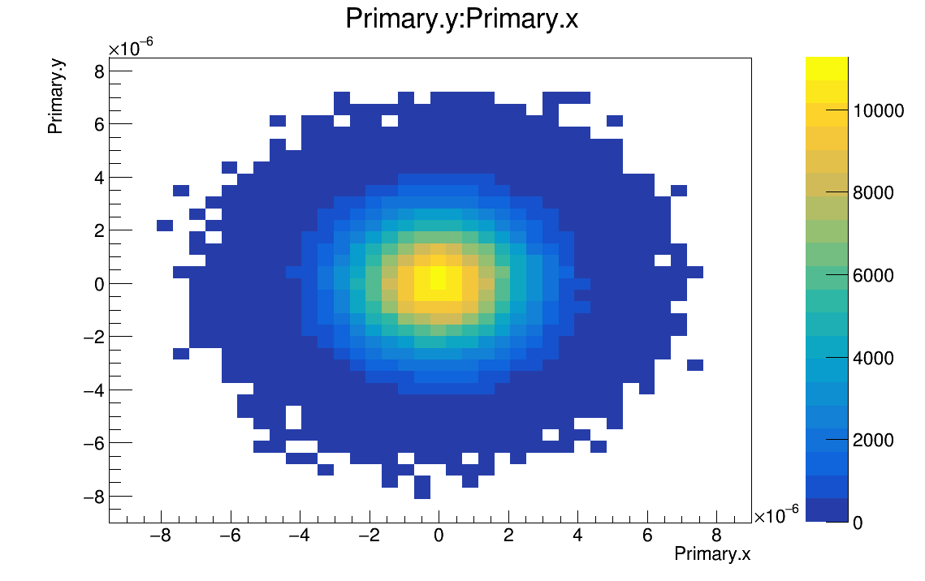
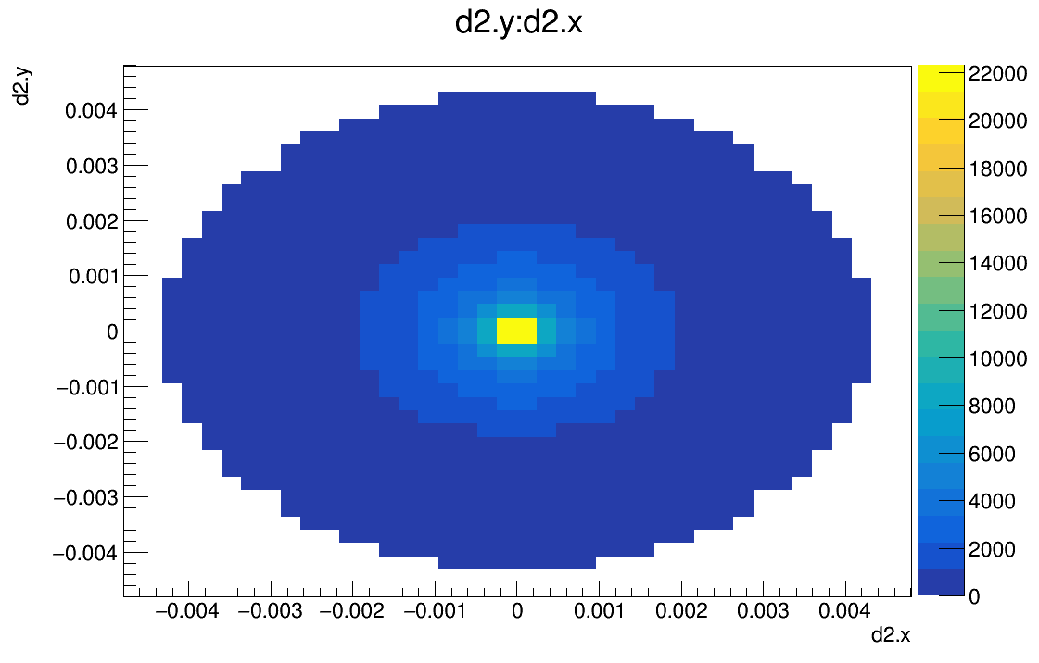
Beam in BDSim
Energy: 8.6MeV±10%
Assumed Gaussian distribution with σ=1.7um.
Run with 1 million particles.

Slide 5
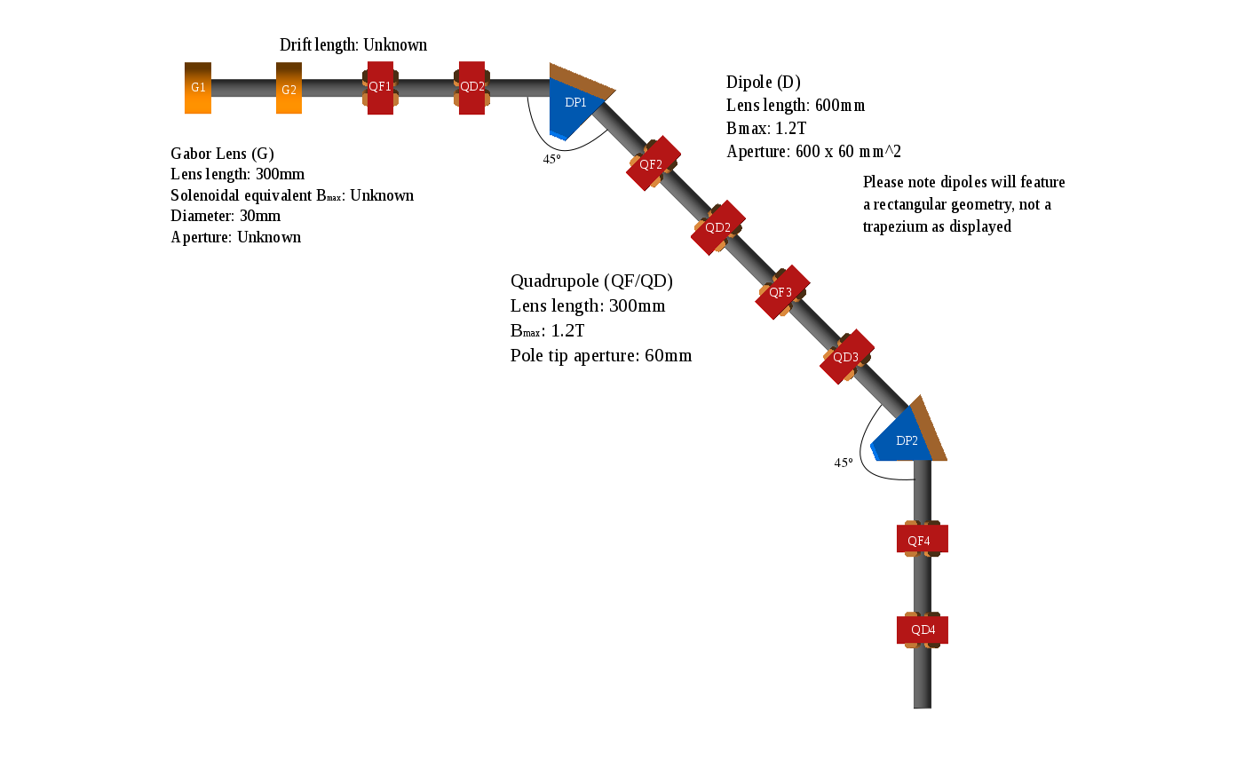

Slide 6
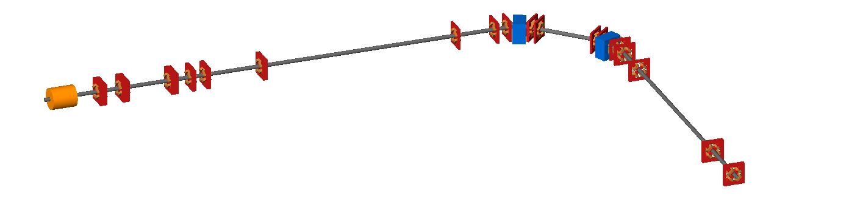

Slide 7
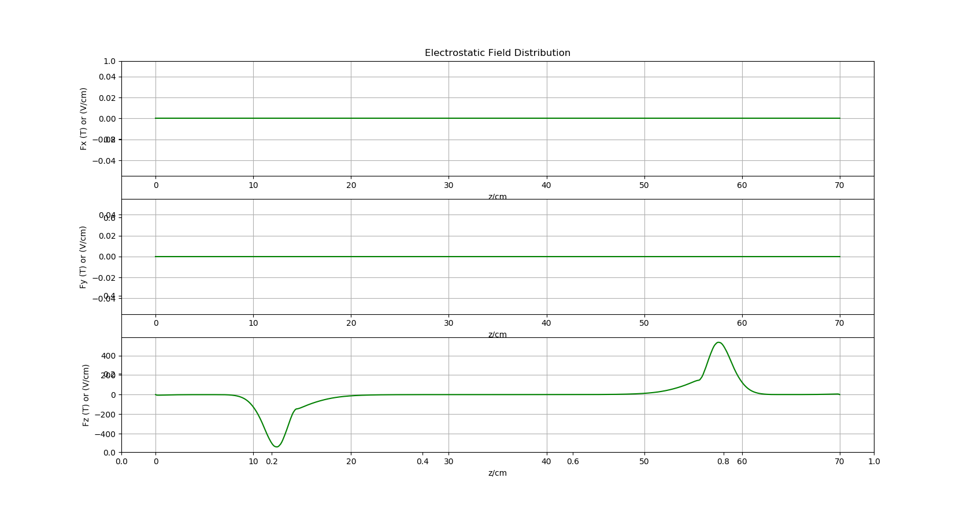
Gabor Lens Electric Field Map (On-Axis)

Slide 8
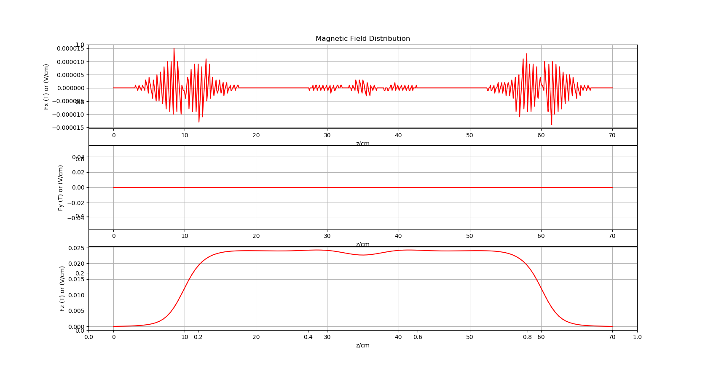
Gabor Lens Magnetic Field Map (On-Axis)

