Slide 1
Centre for the
Clinical Application of Particles

Slide 2
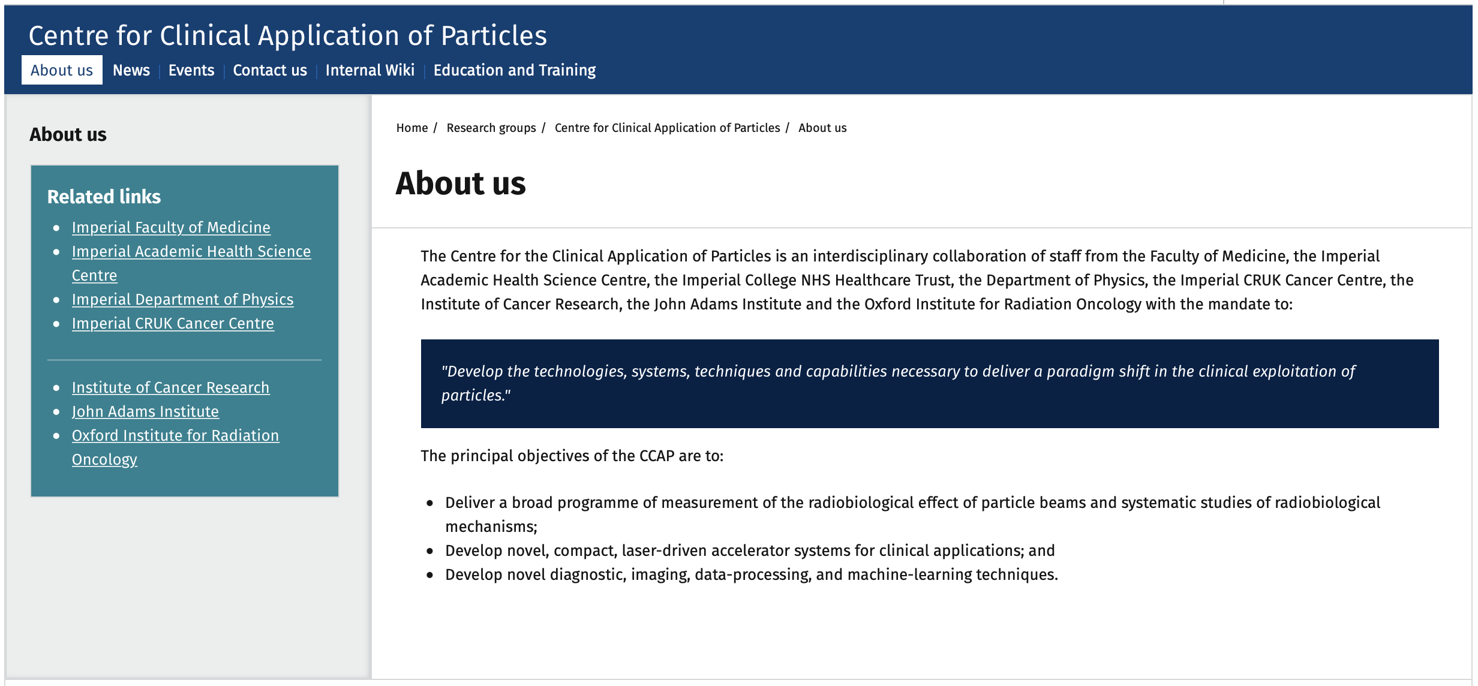
2. Scopes and objectives

Slide 3
1. Centre for the Clinical Application of Particles; details
Host Department: Physics
Departments involved:
Faculty of Medicine:
  Division of Cancer in the Department of Surgery and Cancer
Imperial Academic Health Science Centre
Imperial College NHS Healthcare Trust:
  Department of Radiation Physics and Radiobiology
Department of Physics:
  High Energy Physics Group
  Plasma Physics Group
Imperial CRUK Cancer Centre
Institute of Cancer Research
John Adams Institute
Oxford Institute for Radiation Oncology
Kenneth Long (Physics)
Ajit Kurup (Physics)
Date of approval: July 2017
Latest annual report: November 2019

Slide 4
1. Centre for the Clinical Application of Particles; details
Management Board
Eric Aboagye (Dept. of Surg. & Cancer, FOM)
Iain McNeish (Head Division of Cancer, Dept. of Surg. & Cancer, FOM)
Daniel Elson (Dept. Surgery and Cancer, FoM))
Uwe Oelfke (ICR, Deputy Head Div. of Rtherapy and Imaging,
Head Joint Dept. of Physics; ICR and Royal Marsden NHS Trust)
James Meredith (Director of Operations, Imperial/ICR Convergence Science Centre)
Dorothy Gujral (Consultant clinical oncologist, IC NHS H/c Trust)
Claire Hardiman (Head of Rad. Phys. & Rbio Dept. at IC H/c NHS Trust)
Matthew Williams (Consultant clinical oncologist, IC NHS H/c Trust)
Philip Burrows (JAI, Oxford)
Juergen Pozimski (Physics, HEP, JAI)
Amato Giacca (Director, OIRO)
Frank van den Heuvel (OIRO)
Zulfikar Najmudin (Physics, Plasma)
Jaroslaw Pasternak (Physics, HEP)

Slide 5
1. Centre for the Clinical Application of Particles; details
International Advisory Board
Michael Lamont (CERN, Director of Accelerators and Computing, Chair)
Paul Bolton (LMU, laser-plasma scientist, retired)
Mattheus Baumann (Chairman and Scientific Director, DKFZ, Heidelberg)
Britta Sorensen (Dept. of Clinical Medicine, DCPT, Arhuus)
Being set up; projected first meeting Jan22

Slide 6
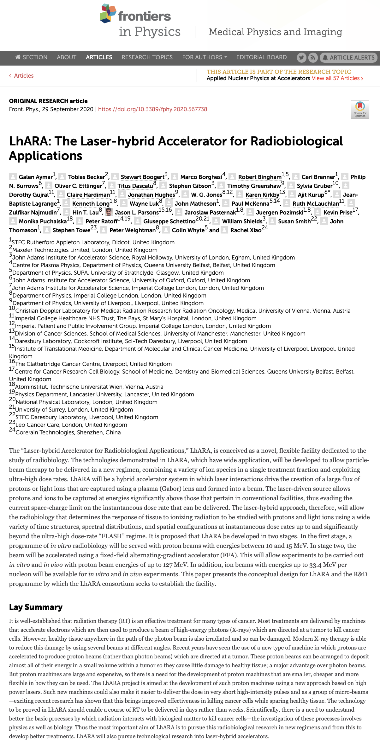
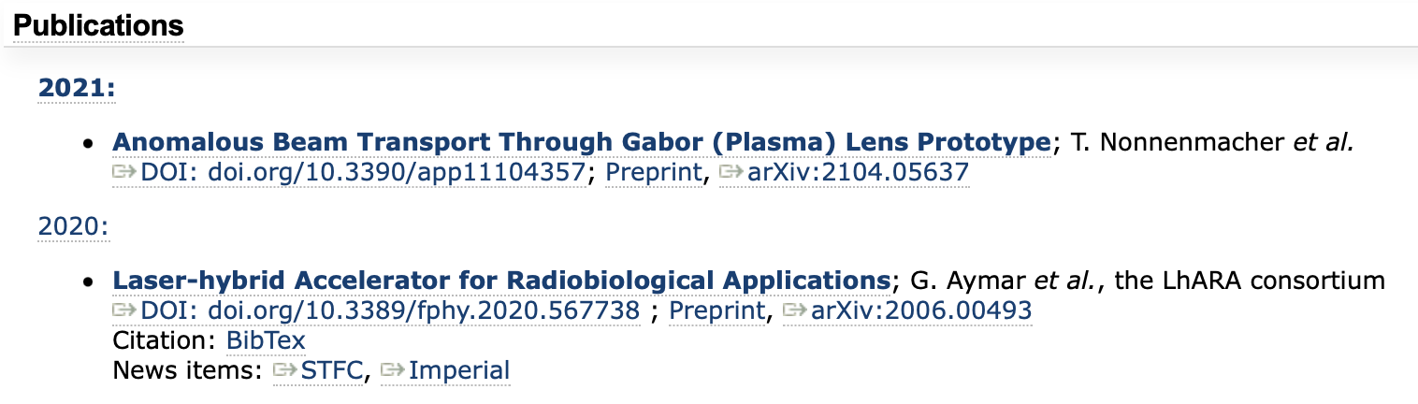
3. Overview of activity undertaken
Please summarise the 5 most relevant activities undertaken since Centre of Excellence status approval

Slide 8
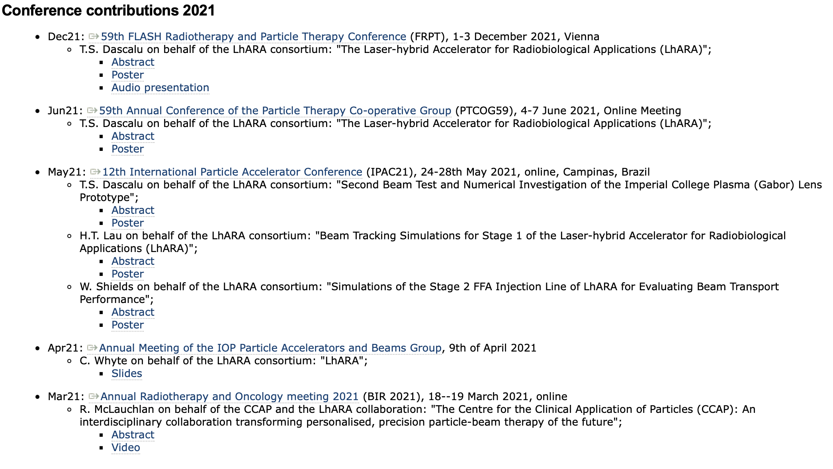
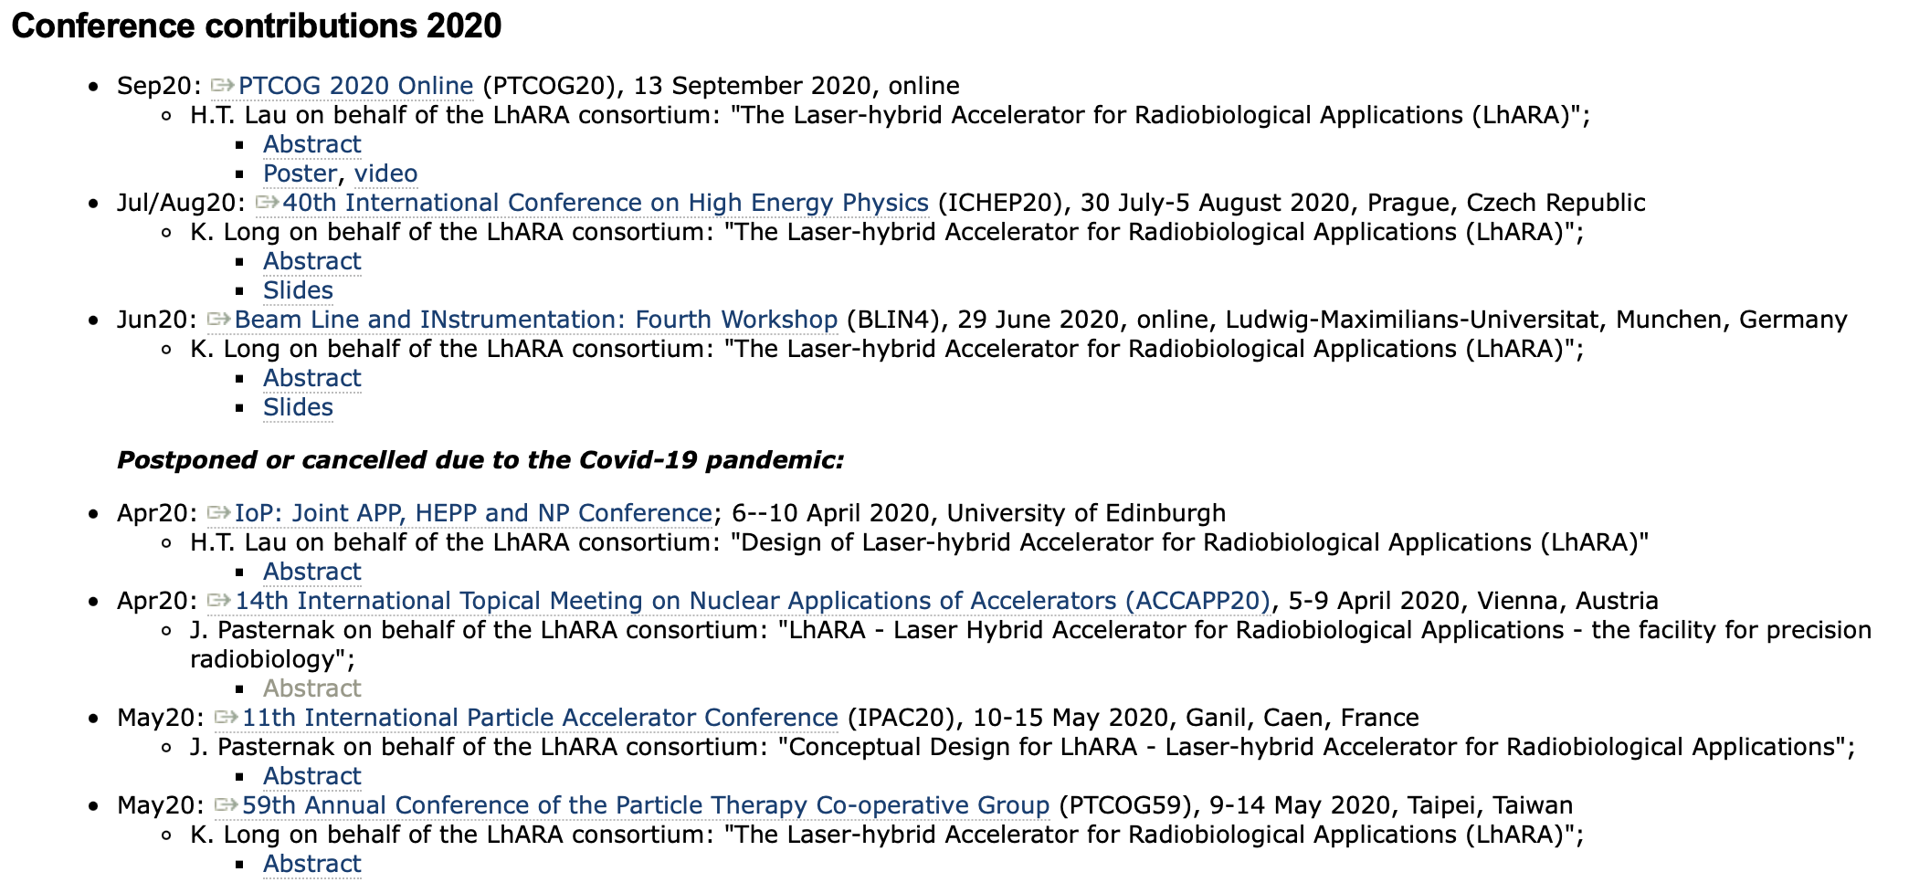
3. Overview of activity undertaken

Slide 9
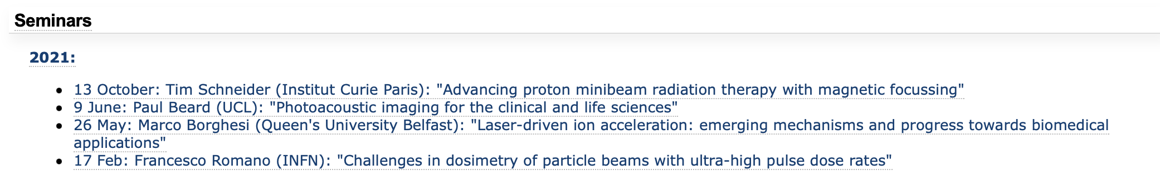
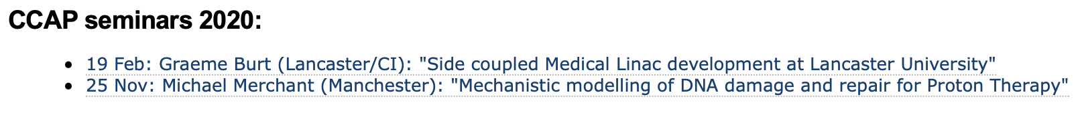
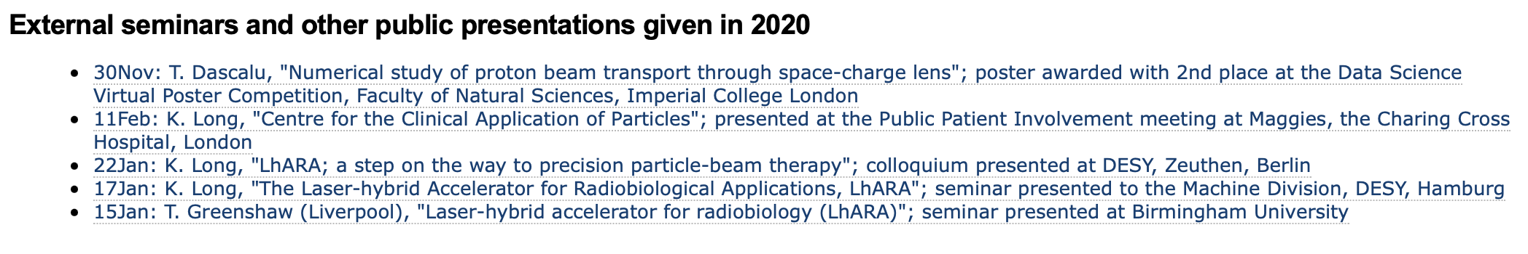
3. Overview of activity undertaken
Add 2021!

Slide 10
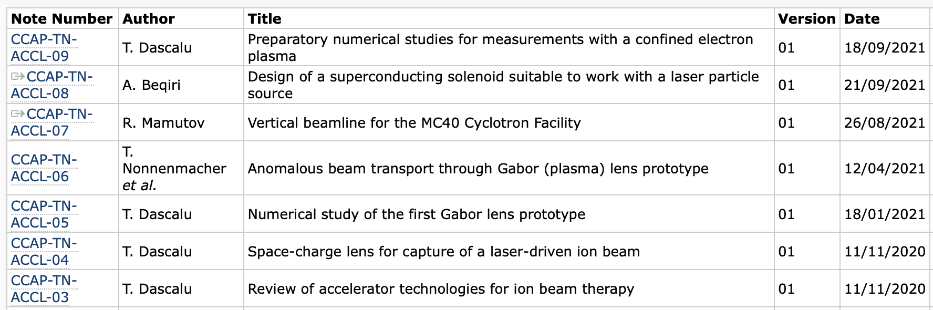
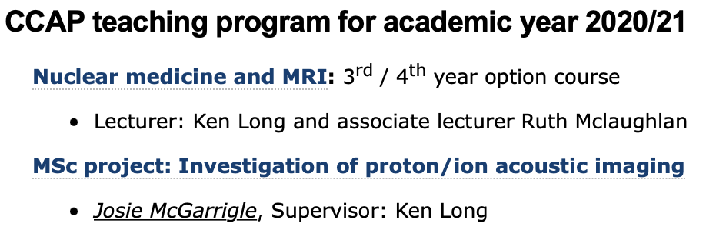
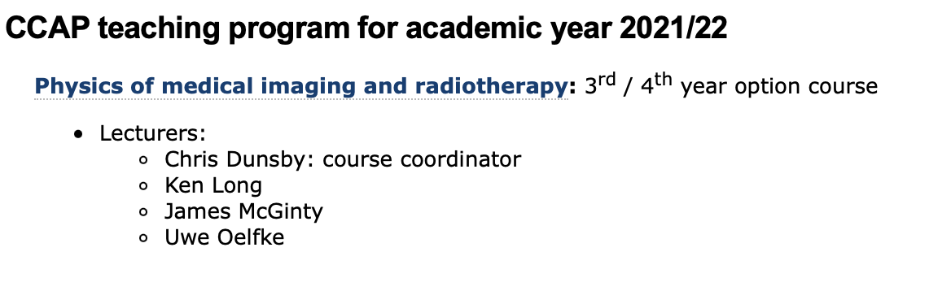
3. Overview of activity undertaken
Graduate students:
HT Lau: 2017 start; submitted xxDec21
T.S. Dascalu: 2019 start; Class of 64
M. Maxouti; 2021 start; JAI/PPD
J. McGarrigle; 2021 start; ICL/CNRS Institut Curie

Slide 11
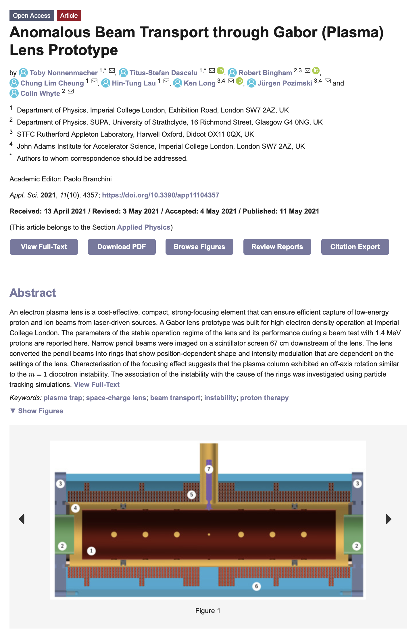
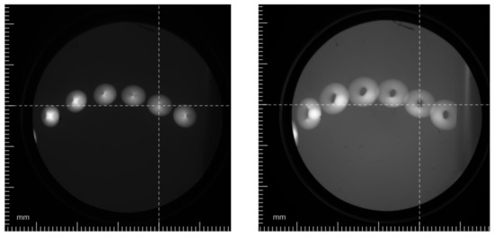
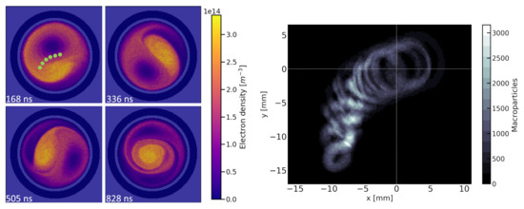
3. Research highlights

Slide 12
5. Opportunities
Repurposing of clinac in bunker for photon/electron radiation biology
  IC NHS H/c trust: Hammersmith
    Claire Hardiman et al
LhARA in the context of the ITRF

