Slide 1


Diagnostics for LhARA: a Laser-based Beam Line for Clinical Applications
CCAP Diagnostics Workshop 2019
Ajit Kurup
19th March 2019

Slide 2





Introduction
The ‘Centre for the Clinical Application of Particles’ (the CCAP) is an interdisciplinary collaboration of personnel from:
  The Imperial Department of Physics, the Imperial Faculty of Medicine, the Imperial Academic Health Science Centre, the Imperial CRUK Cancer Centre, the Institute of Cancer Research, the John Adams Institute and the Oxford Institute for Radiation Oncology
The Centre’s programme will:
  Develop novel, compact, laser-driven accelerator systems for clinical applications;
  Deliver the capability to assess the biological and therapeutic efficacy of different ion species; and
  Develop improved diagnostic, dose-measurement, imaging, treatment-planning, data-processing, and machine-learning techniques.
Conceptual design of Laser Hybrid Accelerator for Radiobiological Applications (LhARA) in preparation.
Diagnostics devices for LhARA under development.

Slide 3
LhARA

Slide 4
Laser Hybrid Accelerator for Radiobiological Applications – LhARA
Laser Hybrid Accelerator for Radiobiological Applications (LhARA) is a facility proposed by the CCAP that will study radiobiological effects using a laser-driven ion beam.
  Intense beams.
  Protons and light ions, e.g. carbon.
  First step will deliver in vitro studies of radiobiological effects.
  Second step will allow in vivo studies.
Conceptual design of LhARA requires simulation of accelerator components and being able to study dose deposition in the cells and surrounding material in the end-station.
Beam optics of the initial conceptual design has been studied.
  Particle tracking simulations using BDSIM (Geant4 based toolkit) to compare with the optics design.
  Study energy loss in the end station and verify required beam parameters.
  Material budget for diagnostics in the end station.

Slide 5
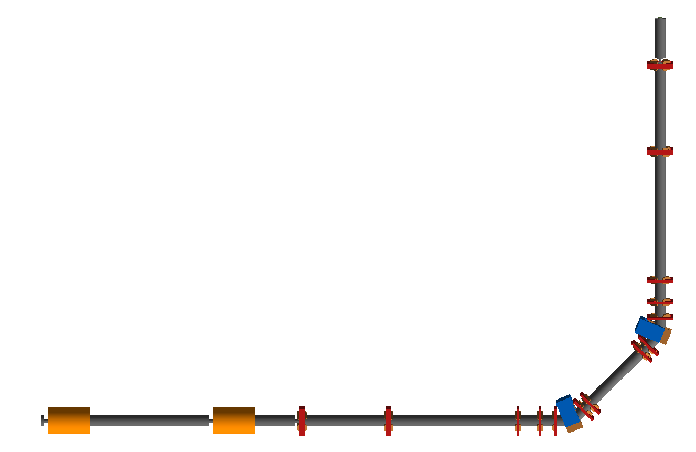



Initial Concept for LhARA Step 1
END STATION
Where the cells will be irradiated. The beam will be delivered vertically from below the cell sample container.
Q14
y
DOWNSTREAM MATCHING
Quadrupole focussing channel to match the beam to the end station
z
Q13
9.21m
LASER TARGET
Laser used to generate intense ions beams and beams of different types of ions, e.g. protons and carbon ions.
ENERGY AND ION SELECTION
Dipole bending and collimator system to select particles based on momentum.
CAPTURE SECTION
Gabor lenses used for compact focussing to capture the large divergence and energy spread of the laser driven ion beam.
Q12
D2
45$°$
Q11
UPSTREAM MATCHING
Quadrupole focussing channel to match the beam from the Gabor lenses to the dipole.
Q10
D1
45$°$
Q9
Q8
45$°$
laser
Q7
Q4
Q5
Q6
GL1
GL2
Q1
Q2
Q3
14.05m
Total beam line length: 22m

Slide 6
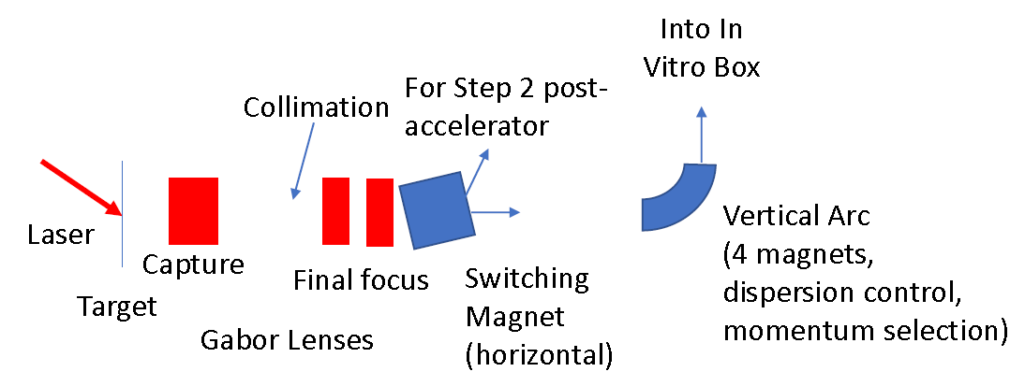
Alternative Beam line
More compact design in progress.
Capture and beam transport based on Gabor lenses.
Energy selection based on collimation.
Momentum selection in the arc.
Option to use normal conducting solenoids.
5m

Slide 7
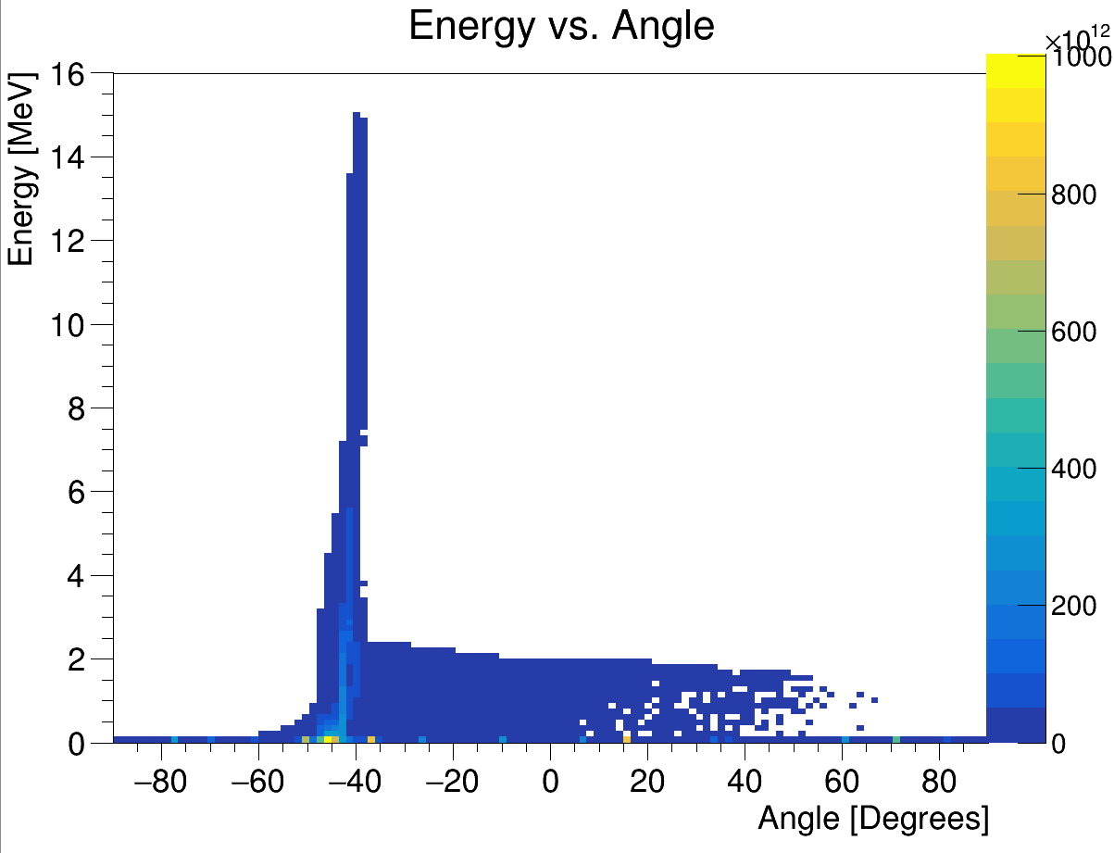
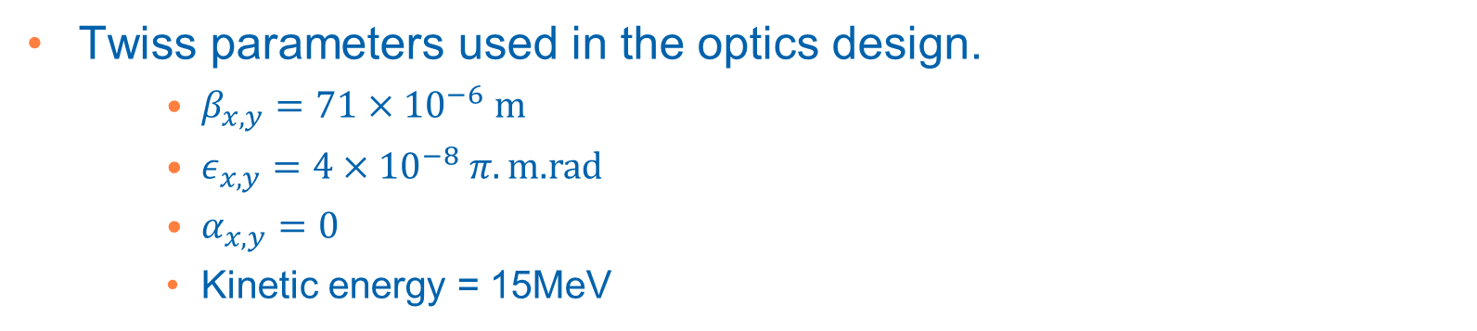
Initial Beam
Energy vs angle with respect to laser beam direction
Positive ions from hydrocarbon contamination on the target surface
LASER
+
+
+
+
+
+
+
+
+
+
-
-
-
-
-
-
-
-
Ion beam
Electron sheath generated by the laser accelerates positive ions from the target
Produces intense beams and multiple species, e.g. proton and carbon ions.
Laser driven ion beam simulation using EPOCH.
Twiss parameters used in the optics design.
    $β_{x,y}=71×{10}^{−6} m$
    $ε_{x,y}=4×{10}^{−8} π.\text{m}\text{.}\text{rad}$
    $α_{x,y}=0$
    Kinetic energy = 15MeV
Small beam size and large divergence.

Slide 8
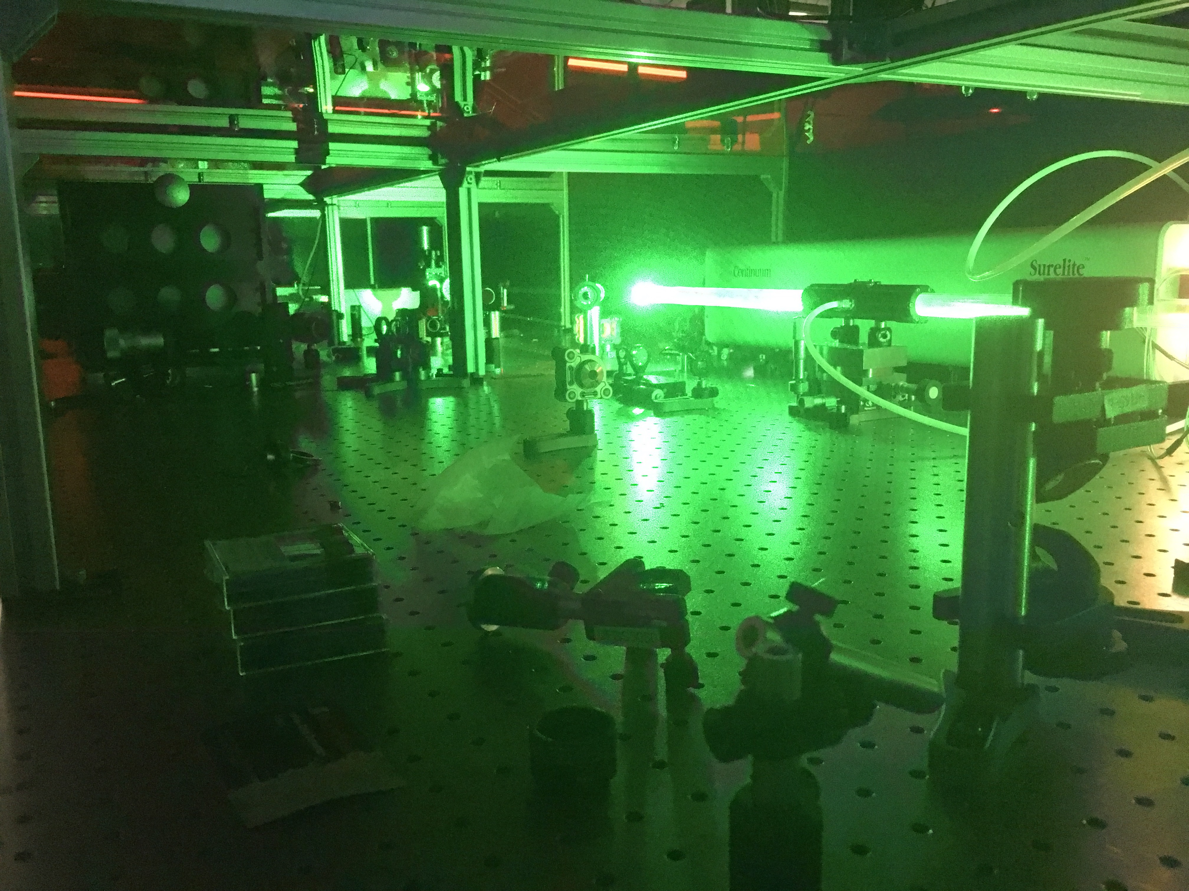
Zhi Laser System
Ti:Sapphire based system – currently 100mJ in 38fs at 10Hz rep rate.
Planned applications: ion acceleration studies (fundamental and for applications); high repetition, compact laser wakefield acceleration and x-ray imaging
Currently about to begin first commissioning experiments
Oliver Ettlinger

Slide 9
Zhi Laser System
Have grant funding to upgrade laser further:
  £250K to spend on laser development:
    Already purchased Dazzler to improve pulse compression further
    Improved pumping to achieve 100Hz rep rate – 100mJ, 100Hz.
    Vacuum compressor and transport to achieve 1J in <40fs at 10Hz → I > 10²⁰ W/cm²
Hope to achieve ion energies of order 10-15MeV from rastered tape targets.
Oliver Ettlinger

Slide 10
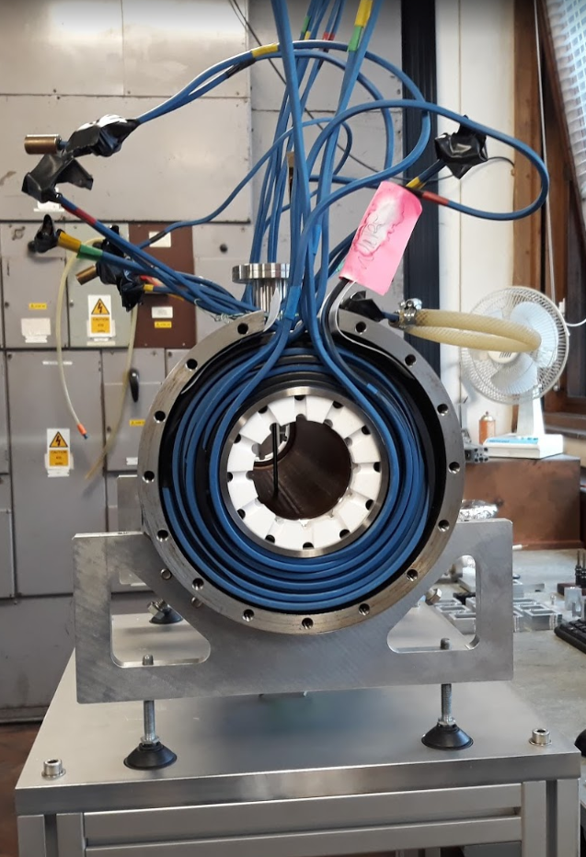
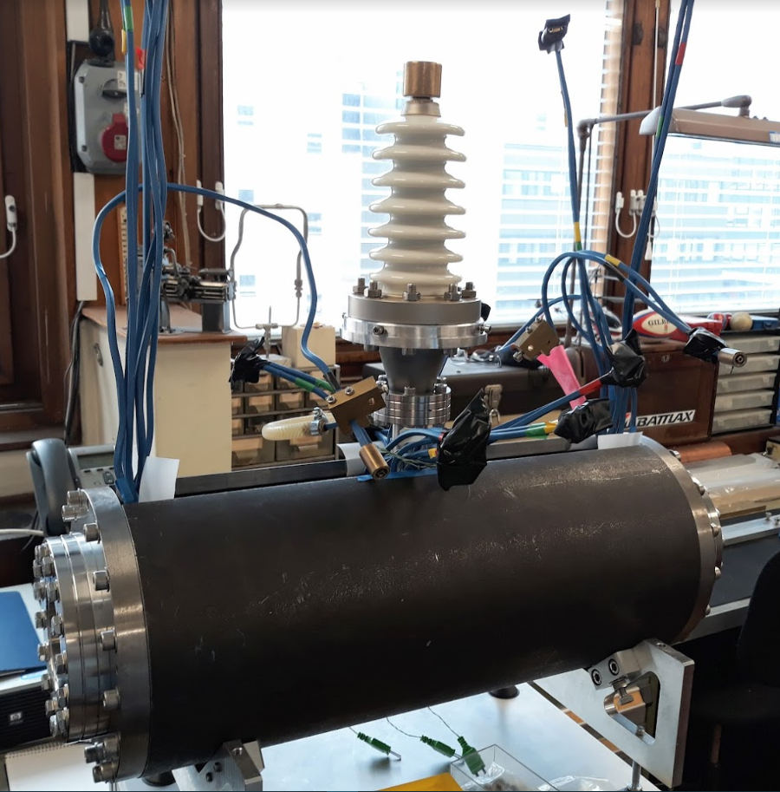
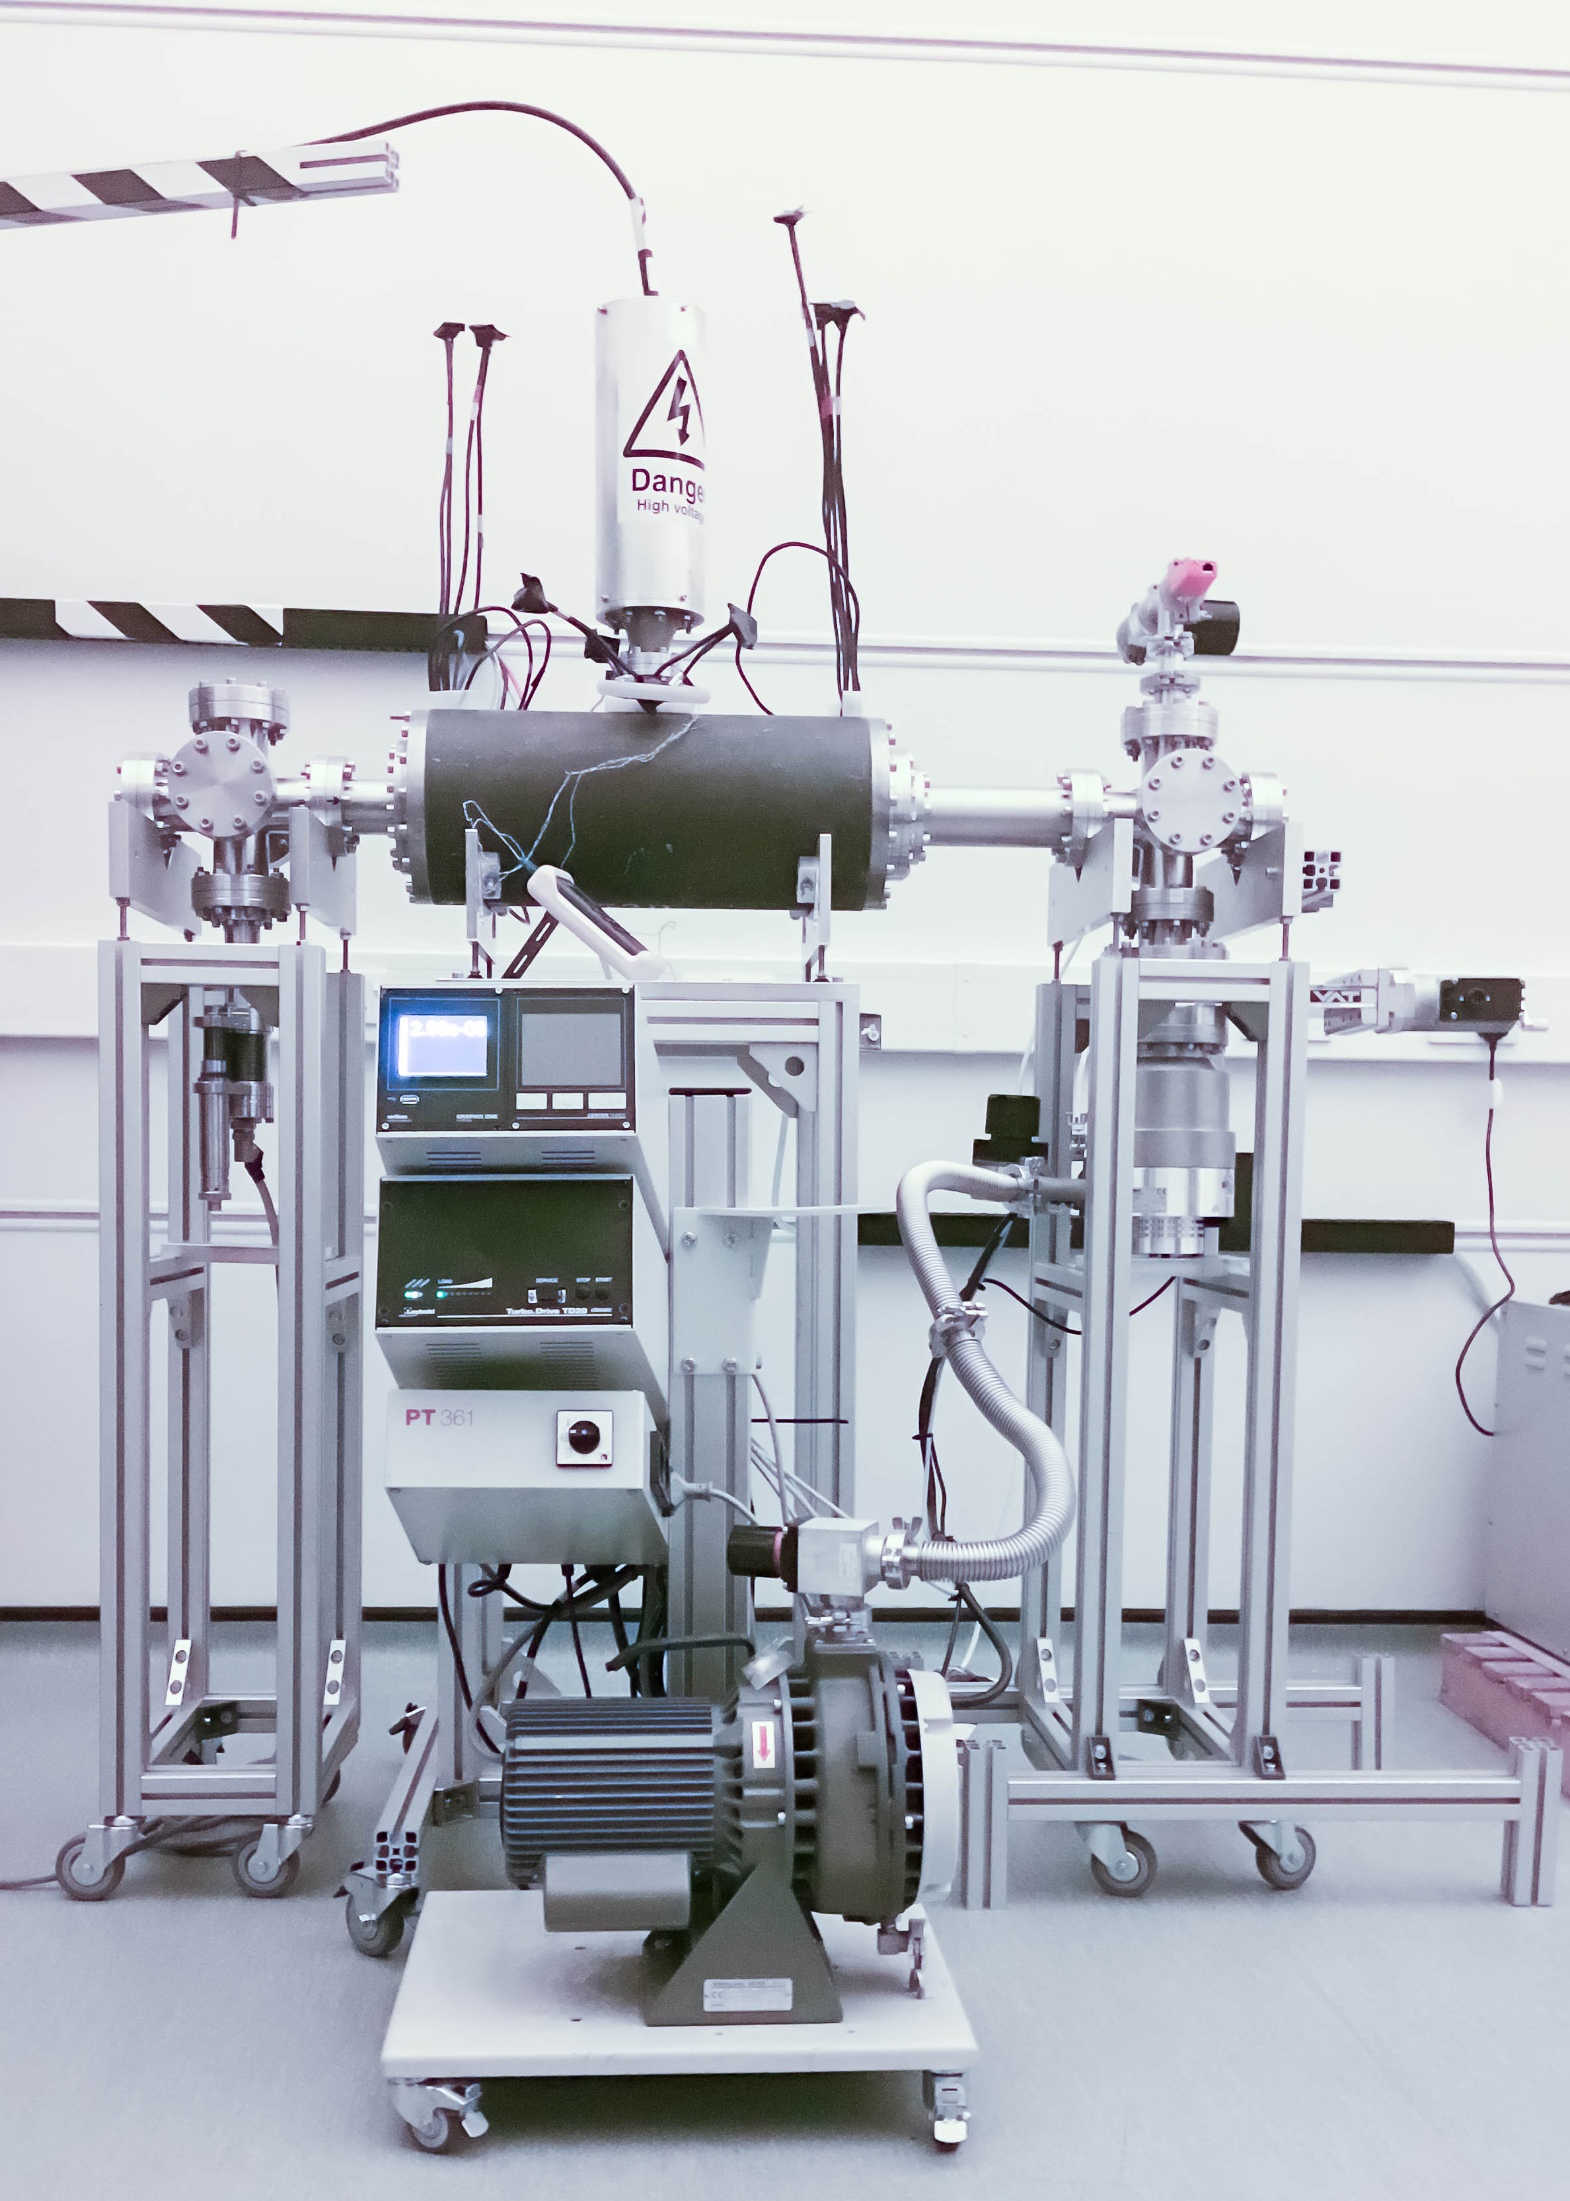
Capture
Solenoid coils
cylindrical
anode
Grounded
end plate
       
       
Grounded
end plate
Ion beam
Electron cloud
       
       
The Gabor lens uses a plasma to generate a strong electro-static focusing field.
Original prototype tested with a 1MeV proton beam at the Surrey Ion Beam Centre.
Upgraded Gabor lens has been assembled and is being tested at Imperial.
  Vacuum tests.
  Tests with a radioactive source.
  Tests with the laser driven ion beam.
Upgraded Gabor lens being assembled December 2018.
Gabor lens tests at Imperial

Slide 11
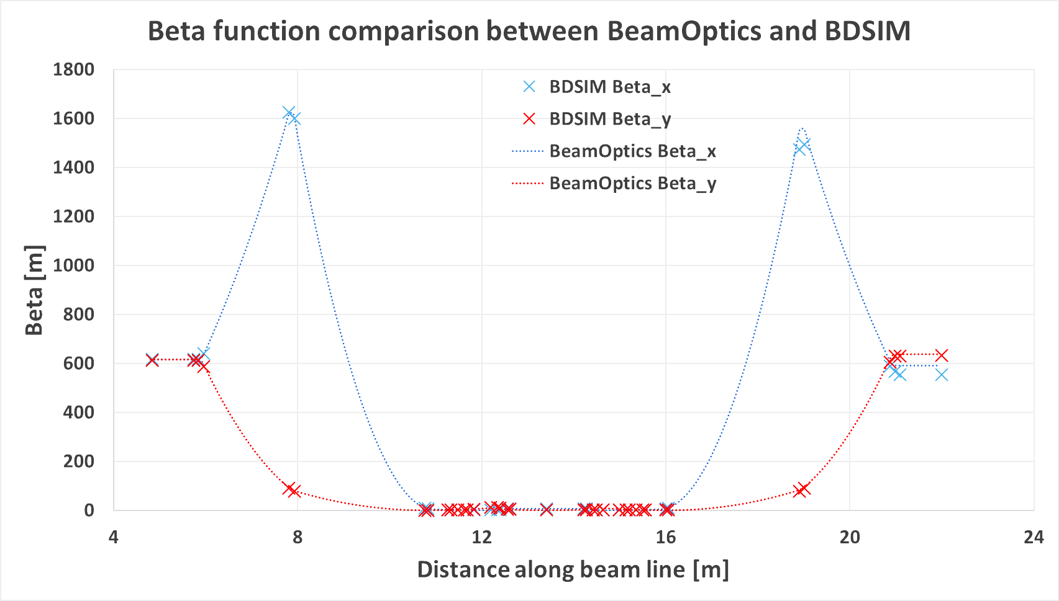
Beam Transport
Dipole bends and collimators for energy selection and vertical delivery of the beam to the end station.
  Option for ion species selection using a Wien filter.
Particle tracking simulations with BDSIM based on optics design.

Slide 12
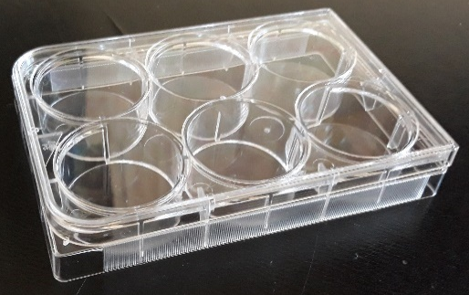
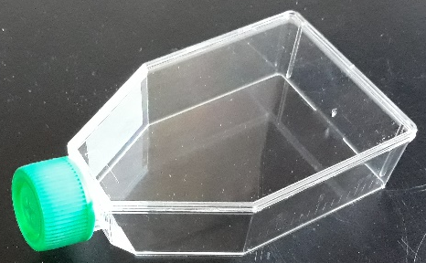
End Station
Material budget determines required beam energy.
  More material increases cost of laser.
  Consider cell sample containers.
Energy deposition and dose calculation very important for the design of the end station.
  Want the Bragg peak in the cell layer.
  Ensure efficient delivery of dose to the cells (i.e. minimize the time needed to irradiate a sample).
  Dose verification.
10 mm
15 mm cell nutrient
solution. G4_WATER
0.03 mm cell layer.
G4_SKIN_ICRP
1.15 mm sample
container base.
G4_POLYSTYRENE
5mm air gap.
G4_AIR
0.25 mm scintillating fibre layer. G4_POLYSTYRENE
0.075 mm vacuum window.
G4_MYLAR
beam

Slide 13
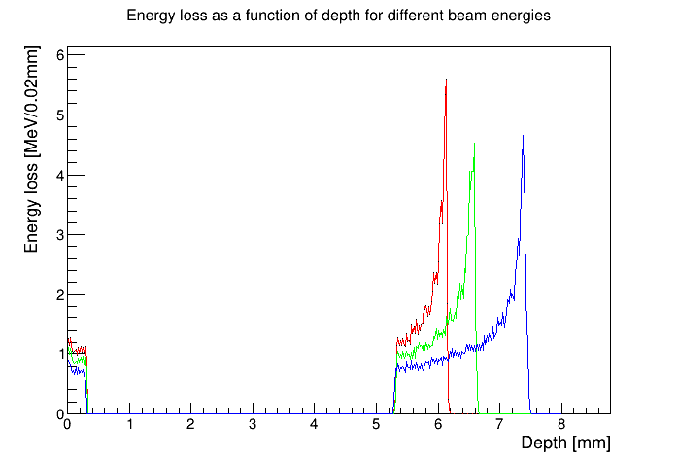
End Station
Energy loss in the end station using the beam tracked from after the capture section.
10 MeV
12 MeV
15 MeV
beam
0.075 mm vacuum window
0.25 mm scintillating fibre layer
5mm air gap
1.15 mm sample
container base
0.03 mm cell layer
15 mm cell nutrient
solution

Slide 14
Diagnostics for LhARA

Slide 15
Diagnostics for LhARA
Diagnostics for beam commissioning.
  CTs and BPMs.
  Beam characterisation, i.e. beam intensity profile and beam energy.
    Intense proton and carbon ion beams, E=15 MeV.
Diagnostics in the end-station.
  Online monitoring.
  Dose verification.
Operation of the laser at 10Hz.
  Films not suitable.

Slide 16

SciWire - Scintillating Fibre Detector
STFC Impact Acceleration Account grant to develop scintillating fibre detector for low-energy ion beams.
  Energy measurement.
  Intensity profile.
Plane made of fibres arranged of two layers of fibres perpendicular to each other.
Detector consists of multiple planes.
Scintillation light from all planes is read out from one side for each orientation.
250$μ$m
5cm
BEAM
5cm

Slide 17
Detector performance characterisation
Step a Sr⁹⁰ source across face of the detector, positioning the source at the centre of a pair of x and y fibres.
Measure.
  Position resolution.
  Cross-talk.
Further tests with the laser driven ion beam.
Possibility of dose profiling.
Sr⁹⁰

Slide 18
SmartPhantom
Instrument a water phantom with fibre planes.
  Measure dose, dose profile.
For experiments at MedAustron with proton and carbon beams at clinical energies.
More details in HT Lau’s poster.

Slide 19
Summary and Future Plans
Initial design of the CCAP radiobiology facility has been simulated.
  Particle tracking simulations compare well with the optics design.
  Details of the materials in the end station has been simulated to verify the required beam energy and thus the requirements on the laser system and diagnostic devices.
Updated transport channel design in progress.
  15 MeV into the end-station.
SciWire construction has started and performance will be characterised using a Sr⁹⁰ source.
Option for future tests with the laser driven ion beam.
Notes:
To summarise …

Slide 20
Acknowledgements
Imperial College London
  Geoff Barber, Victoria Blackmore, Ian Clark, Oliver Ettlinger, Chris Hunt, Vera Kasey, Hin Tung Lau, Ken Long, Daniel Nardini, Jaroslaw Pasternak and Juergen Pozimski.
University of Birmingham summer students
  Laura Murgatroyd and Rebecca Taylor.
Medical University of Vienna
  Sylvia Gruber
Royal Holloway, University of London
  Laurie Nevay and William Shields.
Notes:
Finally, I’d like to thank everyone who contributed to this work.

Slide 21
Backup slides

Slide 22
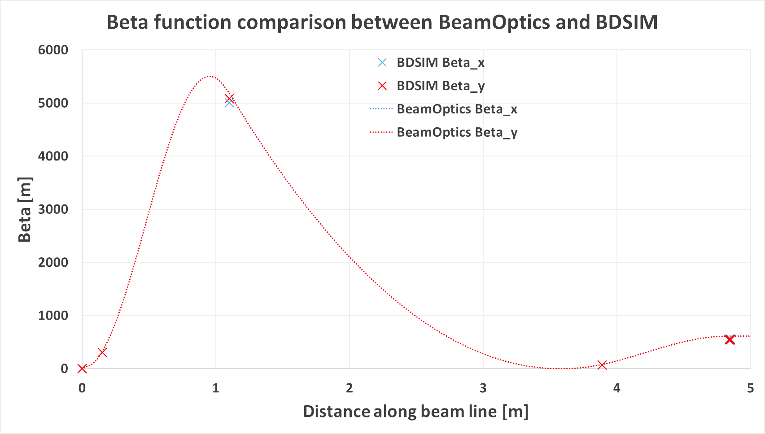
Capture
 | Equivalent Solenoid
Gabor lens 1 | 1.4T
Gabor lens 2 | 1.1T
Included in the BDSIM simulation as a solenoid of equivalent focusing strength.
  Can use electro-static field map from a plasma simulation.
  BDSIM developers may provide a Gabor lens element in the future.
Notes:
What we plan to use to capture these particles is a a Gabor lens. This can provide a very strong focusing field in a short space by utilizing a confined electron plasma.
Schematic of the principle and a prototype at Imperial that we plan to test with a laser-ion beam.
To model in BDSIM
Lines from Jaroslaw’s beam optics code shows Beta_x and Beta_y (a measure of the beam envelope) are on top of each other. The points from BDSIM show the particle tracking simulations are well matched to the optics design.

Slide 23
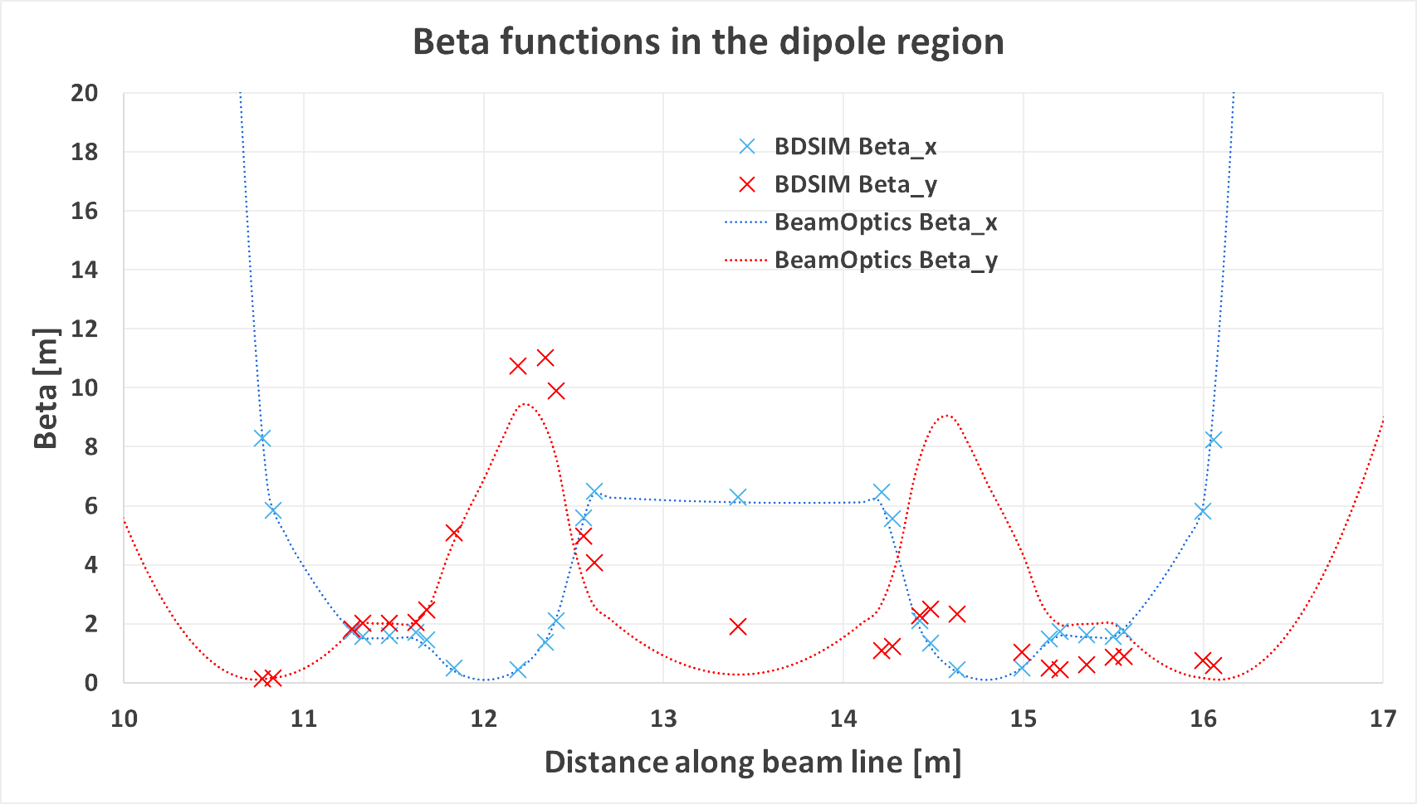
Transport
Optics in the bending region. Differences in Beta_y may be due to different treatments of edge focussing.

Slide 24
LhARA – Stage II
Goal is to irradiate animal models.
  Need post-acceleration to increase energy of the beam driven by the laser.
Current solution is based on an FFA.
  Can achieve factor 3 increase in momentum or more.
    For 15 MeV input can get 127MeV.
  Would like to accelerate protons, helium, C⁶⁺ and other ions.
  Development follows R&D for ISIS-II at RAL.
In vivo
end station

Slide 25
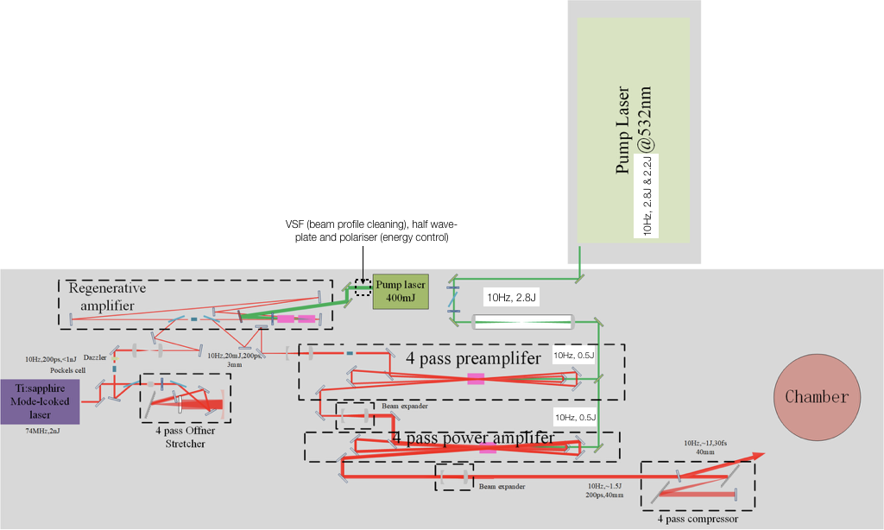
Laser at Imperial
Current operating parameters
  100mJ, 38fs and 10Hz.
Aim to reach
  1J, 30fs and 10Hz.
Schematic diagram of the laser.

