Slide 1
The Centre for the Clinical Application of Particles
Introduction

Slide 2
Growing emphasis
Oct12
https://www.gov.uk/government/uploads/system/uploads/attachment_data/file/213044/national-proton-beam-therapy-service-development-programme-strategic-outline-case-16102012.pdf

Slide 3
Production facilities, development opportunities
Two new NHS proton-beam therapy centres underway
One (Manchester Christie) in operation
Private enterprise also seek to contribute
Scaled to meet business plans
Developed on present understanding of need
Likely to generate additional treatment targets:
Additional opportunities and benefits
Opportunities to contribute:
Incremental development
Paradigm shift through innovation

Slide 4
Centre for the Clinical Application of Particles
Mission:
“Develop the technologies, systems, techniques and capabilities necessary to deliver a paradigm shift in the clinical exploitation of particles.”
Context: CCAP within/under:
Imperial/ICR: Cancer Research Centre of Excellence
CRUK Major Centre
Multidisciplinary collaboration (ab initio):
Faculty of Medicine, the Imperial Academic Health Science Centre, the Department of Physics, the Imperial CRUK Cancer Centre, the Institute of Cancer Research, the John Adams Institute and the Oxford Institute for Radiation Oncology
Led by clinical need

Slide 5
The Centre’s emerging programme
Incremental development of existing practice:
E.g. automation of image processing of cone-beam CT
Radio-biology:
Scientific opportunity; vehicle for development
Seek to contribute through forging collaboration …

Slide 6
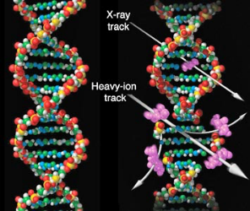
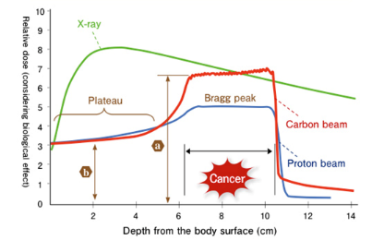
The benefit of hadron beams
Relative Biological Effectiveness (RBE):
Dose required to generate particular biological effect relative to reference radiation

Slide 7
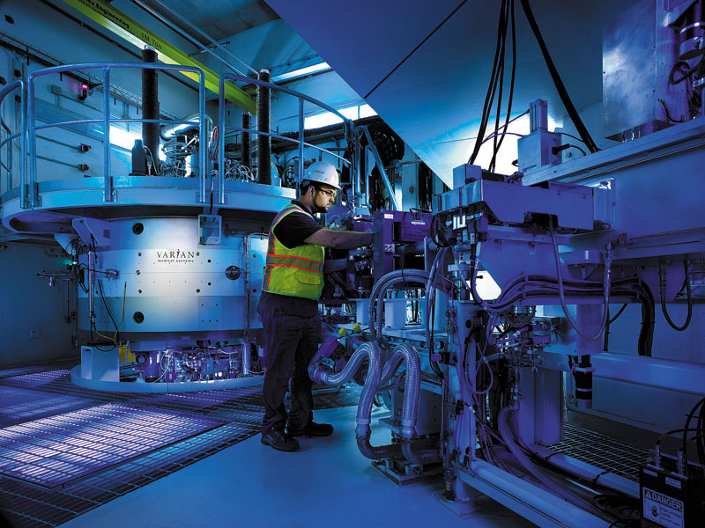
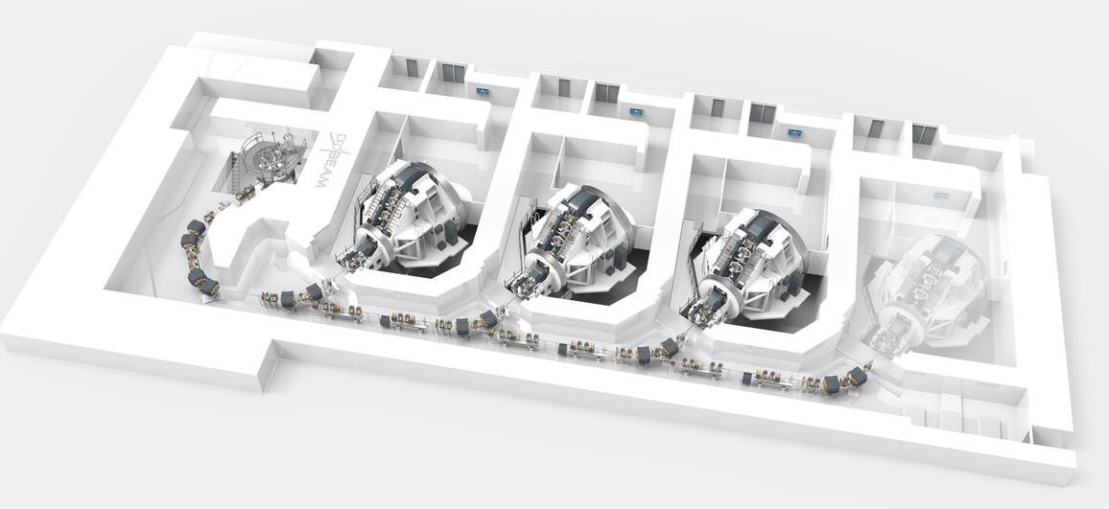
Particle beam therapy
Proton:
Mostly cyclotron-based
Issues:
Energy modulation;
Shielding
Proton & ion (carbon):
Synchrotron based:
Issues:
Energy modulation
Source:
Injector per ion species
Limit to dose rate
Many initiatives!
PIMMS2
LhARA
Christie
MedAustron

Slide 8
Hadron therapy; the issue of precision
RBE:
Known to depend on, e.g.:
Tissue type, energy, dose, dose-rate, ion species …
Yet:
For p, RBE=1.1 is used
For C, less information available
Target (i.e. tissue) fragmentation:
Protons:
Delivers radiation distant from beam
Carbon:
Substantial & distant contributions and strong tail beyond Bragg Peak
Opportunity!
Prove new techniques while contributing to basic radibiology
Proton
Carbon

Slide 9
Ambition … or long-term vision

Slide 10
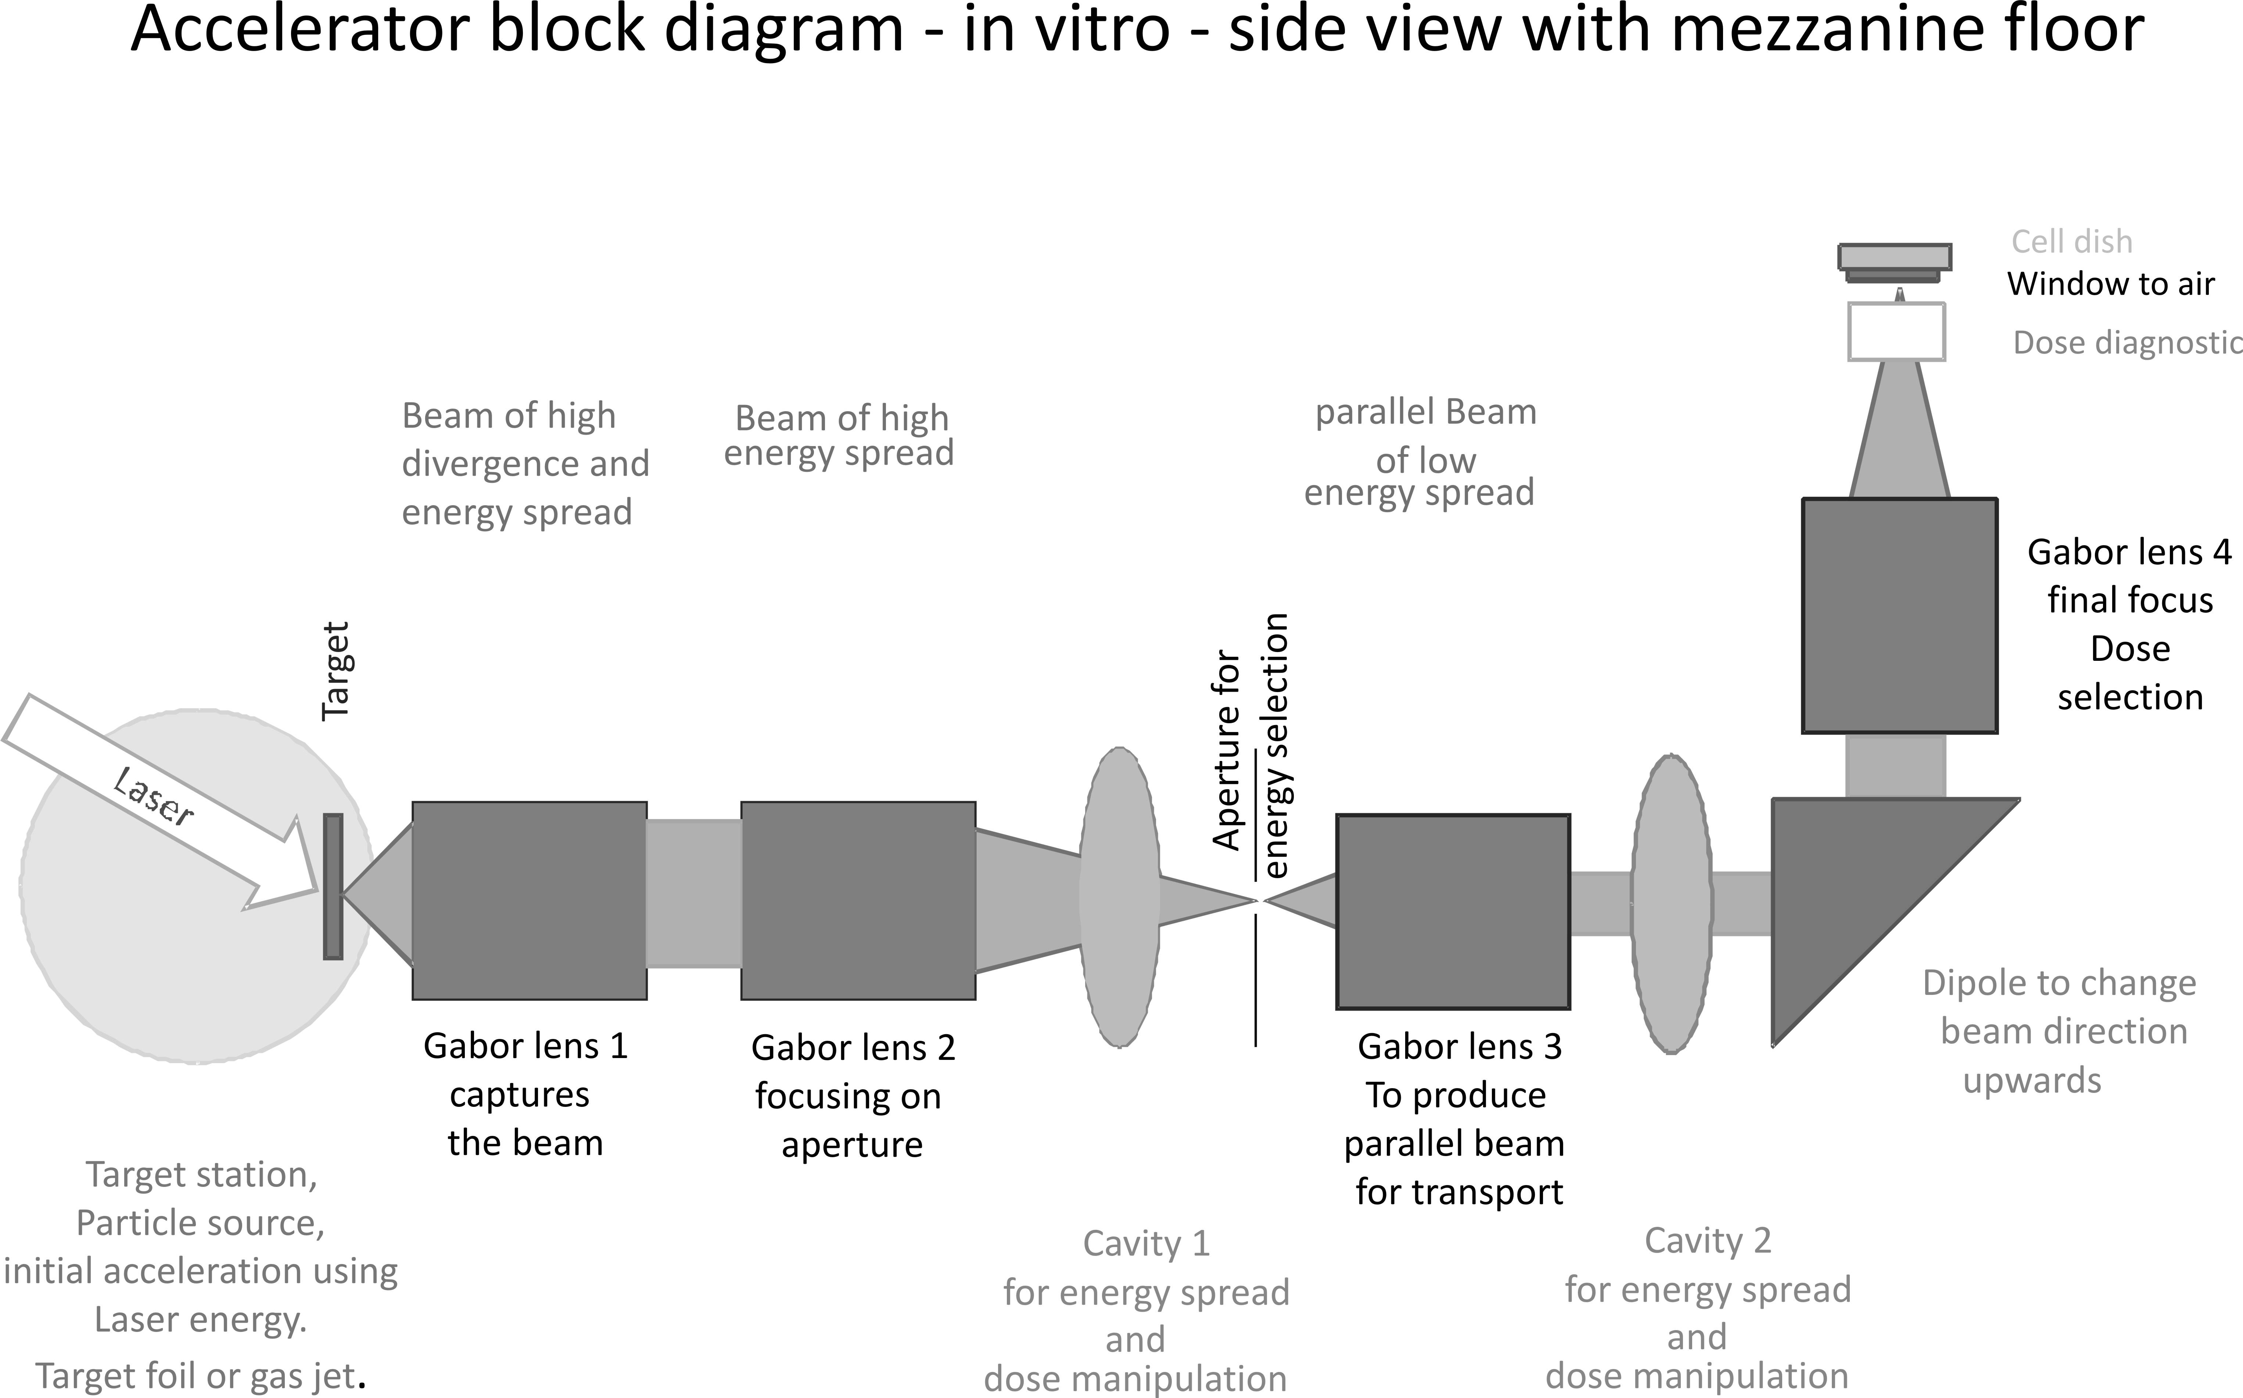
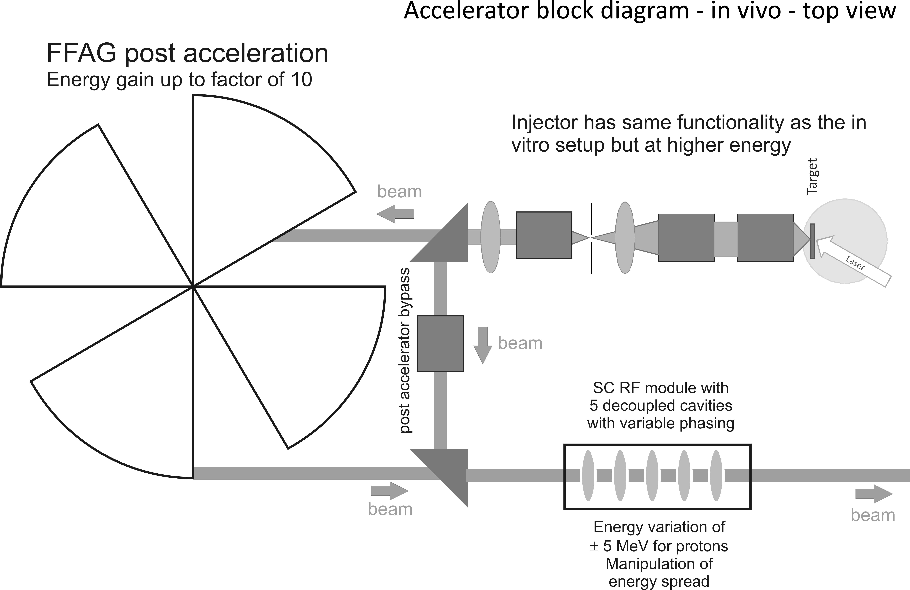

Laser-hybrid Accelerator for Radiobiological Applications
LhARA; a novel, hybrid, approach:
High-flux, laser-driven proton/ion source;
Novel plasma (Gabor) lens capture & focusing
Post-acceleration with large-dynamic aperture FFA
Unique features:
Very large flux of p or ions in very short pulses:
Enormous instantaneous dose
Inject at ~15 MeV into first accelerating structure
Overcomes space-charge limit of today’s ion sources
Staged implementation:
In-vitro studies permitted at 15 MeV:
Source, capture, transport
In-vivo studies using post-accelerator (75 MeV p; ~20 MeV/u)
Uniquely flexible radiobiology facility:
Many ions, proton to carbon, in single facility
Wide range of energy and dose rate, allows UHDR/FLASH radiotherapy
Technologies can be developed to create uniquely flexible therapy facility
Original concept: Pozimski

Slide 11
LhARA; stage 1
Pasternak
Initial layout for first end-to-end simultion.
Now superceded.
Capture @ 10—15 MeV

Slide 12
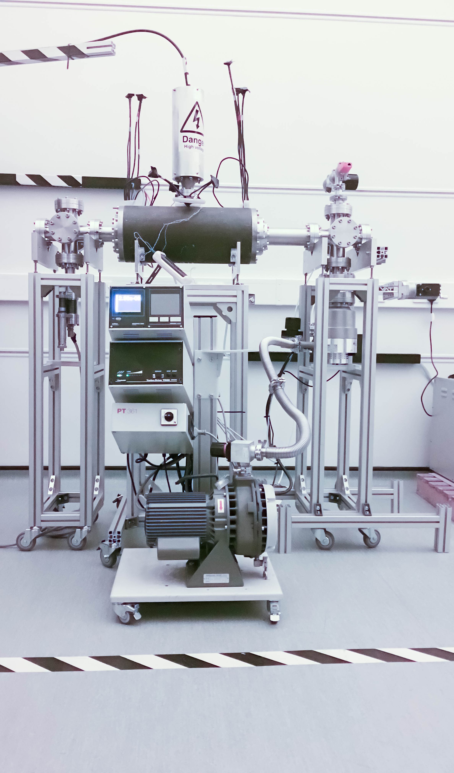
LhARA work in progress
Capture
Towards compact design
Electron plasma:
Strong focusing of +ve ions
1st prototype:
1 MeV protons Surrey Ion Beam Centre
Aberrations observed
Upgraded prototype:
Under test in 022
Capture and transport using Gabor lenses:
Normal conducting solenoids alternative/risk mitigation
Energy selection based on collimation
Momentum selection in the arc
Switching magnet:
Select in-vitro or to send beam to post-accelerator

Slide 13
Today … Diagnostics workshop 2019
Diagnostics and instrumentation:
A key competence in Imperial HEP
An opportunity to contribute
And, a key requirement for the CCAP programme

