Slide 1
Accelerator applications for medicine
M.Dosanjh¹, I.Konoplev², K.Long³, S.Sheehy⁴
¹. CERN, recently appointed Visiting Professor in Oxford
². JAI, Oxford
³. Imperial
⁴. JAI, Oxford
¹. CERN
². JAI, Oxford
³. Imperial
⁴. JAI, Oxford

Slide 2
Medical accelerators; the challenge
Cancer:
2nd most common cause of death globally
Radiotherapy is indicated in half of all cancer patients
Anticipated growth in demand:
14.1 x 10⁶ new cases in 2012 ⇢ 24.6 x 10⁶ by 2030
8.2 x 10⁶ cancer deaths in 2012 ⇢ 13.0 x 10⁶ by 2030
Demographic:
Projections above based on reported cases (i.e. HIC)
Opportunity to save 26.9 x 10⁶ lives in LMIC by 2035
Scale-up in provision:
Requires development of new and novel techniques
Atun, Lancet Oncol. 2015 Sep;16(10):1153-86

Slide 3
Medical accelerators; the opportunity
Scale-up in provision:
Requires development of new and novel techniques
Investment required will generate substantial economic gains
R&D programme:
Incremental development of current practice:
Instrumentation, imaging/image-processing, f/b and control
System approach to robust, flexible next-generation facilities:
Multi-species, combined therapies, integrated imaging
Resilient to e.g. environment, component failure, …
Collaborative R&D to harness novel techniques:
Multi-species, combined therapies, UHDR/FLASH, integrated imaging
Laser-driven, hybrid, novel (e.g. FFA) approaches
Opportunity to contribute to underpinning science and R&D:
Radiobiology: especially charged particle (p, ion)
In-situ dose-deposition imaging: especially p, ion
Integration of planning, on-treatment, imaging, simulation, feedback and control
Atun, Lancet Oncol. 2015 Sep;16(10):1153-86

Slide 4
Electron linacs for X-ray/e therapy
Accelerator applications for medicine

Slide 5
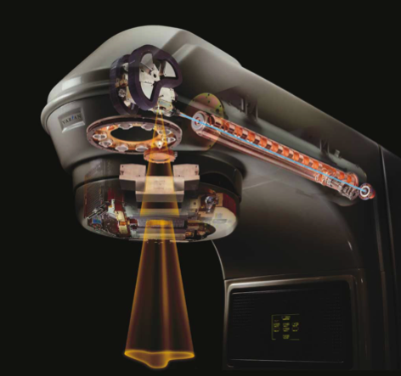
Medical linac
Electrons accelerated to 5—10 MeV:
3 GHz cavity
Delivers e and X-rays:
X-rays created on internal target
Intensity-modulated therapy delivered using sophisticated collimation & gantry systems
Substantial initiative:
“Medical linacs for challenging environments”
CERN, ICEC, JAI, STFC, …
Target proposal to GCRF
Investigation of UHDR (FLASH) RT:
Feasibility of use/modification of linac at CXH for research
CXH, ICL, ICR, RMH

Slide 6
M. Dosanhj

Slide 7
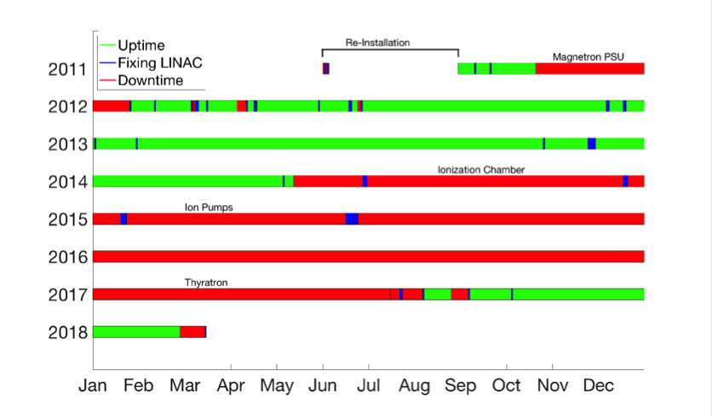
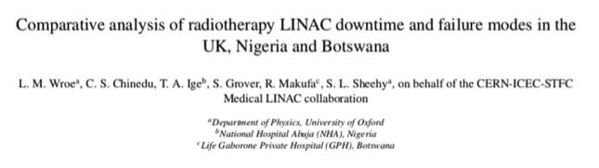
Towards an understanding of the issues
Abuja, Nigeria
In preparation
S. Sheehy

Slide 8
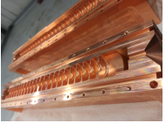
Medical LINAC: accelerating structure
I. Konoplev
Objectives:
Design and build TW 12GHz accelerating structure that is:
Vacuum sealed, has cathode included
From 50keV to 8MeV (x-ray bulb)
Minimise the construction and running cost
Compatible with permanent magnets
Requirements:
Stability (no need to retune or service – “light bulb” approach)
Compactness
Modularity (same composition as for vacuum tubes used in aviation and industrial applications)
Preliminary numerical studies have been carried out.
Technical drawing of the prototype
Prototype of the TW accelerating structure

Slide 9
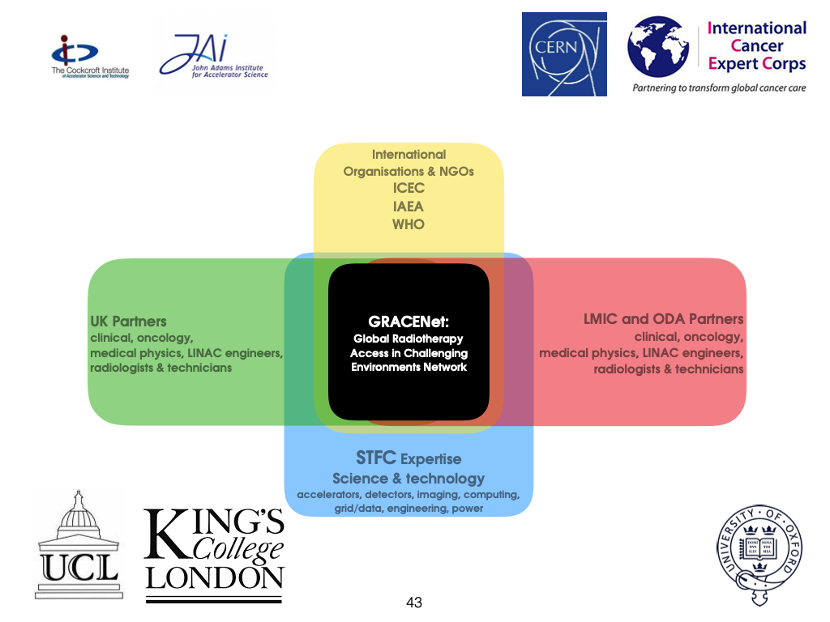
Not funded.
Regroup in Botswana
Imperial seeks to contribute too!
System/engineering aspects:
Dyson School of Engineering Design
Physics
Exploring:
Contributions to system-engineering; &
Integration (incl. imaging ‘n’ control)
S. Sheehy

Slide 10
Hadron-beam therapy
Accelerator applications for medicine

Slide 11
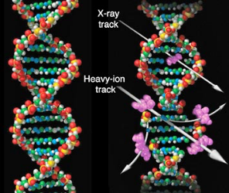
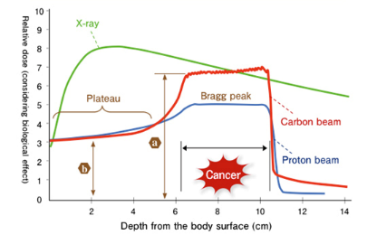
The benefit of hadron beams
Relative Biological Effectiveness (RBE):
Dose required to generate particular biological effect relative to reference radiation

Slide 12

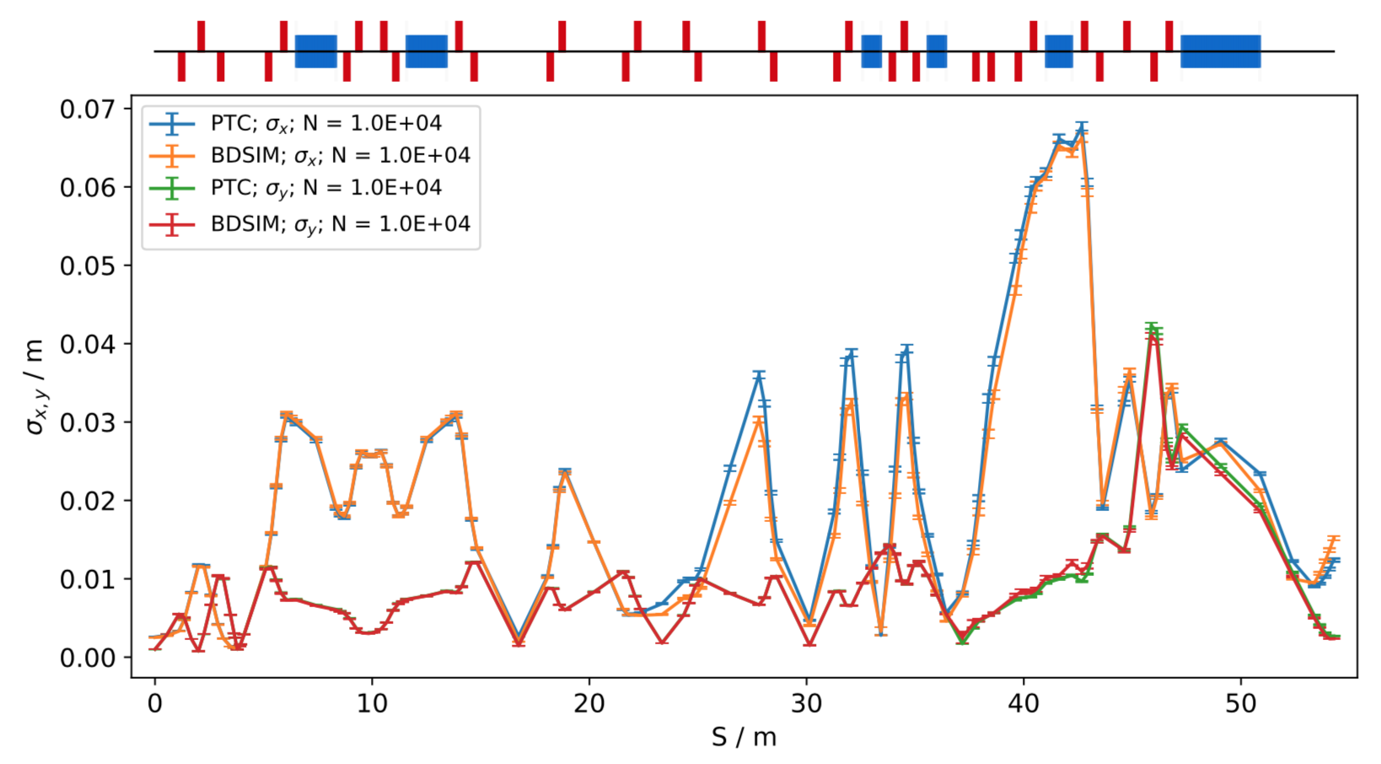
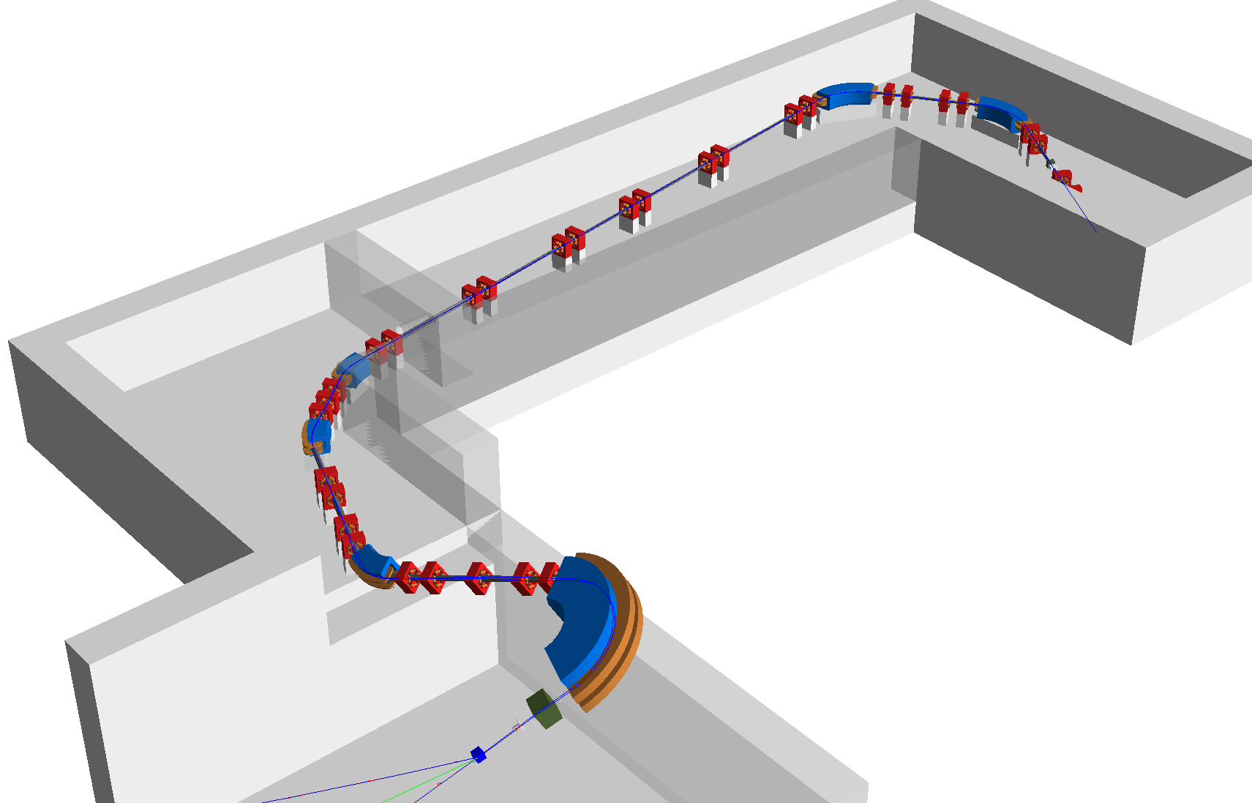
Medical Beam Line Simulations with BDSIM
Optics
Energy Deposition
Tracking & Optics:
Particle tracking though Geant4 models of beam lines
Excellent agreement with accelerator tracking codes
Beam line optics calculations with full statistical uncertainties
Dosimetry:
Record particle-matter interactions and energy deposition:
Energy deposition in beam line, shielding, isocentre target…
Full tracking of secondary particles
Flexibility:
User customization
External geometry and field maps
Separate tool for user-defined analyses.
Impact:
Ongoing simulation studies:
CCAP – LhARA
CCAP – MedAustron
IBA
In-house model (based on PSI Gantry 2)
Concrete shielding and magnet support block geometry.
Degrader for energy selection
Accelerator Beam Line
Analysis
Isocentre target volume (water phantom)
W. Shields, L. Nevay,
S. Boogert, et al. (RHUL)
Contact: william.shields@rhul.ac.uk

Slide 13
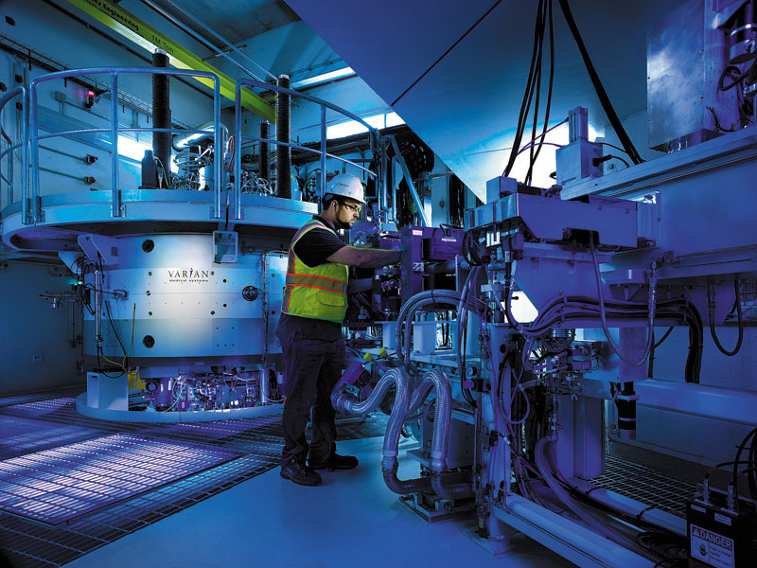
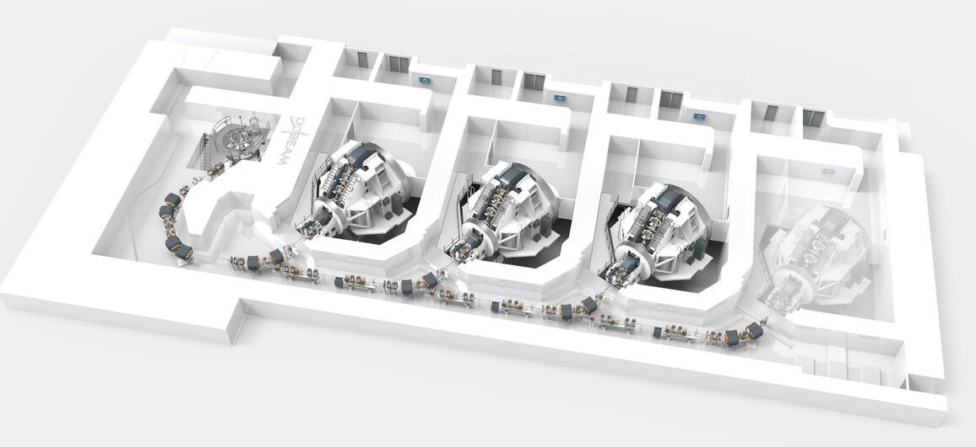
Particle beam therapy
Proton:
Mostly cyclotron-based
Issues:
Energy modulation;
Shielding
Proton & ion (carbon):
Synchrotron based:
Issues:
Energy modulation
Source:
Injector per ion species
Limit to dose rate
Many initiatives!
PIMMS2
LhARA
Christie
MedAustron

Slide 14
Hadron therapy; the issue of precision
RBE:
Known to depend on, e.g.:
Tissue type, energy, dose, dose-rate, ion species …
Yet:
For p, RBE=1.1 is used
For C, less information available
Target (i.e. tissue) fragmentation:
Protons:
Delivers radiation distant from beam
Carbon:
Substantial & distant contributions and strong tail beyond Bragg Peak
Opportunity!
Prove new techniques while contributing to basic radibiology
Proton
Carbon

Slide 15
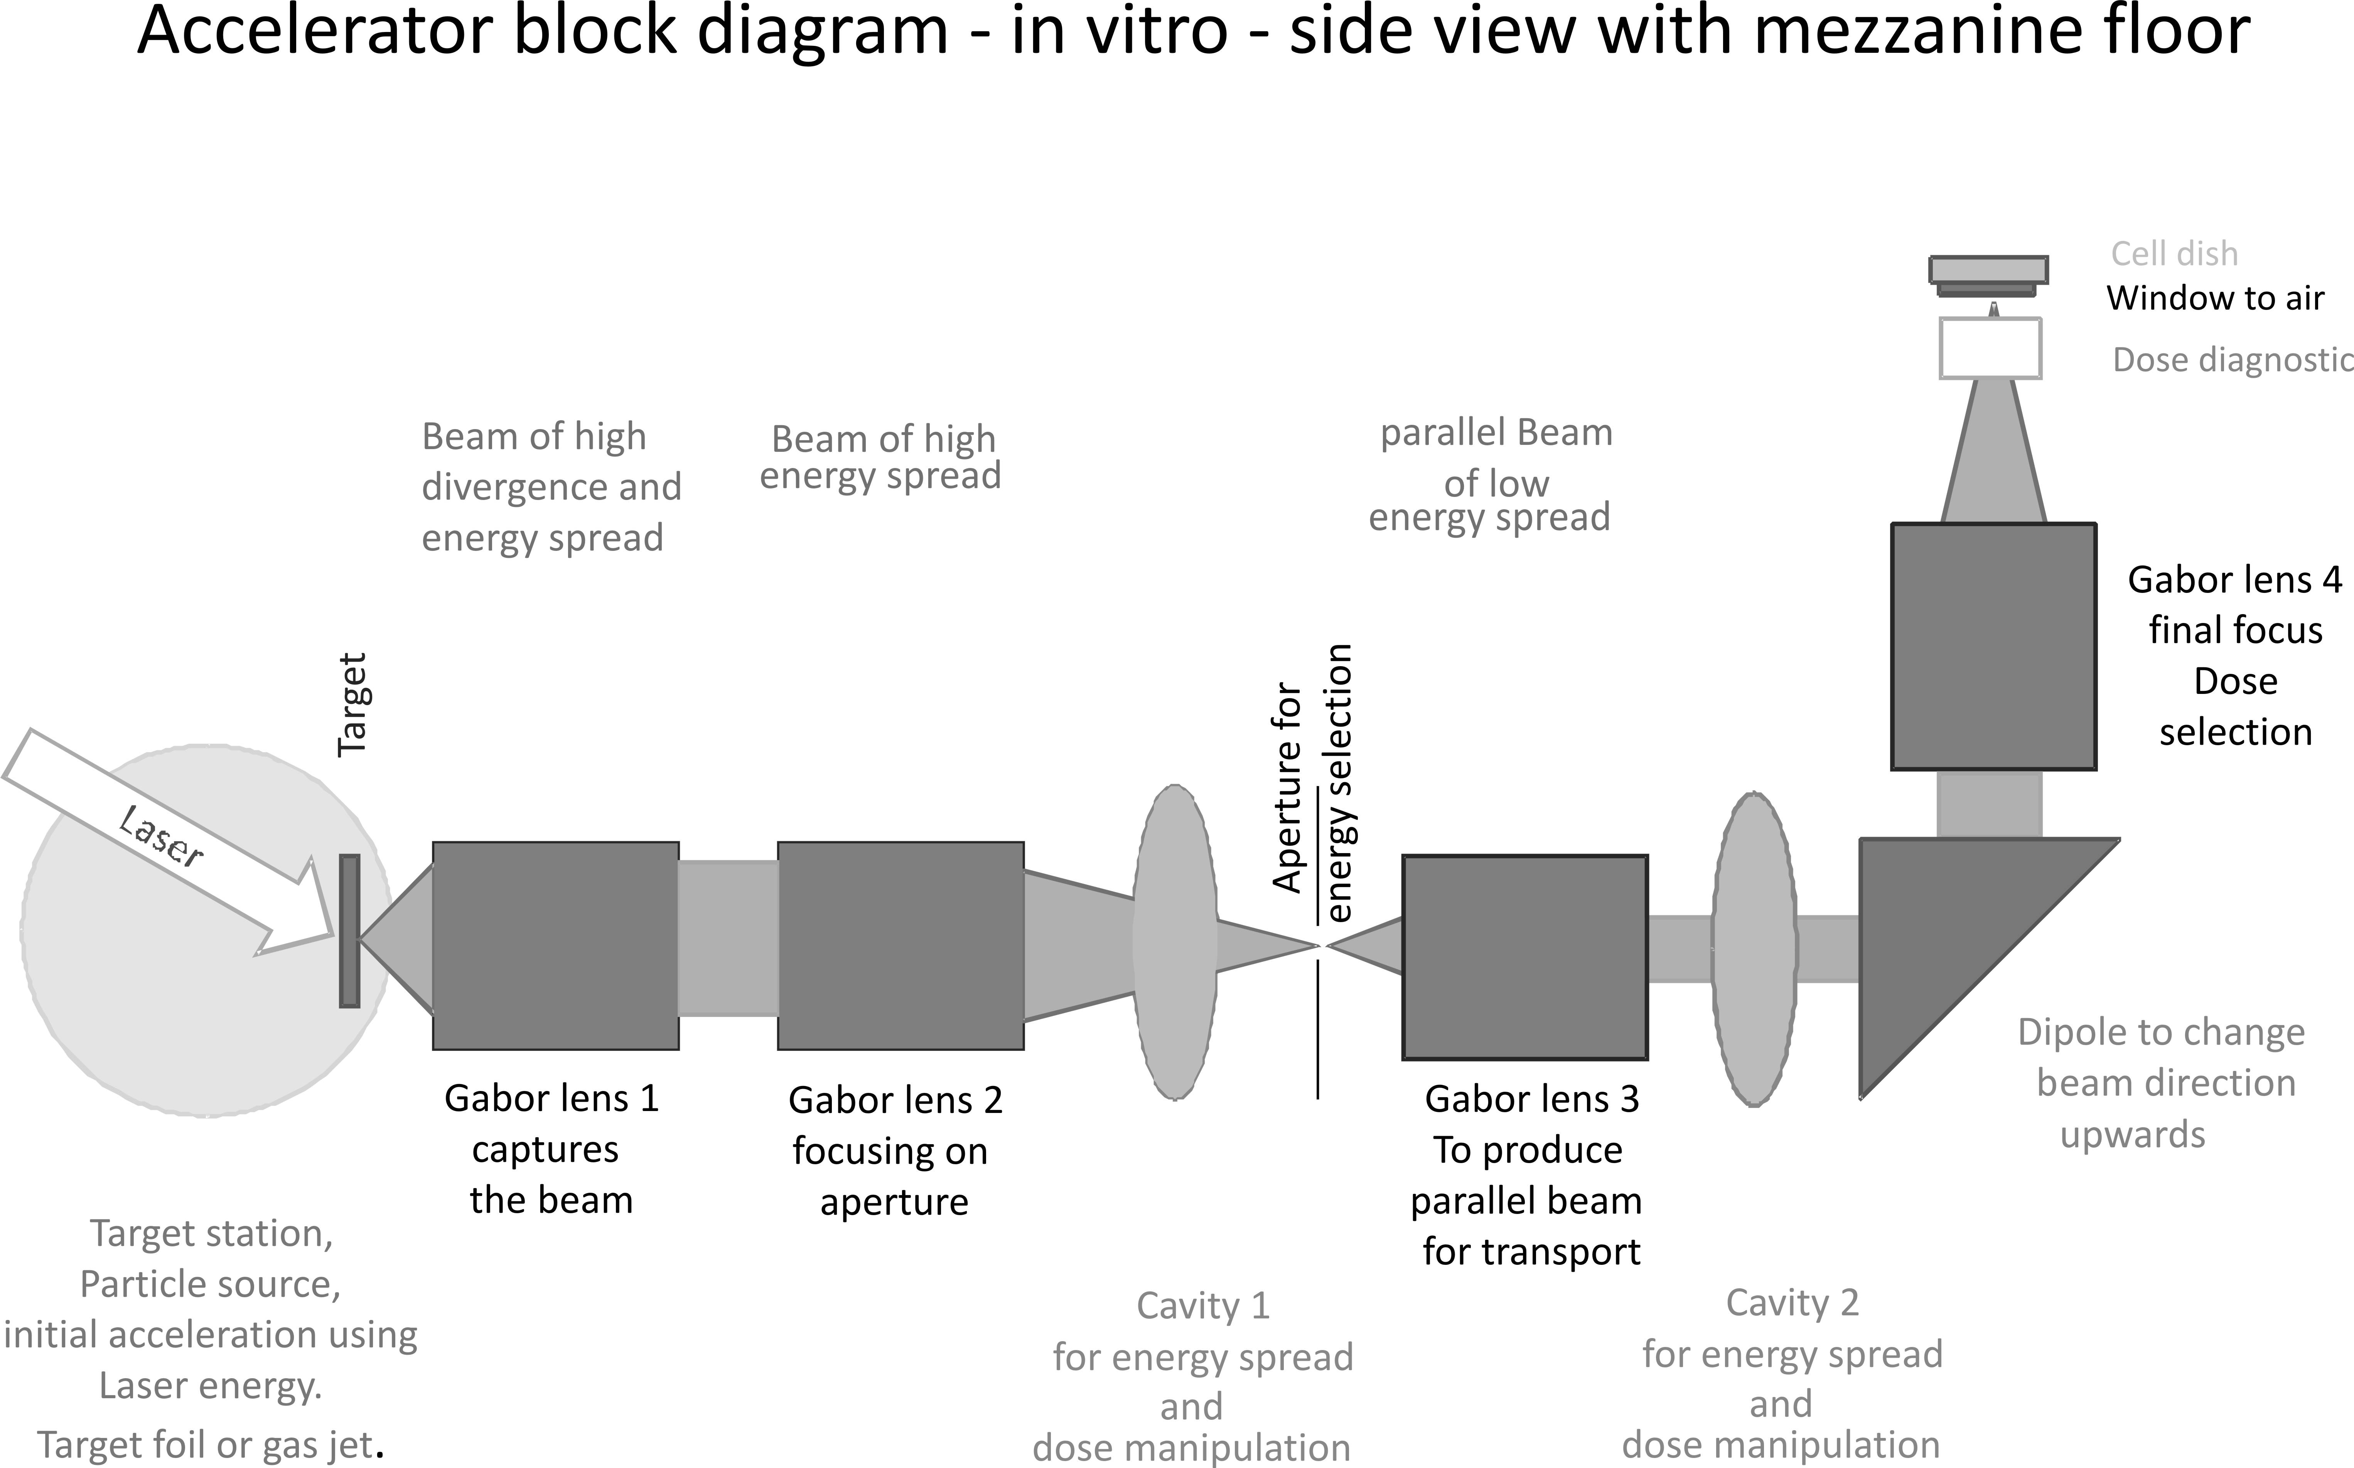
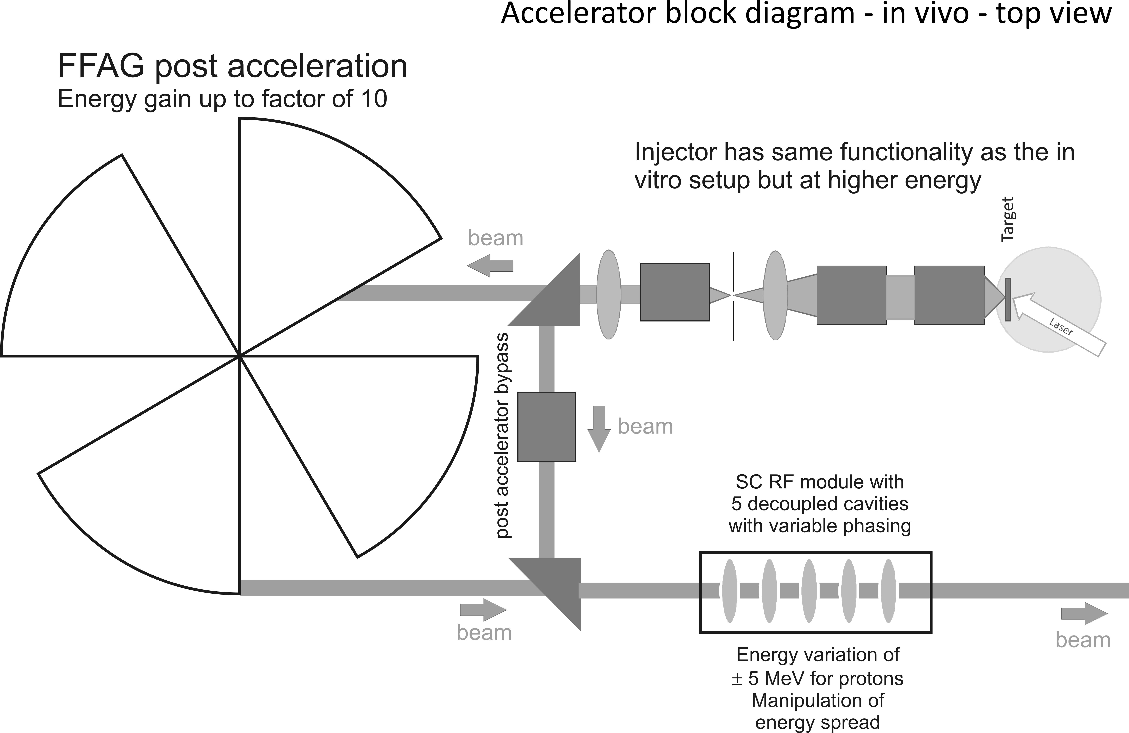

Laser-hybrid Accelerator for Radiobiological Applications
LhARA; a novel, hybrid, approach:
High-flux, laser-driven proton/ion source;
Novel plasma (Gabor) lens capture & focusing
Post-acceleration with large-dynamic aperture FFA
Unique features:
Very large flux of p or ions in very short pulses:
Enormous instantaneous dose
Inject at ~15 MeV into first accelerating structure
Overcomes space-charge limit of today’s ion sources
Staged implementation:
In-vitro studies permitted at 15 MeV:
Source, capture, transport
In-vivo studies using post-accelerator (75 MeV p; ~20 MeV/u)
Uniquely flexible radiobiology facility:
Many ions, proton to carbon, in single facility
Wide range of energy and dose rate, allows UHDR/FLASH radiotherapy
Technologies can be developed to create uniquely flexible therapy facility
Original concept: Pozimski

Slide 16
LhARA; stage 1
Pasternak
Initial layout for first end-to-end simultion.
Now superceded.
Capture @ 10—15 MeV

Slide 17
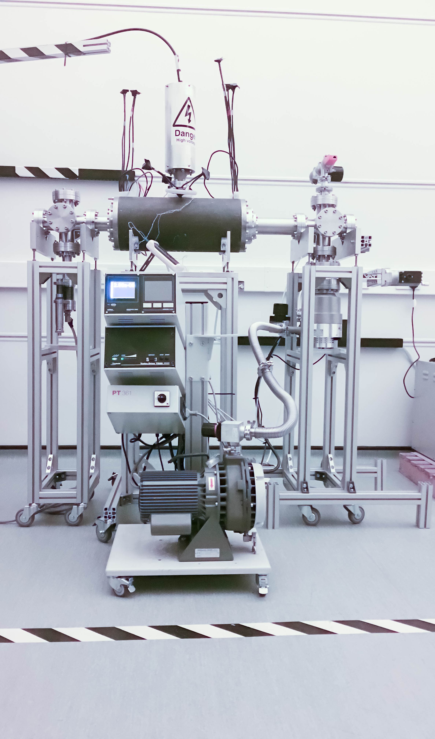
LhARA work in progress
Capture
Towards compact design
Electron plasma:
Strong focusing of +ve ions
1st prototype:
1 MeV protons Surrey Ion Beam Centre
Aberrations observed
Upgraded prototype:
Under test in 022
Capture and transport using Gabor lenses:
Normal conducting solenoids alternative/risk mitigation
Energy selection based on collimation
Momentum selection in the arc
Switching magnet:
Select in-vitro or to send beam to post-accelerator

Slide 18

LhARA SoI to ASB
Modest request; goal:
CDR in two years
Build case and ‘coalition’:
Already broad national and international participation

Slide 19
Conclusions
Accelerator applications for medicine

Slide 20
Conclusions
JAI has exciting programme in medical accelerators:
Electron linacs for X-ray/e therapy:
Medical Linac for Challenging Environments;
Modification of ‘production’ machine for UHDR/FLASH studies
Hadron-beam therapy:
Engagement with PIMMS2 in collaboration with CERN
Development of unique facility, LhARA
Emerging collaborations JAI ⇠⇢ CCAP/Imperial:
A growing strength!

Slide 22
Proton and Ion Medical Machine Study 2
M. Vretenar (CERN)
M. Vretenar (CERN)
PIMMS2 study start 2019
Open collaboration with: CERN and SEEIIST
Resources through EU accession / structural funds
Opportunities:
Ion source / LEBT;
Linac/ring
Gantry, imaging/feedback/control

