Slide 2
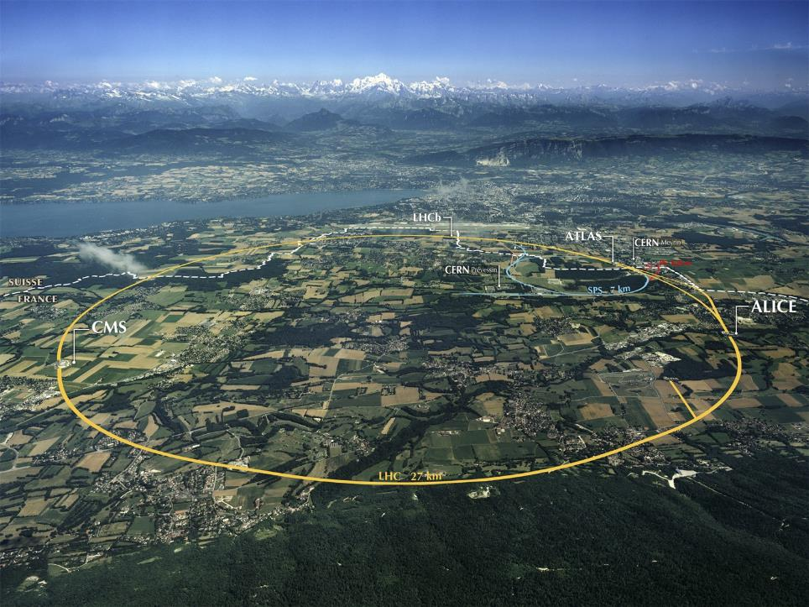
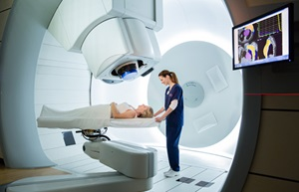
Accelerators for Medicine
Maurizio Vretenar, CERN
Outline
CERN for health
Accelerators for medicine: potential and limitations
Cancer therapy: X-rays and particles
Hadron therapy: accelerators and challenges
The future
Imperial College, London, 12 December 2018
Notes:
Thanks to organisers and apologies – hardware accelerator physicist who has only recently approached the use of our machined in the medical world – physicist point of view but curious on the effect of physical quantities on organism

Slide 3
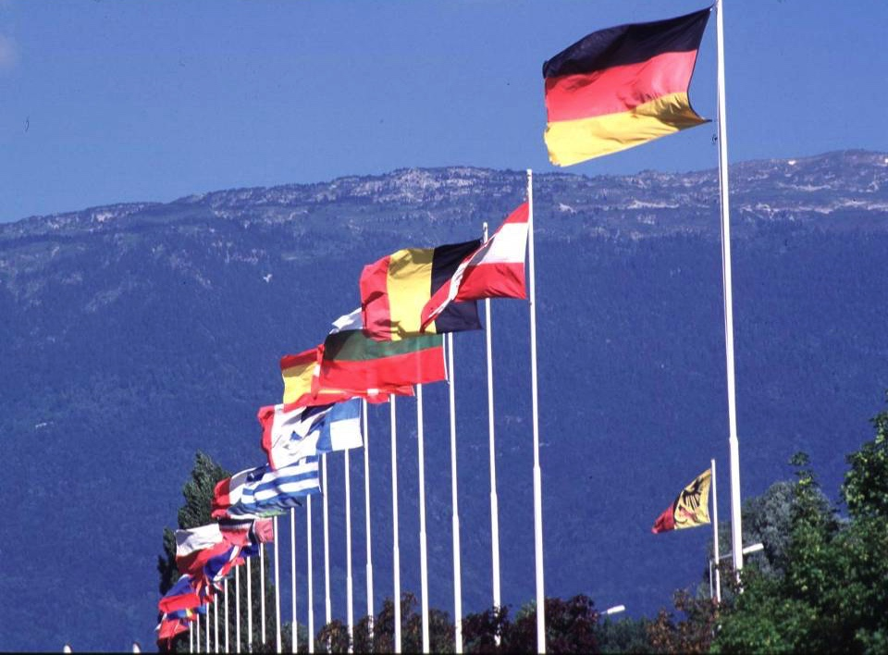
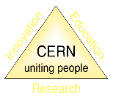
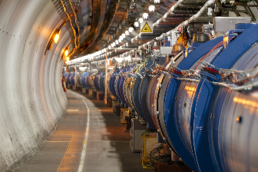
Why CERN?
Home to the LHC, the largest particle accelerator in the world
Mandate: promote and conduct research in particle physics and develop the related instruments
Maximising the societal impact of its research in particle physics is an integral part of CERN’mission.
Goal: knowledge transfer to society, not the development of specific instruments or projects.
CERN Medical Applications: limited budget (0.1% of all CERN) as seed funding for collaborative R&D projects, using technologies and infrastructures that are uniquely available at CERN.
Selected projects must not overlap with activities in Member States or be in competion with industry, and must be driven by the requirements of the medical research community.
3

Slide 4
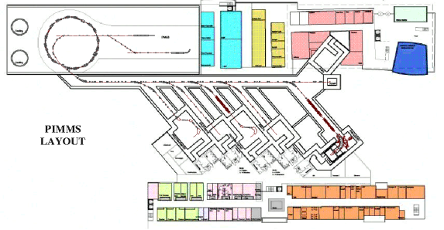
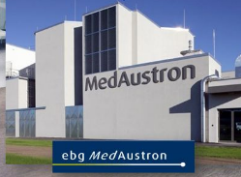
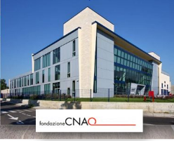
Medical accelerators at CERN - PIMMS
Assets: a wide competence in particle accelerators and an old tradition of being a meeting place where people from different countries and laboratories collaborate.
Long-standing CERN contribution to medical accelerator developments:
  Medicyc 1982-1990, Eulima 1985-1989 → Cyclotrons at Centre Lacassagne, Nice.
  LIBO (Linac Booster) 1998-2001 → LIGHT linac being built by ADAM/AVO.
  PIMMS (Proton Ion Medical Machine Study) 1996-2000 → CNAO and MedAustron proton&ion synchrotrons.
Interruption due to concentration of resources on LHC construction from 2002.

Slide 5
18 years later… PIMMS2
18 years later, some support from the management to restart a medical accelerator activity: I have been charged by the CERN Director for Accelerators and Technology to explore possible directions where CERN accelerator technologies might have an impact on medicine: a new PIMMS, PIMMS2.
Some small individual initiatives are already ongoing, and the idea is to incorporate all this into a coherent picture and a structured project.
But where should we go? Particle therapy has made an enormous progress in the last 20 years and the situation is very different from the initial pioneering years.

Slide 6
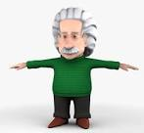



Accelerators for medicine
Number of operating accelerators
protons
proton therapy
Hadron therapy
Primary beam
≈ 75
>300
0
≈ 14’000
7
≈ 1’500
0
ions
ion therapy
(low en.)
IORT Inter Operation Radiation Therapy
electrons
(high en.)
VHEE Very High Energy Electron Therapy
Accelerator
Secondary beam
X-rays
Radiation Therapy
Target
neutrons
neutron therapy
imaging
PET Positron Emission Tomography
Radioisotopes
therapy
theragnostics
Targetd Alpha Therapy, others
≈ 16’000 particle accelerators worldwide operating for medicine

Slide 7
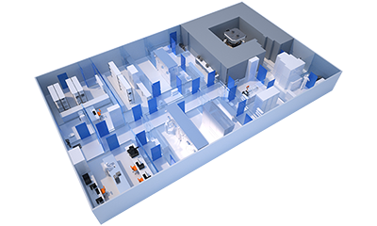
Accelerators in the medical environment
There are today about 16’000 accelerators in hospitals or working for hospitals, but we have to consider that the requirements for a medical accelerator are very different from those of a scientific accelerator:
The beam must be perfectly known, stable and reliable.
The accelerator and the beam delivery stage have to follow strict Quality Assurance procedures.
Example: factor 4 in the complexity and cost of the control system for a medical accelerator as compared to a scientific one!
The role of the medical physicist is essential in planning the treatment and in guaranteeing the delivered dose.
IntegraLab® PLUS combined radiopharmaceutical production centre from IBA.
The accelerator is the small box in the upper right corner, all the rest is what is needed to shield the accelerators and to provide radiopharmaceuticals compliant with quality control procedures (purity, sterility, etc.).

Slide 8
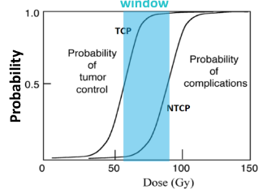
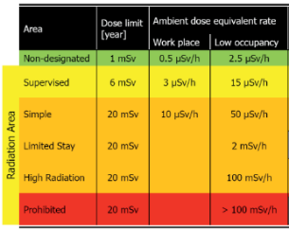
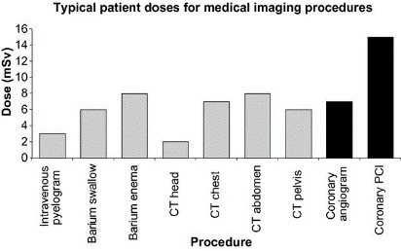
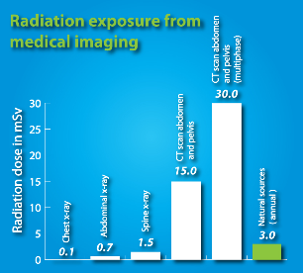
Medical exposure – a critical issue
Radiation management and control is a key issue in nuclear medicine.
- important doses are delivered to patients (comparison risk-benefit)
- the dose to medical personnel has to be limited to legal limits.
CERN limits
Up to 2 mSv highly targeted dose in conventional radiotherapy
S. Liauw et al., Translational Medicine, 5, 173

Slide 9
Radioisotopes – imaging and therapy
protons
proton therapy
Hadron therapy
Primary beam
ions
ion therapy
(low en.)
IORT Inter Operation Radiation Therapy
electrons
(high en.)
VHHE Very High Energy Electron Therapy
Accelerator
Secondary beam
X-rays
Radiation Therapy
Target
neutrons
neutron therapy
imaging
PET Positron Emission Tomography
Radioisotopes
therapy
theragnostics
Targetd Alpha Therapy, others

Slide 10
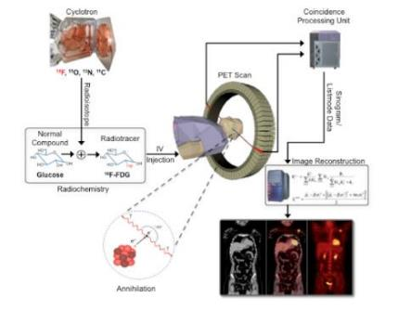
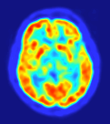
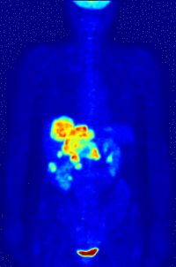
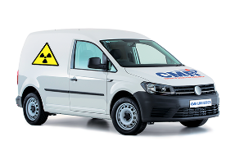
Radioisotope-based tomographies
A radioisotope (radiotracer) is produced by an accelerator (usually a cyclotron) and attached to a chemical compound (a glucose), in a radiopharmaceutical unit.
The compound is injected to the patient and accumulates in tissues with high metabolic activity, as tumours – and metastasis.
When the radioisotope decays, the emitted particles are detected by a scanner allowing a precise mapping of the emitting areas.
SPECT (single photon emission computed tomography): Technetium-99 (6 hours half-life) that emits a photon. 99-Te is generated in the hospital by Molybdenum-99 (66 hours half-life) produced at a nuclear plant.
PET (Positron Emission Tomography), much more precise: Fluorine-18 (1h50’ half-life) attached to Fludeoxyglucose (FDG), emits positrons that annihilates with electrons producing 2 gamma rays in opposite directions.
(source: Huntsman Cancer Institute)
Isotopes and radiochemical drugs are produced in large centres equipped with a commercial cyclotron.
After production, the drugs are shipped by road or air to the hospital (FDG half-life 1h50’).
This scheme works well in Europe and US (good transport networks), shows limits in Asia and rest of world), and is limited to long-life isotopes.
90% of PET scans are in clinical oncology

Slide 11
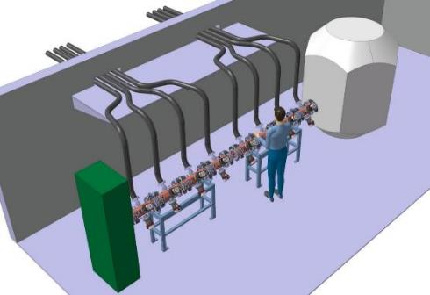
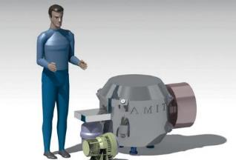
The challenge: miniaturizing the accelerator
Alternative accelerator systems under study to extend the availability of PET imaging to areas far from the large production centres, and to allow using alternative isotopes with shorter half-life (e.g. 11C, 20 min) more effective for some cancer imaging and with reduced dose to the patient.
AMIT superconducting cyclotron for isotope production in hospitals
(CIEMAT, Spain, with CERN contribution)
The CERN design of a 2-stage HF-RFQ system to 10 MeV
Only the production target is shielded (by layers of steel and borated polyethilene). Footprint: 15m2

Slide 12
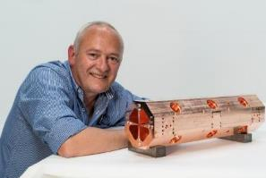
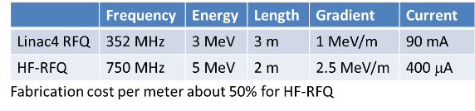
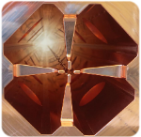
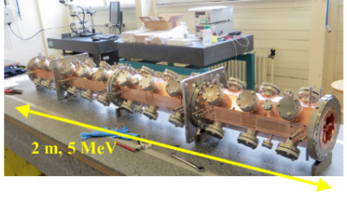
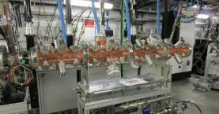
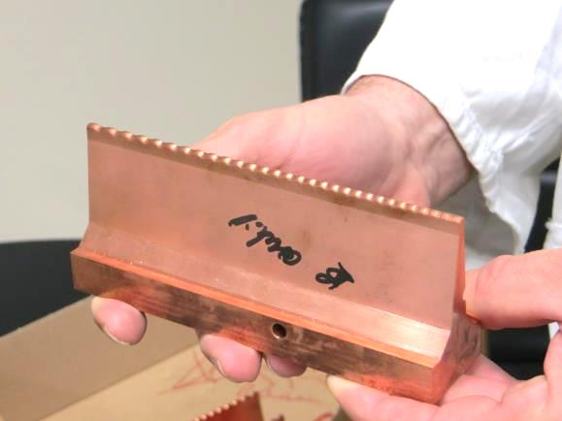
The CERN mini-RFQ
CERN has developed and built a «mini-RFQ» (Radio Frequency Quadrupole) at 750 MHz, extending to higher frequencies and applications outside science the experience of the recent Linac4 RFQ.
RFQ (the first element of any ion acceleration chain) at high frequency – targeted at low current applications requiring small dimensions, low cost, low radiation emissions, up to portability
The prototype unit (5 MeV protons) has been built at the CERN Workshops and is now used in front of the LIGHT proton therapy prototype linac of ADAM/AVO.

Slide 13
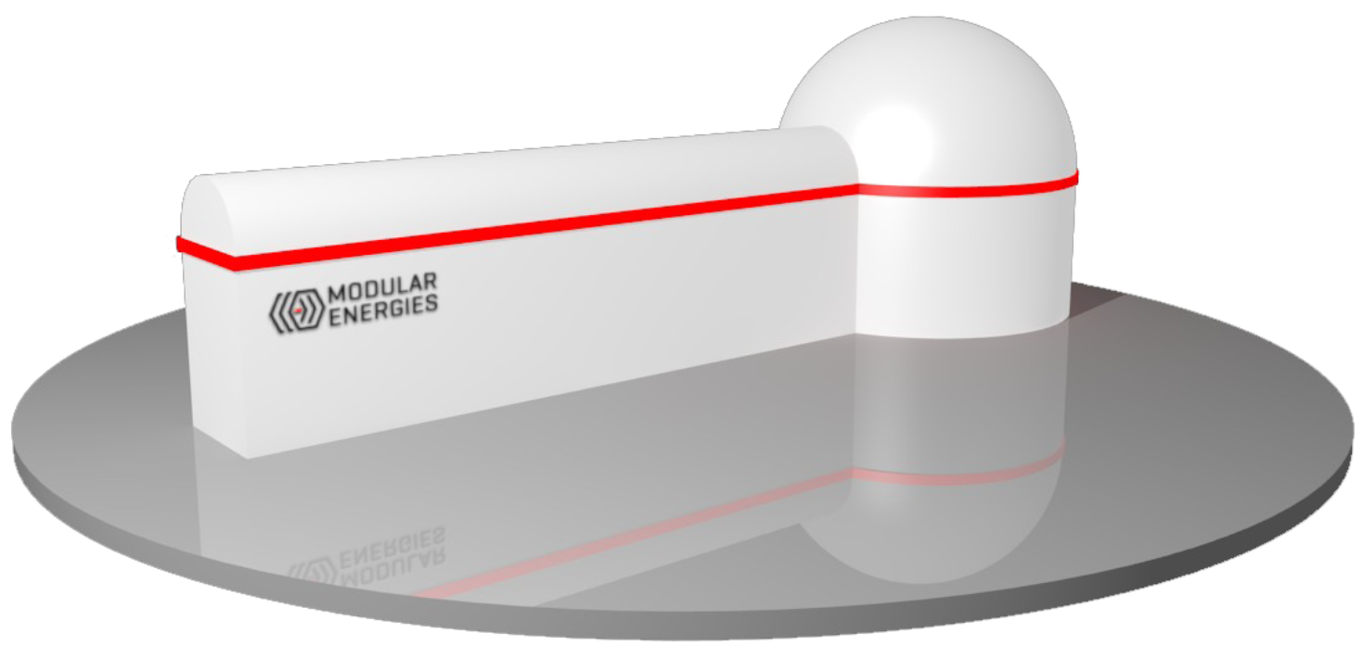
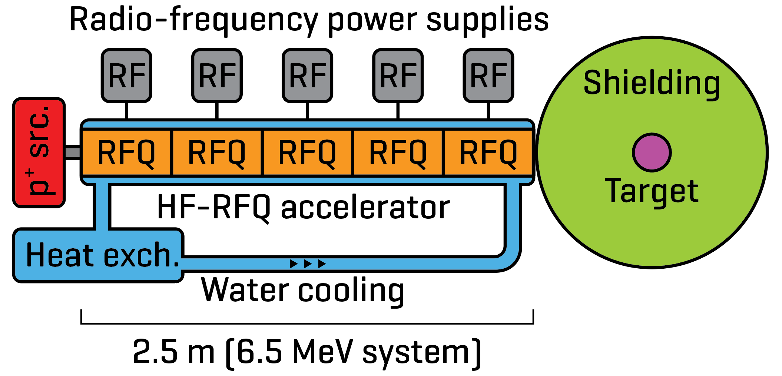
The isotope production RFQ
Interest from a start-up based in the Netherlands
The design has evolved towards lower energies (6.5 MeV) and small footprint
Production rate: >30 average patient doses of ¹⁸F per hour

Slide 14
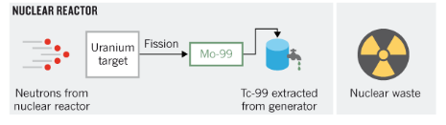
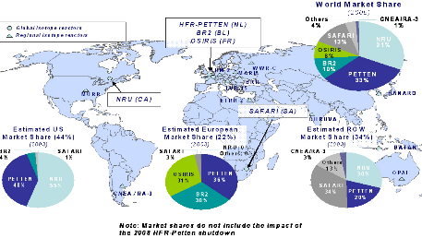
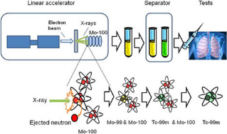
Accelerators replacing nuclear reactors?
Single-Photon Emission Computed Tomography
Accelerator Production of Technetium-99 (half-life 6 h)
Source: Nature, 2013
SPECT isotopes are now produced in nuclear reactors (Molybdenum-99 generators, 66 hrs., converted to Technetium-99 in the hospital).
30 MeV cyclotron
Photo-fission of U
Neutron-spallation of Mo
Source: Government of Canada
2009 shortage crisis

Slide 15
Radiation therapy - Xrays
protons
proton therapy
Hadron therapy
Primary beam
ions
ion therapy
(low en.)
IORT Inter Operation Radiation Therapy
electrons
(high en.)
VHHE Very High Energy Electron Therapy
Secondary beam
Accelerator
Radiation Therapy
X-rays
Target
neutrons
neutron therapy
imaging
PET Positron Emission Tomography
Radioisotopes
therapy
theragnostics
Targetd Alpha Therapy, others

Slide 16
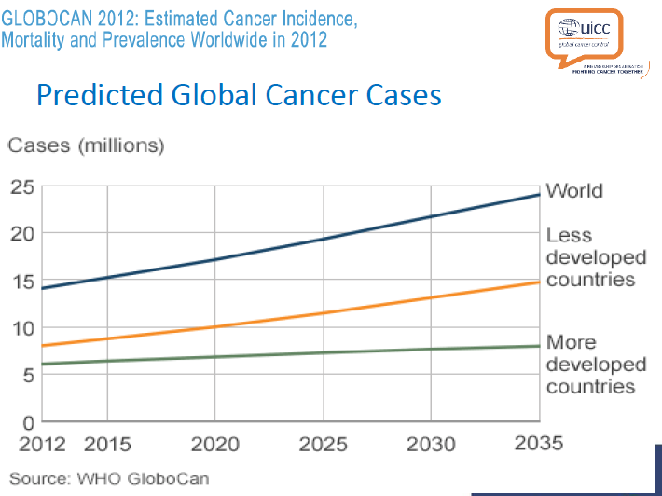
Impact of cancer on world population
Cancer is the second leading cause of death globally, and was responsible for 8.8 million deaths in 2015. Globally, nearly 1 in 6 deaths is due to cancer (WHO).
Increase of cancer cases due to:
Increasing age of population
Aggressive environmental and living conditions in developing countries.
Nowadays, the standard protocol for treatment of most cancers is based on:
Surgery
Radiotherapy (accelerator-based)
Chemiotherapy
(Immunotherapy)
(courtesy M. Dosanih)

Slide 17
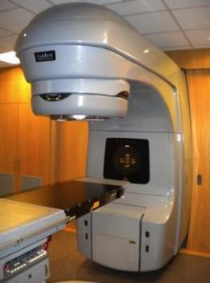
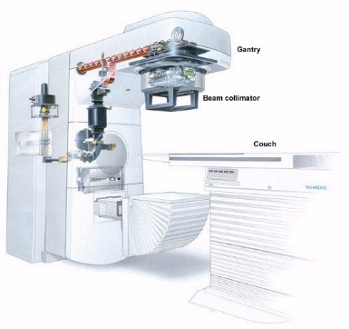
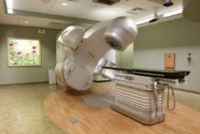
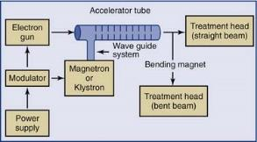
The most successful accelerator
Electron Linac (linear accelerator) for radiotherapy (X-ray treatment of cancer)
5 – 25 MeV e-beam
Tungsten target
14,000 in operation worldwide!

Slide 18
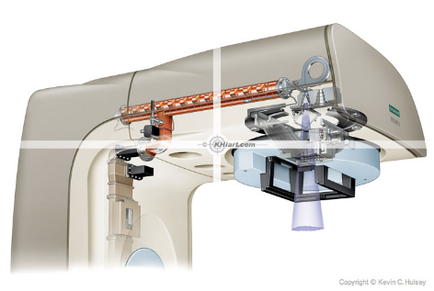
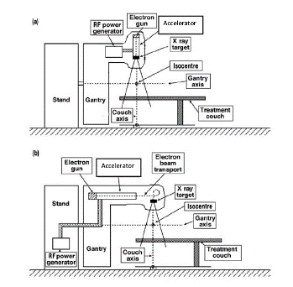
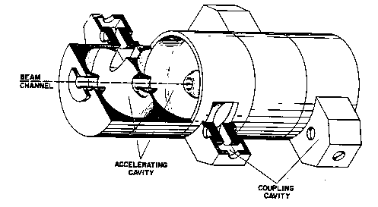
Inside a radiation therapy linac
The Side Coupled Linac structure was invented at Los Alamos in the late 60’s for the 800 MeV LA meson facility.
Because of its robustness, stability, reliability and low cost is used since the 70’s – in a 3 GHz version – to produce X-rays for radiation therapy
A great example of technology transfer from basic science to society

Slide 19
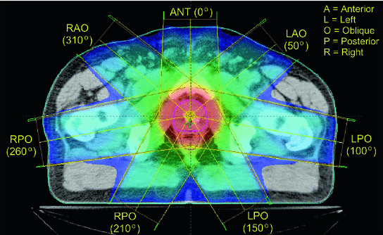
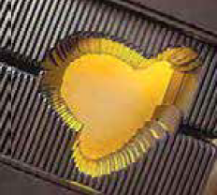
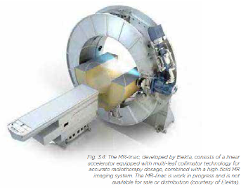
Modern radiotherapy
X-rays are used to treat cancer since last century. The introduction of the electron linac has made a huge development possible, and new developments are now further extending the reach of this treatment.
Accurate delivery of X-rays to tumours (3D CRT)
To spare surrounding tissues and organs, computer-controlled treatment methods enable precise volumes of radiation dose to be delivered. The radiation is delivered from several directions and transversally defined by multi-leaf collimators (MLCs).
Combined imaging and therapy
Modern imaging techniques (CT computed tomography, MRI magnetic resonance imaging, PET positron emission tomography) allow an excellent 3D (and 4D, including time) modelling of the region to be treated.
The next challenge is to combine imaging and treatment in the same device.

Slide 20

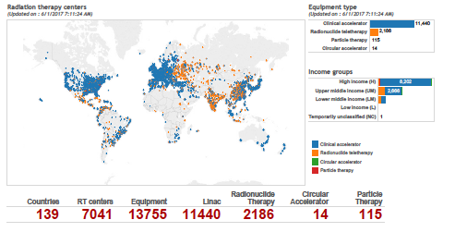
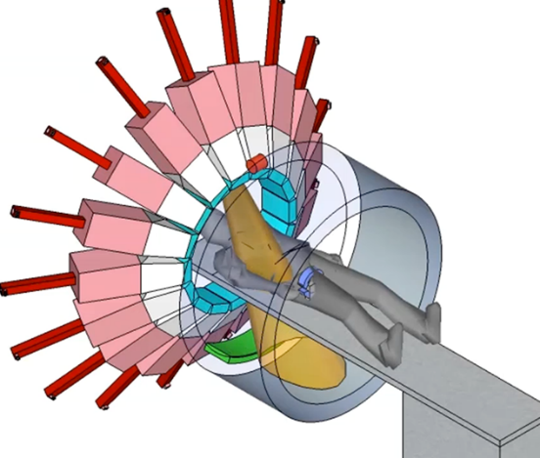
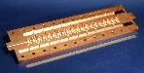
Future trends in radiation therapy accelerators
Burying the complexity:
Collaboration STFC-CERN-ICEC (International Cancer Expert Corps) to development a new generation of radiotherapy linac specifically aimed at low and medium income countries.
Pluridirectional High-energy Agile Scanning Electronic Radiotherapy (PHASER)
Conventional radiation therapy linac expensive, requires maintenance and a stable operating environment (electricity, humidity, dust, etc.) → limiting the access of low and middle income countries to radiation therapy.
Faster radiation therapy (freeze motion):
300 times beam output, no mechanical motion.
Scanning the beam through scanning the phases of 16 11 GHz high-gradient high-efficiency linacs
Ongoing programme, aiming at technology development in 2019-22

Slide 21
Particle Therapy
protons
proton therapy
Hadron therapy
Primary beam
ions
ion therapy
(low en.)
IORT Inter Operation Radiation Therapy
electrons
(high en.)
VHHE Very High Energy Electron Therapy
Accelerator
Secondary beam
Radiation Therapy
X-rays
Target
neutrons
neutron therapy
Radioisotopes
imaging
PET Positron Emission Tomography
therapy
theragnostics
Targetd Alpha Therapy, others

Slide 22
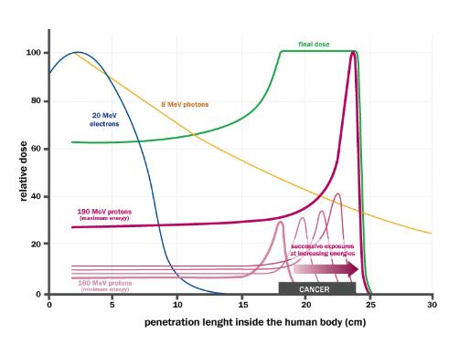
The fascination of the Bragg peak
Bethe-Bloch equation of ionisation energy loss by charged particles
Different from X-rays or electrons, protons (and ions) deposit their energy at a given depth inside the tissues, minimising the dose to the organs close to the tumour.
Required energy (protons) about 230 MeV, corresponding to 33 cm in water.
Small currents: 10 nA for a typical dose of 1 Gy to 1 liter in 1 minute.
Spread-Out Bragg Peak (SOBP)
accelerators-for-society.org

Slide 23
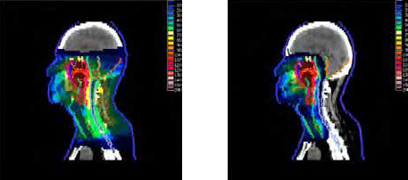
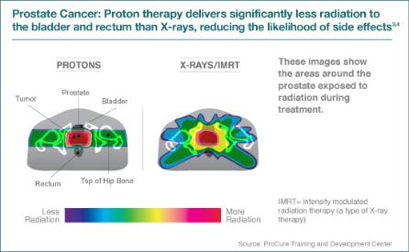
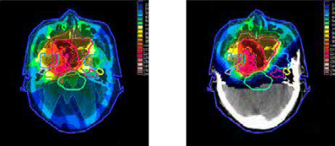
Comparing proton and X-ray therapy
The results of irradiating a nasopharyngeal carcinoma by X-ray therapy (left) and proton therapy (right), showing the potential reduction in dose outside the tumour volume that is possible with proton treatment.
(Z. Taheri-Kadkhoda et al., Rad. Onc., 2008, 3:4 – from APAE Report, 2017).

Slide 24
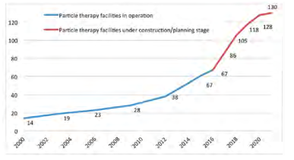

The rise of particle therapy
First experimental treatment in 1954 at Berkeley.
First hospital-based proton treatment facility in 1993 (Loma Linda, US).
First treatment facility with carbon ions in 1994 (HIMAC, Japan).
Treatments in Europe at physics facilities from end of ‘90s.
First dedicated European facility for protons and carbon ions in 2009 (Heidelberg).
From 2006, commercial proton therapy cyclotrons appear on the market (but Siemens gets out of proton/carbon synchrotrons market in 2011).
Nowadays 3 competing vendors for cyclotrons, one for synchrotrons (all protons).
More centres are planned in the near future.
A success story, but …
many discussion on effectivness, cost and benefits.
Some negative feedback from the running centers: lack of patients, high running costs,…

Slide 25
The challenges of particle therapy
Cost: a commercial single-room proton therapy system has a price starting from 30 M€, to be compared with 2-3 M€ of a X-ray radiotherapy system. A proton and ion therapy centre has a cost of 150-200 M€. Running costs are also high, mainly because of the needs in personnel to run the facilities.
Range uncertainties: X-ray therapy has reached a high level of precision and can be coupled to on-line diagnostics. Particle therapy is difficult to calibrate (energy loss depends on tissues), dosimetry is less precise, and on-line scanning is not possible.
Assessing performance: advantage of particle therapy in reducing dose to tissues surrounding the tumour, with less risk of secondary cancer and less damage to critical organs. There is no or little impact on survival rate, the main result is in improving quality of life after treatment. While survival rates are easy to measure and compare, quality of life is not an easily measureable parameter; only recently studies are starting to take this parameter into account.
Centralisation of medicine: the high cost of particle treatment calls for large centralised units that have difficulties in attracting patients from hospitals located in a large region.

Slide 26


Advantages of proton therapy
The main recognised advantage of proton therapy are for:
Pediatric tumours, where surrounding tissues are more delicate and the risk of secondary tumours is higher.
Tumours close to vital organs: base of skull, central nervous system, head and neck.
Source: IBA, state of proton therapy market entering 2017
Source: IBA proton therapy fact-sheet,

Slide 27



Proton therapy accelerators: cyclotrons
At present, the cyclotron is the best accelerator to provide proton therapy reliably and at low cost (4 vendors on the market).
Critical issues with cyclotrons:
Energy modulation (required to adjust the depth and scan the tumour) is obtained with degraders (sliding plates) that are slow and remain activated.
Large shielding
ProteusOne and ProteusPlus turn-key proton therapy solutions from IBA (Belgium)

Slide 28


Proton therapy accelerators: synchrotrons
The Loma Linda Medical Centre in US (only protons) and the ion therapy centres in Japan have paved the way for the use of synchrotrons for combined proton and ion (carbon) therapy).
2 pioneering initiatives in Europe (ion therapy at GSI and the Proton-Ion Medical Machine Study PIMMS at CERN) have established the basis for the construction of 4 proton-ion therapy centres: Heidelberg and Marburg Ion Therapy (HIT and MIT) based on the GSI design, Centro Nazionale di Terapia Oncologica (CNAO) and Med-AUSTRON based on the PIMMS design.
HIT Heidelberg
CNAO

Slide 29




Alternative solutions: the linear accelerator
The TERA Foundation (U. Amaldi) has launched in 1995 a collaboration with CERN for the development of a proton therapy linac operating at high frequency (3 GHz) and high gradient (30-50 MV/m) reaching 230 MeV in 25 meters.
The LIBO prototype structure and accelerating cells (CERN)
Advantages of a LINAC:
High repetition frequency with pulse-to-pulse energy variability
Small emittance, no beam loss.
The TULIP concept using CLIC high-gradient cavities – 15 meters
The LIGHT linac by ADAM (being assembled and built in a CERN test area) – 25 meters

Slide 30


LIGHT (Linac for Image Guided Hadron Therapy)
25 m
A. Degiovanni, HG2018 Workshop, Shankai, China
750 MHz Radio Frequency Quadrupole (RFQ)
3 GHz Side Coupled Drift Tube Linac (SCDTL)
3 GHz Coupled Cavity Linac (CCL)
ADAM is an old CERN spin-off now part of the UK company AVO (Advanced Oncotherapy). They reported acceleration to 52 MeV in September 2018. From end 2019, the development will continue at Daresbury Laboratory (UK). The first LIGHT unit will be installed at the Harley Street Hospital in London.

Slide 31



Ion therapy: advantages
Light ions (e.g. Carbon) are more effective than protons or X-rays in attacking cancer.
The particle (or X-ray) breaks the DNA; multiple breaks kill the tumour cell. However, the key mechanism is DNA self-repair by the body cells.
Protons and X-rays cause single-strand breaks, easy to repair.
C ions produce a 22 times more ionisations per length generating many double-strand breaks that are much more difficult to repair.
Ions are effective with hypoxic radio-resistant tumours (1 to 3% of cancers), allow for a lower dose thanks to their higher RBE, and have increased dose conformity thanks to less lateral scattering.
So far, 2/3 of cases treated at the mixed facilities (CNAO, etc.) are with carbon.
Radio Biological Effectiveness (RBE) is higher for Carbon than for protons.
1.1 for protons
3 for C ions
(reference is 1 for Co X-rays)

Slide 32





Ion therapy and immunotherapy
The «holy grail» of particle therapy
Combination of local therapies with immunotherapy, to convert the individual tumour into an in situ vaccine. The application of local radiation therapy as an adjuvant to immunotherapy is under active investigation both preclinically and clinically and is currently considered one of the most promising strategies to defeat cancer.
Potential to extend the reach of radiation therapy to diffused tumours and methastasys, responsible for the largest amount of cancer deaths.
Opens the way to personalised treatments, the future of cancer treatment.
Formenti & Demaria, Lancet Oncol. 2009
Selection of immunoradiation therapy or standard therapy for patients based on predictive biomarkers.

Slide 33



Ion therapy: cost and perspectives
For practical and historical reasons, all ion accelerators operate with fully stripped Carbon ions.
Bethe energy loss goes as z², z=charge of the incident particle → the energy loss is higher for ions → we need a higher energy (per atomic mass unit) to fully penetrate inside the body → around 440 MeV/u.
The accelerator is more complex than for protons: magnetic rigidity at full energy is 2.76 times that of proton at full treatement energy.
For a given magnet field, in a medical ion synchrotron with respect to a proton one accelerator and gantries have to be almost 3 times larger.
The HIT gantry has a mass of 600 tons for a dipole bending radius of 3.65 m.
All existing ion medical accelerators are large synchrotrons.
Cyclotrons cannot be easily used because of the dimensions and complexity (needs superconductivity) and because of the complexity of ion extraction from cyclotrons.
We need more studies with alternative ions! (Helium, Neon, Silicium, etc.)

Slide 34

Requirements for the future of ion therapy
Prepariing the future of ion therapy: requirements
Delivery:
Fast dose delivery (possibly with 3D feedback for moving organs);
Some range calibration online (e.g. proton or helium radiography);
The rotating gantry is mandatory (possibly coupled to on-line MRI);
Using multiple ions might be an asset.
Accelerator:
Lower cost, compared to present (120 M€ for HIT and CNAO);
Higher beam intensities than present (e.g. 10 times HIT);
Reduced footprint from present (to about 1’000 m2);
Lower running costs;
Smaller facilities with less treatment rooms, distributed on the territory.
Key messages from the International Workshop organized at Archamps in June 2018

Slide 35


Guidelines for PIMMS2
The new PIMMS2 should concentrate on ions (we leave proton therapy to industry that is already well advanced) and be based on:
Novel accelerator designs (compactness, cost, simple operation)
Fast delivery scheme;
Multiple ion capability;
Equipped with a rotating gantry.
Two technical options:
10 m
23 m
1. Superconducting synchrotron (90⁰ magnets)
2. Bent linear accelerator
Alternative options (cyclotrons, FFAG) are technically complex and far from the CERN expertise

Slide 36


The Superconducting synchrotron
Initial design by the TERA Foundation based on Canted Cosine Theta Magnets.
The TERA-CCT design:
3.5 T magnets with nested quadrupoles, 10e10 ions/cycle;
27 m circumference (+6 m linac injector), footprint <1000 m2;
Magnet rise time may limit beam delivery.
SC gantry with similar CCT magnets

Slide 37




Magnets: CCT or HTS?
2 options being considered for the superconducting magnets:
Canted Cosine Theta (CCT)
LBNL is building a prototype 90deg CCT for use in a gantry
High Temperature Superconductor (HTS)
Large development effort in Europe based on YBCO conductors (yttrium barium copper oxyde)
Tape developed with industry, to reach 20T in high-field dipoles for high-energy colliders.
S. Caspi, L. Brouwer, LBNL
Advantages:
Simple construction;
Nested quadrupole (additional quadrupole layer)
Disadvantages:
Limited field
Possible field errors
Advantages:
Higher field;
Technology being developed at CERN
Disadvantages:
Cost of magnetic material
Need external quadrupoles

Slide 38





The high-frequency linac
Concept under development by CERN and TERA. 400 MeV/u linac for fully stripped Carbon (6+)
3 GHz linear accelerator similar to the proton linac of ADAM/AVO for the high-energy part.
3 innovations: ion source and LEBT for C6+, bending section at 100 MeV, low-beta accelerating structures
C6+ ion source and beam transport
High-frequency RFQ
High energy section
Advantages:
Much faster beam delivery (200 Hz, 10e8 ions/pulse);
Easy pulse-to-pulse energy variation (fast 3D scanning).
Disadvantages:
More innovative solution, several new components and R&D time;
Present delivery schemes and protocols optimised for synchrotrons, important modifications on the medical side.

Slide 39



The ion linac: structures and gradients
Present Design (430 MeV/u)
Tot. length 53 m
Tot. RF power 260 MW
Optimised for power consumption
Gradient 30 MV/m: higher values are possible but at the price of a drastic increase in RF power.
IH
DTL
CCL
S. Benedetti, A. Grudiev and A. Latina, Design of a 750 MHz
IH structure for medical applications, Linac16
High frequencies and low particle velocity (case of ions) don’t go well together (cell length in a linac is βλ/2).
Need of new designs adapted to the high-frequency and to introduce an intermediate frequency (70 MHz).
S. Benedetti, High-gradient and high-efficiency linear accelerators for hadron therapy, EPFL PhD Thesis

Slide 40


An open collaboration based on CERN and SEEIIST
2019 will see the start of the PIMMS2 study, in collaboration with the SEEIIST. Other partners are welcome to join the collaboration.
4 Workpackages:
Injector linac
SC synchrotron
Linac
Beam delivery and gantry.
South-East European International Institute for Sustainable Technologies.
Establishment of a particle accelerator laboratory in SEE, to foster peace and collaboration.
In 2018 the SEEIIST has opted for a combined cancer therapy and biomedical research facility.
Funding primarily from structural and pre-accession EU funds.
01/2019-06/2020 Parallel study and comparison of two designs, superconducting synchrotron and linac
07/2020-06/2022 Technical design of the preferred option

Slide 41


New technologies at the horizon
The goal of the study that we are starting at CERN is to have a Technical Design Report ready in 2022, to be used for the construction of a next-generation facility.
On a longer-term perspective, fascinating options are appearing.
Laser-plasma acceleration
1st Generation Quantum Scalpel
Positive: minimum footprint and limited energy to produce the relatively small quantities of ions required for therapy.
Negative: the requirements of reliability, stability and reproducibility of medical standards are very far from what achievable with present laser-based accelerators.
An interesting idea from K. Noda (HIMAC, Japan):
The future generation facility should be a «quantum scalpel» where a supercondcting synchrotron is fed by a laser-based injector.
The linac (10 MeV/u) is one of the most difficult parts of a conventional facility. Replacing it with a laser system would allow gaining in size and complexity, but the laser produced beam has to respect the requirements for injection into a synchrotron.

Slide 42

Conclusions
Medical accelerators is a vast and promising field, connected to the main technology driver of XXIst century.
There is wide space for improvement and for exciting new developments.
CERN is ready to launch a wide European collaboration for the development of the next generation ion therapy facility.
However, the accelerator is only a small part of the facility. To succeed, we have to optimise the entire sequence from the ion source to the patient, and to industrialise the accelerator at the level required by a medical facility.
the MedAUSTRON hall

Slide 43

Thank you for your attention
maurizio.vretenar@cern.ch

Slide 44
Backup slides

Slide 45


Isotopes for advanced therapies
TARGETED ALPHA THERAPY
Injected radiolabeled antibodies accumulate in cancer tissues and selectively deliver their dose. Particularly effective with alpha-emitting radionuclides (minimum dose on surrounding tissues).
Advanced experimentation going on in several medical centres, very promising for solid or diffused cancers (leukaemia).
Potential to become a powerful and selective tool for personalised cancer treatment.
If the radioisotope is also a gamma or beta emitter, can be coupled to diagnostics tools to optimise the dose (theragnostics)
Alpha particles: high RBE (up to 1’000), penetration in tissues only 10’s of μm
Astatine: the rarest element on earth (only 25 g at any given time), the less stable element in the periodic table <100
Half life (210At): 7.2 hours
Presently only in trial phase, successful expect strong demand of α-emitters that the accelerator community will have to satisfy. For example, production of α-emitter Astatine-211, obtained by α bombardment of a Bismuth target (209Bi(α,2n) 211At nuclear reaction).
Requires an accelerator of α particles (q/m=1/2); optimum energy 28 MeV (sufficient yield but below threshold for 210Po), current >10 mA.
The use of α’s in cyclotrons is limited by extraction losses; linacs have a strong potential.

Slide 46



Electrons: IORT and VHEE
Inter Operational Radiation Therapy (IORT) – (5-20 MeV):
Technique derived from radiation therapy, where a compact electron linac is not used to produce X-rays, but to send the electrons directly on the tissues.
It delivers a concentrated dose of radiation therapy to a tumour bed during surgery. This technology may help kill microscopic diseases, reduce radiation treatment times, preserve more healthy tissue.
Very High Energy Electrons (50-250 MeV) for radiotherapy:
Proposed as a lower-cost alternative to hadron therapy, treat deep seated tumours with high-energy electron beams. High dose deposition, less sensitive to errors, good sparing of healthy tissues.
Made possible by recent advances in high-gradient NC linac technology (CLIC, etc.).

Slide 47


Neutrons: fast neutron therapy and BNCT
Fast Neutron Therapy (> 1 MeV): High RBE but difficulty in controlling and directing the neutral particles. Only 7 centres in the world proposing fast neutron treatement, with beams generated by a proton beam (50 MeV) on target or by a nuclear reactor.
Boron Neutron Capture Therapy
The (normal) stable version of boron, boron-10, captures slow neutrons to give boron-11. This then decays into lithium-7 and alpha particles, which kill any surrounding malignant tissue.
A boron-containing drug designed to localise in cancerous cells is injected into the patient, and a beam of low-energy neutrons shaped to optimise capture by the injected boron is directed at the cancerous sites.
Two-stage creation of the delivered dose, particularly effective with some difficult-to-treat cancers such as brain tumours or malignant melanoma.
Neutron production requires intense proton beams (e.g. 3 MeV, >1 mA CW) with problems of heat load, activation, target (usually solid lithium).
A BNCT centre is in operation in Tokyo, a first commercial unit installed at Helsinki, experimentation progressing in several centres.

Slide 48

Particle therapy centers in Europe
Austria | Med-AUSTRON, Wiener Neustadt | S 250 | 1 gantry, 2 hor., 1 vertical | 2017
Czech Republic | PTC Czech s.r.o, Prague | C 230 (scan) | 3 gantries, 1 horizontal | 2012
United Kingdom | Clatterbridge | C 62 | 1 horizontal. | 1989
France | CAL, Nice | C165 | 1 horizontal | 1991
France | CPO, Orsay | S 250 | 1 gantry, 2 horizontal | 1991
Germany | HZB, Berlin | C 250 | 1 horizontal | 1998
Germany | RPTC, Munich | C 250 (scan) | 4 gantries, 1 horizontal. | 2009
Germany | HIT, Heidelberg | S 250 (scan) | 2 horizontal, 1 gantry | 2009, 2012
Germany | WPE, Essen | C 230 (scan) | 4 gantries, 1 horizontal | 2013
Germany | PTC, Uniklinikum Dresden | C 230 (scan) | 1 gantry | 2014
Germany | MIT, Marburg | S 250 (scan) | 3 horizontal, 1 45 degrees | 2015
Italy | INFN-LNS, Catania | C 60 | 1 horizontal | 2002
Italy | CNAO, Pavia | S 250 | 3 horizontal, 1 vertical | 2011
Italy | APSS, Trento | C 230 (scan) | 2 gantries, 1 horizontal | 2014
Poland | IFJ PAN, Krakow | C 60 | 1 horizontal | 2011
Russia | ITEP, Moscow | S 250 | 1 horizontal | 1969
Russia | St. Petersburg | S 1000 | 1 horizontal | 1975
Russia | JINR 2, Dubna | C 200 | 1 horizontal | 1999
Sweden | The Skandion Clinic,Uppsala | C 230 (scan) | 2 gantries | 2015
Switzerland | CPT, PSI, Villigen | C 250 (scan) | 2 gantries, 1 horizontal. | 1984, 1996, 2013
From 8 centres in 2000 we are now to 20 in operation plus 10 in construction (4 centres offering as well ion therapy)
https://journals.aps.org/prab/pdf/10.1103/PhysRevAccelBeams.19.124802
Protontherapy is rapidly developing: more than 65'000 patients treated worldwide, 5 companies offer turn-key solutions.
Carbon ions have been used to treat about 6000 patients worldwide
Adapted from PTCOG data, May 2016 – from APAE Report

Slide 49
New developments in particle therapy
Pencil Beam Scanning (PBS): (or Intensity-Modulated Particle Therapy IMPT) scanning through the tumour of a small pencil beam, to reduce even more the dose to surrounding organs.
Motion Management: following the movements of the patients (breathing, etc.) with the movement of the beam. It is often called 4-D scanning.
Adaptive image guided therapy (IGPT): combining proton therapy and MRI.
Imaging from secondary emission: imaging during treatment is possible by monitoring secondary emission from the particle beam.
Use of other ions: intermediate ions like e.g. Helium seem to have similar properties than Carbon, while being easier to accelerate. Oxygen and Argon are also considered. More clinical studies and accelerator design effort are needed.
Particle beams for other diseases than cancer: interest for cardiac arrhythmia and other applications.
Compact gantries: the gantry is a critical element of particle therapy centres, in terms of cost, dimensions and limitation to scanning speed. Options being considered are superconducting magnets, FFAG, full accelerators on gantries, etc.

Slide 50


The limits of ion therapy – experience from operating facilities
Mixed messages from the 4 ion therapy facilities operating in Europe. Many successful results, but:
  Doctors reluctant to move patients to large therapy centres;
  High construction and operating costs;
  Focus is more on delivery schemes and procedures than on the accelerator.
Radiotherapy is much more advanced than particle therapy in beam delivery
Breaking news, 14.09.18

Slide 51

The SEEIIST Initiative
Following the initiative of H. Schopper and with the coordination of S. Damjanovic, nuclear physicist and Minister of Science of Montenegro, 8 Balkan countries have signed a Declaration of Intent for the creation of the South-East European International Institute for Sustainable Technologies.
Their goal is to foster peace and collaboration in the area with the creation of a particle accelerator laboratory, following the example of the SESAME facility in Middle East.
In March 2018 the SEEIIST has decided to build a combined cancer therapy and biomedical research facility (preferred to a synchrotron light facility).
Funding (150-200M) primarily from structural and pre-accession EU funds.
CERN was asked to host the headquarters of SEEIIST and the study group, until the site is selected.
2 years to prepare a TDR.

Slide 52
Accelerator and Society
Over 30’000 particle accelerators are in operation world-wide.
Only ~1% are used for fundamental research.
Medicine is the largest application with more than 1/3 of all accelerators.
Research |  | 6%
 | Particle Physics | 0,5%
 | Nuclear Physics, solid state, materials | 0,2 - 0,9%
 | Biology | 5%
Medical Applications |  | 35%
 | Diagnostics/treatment with X-ray or electrons | 33%
 | Radio-isotope production | 2%
 | Proton or ion treatment | 0,1%
Industrial Applications |  | <60%
 | Ion implantation | 34%
 | Cutting and welding with electron beams | 16%
 | Polymerization | 7%
 | Neutron testing | 3.5%
 | Non destructive testing | 2,3%

Slide 53


80 years of accelerators for medicine
1928: Rolf Wideröe at Aachen invents the modern radio-frequency accelerator.
1929: Ernest O. Lawrence in Berkeley adds cyclic acceleration and builds the cyclotron.
1936, the new Berkeley 37-inch cyclotron produces isotopes for physics, biology and medicine – in parallel to the time devoted to discoveries in nuclear physics.
1937: Lawrence’s brother John is using radioisotopes to cure leukemia and blood diseases.
1939: direct irradiation of patients at Berkeley with neutrons from the new 60-inch cyclotron.
1946: Robert Wilson proposes to use protons or ions to treat cancer, profiting of the Bragg peak to deliver a precise dose to the tumour.
1956: First treatment of pituitary tumours at Berkeley.
1990: First hospital-based proton treatment center at Loma Linda (US) in 1990
First direct irradiation of a patient at Berkeley, 20 November 1939

Slide 54
The potential of particle accelerators
All these systems share the vision of a bloodless surgery and imaging: penetrate into the human body to treat diseases and to observe internal organs without using surgical tools.
Particle beams (primary and secondary) precisely deliver large amounts of energy to small volumes, penetrate in depth (different from lasers) and interact with cells, molecules, and atoms (electrons and nuclei).
Particles beams can activate the nuclei generating radiation that can destroy cancerous cells or can be detected from outside.
Nuclear medicine:
application of radioactive substances in the diagnosis and treatment of disease
Radiation therapy:
therapy using ionizing radiation, generally as part of cancer treatment to control or kill malignant cells

