Slide 1
LhARA Instrumentation – Update and next steps
John Matheson
Rutherford Appleton Laboratory
Dec 2020
Research Plan from the pre-CDR
SciWire
Thin ceramic monitors
SmartPhantom
Dosimetry
FFA Instrumentation
What are the next steps ?
(Not yet including instrumentation beyond the interaction of the proton beam, e.g. secondary particles and photons)

Slide 2
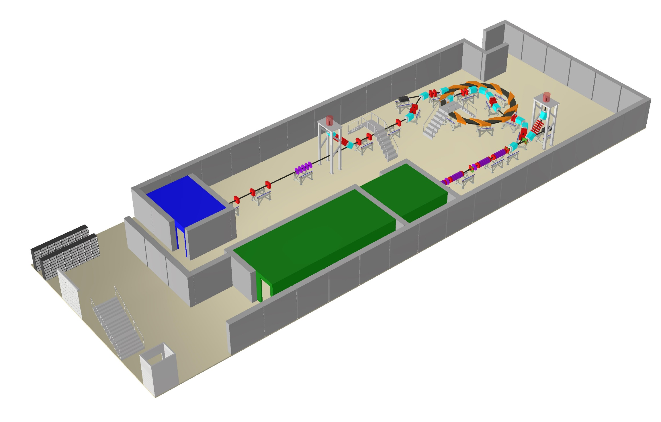
Layout of the facility – Overall
High energy in vitro end station
In vivo end station
Low energy in vitro end station
Laser target
Laser

Slide 3
Pre-CDR Research Plan
Low energy beam Conventional diagnostics
Beam position – capacitive button pickups
Beam current - BCT
Beam current and energy - multi-layer Faraday cups (destructive)
Emittance - slit-grid/slit scanners or pepper-pot emittance monitors
Low energy beam diagnostics
SciWire - online beam profile measurement
Thin ceramic monitors - online beam profile measurement
Fast feedback and controls
Initial R&D for the fast feedback system will focus on Stage 1
Depends on details of the low energy beam instrumentation
Development of an automated system for tuning the beam
Monte Carlo simulation of the LhARA beam line in firmware
Later extend to include Stage 2
High energy beam diagnostics
Develop beam position measurement for the FFA
Investigate conventional diagnostics for beam current, position and profile measurement in the transfer lines
Bunch length is important in the transfer line to the in vivo end station
Emittance measurements by conventional instruments
Use COTS solutions wherever possible
High intensity short pulses may be challenging
Online dosimetry and dose profile
Development of SciWire - dose profile at low energy end station
Development of thin ceramic monitors - dose profile at low energy end station
Development of SmartPhantom - online dose measurements in the high energy end stations
Absolute dosimetry at ultra-high dose rates
Characterisation of nonlinear response of film detectors at high dose rates
Films / calorimetry for calibrating the online dose monitors

Slide 4
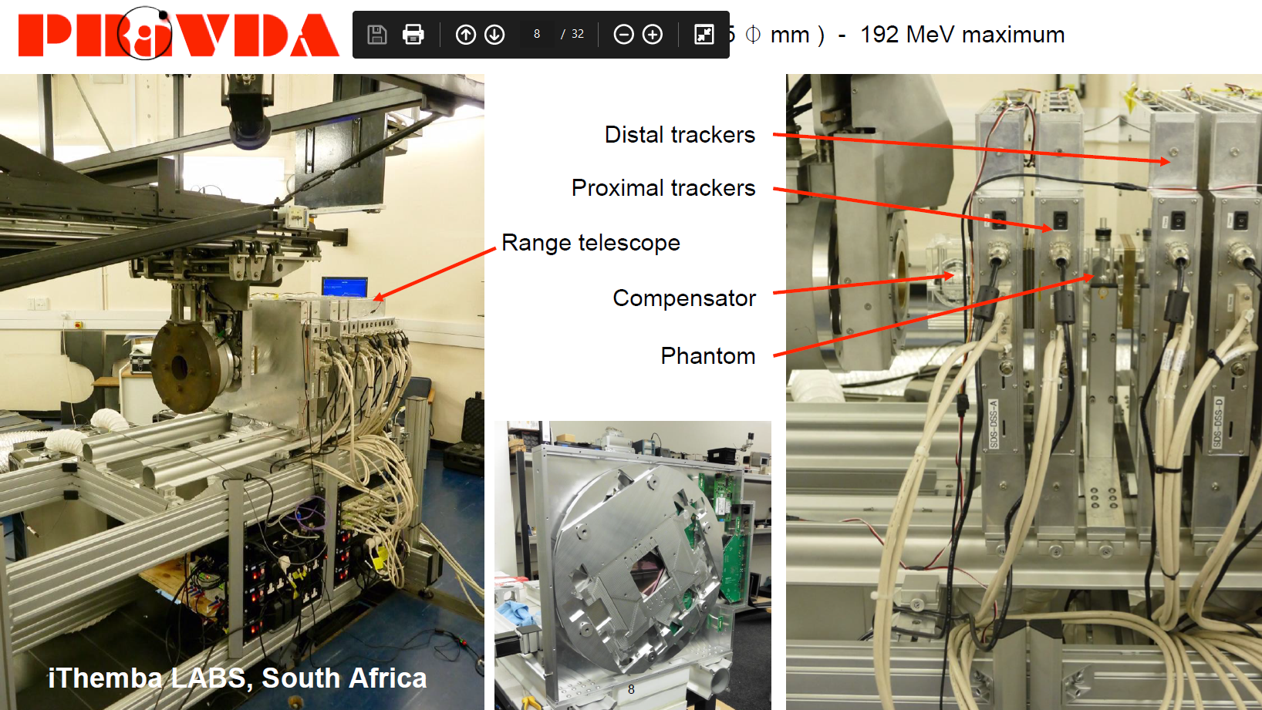
Birmingham have joined the collaboration
Experience in proton beam instrumentation for radiotherapy – Pravda/Optima
Access to proton beam from cyclotron (28 or 36 MeV, fA to nA current, 50mm beam diameter)
Where can we use this for testing LhARA instrumentation ?
Passively scattered broad beam, dia 85mm, max. 192 MeV
Slide from Nigel Allinson

Slide 5

SciWire - Scintillating Fibre Detector
STFC Impact Acceleration Account grant to develop scintillating fibre detector for low-energy ion beams.
  Energy measurement.
  Intensity profile.
Plane made of fibres arranged in two layers perpendicular to each other.
Detector consists of multiple planes.
250$μ$m
5cm
Similar approach proposed by Chris Armstrong (RAL CLF)
Scintillating fibre good for lasers – keep electronics away from interaction (EMP)
So far readout by fibre bundles to CMOS or CCD camera
Could it be possible to look at output from both fibre ends and use relative pulse height to get position along the fibre ?
Possibility of collaboration
Could apply for STFC CfI money
5cm
Finish building prototype(s) for test.
Source tests, proton beam tests.
Measure position resolution and cross-talk.
Possibility of dose measurement
Tests at CLF or other laser facility ?

Slide 6
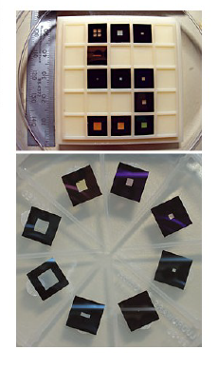
Thin ceramic monitors
AlN or SiN membrane, in supporting “frame”
Chemically etched and metal electrodes deposited
Beam induces currents on the electrodes
Available from industry (Silson, Ametek/HSFoils)
Thin windows are not expensive, budget near £1.5K
Electrodes – decide on geometry, photomask or shadow mask
Company can do everything for us including mounting on a vacuum flange, just need the mask for electrode deposition
Interconnect – Wirebonding ?
Readout ?
To buy the windows should be easy enough but the rest needs funding too.
Possible candidate for STFC PoC funding ?
https://www.silson.com/
Thanks to Alex Howard

Slide 7
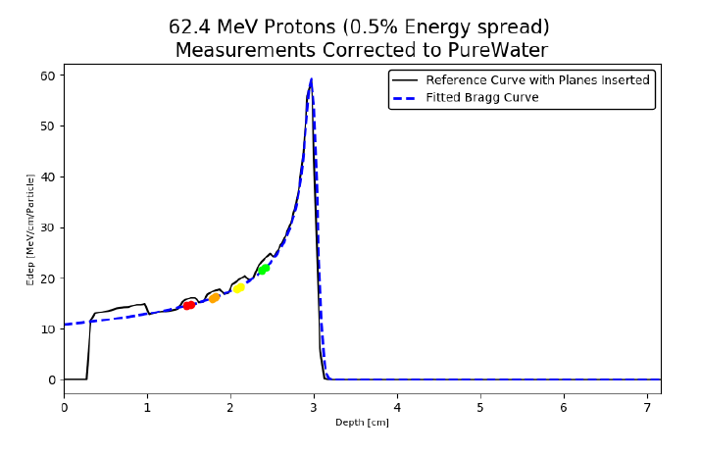
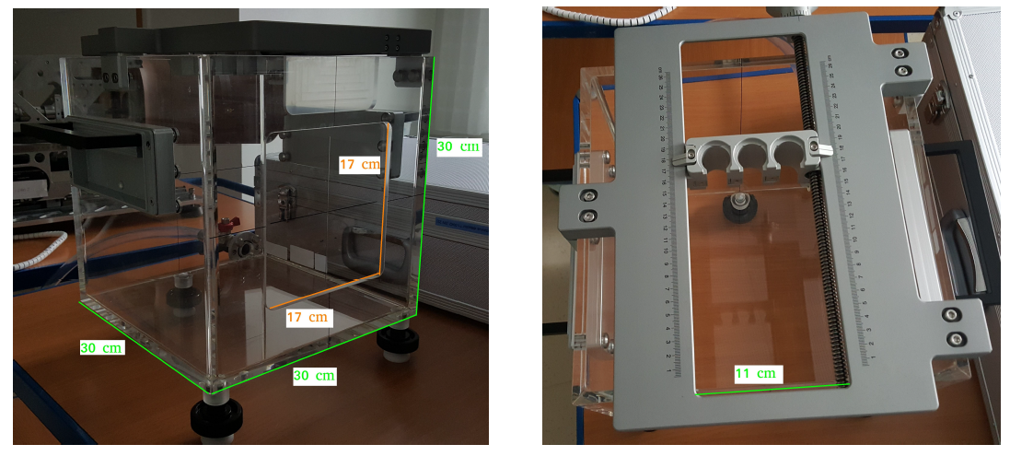
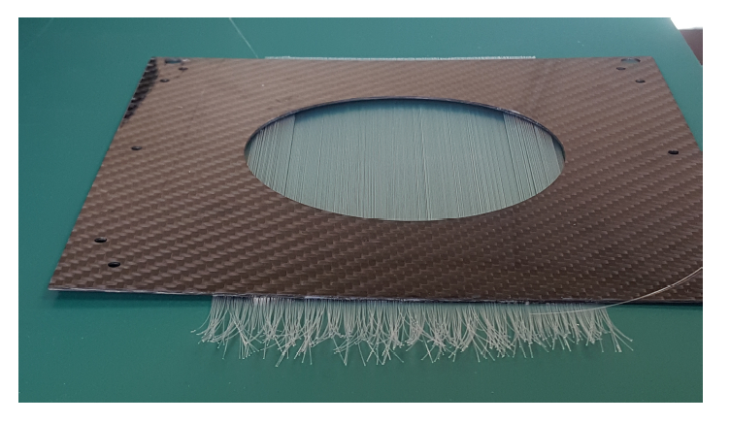
SmartPhantom Prototyping
H.T.Lau
SmartPhantom is being simulated in GEANT4
Simulations will be used to develop analysis scripts, to fit the data and find the position of the Bragg peak, beam profile, LET and dose delivered in real time.
Derive these parameters from measurements taken shot by shot, not purely from Monte Carlo simulations.
Collaboration with the Technical University of Vienna
Decide on readout (CMOS camera, PIN diode….. ?)
Test first prototypes of the SmartPhantom at MedAustron (delayed)

Slide 8
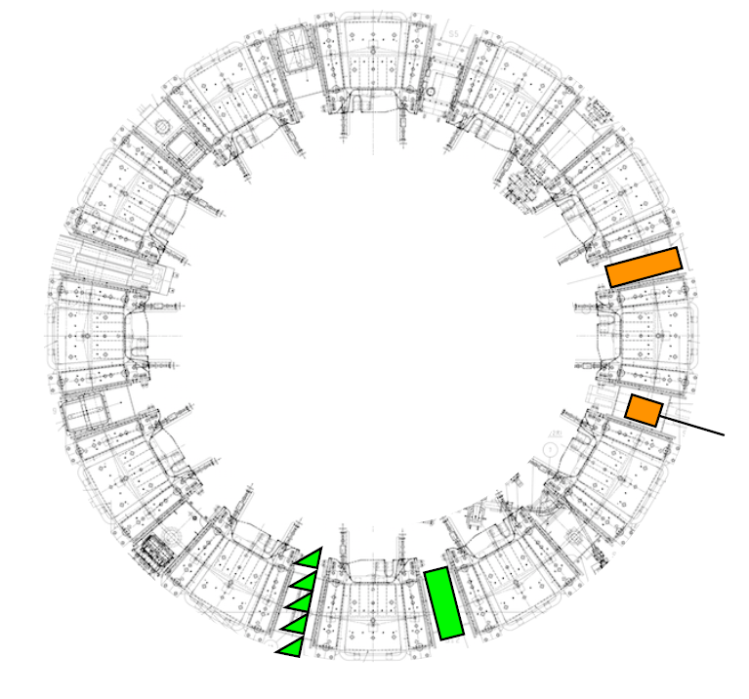
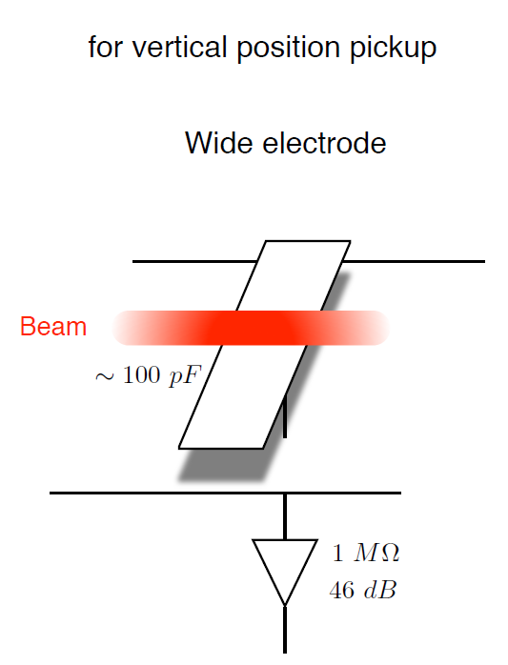
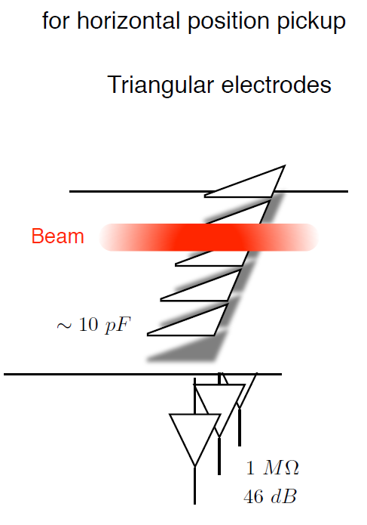
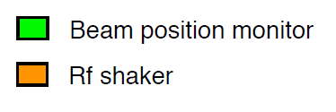
FFA Instrumentation
KURNS FFA main ring
Would be useful to understand beam pickup response
Wasn’t done at KURNS, Tomonori Uesugi thinks it’s interesting
Currently gives info on oscillation rather than position
Moveable shoebox pickup can give actual position
Consensus to use CST Particle Studio, RAL (ISIS) has access
CERN (Rhodri Jones) willing to collaborate
Could be a good project for student/postdoc
LhARA FFA based on RACCAM, 10 cells
Beam position measured at injection and extraction septa
Position measurement at least every second cell
KURNS = Institute for Integrated Radiation and Nuclear Science, Kyoto University

Slide 9
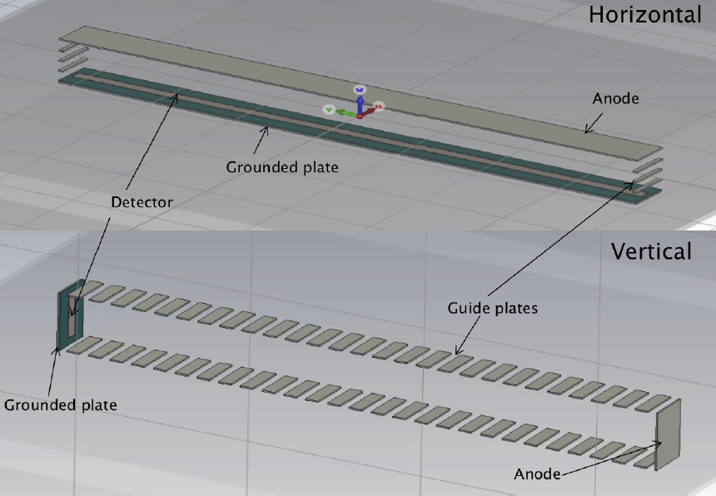
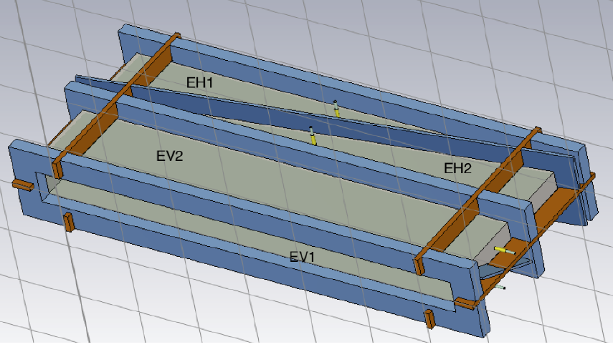
ISIS Upgrade – BI for FETS-FFA
ISIS Upgrade (thanks to Emi Yamakawa, Chris Rogers, Chris Wilcox)
FETS-FFA demonstrator, design report due Spring ’21
Very similar to KURNS FFA and working closely with Kyoto
Diagnostics a challenge because of big beam excursion 700mm x 60mm beam pipe
Studying using CST Particle Studio
BPM – using shoebox type pickup, half-size prototype under construction
IPM – field electrodes + channeltrons
Drift the ions within 1 turn to avoid pileup
Horizontal OK, Vertical - problem to get big field
Need to keep in touch !
BPM
IPM
Yamakawa et al., IBIC ’19

Slide 10
Next Steps
Experimental work
  Test SciWire with suitable beam
  Build and test thin ceramic monitors
  Test SmartPhantom with suitable beam
  Calibration of SciWire/Smartphantom dose against standards
Simulation
  Build a CST Particle Studio model of the KURNS BPM
  Simulate other beam instruments ?
  Whole beamline MC - inputs to fast feedback and control
Students/postdocs required ! Looks like we should get a PhD student jointly funded by RAL PPD and JAI - Interviews Feb, for a Sept start
Many possibilities, but with finite resources, what things should we prioritise ?
(Include things I may have missed !)

Slide 11
Spare Slides

Slide 12
Dosimetry
Aim to have online dosimetry pulse by pulse
Based on SciWire, SmartPhantom
How to calibrate against a standard ?
May use:
Nuclear track detectors (NTDs) or radiochromic films (RCFs)
CR39 plastic (chemical etch)
Al2O3:C,Mg crystals (fluorescence microscopy)
Or:
Radiochromic films (RCFs)
Gafchromic – monomer microcrystals, polymerised by radiation (scanner)
Significant dose under-response in some Gafchromic film types, with increasing LET in the vicinity of the Bragg peak. We will enlist help from NPL to characterise suitable NTDs and RCFs in known beams.
From Francesco Romano (NPL):
NPL is developing portable graphite calorimeters
Independent of dose rate – good for ultra-high pulse dose rates
Primary standard portable graphite calorimeter has been developed
Calibrate proton beams directly at clinical facilities
Prototype has been tested with laser-driven beams
Ultra-high dose rate measurements made at CLEAR at CERN

