Slide 1

Welcome and introduction

Slide 2
Welcome!

Slide 3
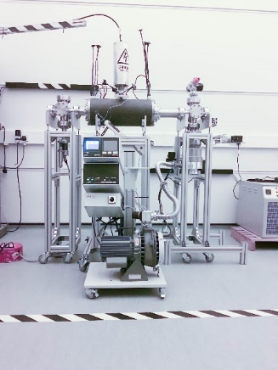
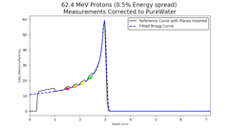
Novel accelerator techniques
11Dec19
System: image processing
fast feedback, control
Fundamental
radiobiology

Slide 4
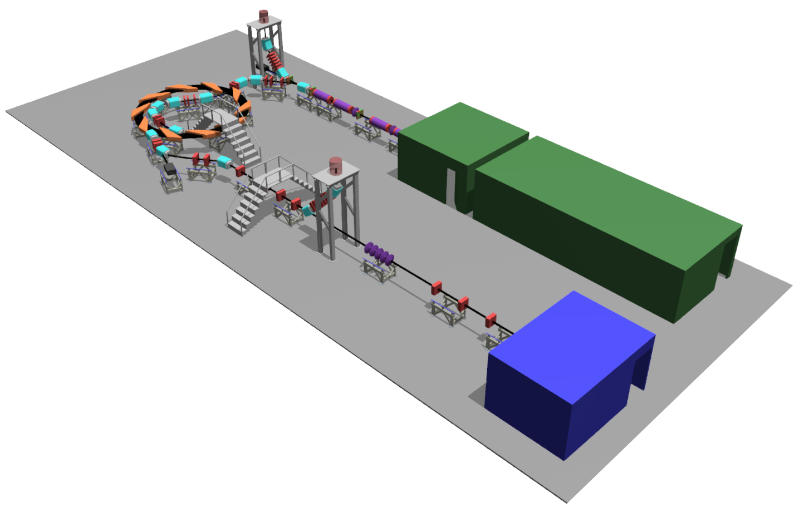

Front. Phys., 29 September 2020; DOI: 10.3389/fphy.2020.567738

Slide 6
Building on success …

Slide 7
Next meetings
16th December 2020
16th June 2021
15th December 2021

Slide 8
This meeting
Welcome and introduction

Slide 9
