Slide 1
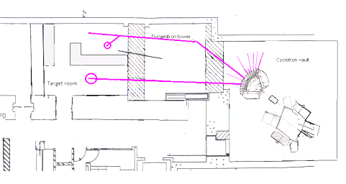
The University of Birmingham MC40 Facility
Dr Tony Price*, Prof. Phil Allport, Prof. Stuart Green, Dr Tzany Kokalova Wheldon, Dr Carl Wheldon, Dr Ben Phoenix, Prof. David Parker
CCAP Plenary Meeting
24th June 2020

Slide 2
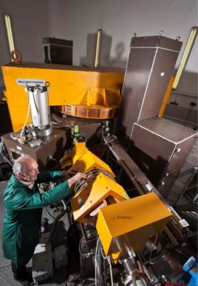
MC40 Accelerator
The Scanditronix MC40 was purchased at auction from the Veterans Affairs Medical Centre, Minneapolis in 2002 and following transfer and commissioning has been operational at UoB since 2004.
Capable of accelerating beams of:
Protons (3-38 MeV)
Deuterons (5.5-19 MeV)
Helium-3 (9-53 MeV)
Helium-4 (11-37 MeV)
Currents of fA to μA are possible dependant on beam line and experiment.

Slide 3
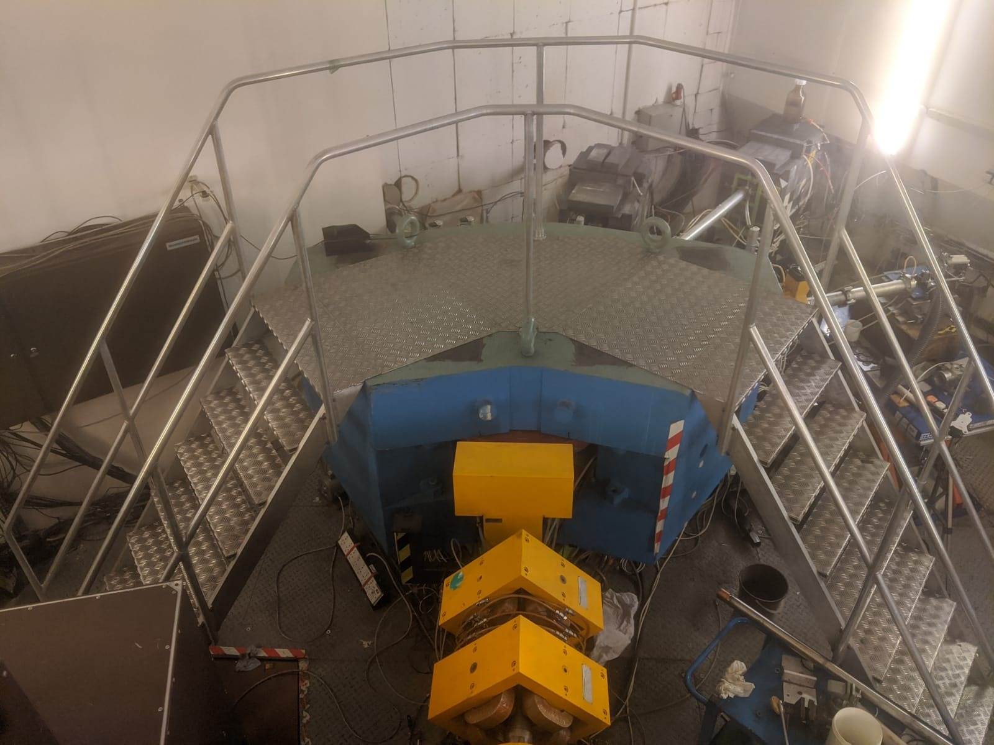
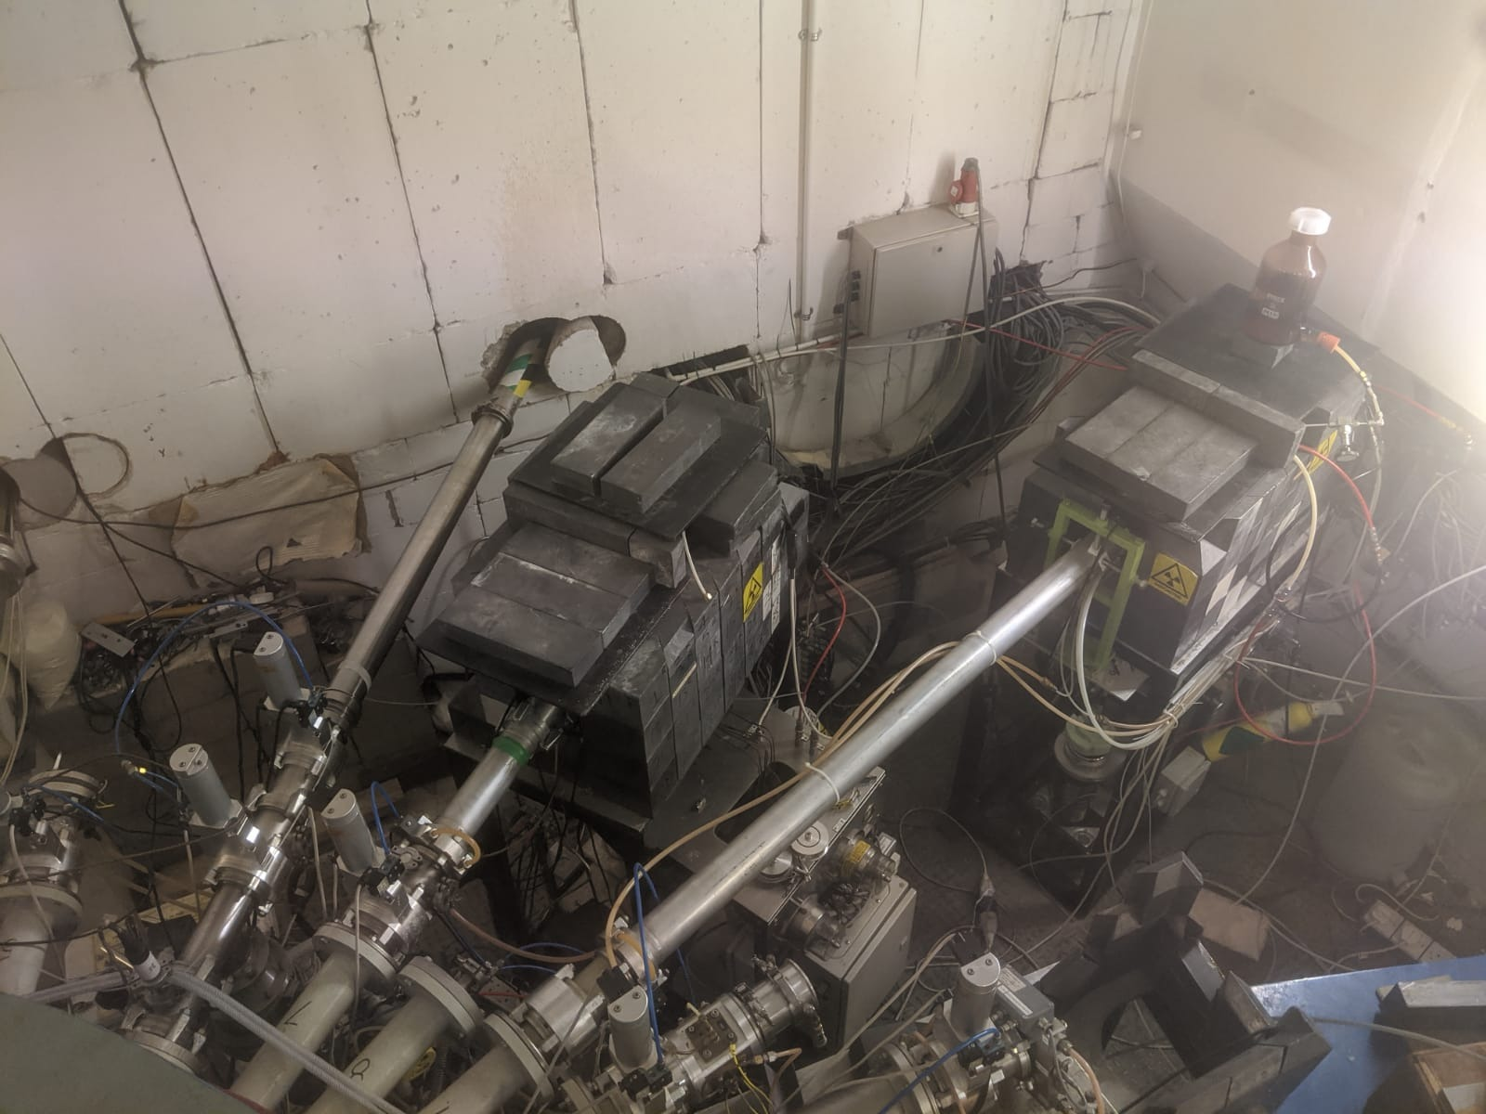
Switching Magnet
Switching Magnet selects one of 12 potential experimental beam lines including
Production of rubidium-81 five evenings a week for medical imaging of lungs at NHS trusts across the UK.
Daily production of fluorine-18 for use at the UKs only Position Emission Particle Tracking Facility in the Positron Imaging Centre (Director Tz Kokalova Wheldon).
Industrial component irradiation.
High intensity particle physics component irradiation facility.
Nuclear and Medical Beam line.

Slide 4
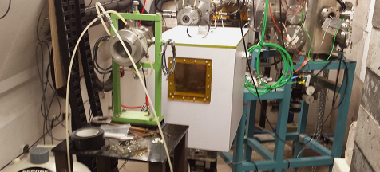
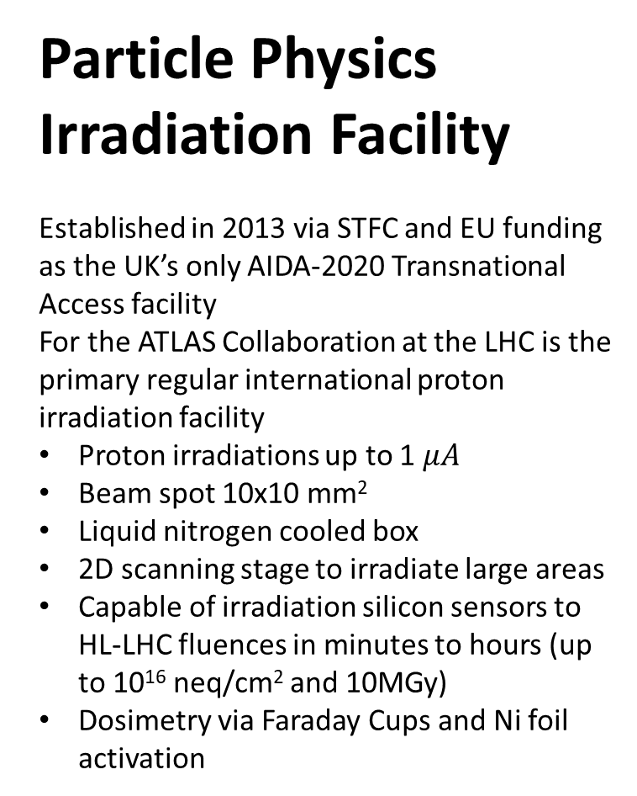
Particle Physics Irradiation Facility
Established in 2013 via STFC and EU funding as the UK’s only AIDA-2020 Transnational Access facility
For the ATLAS Collaboration at the LHC is the primary regular international proton irradiation facility
Proton irradiations up to 1 $μA$
Beam spot 10x10 mm²
Liquid nitrogen cooled box
2D scanning stage to irradiate large areas
Capable of irradiation silicon sensors to HL-LHC fluences in minutes to hours (up to 10¹⁶ neq/cm² and 10MGy)
Dosimetry via Faraday Cups and Ni foil activation
p beam

Slide 5
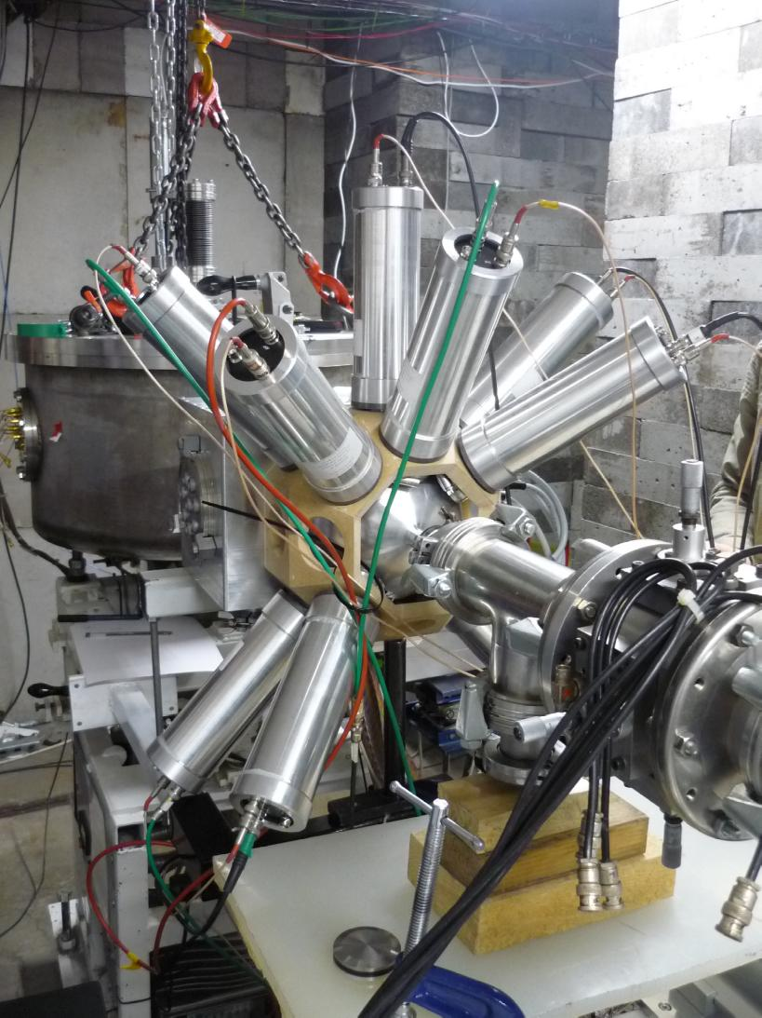
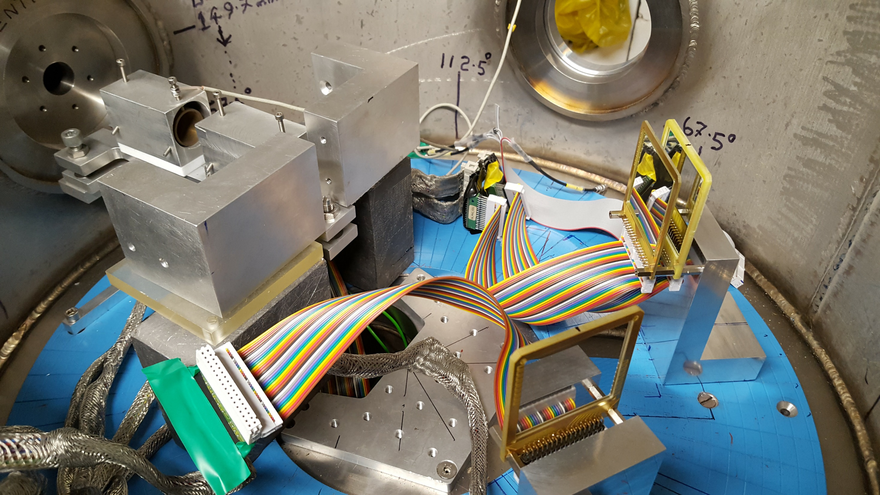
Nuclear Physics Research
Nuclear physics chamber used for nuclear structure measurements.
Beams of protons, deuterons, and alphas are accelerated and collimated to limit the beam divergence.
The beams are incident on a target and the scatter or decay products are measured using double sided silicon strip detectors.
Leading research into important nucleosynthesis processes, producing world best measurements.

Slide 6
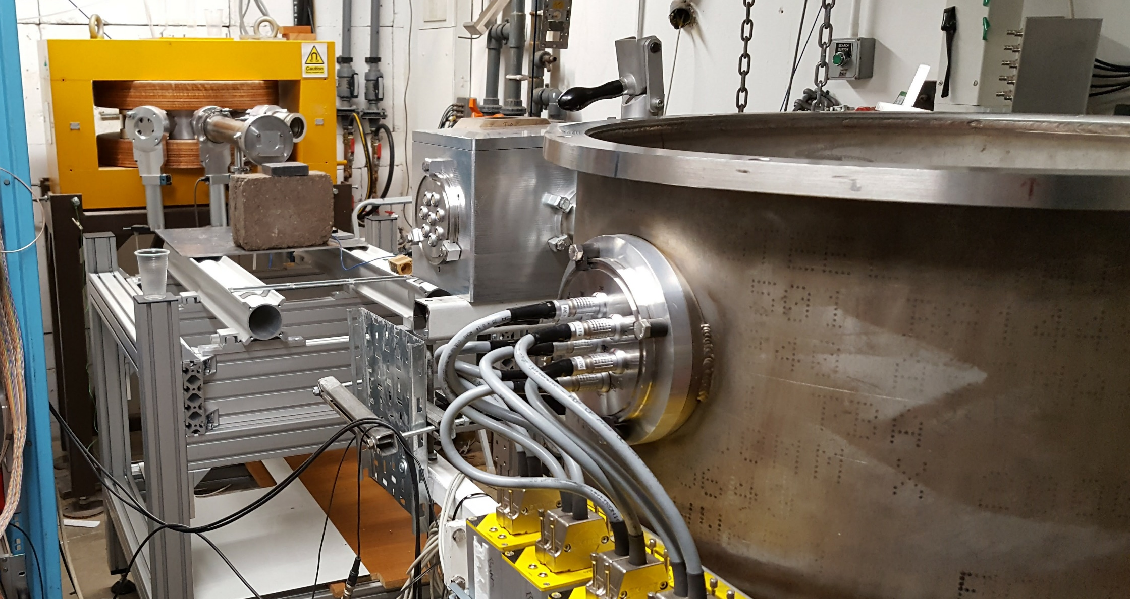
Medical Physics Research
Before the nuclear physics chamber is the Medical Physics Bench.
A beam of up to 50 mm diameter and 95 % dose uniformity is possible due to scattering system.
Rapid change collimators allow different beam shapes and sizes.
Beam current monitored via Ionisation chambers.
Doses calibrated using Markus Chambers.
Allows currents down to fA to test detectors for pCT and up to 100s of nA for FLASH dose rates.
Radiobiological experimental facilities currently under development.
Used as a test bed for PRaVDA silicon strip tracker systems

Slide 7
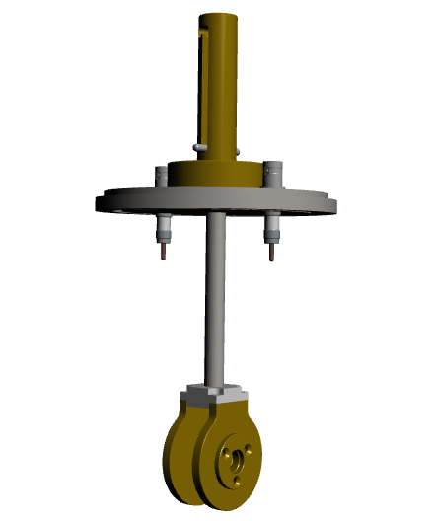
Scattering system
Consists of 10 mm copper collimators and an 80 micron tantalum scattering foil.
Small angle scattering combined with a throw of 4 m yields a 50 mm diameter beam which is 95 % uniform at the Medical Physics Research Station.
Consists of two independent units such that the beam can be steered, collimated, and then enlarged.

Slide 8

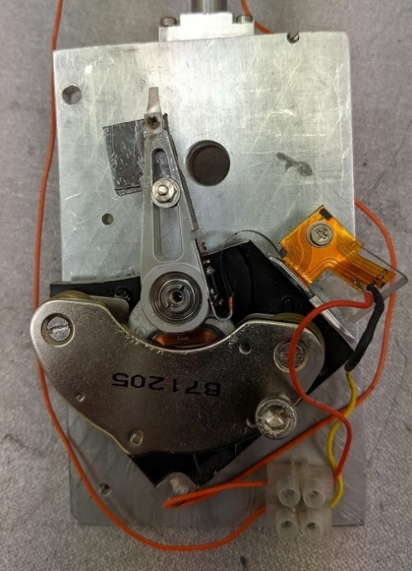
FLASH Shutter Mechanism
FLASH radiotherapy requires dose rates of >40Gy/s Dose must be delivered in fractions of a second.
Masters project of Edward Taylor to develop a FLASH delivery system for the Medical Physics bench.
Uses a voice coil actuator from an old 3.5 inch hard drive.
Apply voltage from Arduino and arm rapidly moves in and out of beam.
Deployed between scatter collimators to reduce travel distance and time.
Transit time < 6 ms from measurements using CMOS detector.

Slide 9

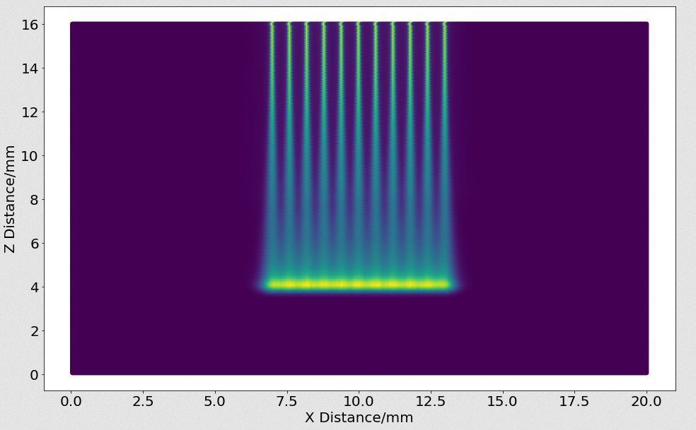
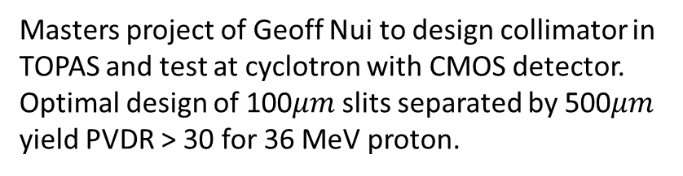
Microbeam Collimator
Spatially fractionated beams have the potential to control radiosensitive tumours as higher doses can be delivered without damaging healthy tissue.
Proton micro-beams are spatially fractionated but can scatter to provide a uniform dose to tumour.
Project funded by STFC Advanced Radiotherapy Network+ to develop a micro-beam collimator.
Masters project of Geoff Nui to design collimator in TOPAS and test at cyclotron with CMOS detector.
Optimal design of 100$μm$slits separated by 500$μm$ yield PVDR > 30 for 36 MeV proton.

Slide 10
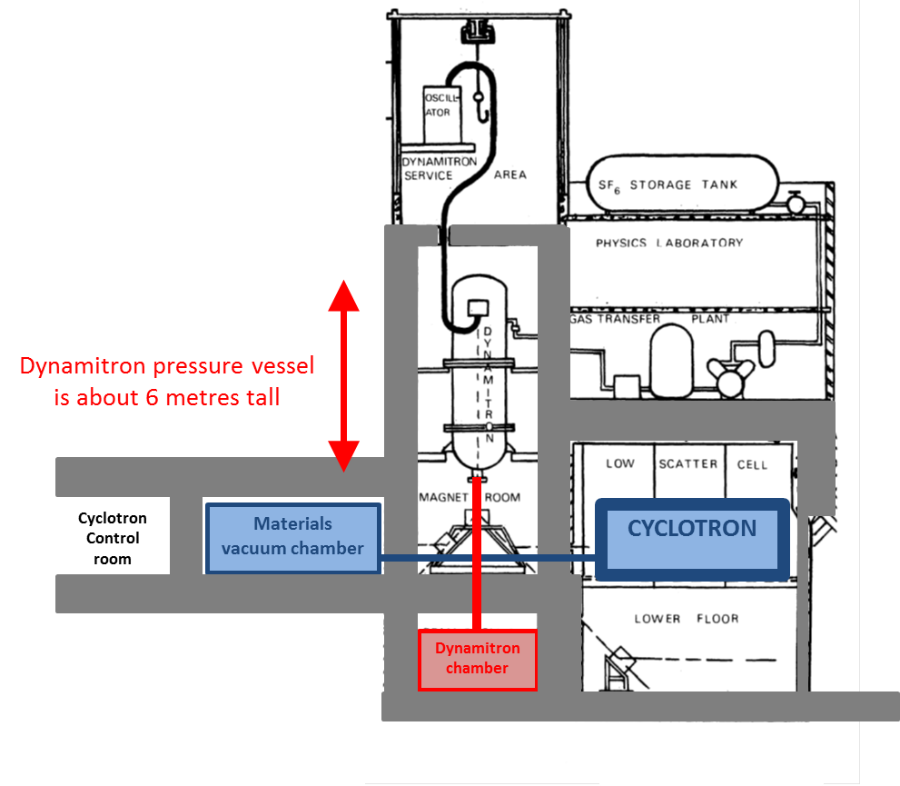
Future Development: Dedicated Beamline
High Intensity Neutron Source funded by EPSRC scheduled to open in 2021 for material studies and BNCT.
Replaces the current dynamitron which will be removed.
Aim to turn the vacated space above the magnet room into a dedicated radiobiological research area with a vertical beam line served by the medical line and capable of studying FLASH and micro-beam radiotherapy on cells and organoids

Slide 11
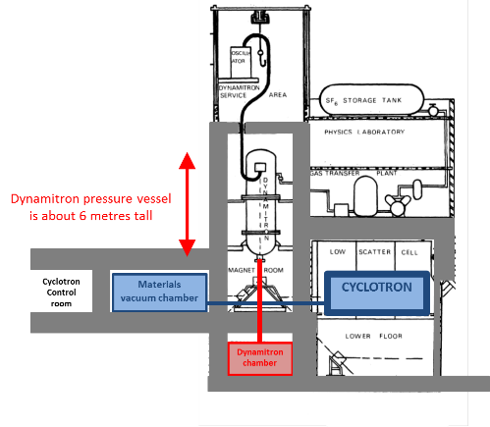
p beam
Any Questions?

