Slide 1

Welcome and introduction

Slide 2
Welcome!

Slide 3
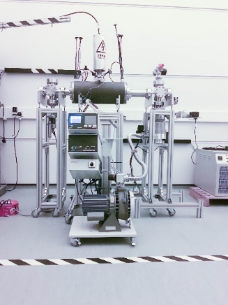
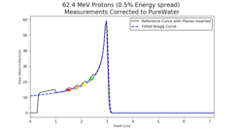
Novel accelerator techniques
11Dec19
System: image processing
fast feedback, control
Fundamental
radiobiology

Slide 4
LhARA … the vision
The execution of the LhARA programme will:
Create the capability to deliver particle-beam therapy in completely new regimes
  by combining a variety of ion species in a single treatment fraction and exploiting ultra-high dose rates and novel spatial-fractionation schemes.
Make "best in class" treatments available to the many
  by demonstrating in operation a system that incorporates dose-deposition imaging in a fast feedback-and-control system thereby reducing the requirement for a large gantry.

Slide 5
STFC Opportunities 2019 award
Modest resources to deliver LhARA "pre-CDR":
Leveraged additional resources from consortium
Milestone: pre-CDR by April 2020:
Completed.
  Review by international panel 25&31 Mar20
    Peer-endorsement subsequent to 2019 PPRP review
Publication based on the pre-CDR:
  Submitted to Frontiers in Physics Medical
  Physics and Imaging
  Uploaded to the arXiv as arXiv:2006.00493

Slide 6
Growing momentum …
Opportunities award created momentum . . . that continues to grow:
Since completion of pre-CDR, the following groups have joined
the consortium;
  The National Physical Laboratory
  Surrey
  Birmingham:
    School of Physics and Astronomy
    University Hospitals Birmingham NHS
    Foundation Trust
    Birmingham Cyclotron Facility
    Positron Imaging Centre
    at the University of Birmingham
  Institut Curie (Paris)
LhARA consortium Nov19

Slide 7
Building on success …
The STFC Opportunities 2019 award has created a new collaboration, and a new opportunity
The programme is multidisciplinary and a multidisciplinary collaboration has been forged
The programme will develop core competences for biomedical application and for "spin-in" to particle physics, neutron production, development of laser-driven beams ...
Now planning proposal to new EPSRC Transformative Healthcare Technologies call
Link: Second Call for Transformative Healthcare Technologies—Pre-announcement and engagement event

Slide 8
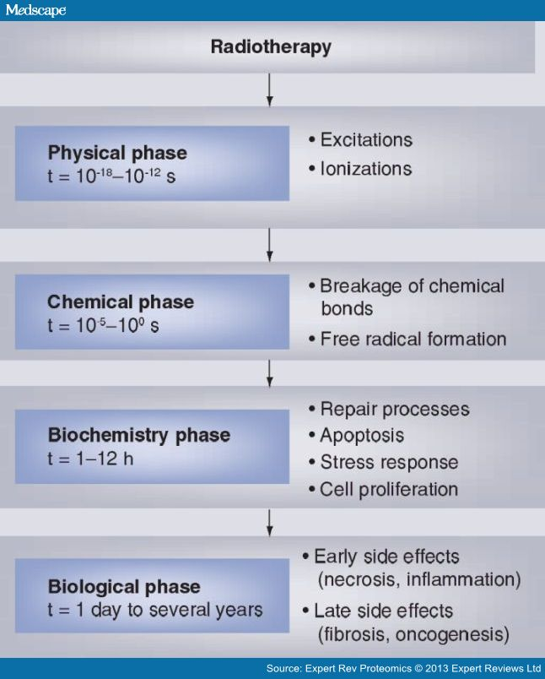
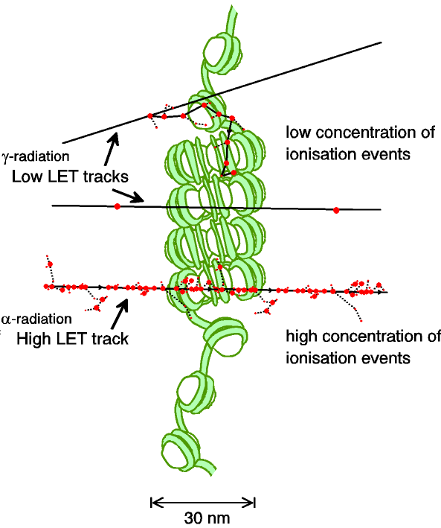
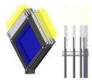
Radiobiology
Carter et al, and Parsons
(2018) IJROBP & (2019) IJROBP
Time

Slide 9
Imaging, instrumentation, and dosimetry
Patient-specific treatment central to LhARA vision
High-fidelity instrumentation essential for LhARA
Automation key to throughput
  Research and clinical
Initiatives:
  SciWire, SmartPhantom
  Modelling (G4DNA, TOPAZ)
  Feature recognition in CBCT
This meeting:
  Begin process of convergence
L. Jaugey, A. Moawad (Erasmus project)

Slide 10
Fundamental radiobiology
24Jun20
LhARA
Begin “firm up”
this meeting
Imaging, instrumentation, and dosimetry

Slide 11
Next meetings
24th June 2020
9th December 2020

Slide 12
This meeting
Welcome and introduction

Slide 13
