Slide 1
Investigation of FEATURE recognition in clinical CT IMAGES AS A STEP TOWARDS ADAPTIVE RADIOTHERAPY
Louis Jaugey
Alix Moawad
BSc Research Project
Notes:
Hello everybody! I am Alix and this is Louis. We are two exchange students in third year at Imperial and we would like to present our BSc Research Project and results to you so far.
One of the goals of the research program of the Centre for the Clinical Application of Particles is to develop techniques to enhance the delivery of Radiotherapy.
As part of this program, my partner and I are currently working on one technique as a step towards Adaptive Radiotherapy.
Why do we need Adaptive Radiotherapy? Because we want to take into account the temporal changes in anatomy like weight loss and changes in tumour shape occurring during a patient’s radiation treatment.
The aim of our project is then to automate the recognition of tumour contours in CT images. As a first step we will focus here on general feature recognition.

Slide 2

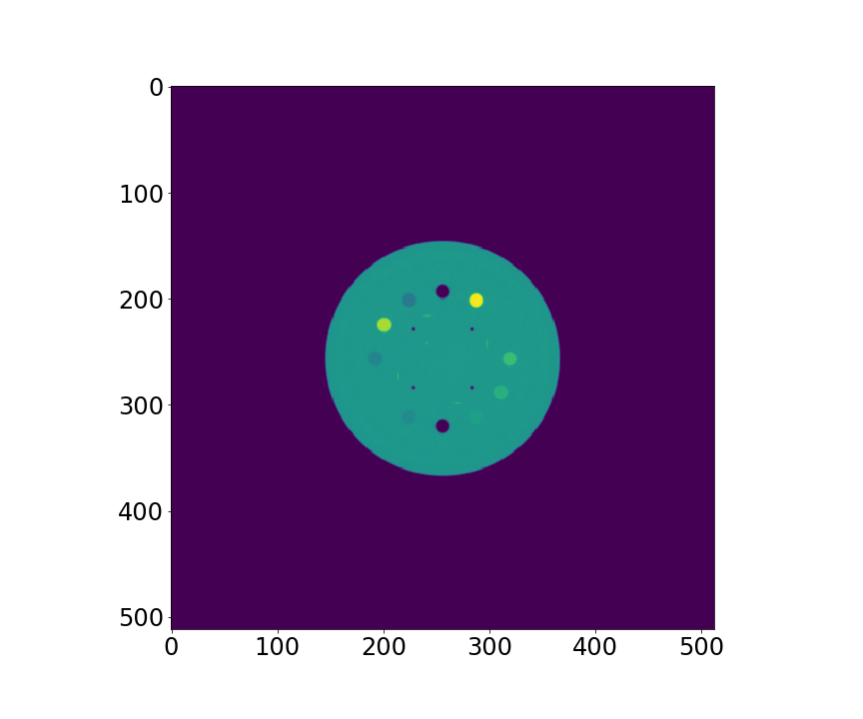
Study material: phantom
3D Phantom cut into 88 2D slices
To simplify our study at first, only one slice chosen: slice 60
Our study becomes a 2D problem that could eventually turn back into a 3D problem
Notes:
To this end, we started by working on CT-scans of a phantom. What is a phantom? A phantom is a specially designed object which is scanned to calibrate and evaluate performances of imaging devices like CT-scans. As a phantom is a 3D object, we used 2D slices of these CT-scans to simplify our first approach of this problem. We will work all along this project on slice 60 which is displayed on this slide. Our study then becomes a 2D problem that could eventually turn back into a 3D problem. Computationnally speaking, slice 60 is implemented as a pixel matrix. We will then talk indifferently about slice 60 and the pixel matrix.

Slide 3
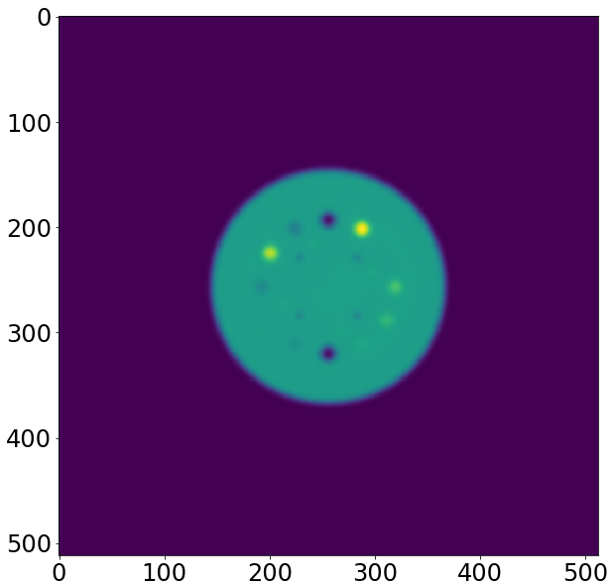
Gaussian filter
Smoothes the raw image and gives a blurry image by removing noise
Applies a convolution product between the image and a 5 x 5 matrix whose inputs are given by a 2D Gaussian function
On the right, result after applying the Gaussian Filter with a larger sigma than we actually used
Notes:
Before processing slice 60 to determine its contours, a Gaussian filter is applied. How does this filter work? This filter applies a convolution product between the pixels of the matrix and a 5x5 matrix whose input values are given by a 2D Gaussian function. This filter smoothes the raw image and facilitates subsequent studies. The initial image is represented on the left and you can see the effects of the Gaussian filter on the right image.

Slide 4
PLAN of THE PRESENTATION
Directional derivatives Method
Laplacian Method
Edge Canny Filter Method
Notes:
Our presentation will be based on the study of 3 methods used to contour the borders of the phantom: the Directional Derivatives method, the Laplacian method and finally the Edge Canny Filter.
3 min à ce stade

Slide 5
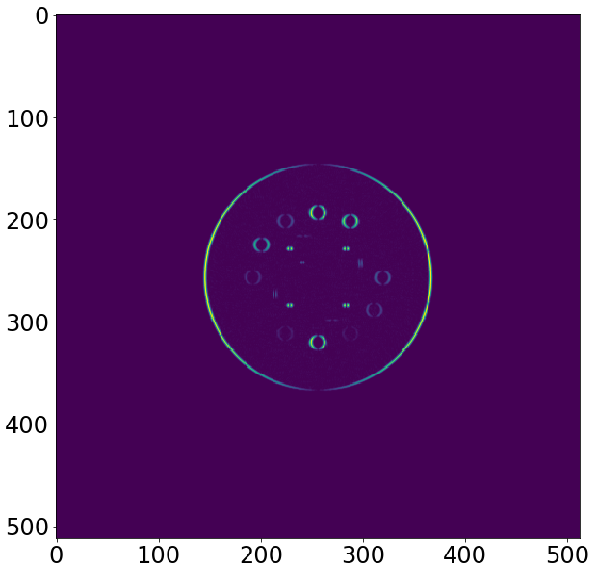

DIRECTIONAL DERIVATIVES METHOD
Computation of the Horizontal and Vertical derivatives using centred finite difference
The horizontal derivatives (on the left) emphasize vertical edges and vice versa for vertical derivatives
The next step is to detect peaks on both images
Notes:
The first method we developed relies on the fact the regions inside the phantom have different intensities. This implies that the intensity variation is nonzero when we move from one region to another. So this algorithm looks for these nonzero variations. To do so, we computed the intensity derivatives in both x- and y- directions.
On the left, we can see the horizontal derivatives of the intensity and on the right, the vertical ones.
As you can see, the horizontal variations emphasize the vertical edges and vice versa for the vertical variations.
The peaks of these derivatives give us the pixels for which the intensity variation is locally maximal.

Slide 6
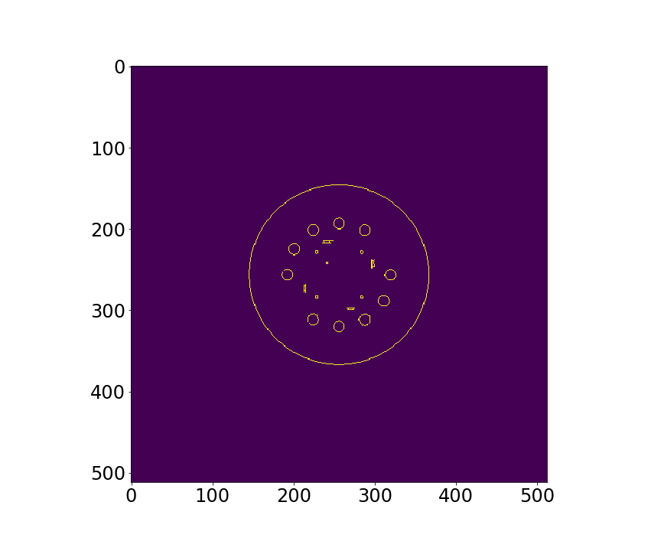
DIRECTIONAL DERIVATIVES METHOD
Search for the peaks with two different minimal peak intensity
Connect the pixels of low intensity with the high intensity ones
Notes:
To find the peaks, we used the find_peaks function which is already implemented in python.
This function needs two arguments: a 1D array (a row or a column of the pixel matrix in our case) and a threshold defining the minimal peak height (or intensity). Peaks whose intensity is above the threshold are stored and the ones below the threshold are ignored.
We have now to determine which peaks will be considered as borders.
To do so, we used a method called “EDGE TRACKING BY HYSTERESIS” that needs three peak’s categories. The first category is defined by peaks whose intensity is above the high threshold. The second category are the peaks whose intensity is contained between the thresholds and the last category are peaks with an intensity below both thresholds. Pixels from the first category are automatically considered as borders whereas the ones from the second category are only considered as borders if they are connected a border.

Slide 7
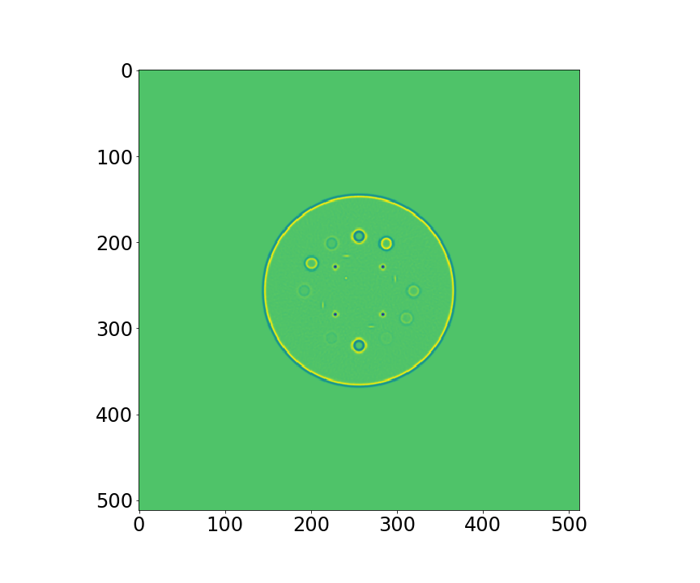
LAPLACIAN METHOD
Laplacian computed at each point using central finite differences
Some holes are not visible anymore
Notes:
Mathematically speaking, the search for the maxima of the derivatives in the previous method is equivalent to the search for zero crossings of the Laplacian operator. To find those zeros, the Laplacian was computed at each point of the image using central finite differences. As you can see on the image, some holes are not visible anymore. These are the holes whose intensity is closest to that of the bottom.

Slide 8
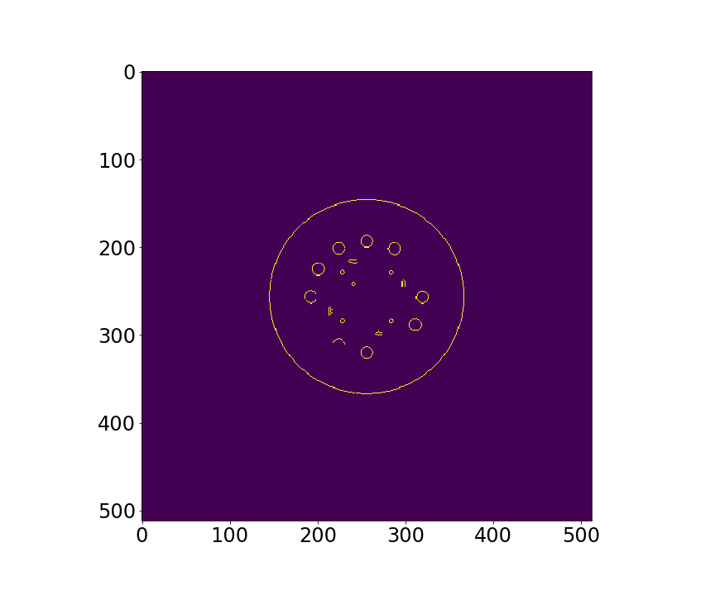
LAPLACIAN METHOD
Search for zero crossings of the Laplacian operator
Threshold method by percentage: less than 15% of the brightest contours displayed
Notes:
How do we detect a zero crossing? If from one point to another the Laplacian value changes from negative to positive (or the opposite), a zero crossing is found, and the pixel is therefore contained in a border. As such, the method also takes into account the background noise. To avoid this, only a small percentage (ca. 15%) of the brightest contours were displayed. The percentage value was obtained arbitrarily with only one goal in mind: to display as many contours as possible without causing too much noise.
However, the noise cannot be completely eliminated: this is why we applied an algorithm that filters the isolated points at the end of the Laplacian method.
As you can see in the final image, not every holes are displayed: we lost information during the process. This loss of information was already visible on the previous slide with the representation of the Laplacian.

Slide 9
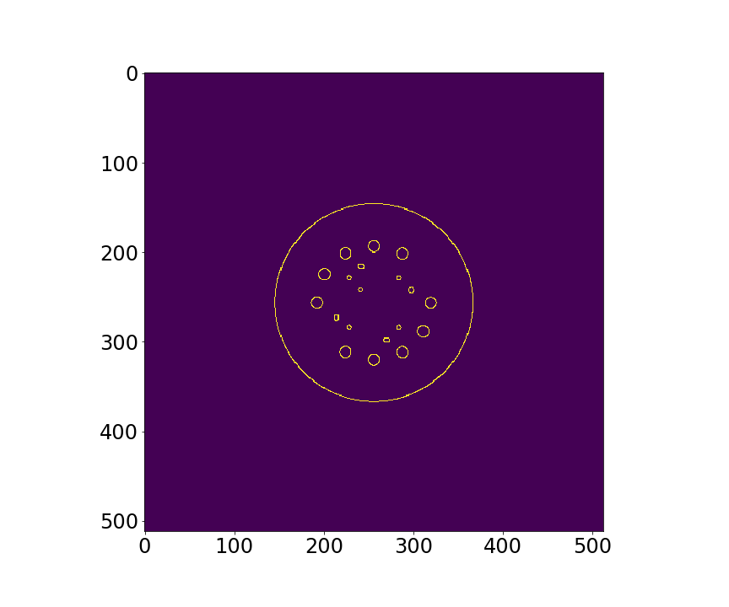
EDGE CANNY FILTER: FILTER APPLICATION
Computation of the intensity gradient in each pixel
Pixel separation in two categories: high and low gradient intensity
Connect the pixels having a low gradient intensity with the ones having a high intensity
Notes:
The Canny edge detector is well known algorithm used for edge detection and it is already implemented in python.
The first step is to compute the intensity gradient.
As with the first method, this one also use the edge tracking by hysteresis. Two thresholds are defined by the user. If the gradient's norm is higher than the high threshold, it is considered as a boundary. If it is lower than the low threshold, the pixel is ignored and finally, if the norm is in between the threshold, it is a boundary if it is connected to a boundary.
This method requires a high sigma for the gaussian filter in order to remove the noise. This affects the final result by defining bigger regions than they actually are.

Slide 10
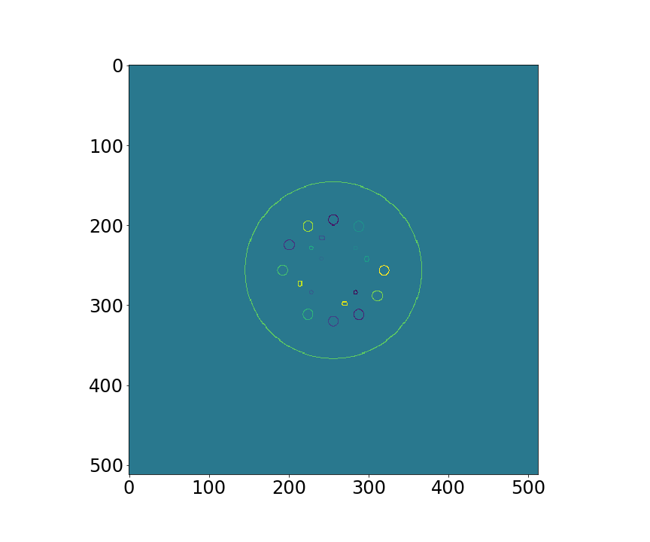
EDGE CANNY FILTER: border separation
Attribution of a number specific to a border, using a recursive algorithm
This number is random for better visualization
Filling Regions with the same colour as the border
Notes:
Once we have the pixels defing the boundaries, we want to differentiate which border is which.
To do so we use a recursive algorithm that assign a random number to each border.
Once we did this, we can fill the region with the same coulour/number as the border.

Slide 11
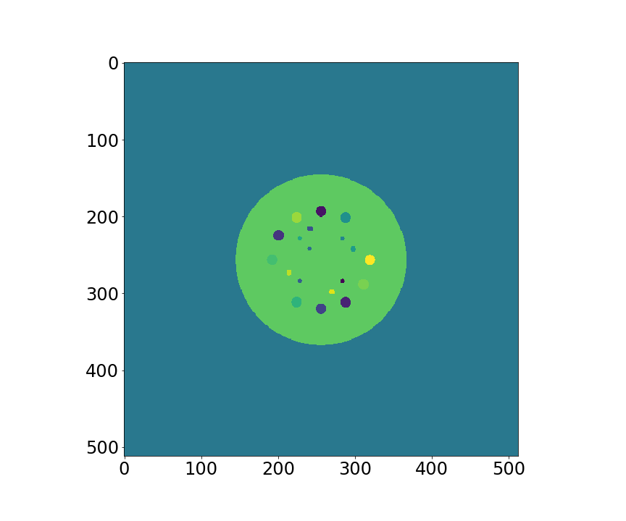
EDGE CANNY FILTER: BORDER SEPARATION
Attribution of a number specific to a border, using a recursive algorithm
This number is random for better visualization
Filling Regions with the same colour as the border

Slide 12
Further work and Conclusion
Phantoms have very well-defined regions. Edge detection on real patients' images is a much harder problem.
Application of these methods on 3D CT-scans.
Latest algorithms used in image treatment rely on Machine Learning techniques. This will be the subject of interest for the second term.

