Slide 1





Pre-CDR end station update
Dr Jason Parsons
Senior Lecturer – University of Liverpool
Lead of Radiobiology Research – Clatterbridge Cancer Centre

Slide 2
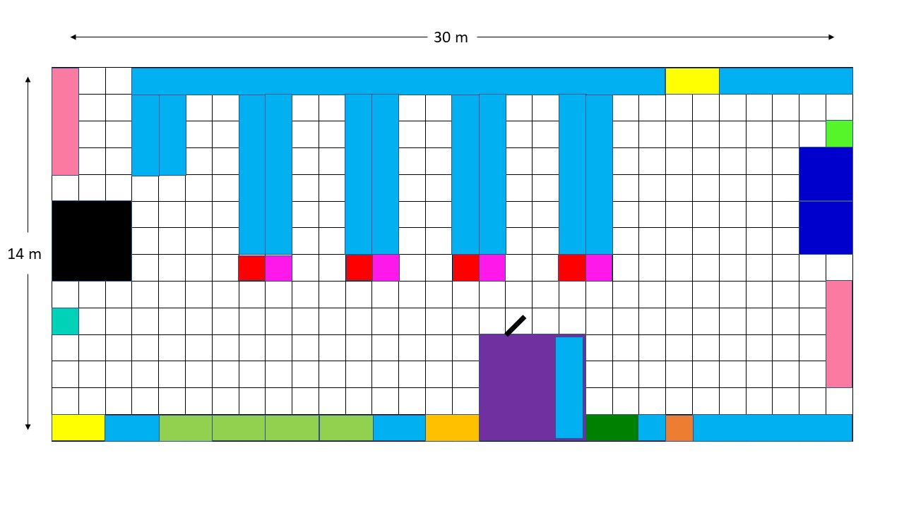
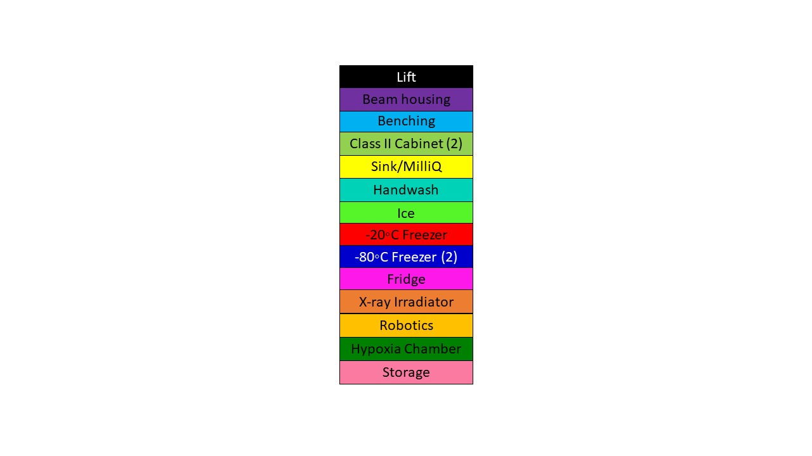
Draft floor plan
Benching for molecular/cell biology work
Cell culture and robotics
End-station
Hypoxia workstation
X-ray irradiator
Cost of equipment ~£500k (without end-station, microscopy facilities)

Slide 3
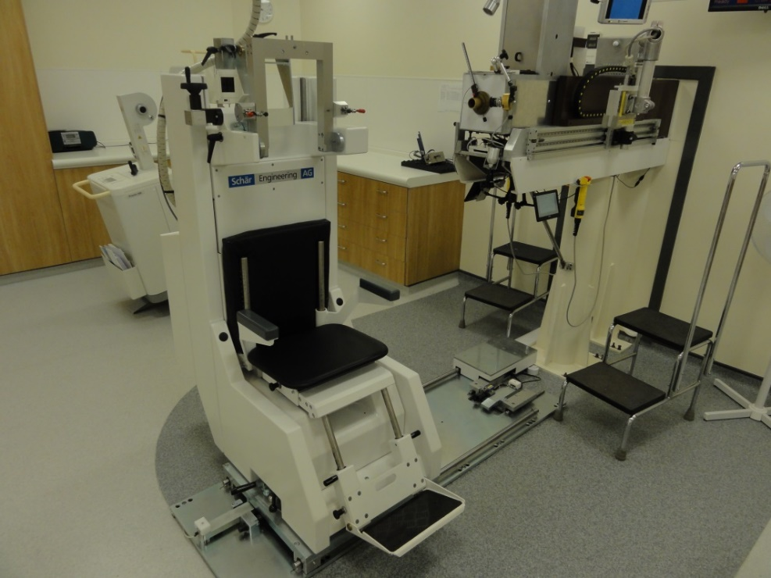
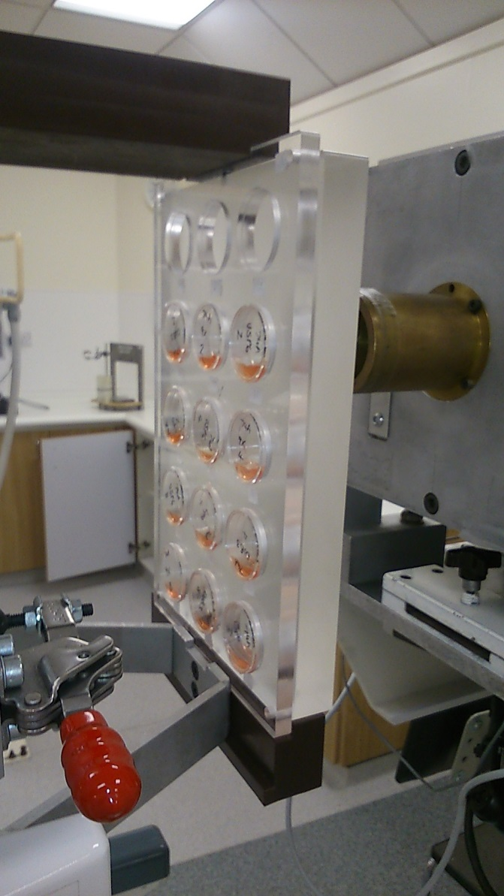
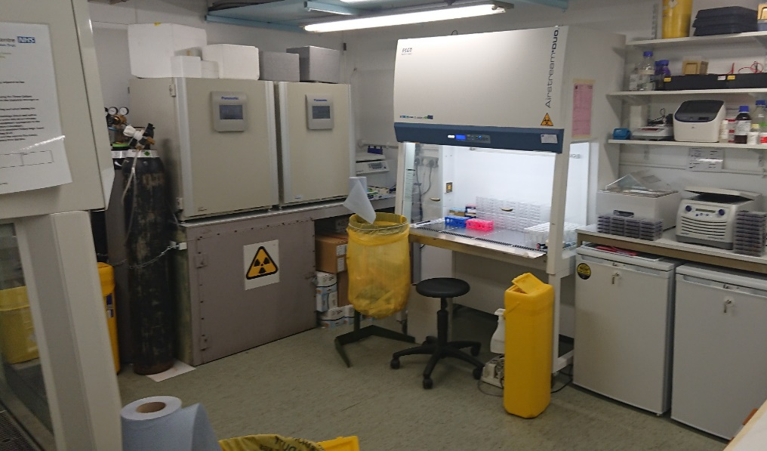
Proton beam and radiobiology facilities at the Clatterbridge Cancer Centre

Slide 4
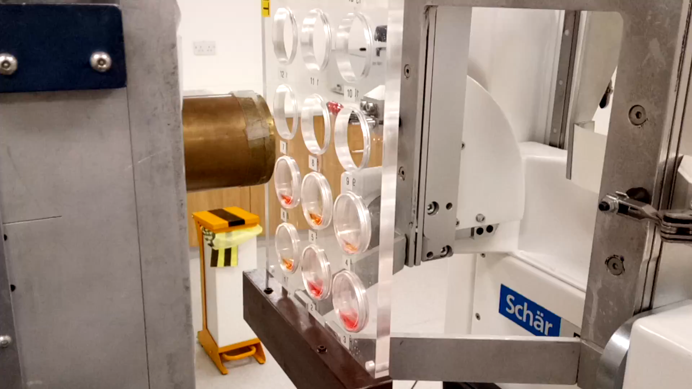
Proton beam and radiobiology facilities at the Clatterbridge Cancer Centre

Slide 5
End-station considerations
In vitro end-station
Platform for housing cell culture dishes/multi-well plates.
Motorisation to allow for quick sample to sample irradiation.
In vivo end-station
Spot-scanning or passive scattering beam?
Beam size (dependent on tumour model).
Tumour models to be used (mice, rat, zebrafish?).
HSE approval.

Slide 7
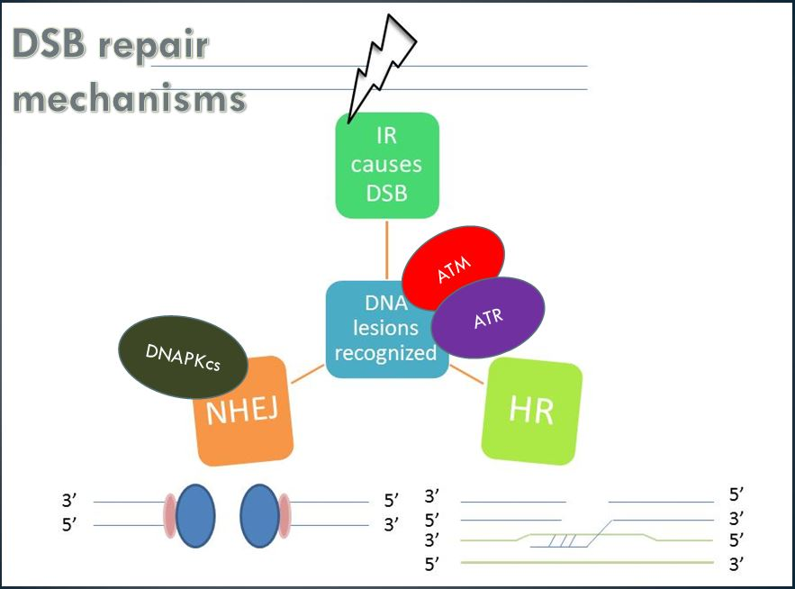
Targeting DNA double strand break repair

Slide 8
Inhibition of ATM, ATR and DNA-Pk leads to enhanced radiosensitivity of HPV-positive and HPV-negative HNSCC
UMSCC6
UMSCC74A
HPV-negative
UMSCC47
UPCI-SCC090
HPV-positive

Slide 9
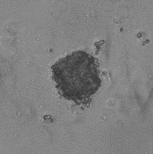
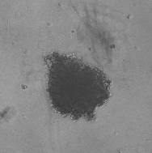
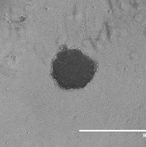
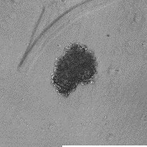
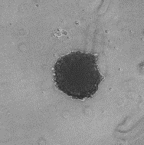
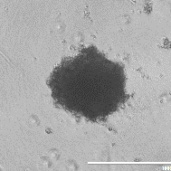
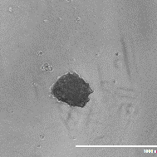
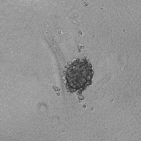
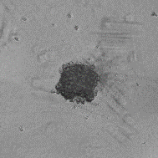
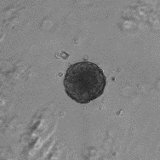
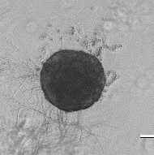
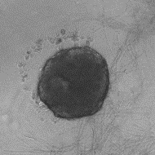
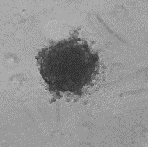
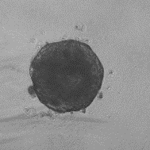
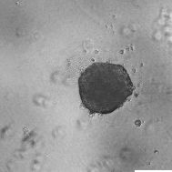
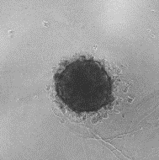
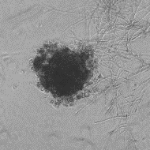
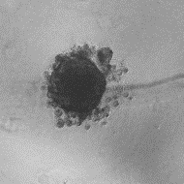
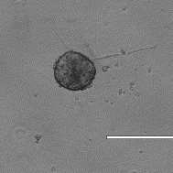
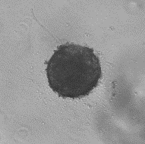
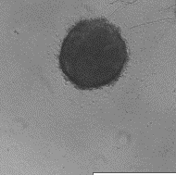
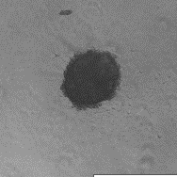
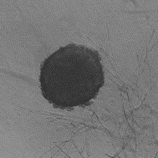
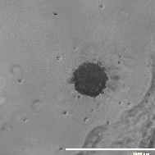
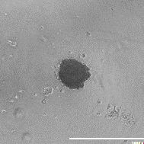
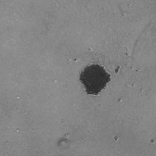
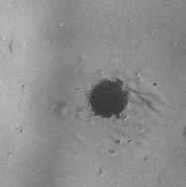
Inhibition of ATM, ATR and DNA-Pk leads to enhanced radiosensitivity of HPV-positive and HPV-negative HNSCC
Day 3
Day 10
Day 10 + protons
Control
DMSO
ATMi
ATRi
DNA-Pki
DMSO
ATMi
ATRi
DNA-Pki
UMSCC74A
UMSCC6
UPCI-SCC090

Slide 10
Inhibition of ATM, ATR and DNA-Pk leads to enhanced radiosensitivity of HPV-negative HNSCC
ATMi
ATRi
DNA-Pki
UMSCC74A
UMSCC6

Slide 11
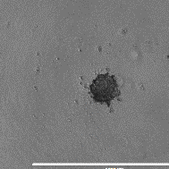
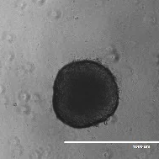
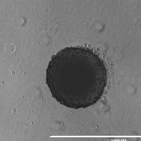
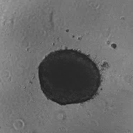
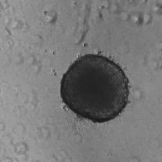
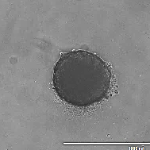
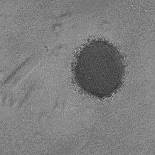
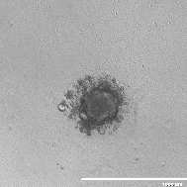
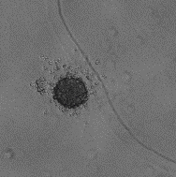
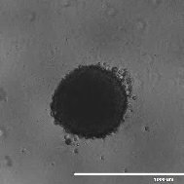
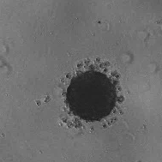
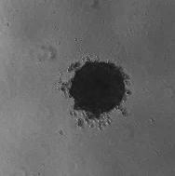
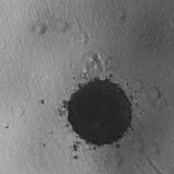
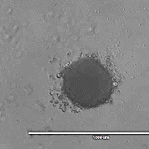
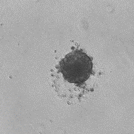
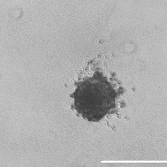

Inhibition of ATM, ATR and DNA-Pk leads to enhanced radiosensitivity of HPV-negative HNSCC
Day 3
Day 10
Day 10 + protons
Control
DMSO
ATMi
ATRi
DNA-Pki
DMSO
ATMi
ATRi
DNA-Pki
FaDu
A253

Slide 12
Inhibition of ATM, ATR and DNA-Pk leads to enhanced radiosensitivity of HPV-negative HNSCC
FADU
A253

